Slide 1
Logic- Part-I
Some slides have been taken from the sites
http://cse.unl.edu/~choueiry/S13-235/
and
http://www.csee.umbc.edu/~ypeng/S03203/S03203.html

Slide 2
Logic
Important for mathematical reasoning, program design.
Used for designing electronic circuitry
(Propositional ) Logic is a system based on statements (also called propositions).

Slide 3
Logic
A statement is a (declarative) sentence that is either true or false (not both).
We say that the truth value of a proposition is either true (T) or false (F).
Corresponds to 1 and 0 in digital circuits
We usually denote a proposition by a letter: p, q, r, s, …

Slide 4
Consider a sentence: The sun rises in the east
Is it a statement?
What is the truth value
of the proposition?

Slide 5
Consider a sentence: The sun rises in the east
Is it a statement? YES
What is the truth value
of the proposition? TRUE

Slide 6
Consider a sentence: {0,2,3} ∩ N = Φ
Is it a statement?
What is the truth value
of the proposition?

Slide 7
Consider a sentence: {0,2,3} ∩ N = Φ
Is it a statement? YES
What is the truth value
of the proposition? False

Slide 8
Consider a sentence: y > 21
Is it a statement?
What is the truth value
of the proposition?

Slide 9
Consider a sentence: y > 21
Is it a statement? No
What is the truth value
of the proposition? Its truth value
depends on unspecified y.
This statement is called an
open statement.

Slide 10
Consider a sentence: Please do not fall asleep.
Is it a statement?
What is the truth value
of the proposition?

Slide 11
Consider a sentence: Please do not fall asleep.
Is it a statement? No
What is the truth value
of the proposition? It is neither true nor
false.

Slide 12
Sentences that are not statements with similar expressions that are statements

Slide 13
Consider a sentence:
Every even integer greater than 2 is a sum of two prime numbers.
Goldbach conjecture
Is it a statement?
What is the truth value
of the proposition?

Slide 14
Consider a sentence:
Every even integer greater than 2 is a sum of two prime numbers.
Goldbach conjecture
Is it a statement? Yes
What is the truth value
of the proposition? Probably true

Slide 15
Consider a sentence:
Either x is a multiple of 7 or it is not
Is it a statement?
What is the truth value
of the proposition?

Slide 16
Consider a sentence:
Either x is a multiple of 7 or it is not
Is it a statement? Yes
What is the truth value
of the proposition? True since it is true
for all x.

Slide 17
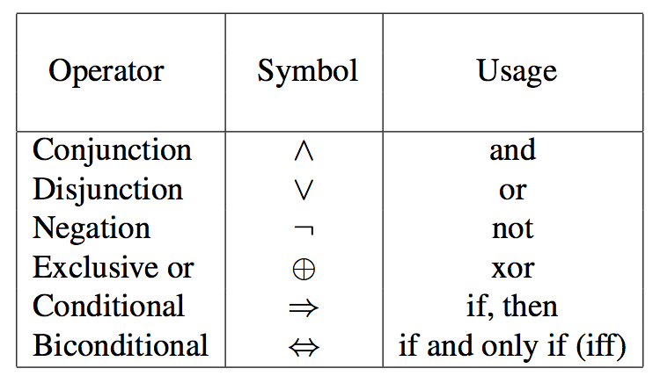
Logical Connectives (Operators)
Combining statements to make compound statements.
p, q, r, s, … represent statements/propositions.
Following connectives are considered now.

Slide 18
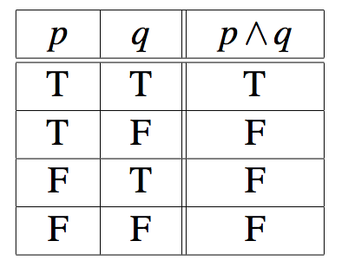
Logical Connective: Logical And
The logical connective AND is true only when both of the propositions are true. It is also called a conjunction
Examples
It is raining and it is warm
(2+3=5) and (1<2).
Truth table

Slide 19
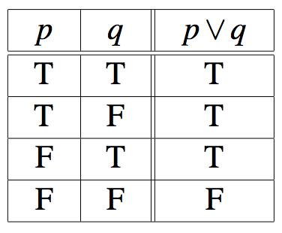
Logical Connective: Logical OR
The logical disjunction, or logical OR, is true if one or both of the propositions are true.
Examples
It is raining or it is the second lecture
(2+2=5) ∨ (1<2)
Truth table

Slide 20
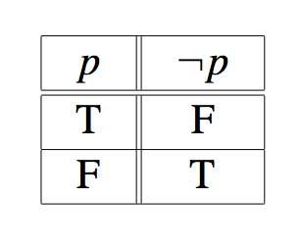
Logical Connective: Negation
¬p, the negation of a proposition p, is also a proposition
p: Today is Monday
Examples:
Today is not Monday
It is not the case that today is Monday, etc.
Truth table

Slide 21
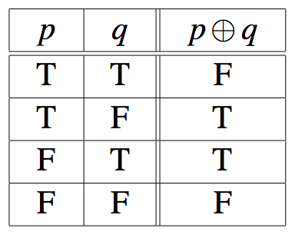
Logical Connective: Exclusive Or
The exclusive OR, or XOR, of two propositions is true when exactly one of the propositions is true and the other one is false
Example
The circuit is either ON or OFF but not both
Let ab<0, then either a<0 or b<0 but not both
Truth table

Slide 22
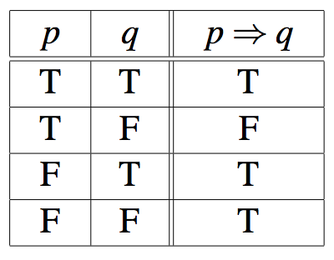
Logical Connective: Implication (1)
Definition: Let p and q be two propositions. The implication p→q is the proposition that is false when p is true and q is false and true otherwise
p is called the hypothesis, antecedent, premise
q is called the conclusion, consequence
Truth table

Slide 23
Logical Connective: Implication (2)
The implication of p→q can be also read as
p implies q
If p, then q
whenever p, then also q
q follows from p
p only if q (p cannot be true if q is not true)
p is a sufficient condition for q (p is sufficient for q)
q is a necessary condition for p (q is necessary for p) (p cannot be true unless q is true (i.e. if q is false, p is false)

Slide 24
Logical Connective: Implication ()
Consider the statements:
you pass the exam → you pass the course
Equivalent statements:
Passing the exam is sufficient for passing the course.
For you to pass this course, it is sufficient that you pass the exam.

Slide 25
Exercise: Which of the following implications is true?
If -1 is a positive number, then 2+2=5

Slide 26
Exercise: Which of the following implications is true?
If -1 is a positive number, then 2+2=5
True. The premise is obviously false, thus no matter what the conclusion is, the implication holds.

Slide 27
Exercise: Which of the following implications is true?
If -1 is a positive number, then 2+2=5
If -1 is a positive number, then 2+2=4
True. The premise is obviously false, thus no matter what the conclusion is, the implication holds.
True. Same as above.

Slide 28
Exercise: Which of the following implications is true?
If -1 is a positive number, then 2+2=5
If -1 is a positive number, then 2+2=4
If you get an 100% on your Midterm 1, then you will have an A⁺.
True. The premise is obviously false, thus no matter what the conclusion is, the implication holds.
True. Same as above.

Slide 29
Exercise: Which of the following implications is true?
If -1 is a positive number, then 2+2=5
If -1 is a positive number, then 2+2=4
If you get an 100% on your Midterm 1, then you will have an A⁺.
True. The premise is obviously false, thus no matter what the conclusion is, the implication holds.
True. Same as above.
False. Your grades homework, quizzes, Midterm 2, and Final, if they are bad, would prevent you from having an A⁺.

Slide 30
Exercises
To take discrete mathematics, you must have taken calculus or a course in computer science.
When you buy a new car from Acme Motor Company, you get $2000 back in cash or a 2% car loan.
School is closed if more than 2 feet of snow falls and if the wind chill is below -80.

Slide 31
Exercises
To take discrete mathematics, you must have taken calculus or a course in computer science.
Propositions
- p: take discrete math
- q: you have taken calculus
- r : you have taken a course in CS

Slide 32
Exercises
When you buy a new car from Acme Motor Company, you get $2000 back in cash or a 2% car loan.
Propositions
- p: you buy a car
- q: you you get $2000 back
- r : you get 2% car loan

Slide 33
Exercises
School is closed if more than 2 feet of snow falls and if the wind chill is below -80.
Propositions
- p: School is closed
- q: 2 feet of snow falls
- r : wind chill is below -80

Slide 34
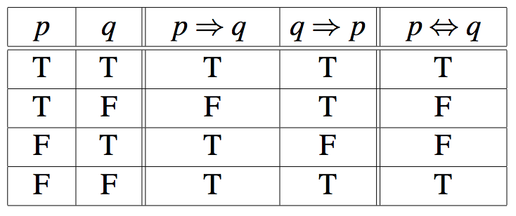
Logical Connective: Biconditional (1)
Definition: The biconditional is the proposition that is true when p and q have the same truth values. It is false otherwise.
Note that it is equivalent to
Truth table

Slide 35
Logical Connective: Biconditional (2)
The biconditional p↔q can be equivalently read as
p if and only if q
p is a necessary and sufficient condition for q
if p then q, and conversely
p iff q
Examples
x>0 if and only if x² is positive
The alarm goes off iff a burglar breaks in

Slide 36
Truth Tables
Truth tables are used to show/define the relationships between the truth values of
the individual propositions and
the compound propositions based on them

Slide 38
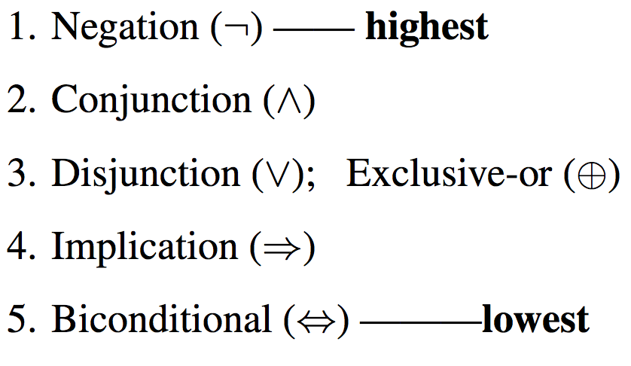
Precedence of Logical Operators
As in arithmetic, an ordering is imposed on the use of logical operators in compound propositions
However, it is preferable to use parentheses to disambiguate operators and facilitate readability
¬ p ∨ q ∧ ¬ r ≡ (¬p) ∨ (q ∧ (¬r))
To avoid unnecessary parenthesis, the following precedence hold:

Slide 39
Examples
Sentence ?
Some sets are finite.
N ∈ PowerSet (N)
Express each statement or open statement in one of the forms: p ∧ q, p ∨ q, or ¬p.
Today is cold but it is not cloudy
x ∈ A – B
At least one of the numbers x and y equals 0.

Slide 40
Examples
Express the following sentence in the form If P, then Q.
We will order pizza today if there are 100 students in the class.
(If there are 100 students, then we will order pizza today)
We will order pizza today only if there are 100 students in the class.
(If we order pizza today, there are 100 students in the class)
You can use the lab if you are a cs major or not a freshman.
(if you are a cs major or not a freshman, then you can use the lab.)
An integer is divisible by 8 only if it is divisible by 4.
(If an integer is divisible by 8, then it is divisible by 4.)

Slide 41
Logical Equivalence
Two statements are logically equivalent if their truth values match up line-for-line in a truth table.
Logical equivalence gives us different ways of looking at the same thing.
Consider the following truth table concerning p q.

Slide 42
Example
If m is an even integer then m+7 is odd.
Let p: m is an even integer; q: m+7 is odd.
Using propositional notation p q.
Proving p q.
p is true
m=2a, a ∈ Z
2a + 6 is an even number
(2a +6) +1 is an odd number
m + 7 is an odd number
q

Slide 43
Example
Proving ¬q ¬p.
q is not true
m+7 is even
m + 7 = 2b, b ∈ Z
2b – 7 = 2(b-4) +1
2b – 7 is odd
m is odd
¬p

Slide 44
Tautology
A compound proposition (a formula) that is always true no matter what the truth values of the propositions in the formula is called a tautology.
p ∨ ¬p is a simple tautology.
p q and ¬ q ¬p are logically equivalent
i.e. (p q) (¬q ¬p) is a tautology.
(Truth table will be shown in the class)

Slide 45
Tautology
A compound proposition (a formula) that is always true no matter what the truth values of the propositions in the formula is called a tautology.
Informally, two compound propositions P and Q are logically equivalent if whenever P is true, Q is true, and whenever Q is true then P is true.
In other words P Q is a tautology
It is denoted as P = Q (in the text)
Also denoted as P ≡ Q (Rosen); P Q (Grimaldi)

Slide 46
Contradiction
A compound proposition (a formula) that is always false no matter what the truth values of the propositions in the formula is called a contradiction.
p ∧ ¬p is a simple contradiction.

Slide 47
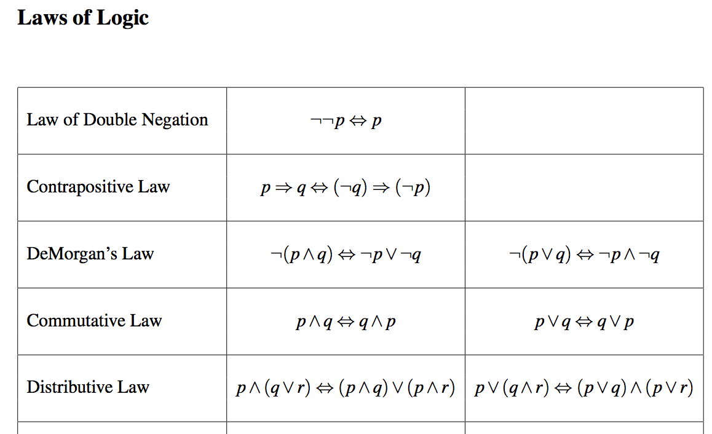
The following table contains some important equivalences

Slide 48
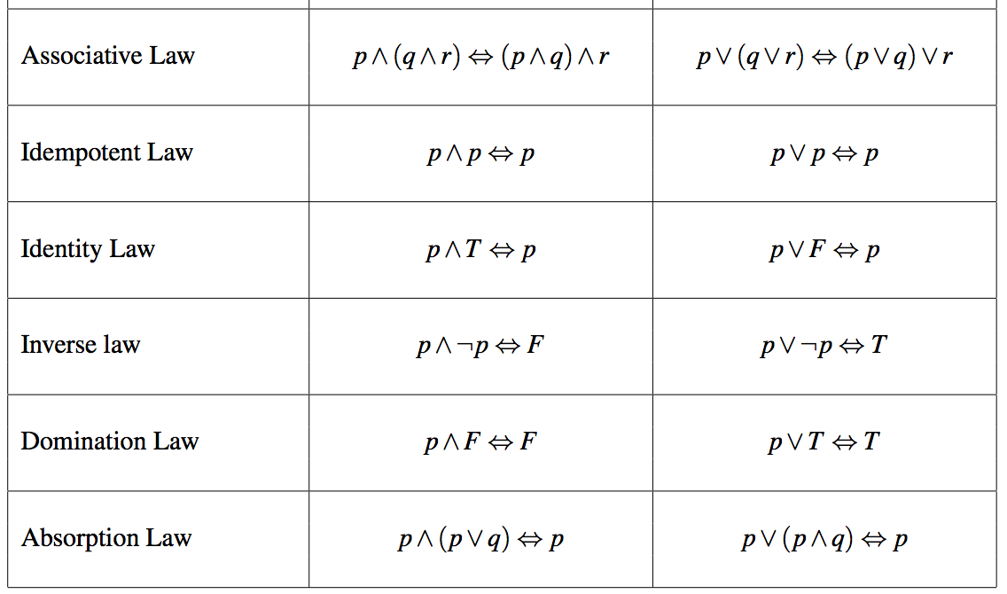
The following table contains some important equivalences (contd.)

Slide 49
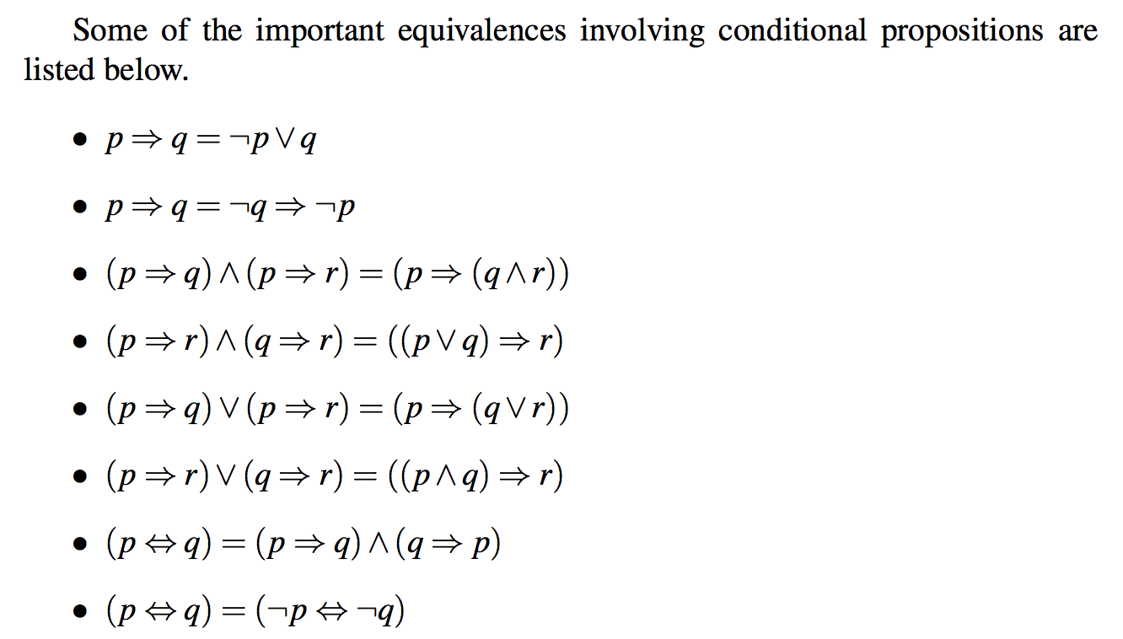
Some equivalences involving conditional statements

Slide 50
Example
if ((x > 0) and (y > 0)) then writeln(…) is equivalent to if (x > 0) then if (y > 0) then writeln (---)
Propositions (x and y are constants)
p : x > 0
q : y > 0
r : line gets written
Claim is (p ∧ q r) = (p (q r))

Slide 51
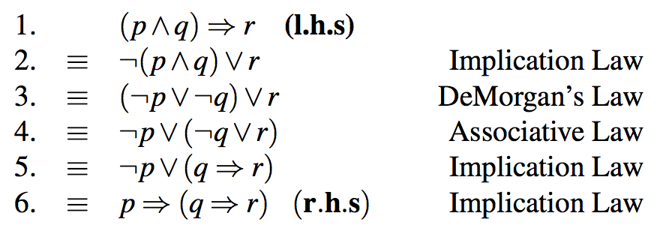
Example
if ((x > 0) and (y > 0)) then writeln(…) is equivalent to if (x > 0) then if (y > 0) then writeln (---)
Propositions (x and y are constants)
p : x > 0
q : y > 0
r : line gets written
Claim is (p ∧ q r) = (p (q r))

Slide 52
A general approach to proving equivalence using the laws of logic
Remove double negation
Remove implication by disjunction (∨)
Push negation inside the parentheses using DeMorgan’s law
Use distribution law

Slide 53
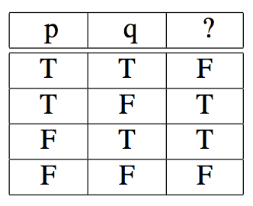
Other Examples
Find a proposition with truth value

Slide 54
Other Examples
Determine a logically equivalent proposition to p ⊕ q.
Logically equivalent: (p ∧ ¬q) ∨ (¬ p ∧ q)
Replacing each row with value T with an equivalent proposition. These rows are then combined with ∨.

Slide 55
Using the truth table, one can show that …
Any compound proposition (a formula) can be transformed to a logically equivalent formula involving only ¬, ∧, ∨ operators.

Slide 56
Other Examples
Write a proposition equivalent to ¬p ∧ ¬q using only ¬ and ∨.
Determine whether p (¬q ∧ r), ¬p ∨ ¬(r q) are logically equivalent
Prove that (q ∧ (p ¬q)) ¬p is a tautology using propositional equivalence and laws of logic.
Write the negation of
If it is sunny, we go skiing.
I will go the movie or read a book, but not both.

Slide 57
Practice problems from the text:
Section 2.1
2, 3, 10, 11
Section 2.2
1, 3, 4, 6, 7, 12
Section 2.3
1, 3, 9, 10, 11
Section 2.4
3, 4, 5
Section 2.5
2, 6, 7, 10, 11
Section 2.6
1, 2, 7, 9, 10, 12, 13

