Slide 1
Induction (Chapter 10)
Some slides have been taken from the sites
http://cse.unl.edu/~choueiry/S13-235/

Slide 2
Motivation
How can we prove the following proposition?
∀x∈A S(x)
For a finite set A={a₁,a₂,…,a_{n}}, we can prove that S(x) holds for each element because of the equivalence
S(a₁)∧S(a₂)∧…∧S(a_{n})
For an infinite set, we can try to use universal generalization
Another, more sophisticated way is to use induction

Slide 3
Principle of Mathematical Induction
To prove that a statement S(n) is true for all positive integers n (i.e. n ∈ N) , we perform two steps:
Basis step: We verify that S(1) is true.
Inductive step: We show that the conditional statement
S(k) ⇒ S(k+1) is true ∀k ∈ N
Symbolically, the statement
(S(1) ∧ ∀(k ≥ 1) (S(k) ⇒ S(k+1))) ⇒ ∀(n ∈ N) S(n)

Slide 4
Principle of Mathematical Induction
How do we do this?
S(1) is usually an easy property to show.
To prove the conditional statement, we assume that S(k) is true (it is called inductive hypothesis) and show that under this condition S(k+1) is also true.

Slide 5
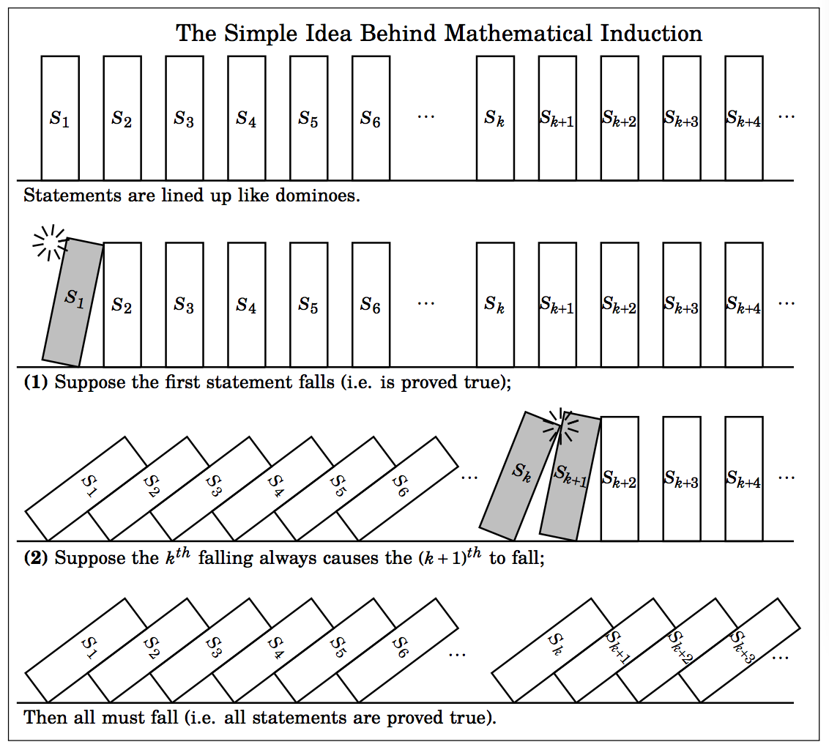
Mathematical Induction
It is a powerful proof techniques.

Slide 6
Mathematical Induction
It is a powerful proof techniques.
The Domino Effect
Show that all dominos fall.
Basis Step: The first domino falls.
Inductive step: Whenever a domino falls, its next neighbor will also fall.

Slide 8
Another View
To look at it in another way, assume that the statements
S(1)
S(k) ⇒ S(k+1)
are true. We can now use a form of universal generalization as follows:

Slide 9
Another View
To look at it in another way, assume that the statements
(1) S(1)
(2) P(k) ⇒ P(k+1)
are true. We can now use a form of universal generalization as follows.
Say we choose an element c of N. c is finite. We wish to establish that S(c) is true. If c=1, then we are done.

Slide 10
Another View
To look at it in another way, assume that the statements
(1) S(1)
(2) S(k) ⇒ S(k+1)
are true. We can now use a form of universal generalization as follows.
Say we choose an element c of N. c is finite. We wish to establish that S(c) is true. If c=1, then we are done.
Otherwise, we apply (2) above to get
S(1) ⇒ S(2), S(2)⇒ S(3), S(3) ⇒ S(4), …, S(c-1) ⇒ S(c)
via a finite number of steps (c-1) we get that S(c) is true.

Slide 11
Another View
To look at it in another way, assume that the statements
(1) S(1)
(2) S(k) ⇒ S(k+1)
are true. We can now use a form of universal generalization as follows.
Say we choose an element c of N. c is finite. We wish to establish that S(c) is true. If c=1, then we are done.
Otherwise, we apply (2) above to get
S(1) ⇒ S(2), S(2)⇒ S(3), S(3) ⇒ S(4), …, S(c-1) ⇒ S(c)
via a finite number of steps (c-1) we get that S(c) is true.
Because c is arbitrary, the universal generalization is established and
∀n ∈ N S(n)

Slide 12
Example 1
Prove that for any integer n≥1, 2^{2n}-1 is divisible by 3.
Define S(n) to be the statement 3 | (2^{2n}-1).

Slide 13
Example 1
Prove that for any integer n≥1, 2^{2n}-1 is divisible by 3
Define S(n) to be the statement 3 | (2^{2n}-1)
We note that for the basis case n=1, we do have S(1)
2^{2∙1}-1 = 3 is divisible by 3.

Slide 14
Example 1
Prove that for any integer n≥1, 2^{2n}-1 is divisible by 3
Define S(n) to be the statement 3 | (2^{2n}-1)
We note that for the basis case n=1 we do have P(1)
2^{2∙1}-1 = 3 is divisible by 3
Next we assume that S(k) holds. That is, there exists some integer t such that
2^{2k}-1 = 3t. (Inductive hypothesis)

Slide 15
Example 1
Prove that for any integer n≥1, 2^{2n}-1 is divisible by 3
Define S(n) to be the statement 3 | (2^{2n}-1)
We note that for the basis case n=1 we do have P(1)
2^{2∙1}-1 = 3 is divisible by 3
Next we assume that S(k) holds. That is, there exists some integer t such that
2^{2k}-1 = 3t. (Inductive hypothesis)
We must prove that S(k+1) holds. That is, 2^{2(k+1)}-1 is divisible by 3.

Slide 16
Example 1 (contd.)
Note that: 2^{2(k+1)} – 1 = 2²2^{2k} -1=4.2^{2k} -1

Slide 17
Example 1 (contd.)
Note that: 2^{2(k+1)} – 1 = 2²2^{2k} -1=4.2^{2k} -1
The inductive hypothesis: 2^{2k} – 1 = 3t ⇒ 2^{2k} = 3t+1

Slide 18
Example 1 (contd.)
Note that: 2^{2(k+1)} – 1 = 2²2^{2k} -1=4.2^{2k} -1
The inductive hypothesis: 2^{2k} – 1 = 3t ⇒ 2^{2k} = 3t+1
Thus: 2^{2(k+1)} – 1 = 4∙2^{2k} -1 = 4(3t+1)-1
= 12t+4-1
= 12t+3
= 3(4t+1), a multiple of 3

Slide 19
Example 1 (contd.)
Note that: 2^{2(k+1)} – 1 = 2²2^{2k} -1=4.2^{2k} -1
The inductive hypothesis: 2^{2k} – 1 = 3t ⇒ 2^{2k} = 3t+1
Thus: 2^{2(k+1)} – 1 = 4∙2^{2k} -1 = 4(3t+1)-1
= 12t+4-1
= 12t+3
= 3(4t+1), a multiple of 3
We conclude, by the principle of mathematical induction, for any integer n≥1, 2^{2n}-1 is divisible by 3.

Slide 20
Example 2 (page 154)
Open Statement S_{n} : 1 + 3 + 5 +…..+ (2n-1) = n^{2 .}
The rest of the details will be shown in the class.
Notes:
Will use direct proof.

Slide 21
Example 3: Summation
Show that Σ_{i=1}^{n} (i³) = (Σ_{i=1}^{n} i)² for all n ≥ 1.
The basis case is trivial: for n =1, 1³ = 1²
The inductive hypothesis assumes that for some n≥1 we have Σ_{i=1} ^{k} (i³) = (Σ_{i=1}^{k} i)²
We now consider the summation for (k+1): Σ_{i=1}^{k+1} (i³)
= (Σ_{i=1}^{k} i)² + (k+1)³
= ( k(k+1)/2 )² + (k+1)³
= ( k²(k+1)² + 4(k+1)³ ) /2²
= (k+1)² (k² + 4(k+1) ) /2²
= (k+1)² ( k² +4k+4 ) /2²
= (k+1)² ( k+2)² /2²
= ((k+1)(k+2) / 2) ²
Thus, by the PMI, the equality holds

Slide 23
Examples solved in the text

Slide 24
Example
Let S(n) : p|(a₁ x a₂ x … x a_{n}), n ≥ 2, p a prime integer.
The basis step involves proving p|(a₁ x a₂).

Slide 25
Example
Let S(n) : p|(a₁ x a₂ x … x a_{n}), n ≥ 2, p a prime integer.
The basis step involves proving p|(a₁ x a₂).
Suppose p does not divide a₁.
gcd(p,a₁) = 1.

Slide 26
Example
Let S(n) : p|(a₁ x a₂ x … x a_{n}), n ≥ 2, p a prime integer.
The basis step involves proving p|(a₁ x a₂).
Suppose p does not divide a₁.
gcd(p,a₁) = 1.
Therefore, 1 = p.k + a₁l, k and l are elements of Z.

Slide 27
Example
Let S(n) : p|(a₁ x a₂ x … x a_{n}), n ≥ 2, p a prime integer.
The basis step involves proving p|(a₁ x a₂).
Suppose p does not divide a₁.
gcd(p,a₁) = 1.
Therefore, 1 = p.k + a₁l, k and l are elements of Z.
We can write a₂ = p.k. a₂ + a₁l. a₂
Since p|(a₁ x a₂), p|a₂.

Slide 28
Example
Let S(n) : p|(a₁ x a₂ x … x a_{n}), n ≥ 2, p a prime integer.
The basis step involves proving p|(a₁ x a₂).
Suppose p does not divide a₁.
gcd(p,a₁) = 1.
Therefore, 1 = p.k + a₁l, k and l are elements of Z.
We can write a₂ = p.k. a₂ + a₁l. a₂
Since p|(a₁ x a₂), p|a₂.
Similar arguments for the case when p does not divide a₂.

Slide 29
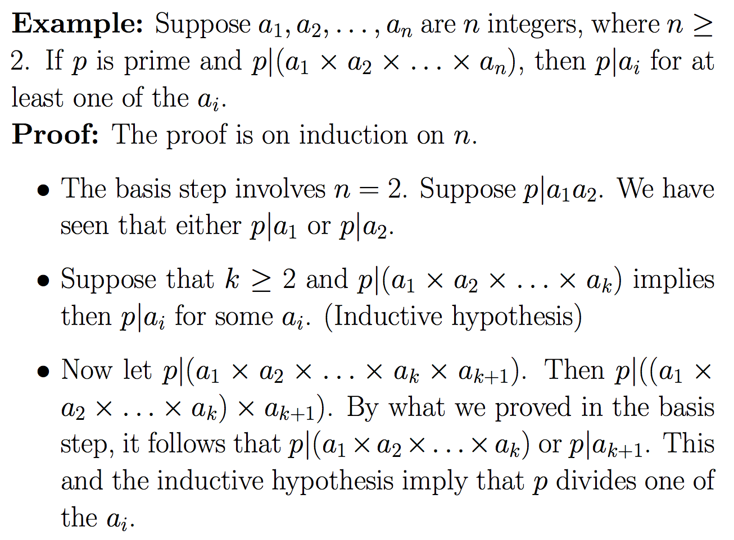

Slide 33
Example
Show that any number larger than 43 can be written as the sum of nonnegative multiples of 6, 9, or 20.
i.e n = 6 t₁ + 9 t₂ + 20 t₃, where t₁, t₂, t₃ ≥ 0, n ≥ 44.

Slide 34
Example
Show that any number larger than 43 can be written as the sum of nonnegative multiples of 6, 9, or 20.
i.e n = 6 t₁ + 9 t₂ + 20 t₃, where t₁, t₂, t₃ ≥ 0, n ≥ 44.
Consider n=1,2,3,….
We notice that only the numbers 6, 9, 12, 15, 18, 20, 21, 24, 26, 27, 29, 30, 32, 33, 36, 38, 39, 40, 42 (less than 43) can be expressed as the sum of 6 and 9.
However, 43 is not expressible as the sum of 6, 9, and 20.

Slide 35
Example
Show that any number larger than 43 can be written as the sum of nonnegative multiples of 6, 9, or 20.
i.e n = 6 t₁ + 9 t₂ + 20 t₃, where t₁, t₂, t₃ ≥ 0, n ≥ 44.
Consider n=1,2,3,….
We notice that only the numbers 6, 9, 12, 15, 18, 20, 21, 24, 26, 27, 29, 30, 32, 33, 36, 38, 39, 40, 42 (less than 43) can be expressed as the sum of 6 and 9.
However, 43 is not expressible as the sum of 6, 9, and 20.
Claim any number greater than or equal to 44 can be expressed as
S(n): n = 6 t₁ + 9 t₂ + 20 t₃, where t₁, t₂, t₃ ≥ 0, n ≥ 44.

Slide 36
Example (contd.)
We can show that S(44), S(45), S(46), S(47), S(48), S(49) are true.
We now show that
(S(44) ∧ S(45) ∧ .... ∧ S(k)) ⇒ S(k + 1), k ≥ 49.

Slide 37
Example (contd.)
We can show that S(44), S(45), S(46), S(47), S(48), S(49) are true.
We now show that
(S(44) ∧ S(45) ∧ .... ∧ S(k)) ⇒ S(k + 1), k ≥ 49.
Consider m= (k+1)-6.
Since k ≥ 49, m ≥ 44.
We assumed (induction hypothesis) that S(m) is true.
i.e. m = 6 t’₁ + 9 t’₂ + 20 t’₃, where t’₁, t’₂, t’₃ ≥ 0.
Hence m+6 = k+1 = 6 (t’₁+1) + 9 t’₂ + 20 t’_{3.}
Therefore, S(k+1) is true. This means that
S(44) ⇒ S(50), S(45) ⇒ S(51), S(46) ⇒ S(52), S(47) ⇒ S(53), …,
completing the induction.
By the principle of strong induction, ∀n∈N S(n), n ≥ 44 is true.

Slide 38
Principle of Strong Mathematical Induction
Sometimes mathematical induction is not enough.
In order to prove that S(n) is true for all positive integer n ≥ n₀, we complete two steps:
Basis step: We verify that S(n₀), S(n₀+1), ..., S(n₁) are true.
Inductive step: We show that conditional statement (S(n₀) ∧ S(n₀+1) ∧ .... ∧ S(k)) ⇒ S(k + 1) for all positive integers k ≥ n₁.
It follows by the principle of strong mathematical induction that every S(n), n≥ n₀ is true.
Symbolically
[(S(n₀)∧S(n₀+1)∧ ... ∧S(n₁) ∧ S(n₁+1) ∧ …∧ S(k) ⇒ S(k+1), k ≥ n₁]
⇒ ∀(n≥ n₀) S(n)

Slide 39
Example
Any integer n > 11 can be written in the form n=4a + 5b for a, b ∈ Z.
Try at home.

Slide 40
Steps to doing an inductive proof
State the theorem, which is the proposition S(n)

Slide 41
Steps to doing an inductive proof
State the theorem, which is the proposition S(n)
Show that S(base case) is true. There could be more than one base case.

Slide 42
Steps to doing an inductive proof
State the theorem, which is the proposition S(n)
Show that S(base case) is true. There could be more than one base case.
State the inductive hypothesis (S(k), S(k-1), … are true)
State what must be proven (substitute k+1 for n)

Slide 43
Steps to doing an inductive proof
State the theorem, which is the proposition S(n)
Show that S(base case) is true. There could be more than one base case.
State the inductive hypothesis (S(k), S(k-1), … are true)
State what must be proven (substitute k+1 for n)
State that you are beginning your proof of the inductive step, and proceed to manipulate the inductive hypothesis (which we assume is true) to find a link between the inductive hypothesis and the statement to be proven. Always state explicitly where you are invoking the inductive hypothesis.

Slide 44
Steps to doing an inductive proof
State the theorem, which is the proposition S(n)
Show that S(base case) is true. There could be more than one base case.
State the inductive hypothesis (S(k), S(k-1), … are true)
State what must be proven (substitute k+1 for n)
State that you are beginning your proof of the inductive step, and proceed to manipulate the inductive hypothesis (which we assume is true) to find a link between the inductive hypothesis and the statement to be proven. Always state explicitly where you are invoking the inductive hypothesis.
Always finish your proof with something like: S(k+1) is true when S(k) is true, S(k-1) is true, etc., and therefore, S(n) is true for all n ≥ base case.

Slide 45
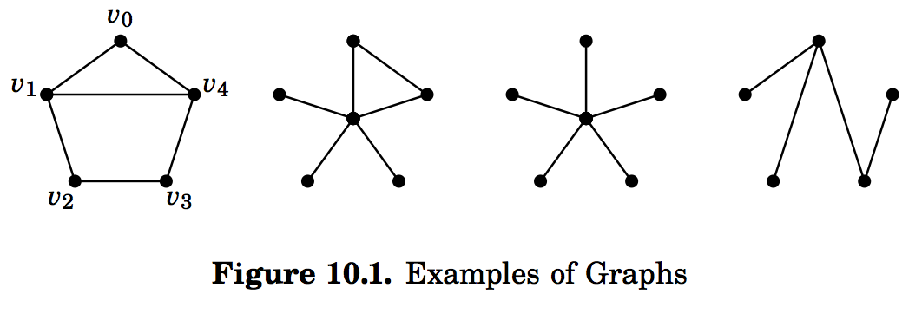
Using strong induction to graphs.
A graph is a configuration consisting of points (called vertices) and edges which are lines connecting the vertices.
Examples of graphs:
First two instances of the graphs have cycles, set of edges together forming a cycle.
A graph with no cycles is called a tree. The two graphs on the right are trees.

Slide 46
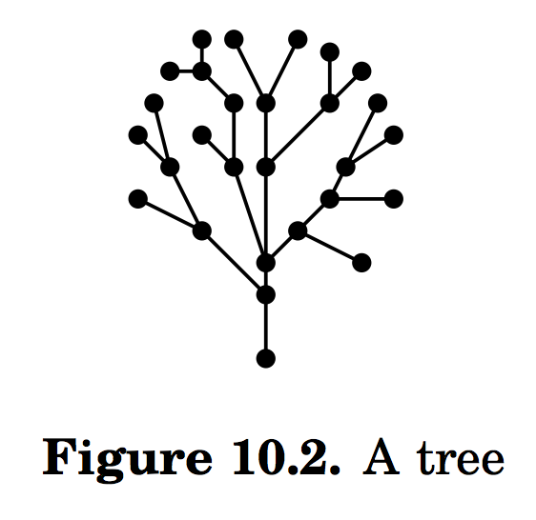
Trees

Slide 47
Proposition:
Proposition: If a tree has n vertices, then it has n-1 edges, ∀n ∈ N.
S(n): A tree with n vertices has n-1 edges.

Slide 48
Proposition:
Proposition: If a tree has n vertices, then it has n-1 edges, ∀n ∈ N.
S(n): A tree with n vertices has n-1 edges.
Basis: If a tree has n = 1 vertex, it has no edges. Thus it has n-1 edges, so the theorem is true when n=1.

Slide 49
Proposition:
Proposition: If a tree has n vertices, then it has n-1 edges, ∀n ∈ N.
S(n): A tree with n vertices has n-1 edges.
Basis: If a tree has n = 1 vertex, it has no edges. Thus it has n-1 edges, so the theorem is true when n=1.
Inductive hypothesis: S(1) S(2) … S(k) is true for any k ≥ 1.

Slide 50
Proposition:
Proposition: If a tree has n vertices, then it has n-1 edges, ∀n ∈ N.
S(n): A tree with n vertices has n-1 edges.
Basis: If a tree has n = 1 vertex, it has no edges. Thus it has n-1 edges, so the theorem is true when n=1.
Inductive hypothesis: S(1) S(2) … S(k) is true for any k ≥ 1.
We need to show that : S(1) S(2) … S(k) ⇒ S(k+1).
The inductive hypothesis is saying that any tree with m vertices, 1 ≤ m ≤ k has m-1 edges.

Slide 51
Proposition:
Proposition: If a tree has n vertices, then it has n-1 edges, ∀n ∈ N.
S(n): A tree with n vertices has n-1 edges.
Basis: If a tree has n = 1 vertex, it has no edges. Thus it has n-1 edges, so the theorem is true when n=1.
Inductive hypothesis: S(1) S(2) … S(k) is true for any k ≥ 1.
We need to show that : S(1) S(2) … S(k) ⇒ S(k+1).
The inductive hypothesis is saying that any tree with m vertices, 1 ≤ m ≤ k has m-1 edges.
Showing S(k+1) is true.

Slide 52
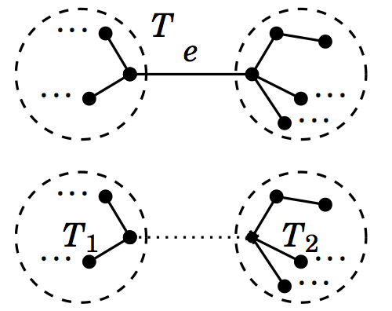
Showing S(k+1) is true.
Consider an arbitrary tree T with k+1 vertices.
The tree has at least one edge.

Slide 53
Showing S(k+1) is true.
Consider an arbitrary tree T with k+1 vertices.
The tree has at least one edge.
Single out an edge e of T .
Remove the edge e from T.
This results in two smaller trees
T₁ and T₂ with no more than k vertices.

Slide 54
Showing S(k+1) is true.
Consider an arbitrary tree T with k+1 vertices.
The tree has at least one edge.
Single out an edge e of T .
Remove the edge e from T.
This results in two smaller trees
T₁ and T₂ with no more than k vertices.
Let T₁ has x vertices, and therefore, T₂
has (k+1)-x vertices.

Slide 55
Showing S(k+1) is true.
Consider an arbitrary tree T with k+1 vertices.
The tree has at least one edge.
Single out an edge e of T .
Remove the edge e from T.
This results in two smaller trees
T₁ and T₂ with no more than k vertices.
Let T₁ has x vertices, and therefore, T₂
has (k+1)-x vertices.
Inductive hypothesis guarantees that T₁ has (x-1) edges and T₂ has (k-x) edges.

Slide 56
Showing S(k+1) is true.
Consider an arbitrary tree T with k+1 vertices.
The tree has at least one edge.
Single out an edge e of T .
Remove the edge e from T.
This results in two smaller trees
T₁ and T₂ with no more than k vertices.
Let T₁ has x vertices, and therefore, T₂
has (k+1)-x vertices.
Inductive hypothesis guarantees that T₁ has (x-1) edges and T₂ has (k-x) edges.
The total number of edges in T is (x-1)+(k-x) +1 = k. The edge e contributes one to the total. Hence S(k+1) is true.

Slide 57
Showing S(k+1) is true.
Consider an arbitrary tree T with k+1 vertices.
The tree has at least one edge.
Single out an edge e of T .
Remove the edge e from T.
This results in two smaller trees
T₁ and T₂ with no more than k vertices.
Let T₁ has x vertices, and therefore, T₂
has (k+1)-x vertices.
Inductive hypothesis guarantees that T₁ has (x-1) edges and T₂ has (k-x) edges.
The total number of edges in T is (x-1)+(k-x) +1 = k. The edge e contributes one to the total. Hence S(k+1) is true.
Follows by strong induction that a tree with n vertices has (n-1) edges.

Slide 58
Fibonacci Number

Slide 59
Fibonacci Number
Proposition: Prove that
F₁ + F₂ + … + F_{n} = F_{n+2} -1 for n ≥ 2

Slide 60
Number of diagonals in a convex polygon with n vertices.
n = 3; # of diagonal =0
n = 5; # of diagonal = 5

Slide 61
Number of diagonals in a convex polygon with n vertices is n(n-3)/2.
S(n) : n ≥ 3 vertex convex polygon realizes N(n) = n(n-3)/2 diagonals.
Proof by Induction.
Basis: S(3) is true, since a triangle realizes N(3 )= 0 diagonal.
Inductive Hypothesis: S(k) is true for any k ≥ 3, N(k) = k(k-3)/2.
Show that S(k+1) is also true.
Consider a convex polygon P with k+1 vertices p₁, p₂, …, p_{k+1}.
N(k+1) = N(k) + ((k – 2) + 1)
= k(k-3)/2 + k-1
= (k+1)((k+1)-3)/2 (details in the class)
Using the principle of strong induction, ∀ n ≥ 3, S(n) is true.

Slide 62
Summation

Slide 63
More Summation

Slide 65
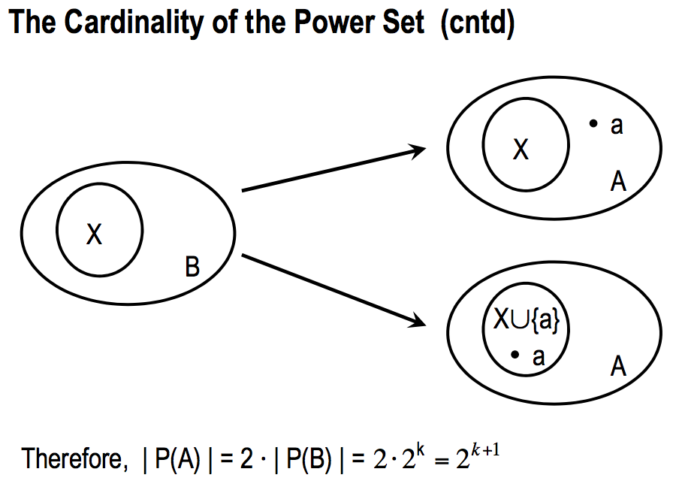

Slide 66
Practice problems from the text. (Chapter 10)
1,2,4,5,9, 11, 16, 23, 24, 33, 35

