Slide 1
Functions
Chapter 12

Slide 2
Acknowledgement
I have used materials from the following sources:
Textbook
Lecture notes slides prepared by Prof. Bulatov.
http://cse.unl.edu/~choueiry/S13-235/
http://www.math-cs.gordon.edu/courses/mat231/notes.html

Slide 3
Outline
Functions
Injective (one-to-one) and Surjective (onto) Functions
Composition of Functions
Inverse Functions
The Pigeonhole Principle.

Slide 4
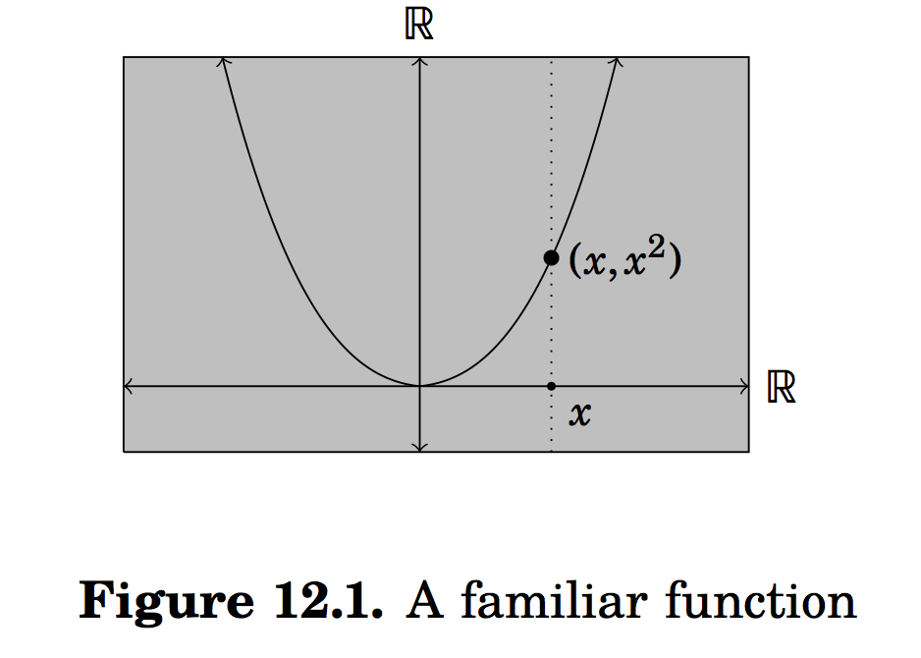
Functions
The concept of relations between the sets plays a big role here.
Consider the function f(x) = x², where x ∈ R.

Slide 5
Functions
The concept of relations between the sets plays a big role here.
Consider the function f(x) = x², where x ∈ R.
The points on the curve are related.
T={(x,x²): x ∈ R} ⊆ R x R.
Functions are special kinds of relations.

Slide 6
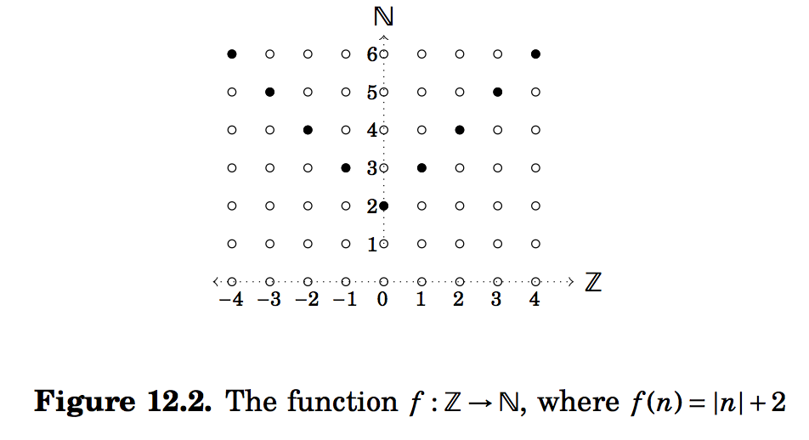
Another example of a function
Here R= {(n,|n|+2): n ∈ N} ⊆ Z x N.

Slide 7
Functions
Definition:
Suppose A and B are sets.
A function f from A to B (denoted as f: : A → B ) is a relation f ⊆ A x B from A to B.
The relation satisfies the property that for each element a ∈ A the relation f contains exactly one ordered pair (2-tuple) of the form (a,b).
The statement (a,b) ∈ f is abbreviated as f(a) = b.
A shorter form of the definition
A function f from A to B is an assignment of exactly one element of B to each element of A.

Slide 8
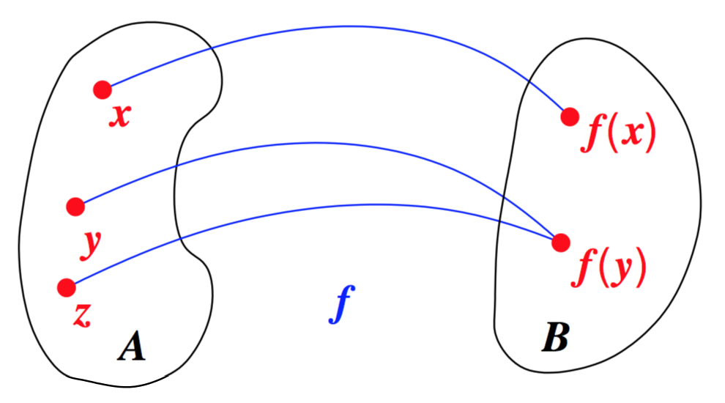
We can diagram f: A → B as
>
>
>

Slide 9
Function: Visualization
Range
Preimage
Image, f(a)=b
f
a
b
A
B
Domain
Co-Domain
A function, f: A → B

Slide 10
Terminology
Let f: A → B and f(a)=b. Then we use the following terminology:
A is the domain of f
B is the co-domain of f
b is the image of a
a is the preimage (antecedent) of b
The range of f is the set of all images of elements of A

Slide 11
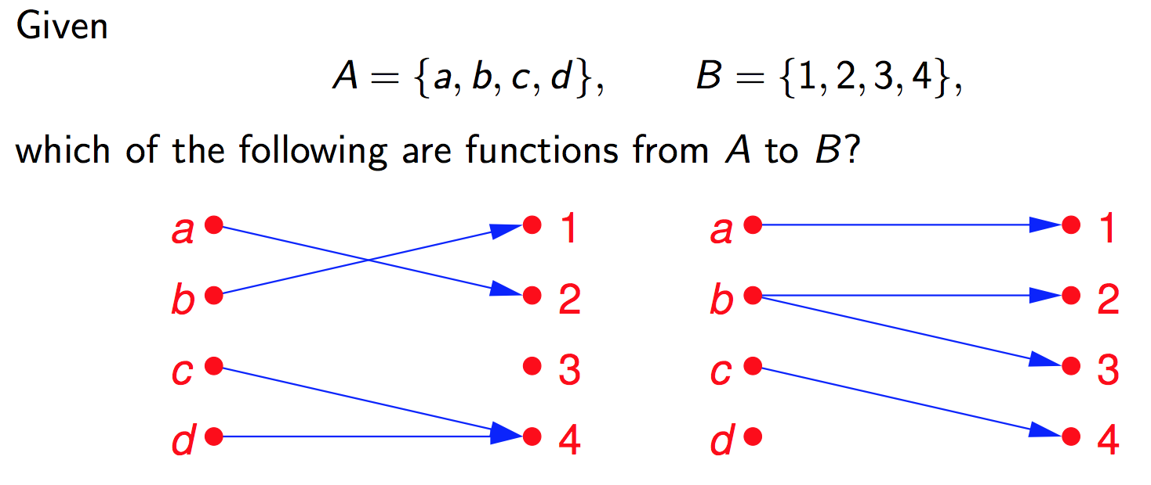
Example

Slide 12
Example
The diagram on the left is a function. The codomain is a subset of B.
The one on the right is not a function. The domain is not A. Moreover b is assigned (mapped) to two different elements of B.

Slide 13
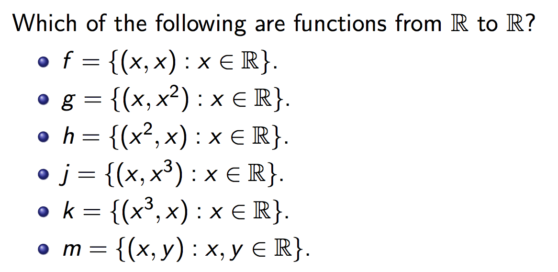
Example

Slide 14
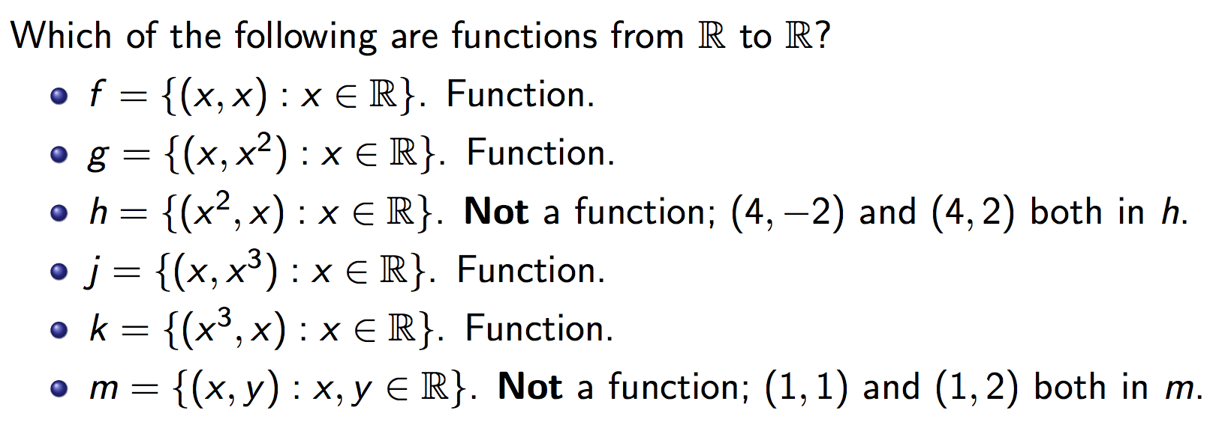
Example

Slide 15
Definitions
A function is called real-valued if its codomain is the set of real numbers.
A function is called integer-valued if its codomain is the set of integers.
Two real-valued functions or two integer-valued functions with the same domain can be added or multiplied.

Slide 16
Example:
Let f: R → R and g: R → R such that f(x) = x² and g(x) = x – x². What are the functions f+g and f.g?
Solution:
(f+g)(x) = f(x) + g(x) = x² + (x – x²) = x.
f.g(x) = f(x).g(x) = x² . (x – x²⁾ = x³ – x⁴.

Slide 17
Equality of functions
Definition: Two functions f: A → B and g: C → D are equal if A = C and ∀x ∈ A, f(x) = g(x).
Note that
f: Z → N and g: Z → Z, f(x) = |x| + 2, g(x) = |x|+ 2
are equal.

Slide 18
More Definitions (2)
Definition: Let f: A→ B and S ⊆A. The image of the set S is the subset of B that consists of all the images of the elements of S. We denote the image of S by f(S), so that
f(S)={ f(s) | ∀ s ∈ S }
Note there that the image of S is a set and not an element.

Slide 19
Image of a set: Example
Let:
A = {a₁,a₂,a₃,a₄,a₅}
B = {b₁,b₂,b₃,b₄,b₅}
f={(a₁,b₂), (a₂,b₃), (a₃,b₃), (a₄,b₁), (a₅,b₄)}
S={a₁,a₃}
f(S) = {b₂, b₃}
Draw a diagram for f
What is the:
Domain, co-domain, range of f?
Image of S, f(S)?

Slide 20
Section 12.2 (Injective and Surjective functions)
In the literature
injective and one-to-one mean the same
surjective and onto mean the same
bijective and one-to-one correspondence mean the same.

Slide 21
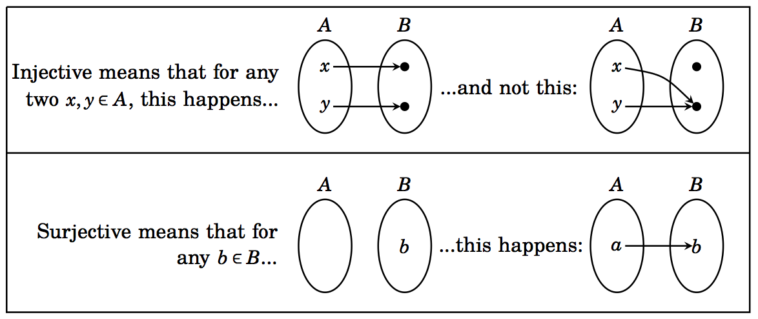
Section 12.2 (Injective and Surjective functions)
Definitions:

Slide 22
Example
Consider the following functions on the students in macm class. Under what conditions is the function one-to-one if it assigns to a student his or her
cell phone number
student id
final grade in the class
home town

Slide 23
Example
Consider the following functions on the students in macm class. Under what conditions is the function one-to-one if it assigns to a student his or her
cell phone number one-to-one
student id one-to-one
final grade in the class generally not one-to-one unless each student gets a unique grade
home town one-to-one if each student comes from a different town

Slide 24
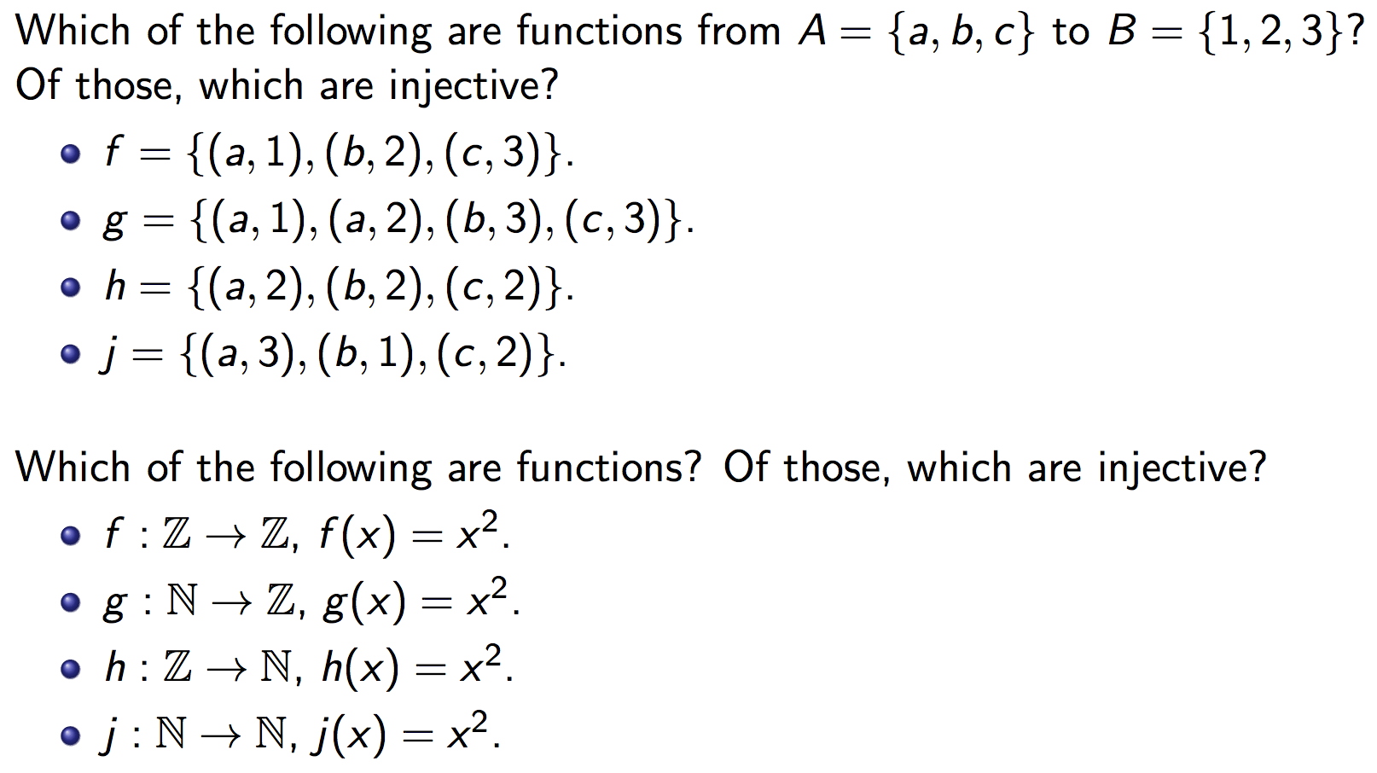
Injective functions One-to-one functions

Slide 25
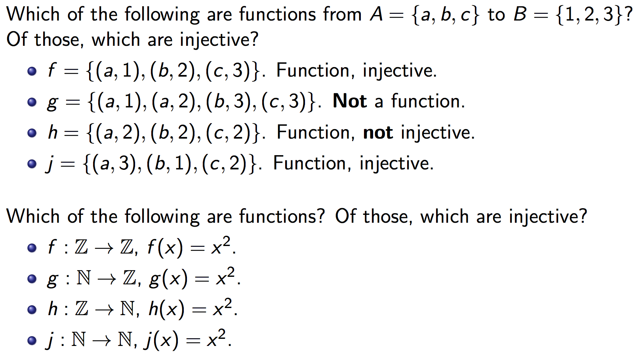
Injective functions One-to-one functions

Slide 26
How to show a function f: A→ B is injective?
∀ x,y ∈ A [{(x ≠ y) (f(x) ≠ f(y))} ≡ {(f(x) = f(y)) (x=y)}]

Slide 27
Injective functions One-to-one functions

Slide 28
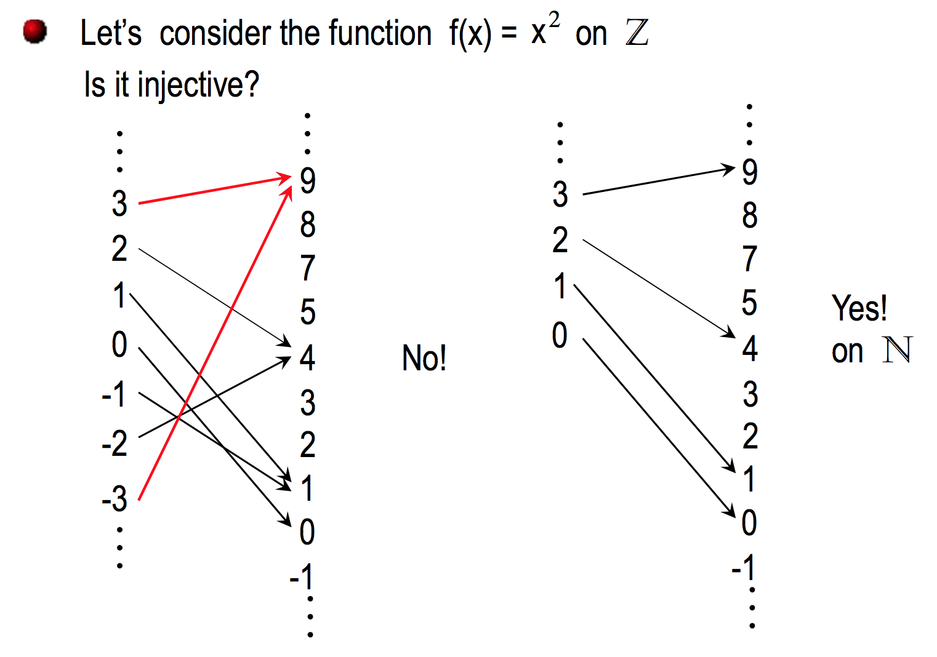

Slide 29
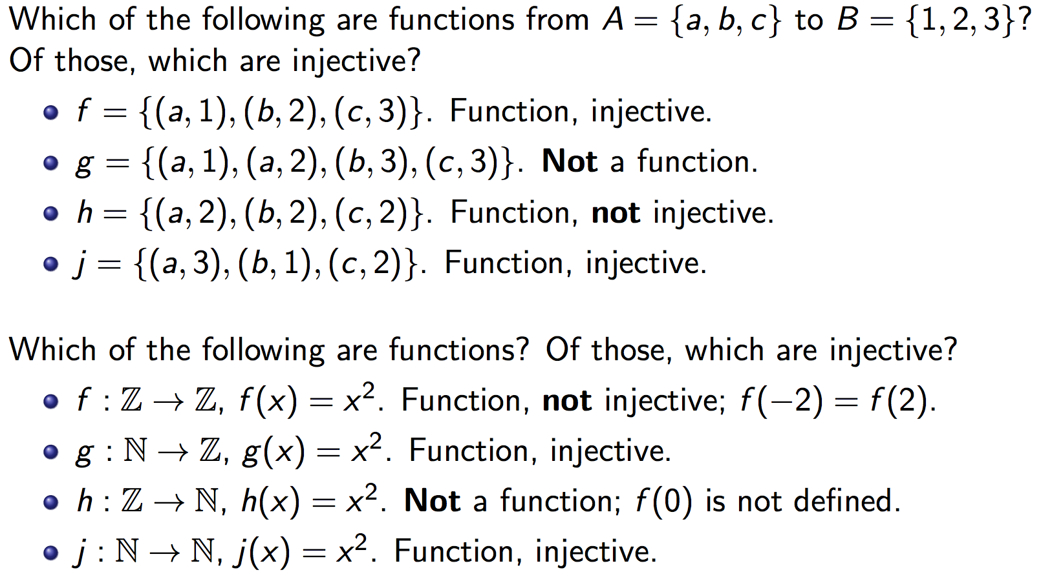
Injective functions One-to-one functions

Slide 30
Recall:

Slide 31
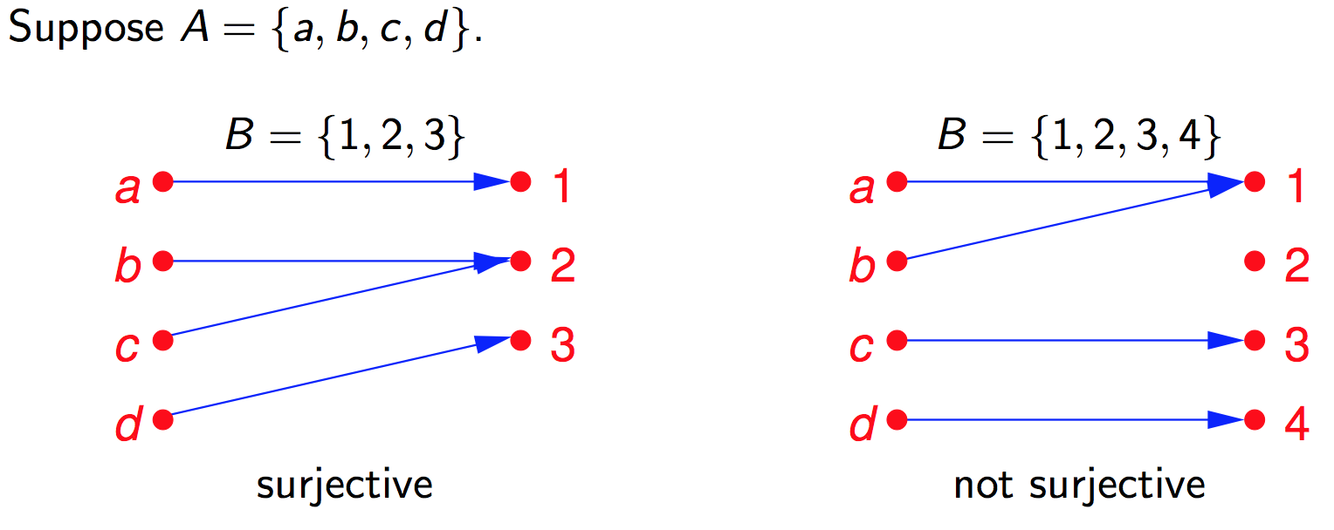
Surjective functions Onto functions range(f) = codomain(f)
range(f) ≠ codomain(f)

Slide 32
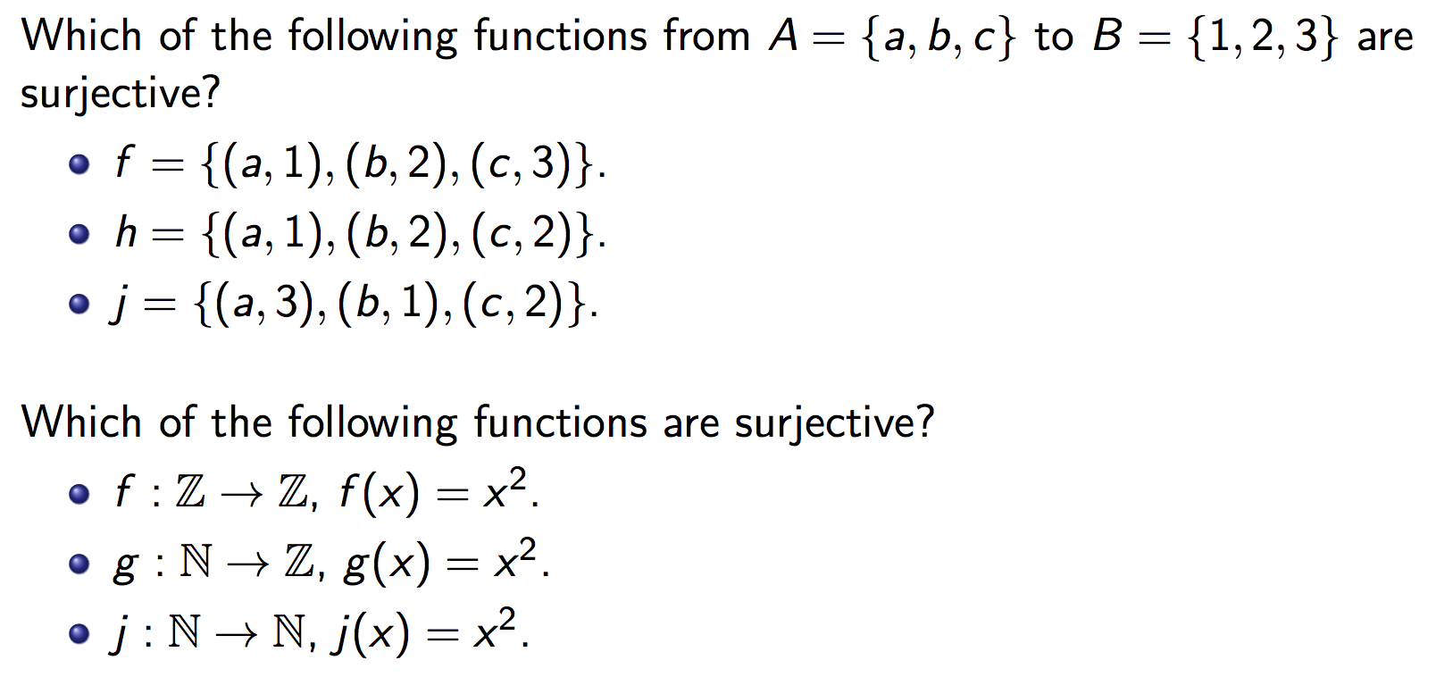
Surjective functions Onto functions

Slide 33
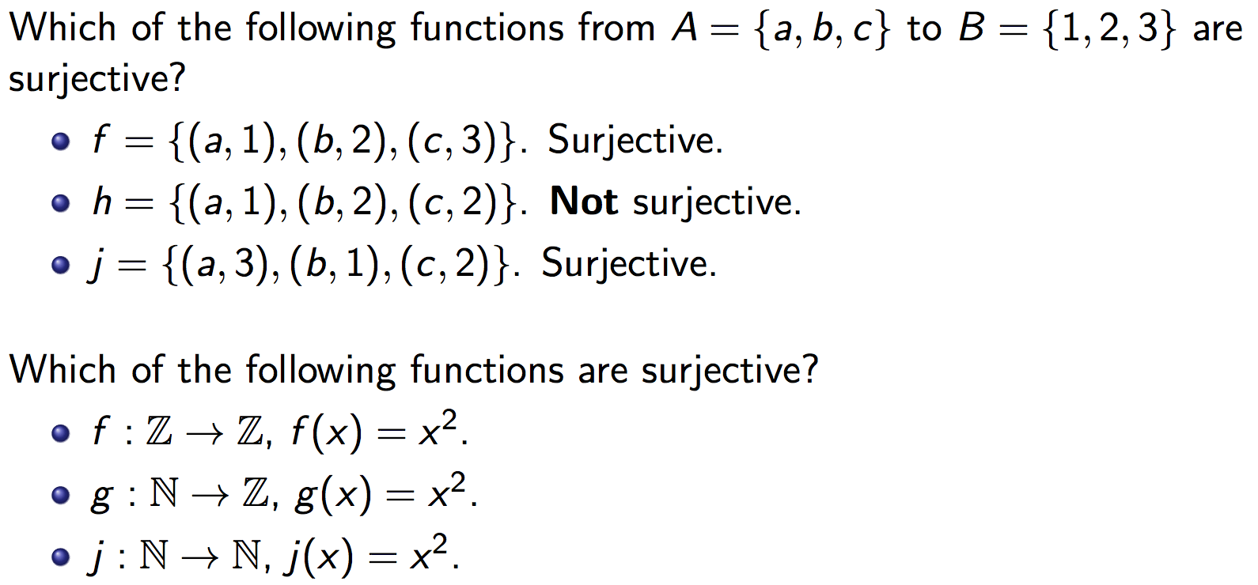
Surjective functions Onto functions

Slide 34
How to show a function f: A→ B is surjective?
∀ b ∈ B [∃a ∈ A (f(a) = b)]

Slide 35
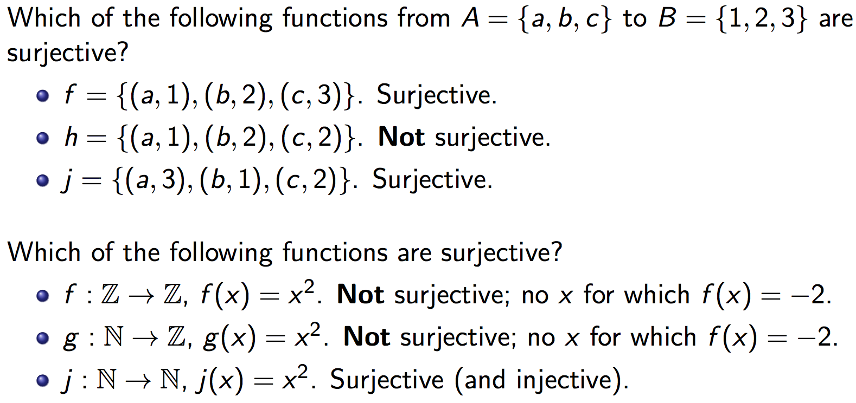
Surjective functions Onto functions
Not surjective (but injective)

Slide 38
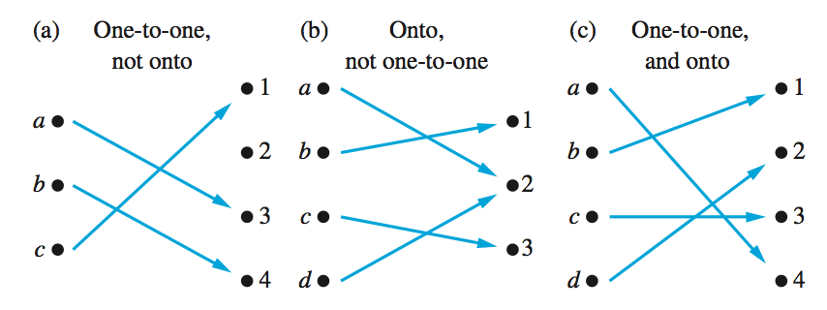
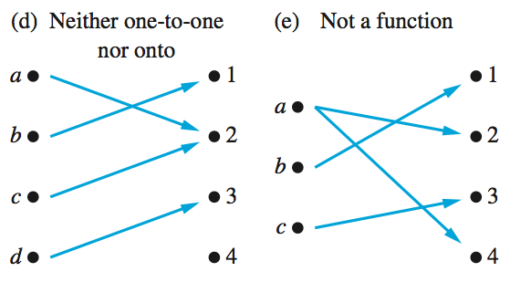
Examples of different types of correspondences

Slide 39
Exercise 1
Let f:Z→Z be defined by
f(x)=2x-3
What is the domain, codomain, range of f?
Is f one-to-one (injective)?
Is f onto (surjective)?
Clearly, domain(f)=Z.
To see what the range is, note that:
b∈ range(f) b=2a-3, for some a ∈ Z
b=2(a-2)+1
b is odd

Slide 40
Exercise 1 (cont’d)
Thus, the range is the set of all odd integers
Since the range and the codomain are different (i.e., range(f) ≠ Z), we can conclude that f is not onto (surjective)
However, f is one-to-one injective. (Contrapositive approach)
For x, y ∈ Z , we can write
f(x) = f(y) ⇒ 2x - 3 = 2y - 3 ⇒ x = y. QED

Slide 41
Exercise 2
Let f be as before
f(x)=2x-3
but now we define f:N →N
What is the domain and range of f?
Is f onto (surjective)?
Is f one-to-one (injective)?
By changing the domain and codomain of f, f is not even a function anymore. Indeed, f(1)=2⋅1-3=-1∉N

Slide 42
Exercise 3
Let f:Z→Z be defined by
f(x) = x² - 5x + 5
Is this function
One-to-one?
Onto?

Slide 43
Exercise 3: Answer
It is not one-to-one (injective)
f(x₁)=f(x₂) ⇒ x₁²-5x₁+5=x₂² - 5x₂+5 ⇒ x₁² - 5x₁ = x₂² - 5x₂
⇒ x₁² - x₂² = 5x₁ - 5x₂ ⇒ (x₁ - x₂)(x₁ + x₂) = 5(x₁ - x₂)
⇒ (x₁ + x₂) = 5
Many x₁,x₂ ∈Z satisfy this equality. There are thus an infinite number of solutions. In particular, f(2)=f(3)=-1
It is also not onto (surjective).
The function is a parabola with a global minimum at (5/2,-5/4). Therefore, the function fails to map to any integer less than -1
What would happen if we changed the domain/codomain?

Slide 44
Exercise 3: Answer
It is not one-to-one (injective)
f(x₁)=f(x₂) ⇒ x₁²-5x₁+5=x₂² - 5x₂+5 ⇒ x₁² - 5x₁ = x₂² - 5x₂
⇒ x₁² - x₂² = 5x₁ - 5x₂ ⇒ (x₁ - x₂)(x₁ + x₂) = 5(x₁ - x₂)
⇒ (x₁ + x₂) = 5
Many x₁,x₂ ∈Z satisfy this equality. There are thus an infinite number of solutions. In particular, f(2)=f(3)=-1
It is also not onto (surjective).
The function is a parabola with a global minimum at (5/2,-5/4). Therefore, the function fails to map to any integer less than -1
What would happen if we changed the domain/codomain?
The function is one-to-one and onto when
domain(f) = {x ∈ R | x > 4}; codomain(f) = {y ∈ R| y > 0}

Slide 45
Exercise 4
Let f:Z→Z be defined by
f(x) = 2x² + 7x
Is this function
One-to-one (injective)?
Onto (surjective)?
Again, this is a parabola, it cannot be onto.

Slide 46
Exercise 4: Answer
f(x) is one-to-one! Indeed:
f(x₁)=f(x₂) ⇒ 2x₁²+7x₁=2x₂² + 7x₂ ⇒ 2x₁² - 2x₂² = 7x₂ - 7x₁
⇒ 2(x₁ - x₂)(x₁ + x₂) = 7(x₂ - x₁) ⇒ 2(x₁ + x₂) = -7 ⇒ (x₁ + x₂) = -7
⇒ (x₁ + x₂) = -7/2
But -7/2 ∉ Z. Therefore it must be the case that x₁ = x₂.
It follows that f is a one-to-one function. QED
f(x) is not surjective because f(x)=1 does not exist
2x² +7x=1 ⇒ x(2x +7)=1 the product of two integers is 1 if both integers are 1 or -1
x=1 ⇒ (2x+7)=1 ⇒ 9 =1, impossible
x=-1 ⇒ -1(-2+7)=1 ⇒ -5=1, impossible

Slide 47
Exercise 5
Let f:Z→Z be defined by
f(x) = 3x³ – x
Is this function
One-to-one (injective)?
Onto (surjective)?

Slide 48
Exercise 5: f is one-to-one
To check if f is one-to-one, again we suppose that for x₁,x₂ ∈Z we have f(x₁)=f(x₂)
f(x₁)=f(x₂) ⇒ 3x₁³-x₁=3x₂³-x₂
⇒ 3x₁³ - 3x₂³ = x₁ - x₂
⇒ 3 (x₁ - x₂)(x₁² +x₁x₂+x₂²)= (x₁ - x₂)
⇒ (x₁² +x₁x₂+x₂²)= 1/3
which is impossible because x₁,x₂ ∈Z
thus, f is one-to-one

Slide 49
Exercise 5: f is not onto
Consider the counterexample f(a)=1
If this were true, we would have
3a³ – a=1 ⇒ a(3a² – 1)=1 where a and (3a² – 1) ∈Z
The only time we can have the product of two integers equal to 1 is when they are both equal to 1 or -1
Neither 1 nor -1 satisfy the above equality
Thus, we have identified 1∈Z that does not have an antecedent and f is not onto (surjective)

Slide 50
Practice Problems
Section 12.1: 1, 2, 3, 6, 7, 11
Section 12.2: 1, 2, 4, 5, 9, 10, 13, 15, 17

Slide 51
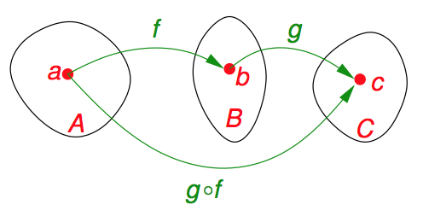
Composition (Section 12.4)
Definition:
Suppose f : A → B and g : B → C are functions with the property that the codomain(f ) equals the domain(g).
The composition of f and g is another function, denoted as g ^{ο} f and defined as follows: If x ∈ A, then g ^{ο} f (x) = g(f(x)). This function g(f(x)) sends (maps) elements of A to elements of C, so g ^{ο} f: A → C.

Slide 52
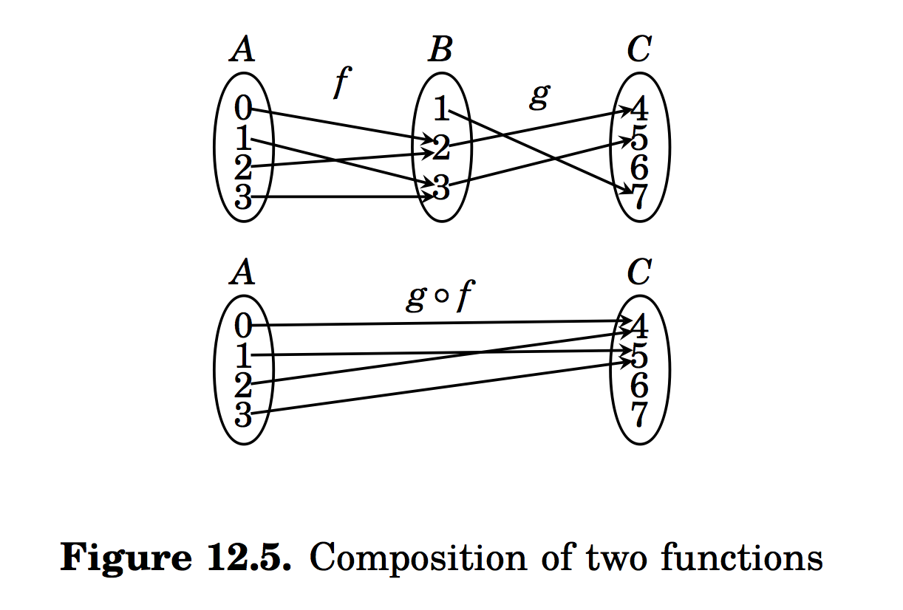

Slide 53
Composition: Example 1
Let f, g be two functions on R→R defined by
f(x) = 2x – 3
g(x) = x² + 1
What are f ^{ο} g and g ^{ο} f?

Slide 54
Composition: Example 1 (cont’d)
Given f(x) = 2x – 3 and g(x) = x² + 1
(f ^{ο} g)(x) = f(g(x)) = f(x²+1) = 2(x²+1)-3
= 2x² - 1
(g ^{ο} f)(x) = g(f(x)) = g(2x-3) = (2x-3)² +1
= 4x² - 12x + 10
Thus the composition of functions is not commutative.

Slide 55
Associativity
Lemma: The composition of functions is an associative operation, that is
(f ^{ο} g) ^{ο} h = f ^{ο} (g ^{ο} h)

Slide 56
Composition: Injection and Surjection
Theorem:
Suppose f: A → B and g: B → C. If both f and g are injective then g ^{ο} f is injective. If both f and g are surjective, g ^{ο} f is also surjective.

Slide 57
_{Proof of:} Suppose f: A → B and g: B → C. If both f and g are injective then g ο f is injective.
Here both f and g are injective.
To see that g ^{ο} f is injective, we must show that g(f(x)) = g(f(y)) implies x = y.
Suppose g(f(x)) = g(f(y)).
Since g is injective, f(x) = f(y).
Since f(x) = f(y), and f is injective, x = y.
Hence g(f(x)) = g(f(y)) implies x = y.
Therefore, g ^{ο} f is injective.

Slide 58
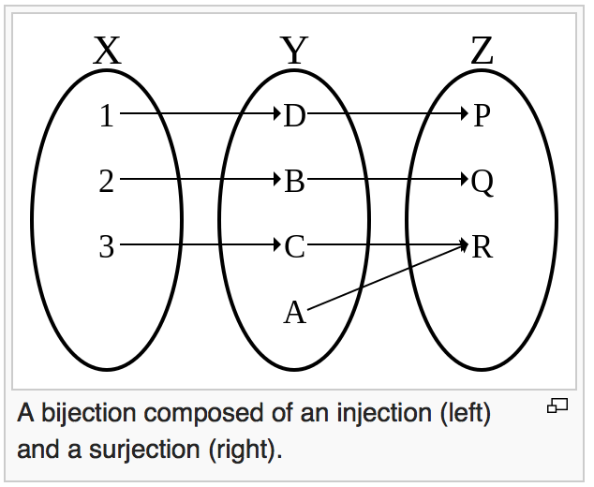
Conversely,
Suppose f : X → Y and g: Y → Z.
If the composition g ^{ο} f of two functions is bijective, we can only say that f is injective and g is surjective.

Slide 59
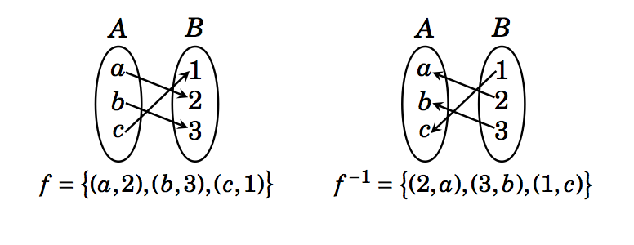
Definition: Given a relation R from A to B, the inverse relation of R is the relation from B to A defined as R⁻¹ = {(y,x): (x,y) ∈ R}.
f is function, but f⁻¹ is also a function.

Slide 60
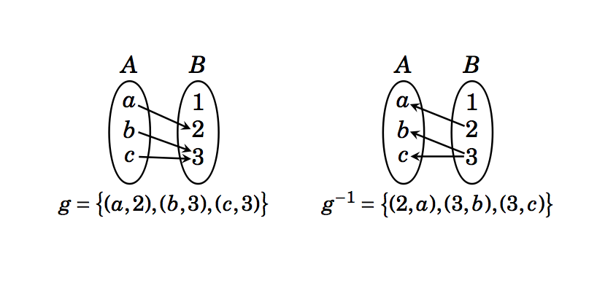
Definition: Given a relation R from A to B, the inverse relation of R is the relation from B to A defined as R⁻¹ = {(y,x): (x,y) ∈ R}.
g is function, but g⁻¹ is not a function.

Slide 61
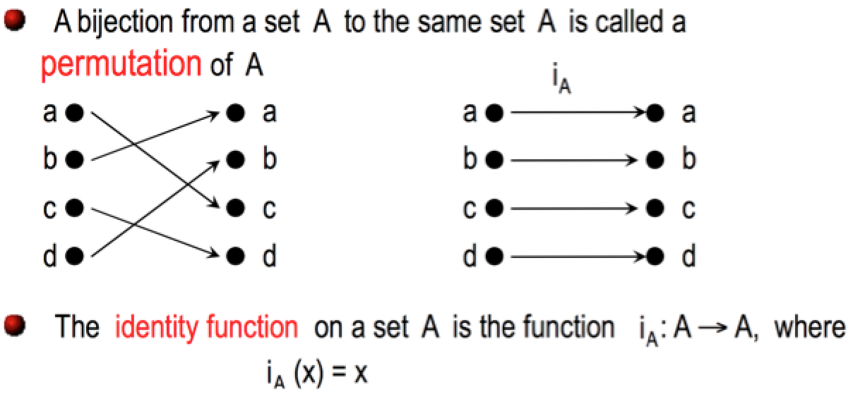
Inverse Functions

Slide 62
Definition: Suppose f : A → B is bijective. The inverse function of f is the th function that assigns to each element b ∈ B, an element (preimage) a ∈ A such that f(a) = b. We denote the inverse function f⁻¹: B → A and can write
f⁻¹(b) = a when f(a) = b.
f⁻¹ o f = i_{A}
f o f⁻¹ = i_{B}

Slide 63
f ⁻¹ o f = {(a,a), (b,b), (c,c)}
f o f ⁻¹ = {(1,1), (2,2), (3,3)}

Slide 64
Example
Find the inverse of the function f : R → R defined as f(x) = x³ + 1, if it exists.
We first show that f is bijective.
f is one-to-one:
f(x) = f(y) implies (x³ + 1) = (y³ +1)
i.e (x-y)( x² + xy + y² ) = 0.
Since ( x² + xy + y² ) is not zero for any x ≠ y, therefore f(x) = f(y) implies x = y.
Therefore, f is one-to-one.

Slide 65
Example
Find the inverse of the function f : R → R defined as f(x) = x³ + 1, if it exists.
We first show that f is bijective.
f is one-to-one:
We now show that f is onto.
For any y of R, we need to find x such that f(x) = y.
i.e. find x such that x³ + 1 = y, i.e x = (y-1)^{1/3}. Thus we see that f((y-1)^{1/3})= y for any y.
Therefore, f is onto.
Thus f is bijective

Slide 66
Example
Find the inverse of the function f : R → R defined as f(x) = x³ + 1, if it exists.
We now find f⁻¹(x).
We are interested in computing y such that f⁻¹(x) =y.
i.e. computing y such that f(y) = x.
i.e. computing y such that y³ + 1 = x.
i.e. y = (x – 1)^{1/3}.
Thus f ⁻¹ (x) = (x – 1)^{1/3}.
Note that f ⁻¹(f(x)) = f(f ⁻¹ (x))= x.

Slide 67
Another Example
Consider the function g: Z x Z → X x Z defined by g(m,n) = ( m+n, m + 2n). g is bijective (show that). Find its inverse.
We want to find (x,y) ∈ Z x Z such that g⁻¹(m,n) = (x,y).
i.e. (m,n) = g(x,y)
i.e. (m,n) = (x +y, x + 2y)
i.e. m = x+y and n = x+ 2y
i.e. x = 2m – n and y = n – m.
Thus g⁻¹(m,n) = (2m –n, n-m).

Slide 68
Important Functions: Absolute Value
Definition: The absolute value function, denoted |x|, f : R→ {y ∈R | y ≥ 0}. Its value is defined by
x if x ≥ 0
|x| =
-x if x ≤ 0

Slide 69
Important Functions: Floor & Ceiling
Definitions:
The floor function, denoted ⎣x⎦, is a function R→Z. Its values is the largest integer that is less than or equal to x
The ceiling function, denoted ⎡x⎤, is a function R→Z. Its values is the smallest integer that is greater than or equal to x .

Slide 70
Important Functions: Floor
y
3
2
1
x
-5
-4
-3
-2
-1
1
2
3
4
5
-1
-2
-3

Slide 71
Important Functions: Ceiling
3
2
1
x
-5
-4
-3
-2
-1
1
2
3
4
5
-1
-2
-3

Slide 72
Important Function: Factorial
The factorial function gives us the number of permutations (that is, uniquely ordered arrangements) of a collection of n objects
Definition: The factorial function, denoted n!, is a function N→N⁺. Its value is the product of the n positive integers
n! = Π_{i=1} ^{i=n} i = 1⋅2⋅3⋅…⋅(n-1)⋅n

Slide 73
Summary
Definitions & terminology
function, domain, co-domain, image, preimage , range, image of a set
Properties
One-to-one (injective), onto (surjective), one-to-one correspondence (bijective)
Operators
Composition
Inverse functions
Important functions
identity, absolute value, floor, ceiling, factorial

Slide 74
Practice Problems
Section 12.4: 2, 5, 6, 7, 8, 10
Section 12.5: 1, 2, 3, 6, 9
Section 12.6: 2, 3, 4, 5

