Slide 1
Final Exam Info

Slide 2
Details of the final exam
3-hour exam
closed-book
no aides
one page formulae sheet of size 8.5 x 11
both-sided acceptable
Practice final exam:
www.cs.sfu.ca/~binay/2015/macm101/sampleExam
Sample test questions (by the author of the text)
www.people.vcu.edu/~rhammack/math300/tests/index.html

Slide 3
Topics

Slide 4
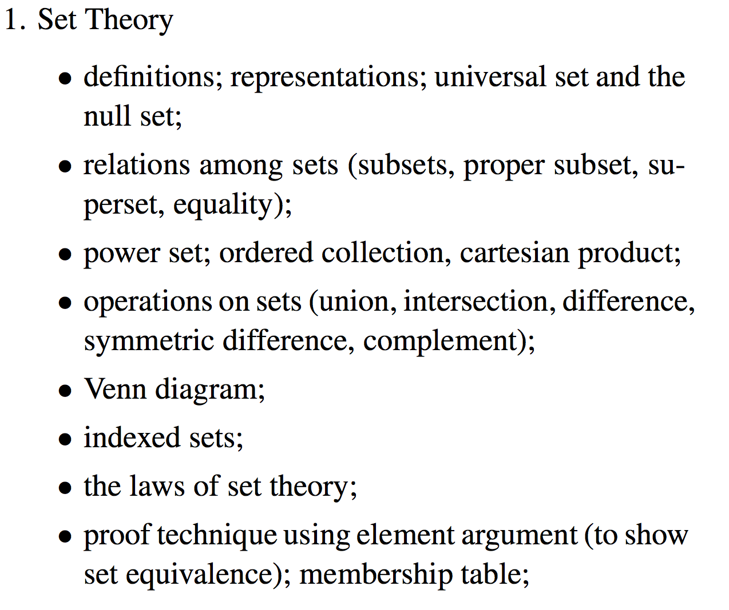

Slide 6
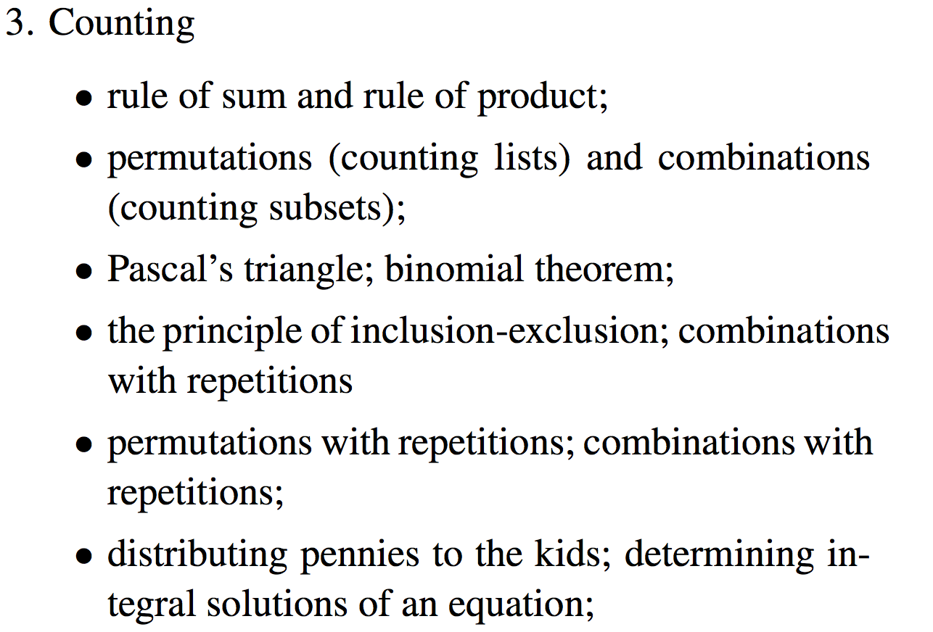

Slide 7
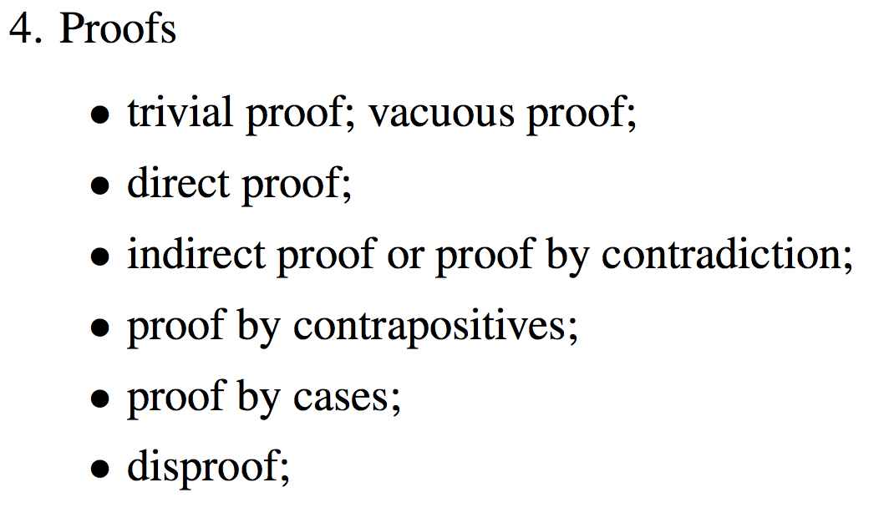

Slide 8
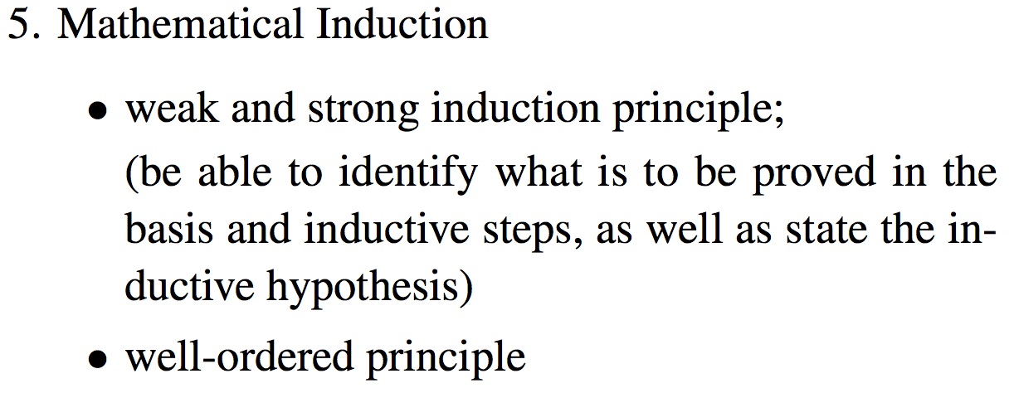

Slide 9
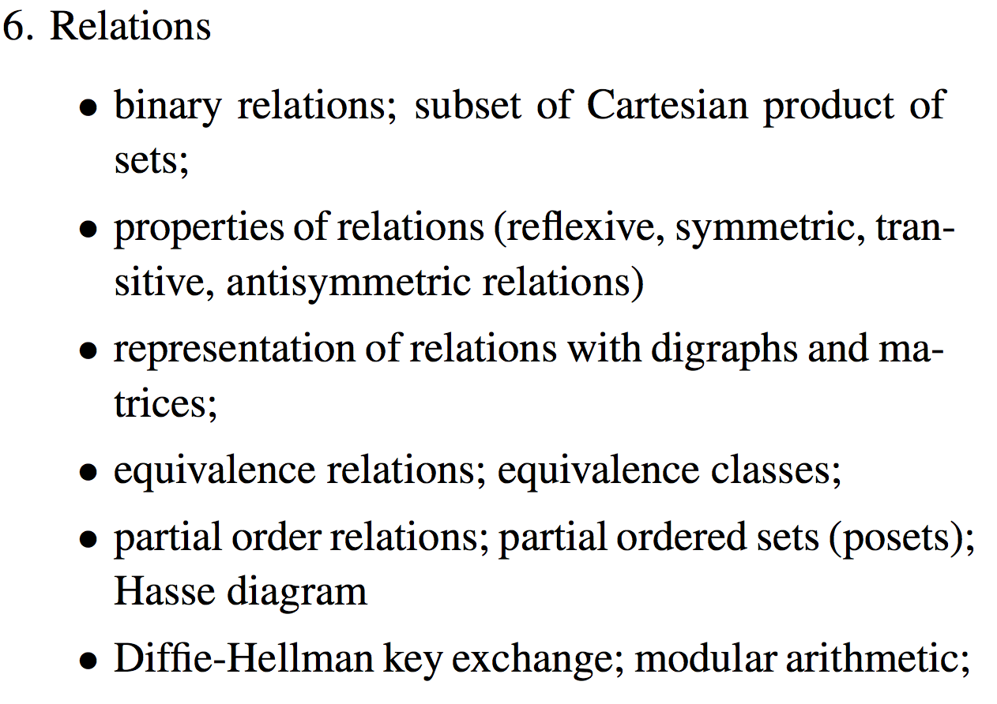

Slide 10
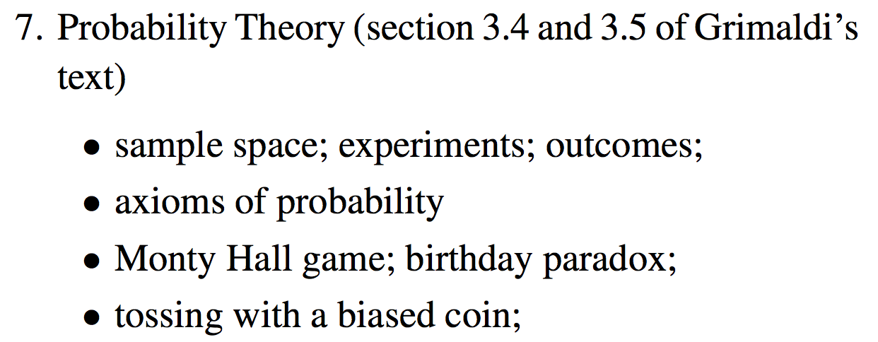

Slide 11
