Slide 1
Discrete Mathematics
MACM 101
Binay Bhattacharya
binay@cs.sfu.ca
Introduction

Slide 2
Borrowed some slides from Prof. Bart Selman slides:
www.cs.cornell.edu/courses/cs2800/

Slide 3
Overview
Course Information
Course themes, goals
Syllabus

Slide 4
Course Information
Lectures: Mon, Wed, and Fri – 3:30 – 4:20
Location: BLU9660
Lecturer: Binay Bhattacharya
Office: TASC I 8017
Phone: 778-782-3133
Email: binay@cs.sfu.ca
Course Web site: www.cs.sfu.ca/~binay/2015/macm101/D2
  Course information handout is available at the site.

Slide 5
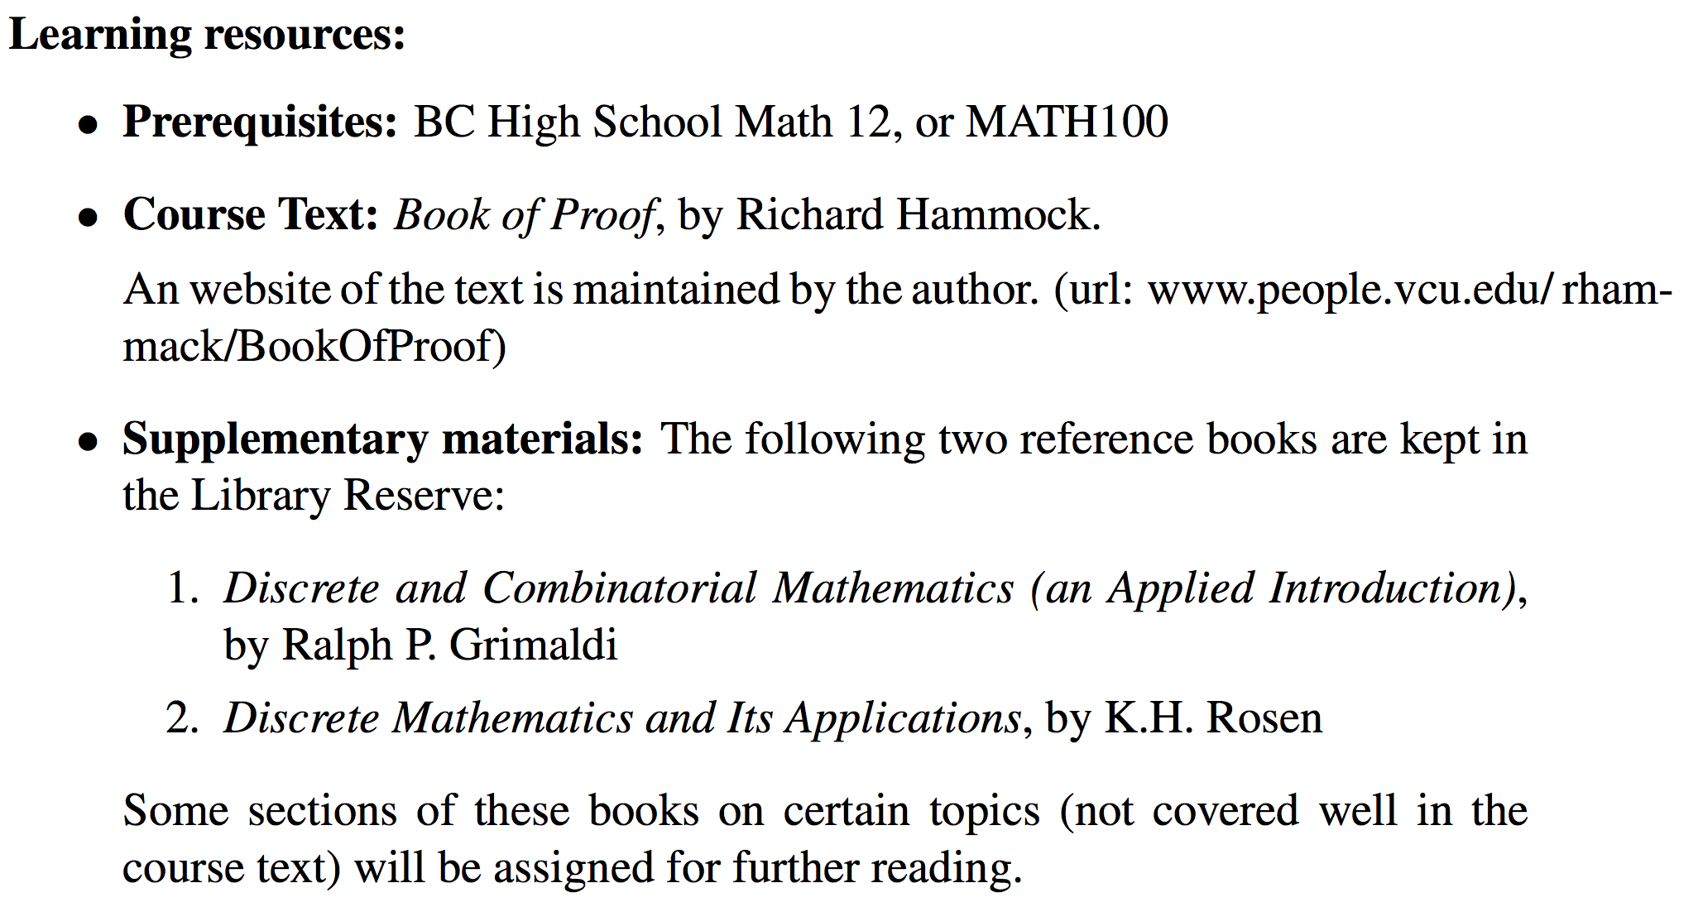
Course Information

Slide 6
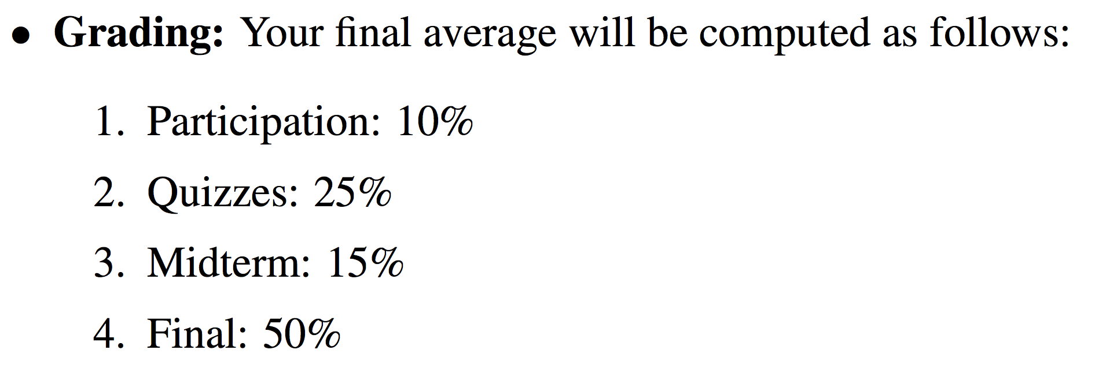
Grading

Slide 7
Grading
Participation
  regular attendance of the classes and tutorials
  working lots of exercises from the text
  taking advantage of the office hours
  overall involvement in the course

Slide 8
Grading
Quiz
  5- to 6 quizzes
  about 30 minutes long
  test will be given during the tutorial
  about a week prior to the quiz, a list of practice questions relevant to the quiz will be handed out.
Exams
  closed-book and closed-notes

Slide 9
Other
Office hour (Monday, Friday 12:30 – 2:00)
  feel free to stop by whenever you have a question, particularly if you are having trouble
  Catching up is very difficult once you get behind
Exercises
  solve as many problems as possible.
  odd numbered questions in the text are solved
  ask TA or the instructor for help.

Slide 10
What is MACM 101 about?
Continuous vs Discrete Math
Why is it computer science?
Mathematical techniques for Discrete Math

Slide 11
Continuous vs Discrete
Continuous Mathematics
  Objects vary continuously
  Example: analog wristwatch: from analog perspective, between 10:30 am to 10:31 am there are infinitely many possible times
  Differential equations

Slide 12
Continuous vs Discrete
Discrete Mathematics
  Objects vary in a discrete way
  Example: digital wristwatch: from analog perspective, between 10:30 am to 10:31 am there are infinitely finitely many possible times. A digital watch does not show split seconds.
  Integers --- core of discrete mathematics
  Computer science – computers are digital.

Slide 13
What is MACM 101 about?
Why is it computer science?

Slide 14
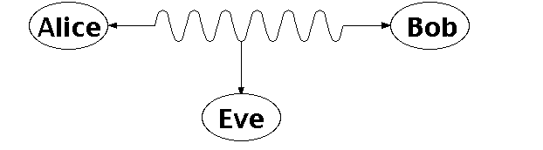
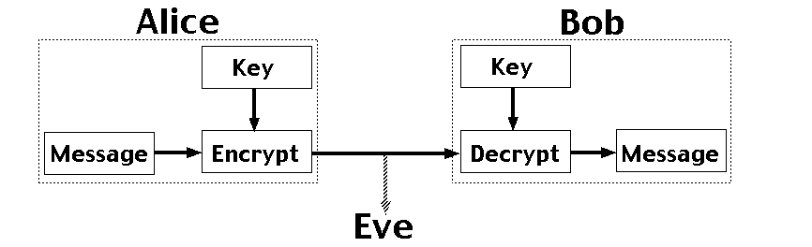
Number Theory:
RSA and Public-key Cryptography
Alice and Bob have never met but they would like to
exchange a message. Eve would like to eavesdrop.
E.g. between you and the Bank of America.
They could come up with a good encryption algorithm and exchange the encryption key – but how to do it without
Eve getting it? (If Eve gets it, all security
is lost.)
CS folks found the solution:
public key encryption. Quite remarkable
that that is feasible.

Slide 15
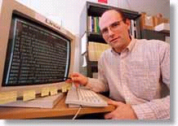
Automated Proofs:
EQP - Robbin’s Algebras are all Boolean
A mathematical conjecture (Robbins conjecture) unsolved for decades.
First non-trivial mathematical theorem proved automatically.
The Robbins problem was to determine whether one particular set of rules is powerful enough to capture all of the laws of Boolean algebra. One way to state the Robbins problem in mathematical terms is:
Can the equation not(not(P))=P be derived from the following three equations?
[1] P or Q = Q or P,
[2] (P or Q) or R = P or (Q or R),
[3] not(not(P or Q) or not(P or not(Q))) = P.
[An Argonne lab program] has come up with a major mathematical
proof that would have been called creative if a human had thought of it.
New York Times, December, 1996
http://www-unix.mcs.anl.gov/~mccune/papers/robbins/

Slide 16
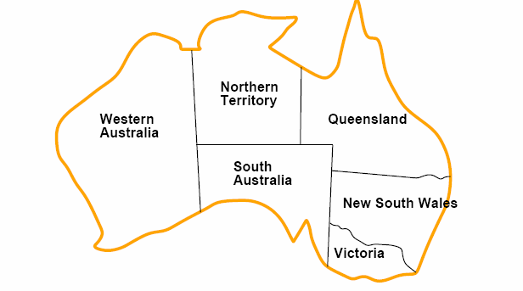
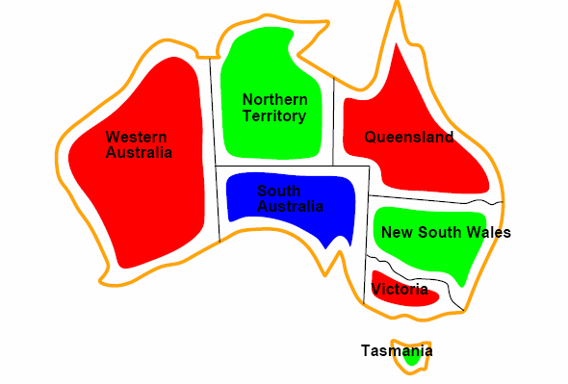

Coloring a Map
How to color this map so that no two
adjacent regions have the same color?

Slide 17
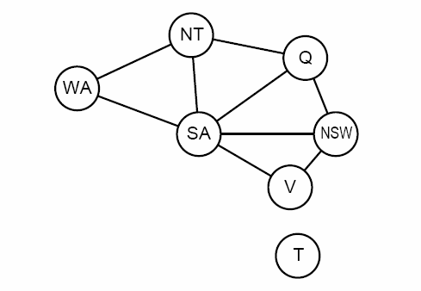
Graph representation
Coloring the nodes of the graph:
What’s the minimum number of colors such that any two nodes
connected by an edge have different colors?

Slide 18
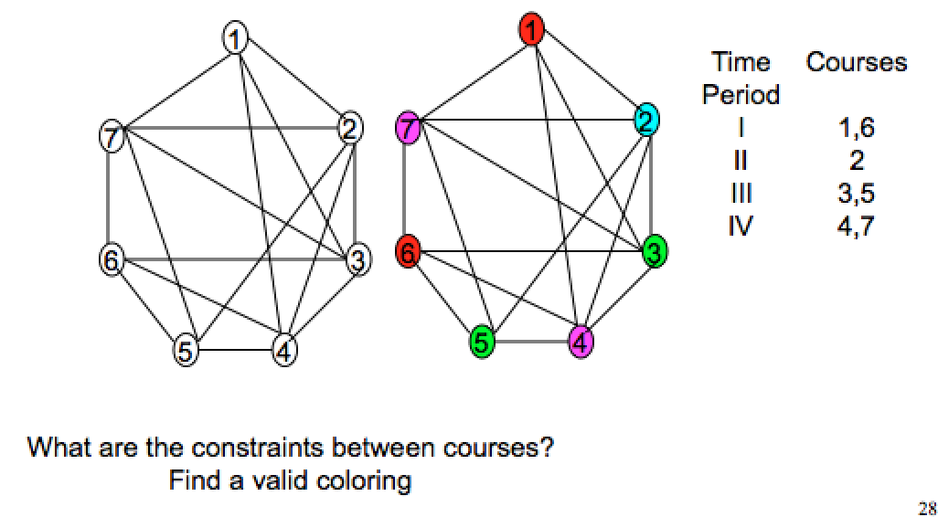
Scheduling Final Exams

Slide 19
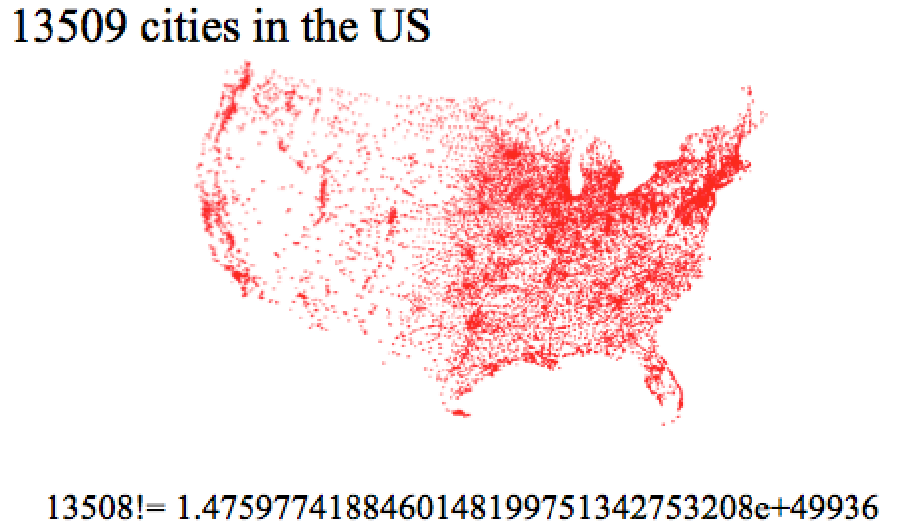
Traveling Salesman Problem

Slide 20
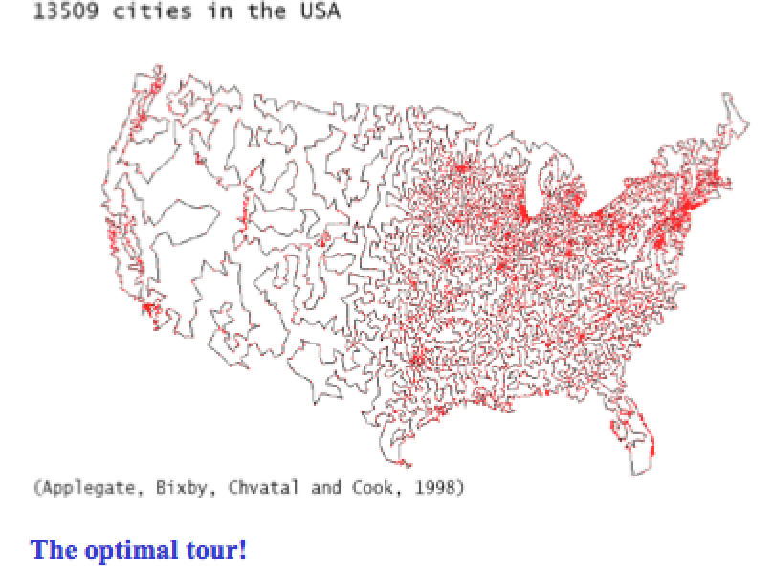
Traveling Salesman Problem

Slide 21
Probability and Chances
Importance of concepts from probability is rapidly increasing in CS:
Randomized algorithms
  primality testing; Google’s PageRank, “just” a random walk on the web!)
  in computation, having a few random bits really helps!
Machine Learning / Data Mining:
  find statistical regularities in large amounts of data.
Natural language understanding
  dealing with the ambiguity of language

Slide 22
Probability and Chances
Computer scientist have recently found a remarkable way to do this:
“holographic proofs”
Ask the author of the proof to write it down in a special encoding
(size increases to, say, 50,000 pages of 0 / 1 bits). You don’t need
to see the encoding! Instead, you ask the author to give you the values
of 50 randomly picked bits of the proof. (i.e., “spot check the proof”).
With almost absolute certainty, you can now determine
whether the proof is correct of not! (works also for 100 trillion page
proofs, use eg 100 bits.) Aside: Do professors ever use “spot checking”?
Started with results from the early nineties (Arora et al. ‘92) with recent refinements
(Dinur ’06). Combines ideas from coding theory, probability, algebra, computation, and
graph theory. It’s an example of one of the latest advances in discrete mathematics.
See Bernard Chazelle, Nature ’07.

Slide 23
Goals of MACM 101
Introduce students to a range of mathematical tools from discrete mathematics that are key in computer science.
How to write statements correctly.
How to read and write theorems.
Areas:
  Set Theory
  Logic and Proof
  Counting
  Relations
  Functions
  Number Theory

Slide 24
Goals of MACM 101
Introduce students to a range of mathematical tools from discrete mathematics that are key in computer science.
How to write statements correctly.
How to read and write theorems.
Areas:
  Set Theory
  Logic and Proof
  Counting
  Relations
  Functions
  Number Theory
Note: Learning to do proofs from
watching the slides is like trying to
learn to play tennis from watching
it on TV! So, do exercises!

Slide 25
