Slide 1
Counting II
Topics not covered in the text
Covered in section 6.5 of Rosen’s book
Covered in section 1.4 of Grimaldi’s book

Slide 2
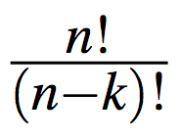
Permutations
A k-permutations of a set of n objects is the same as a length-k lists. Here the order of the objects is important.
The number of k-permutations of n objects with repetition is n^{k}.
The number of k-permutation of n objects without repetition is .
We write

Slide 3
Permutations with indistinguishable objects
Example: How many permutations one can make by reordering the letters of the word JESSEE ?
(JESSEE and SJESEE are two different lists (permutations))

Slide 4
Permutations with indistinguishable objects
Example: How many permutations one can make by reordering the letters of the word JESSEE ?
(JESSEE and SJESEE are two different lists (permutations))
First Method: We first indicate 3 Es as E¹, E², E³ and two Ss as S¹, S². Thus JESSEE can be written as JE¹S¹S²E²E³.

Slide 5
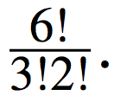
Permutations with indistinguishable objects
Example: How many permutations one can make by reordering the letters of the word JESSEE ?
(JESSEE and SJESEE are two different lists (permutations))
First Method: We first indicate 3 Es as E¹, E², E³ and two Ss as S¹, S². Thus JESSEE can be written as JE¹S¹S²E²E³.
If three Es and two Ss are treated as distinct, the number of 6-permutations is 6!.
Note that JE¹S¹S²E²E³ and JE¹S²S¹E²E³ are the same if two Ss are not distinct.
The number of distinct permutations is

Slide 6
Permutations with indistinguishable objects
Example: How many permutations one can make by reordering the letters of the word JESSEE ?
(JESSEE and SJESEE are two different lists (permutations))
Second Method: The word JESSEE contains 3 Es, 2 Ss and one J.

Slide 7
Permutations with indistinguishable objects
Example: How many permutations one can make by reordering the letters of the word JESSEE ?
(JESSEE and SJESEE are two different lists (permutations))
Second Method: The word JESSEE contains 3 Es, 2 Ss and one J.
We can place 3 Es in 6 places in C(6,3) different ways.

Slide 8
Permutations with indistinguishable objects
Example: How many permutations one can make by reordering the letters of the word JESSEE ?
(JESSEE and SJESEE are two different lists (permutations))
Second Method: The word JESSEE contains 3 Es, 2 Ss and one J.
We can place 3 Es in 6 places in C(6,3) different ways.
There are three more positions to fill once Es are placed.

Slide 9
Permutations with indistinguishable objects
Example: How many permutations one can make by reordering the letters of the word JESSEE ?
(JESSEE and SJESEE are two different lists (permutations))
Second Method: The word JESSEE contains 3 Es, 2 Ss and one J.
We can place 3 Es in 6 places in C(6,3) different ways.
There are three more positions to fill once Es are placed.
In C(3,2) ways we can place 2Ss in three positions.
After all these, J has one (C(1,1)) position to go.

Slide 10
Permutations with indistinguishable objects
Example: How many permutations one can make by reordering the letters of the word JESSEE ?
(JESSEE and SJESEE are two different lists (permutations))
Second Method: The word JESSEE contains 3 Es, 2 Ss and one J.
We can place 3 Es in 6 places in C(6,3) different ways.
There are three more positions to fill once Es are placed.
In C(3,2) ways we can place 2Ss in three positions.
After all these, J has one (C(1,1)) position to go.
The total number of permutations of the letters of JESSEE is

Slide 11
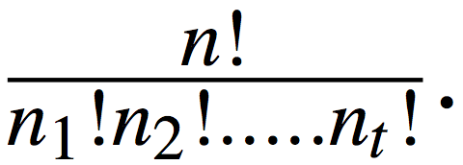
Permutations with indistinguishable objects
Theorem: The number of different permutations of n objects where there are n₁ objects of Type 1 (non-distinct), n₂ objects of Type 2 (non-distinct), …., n_{t} objects of Type t (non-distinct), and , is

Slide 12
Combinations
A k-combination of a set of n objects is an unordered selection of k elements from the set. When the elements are not repeated, a k-combination is a size-k subset. We have seen that

Slide 13
Some important identities

Slide 14
Combinations with repetitions
We consider the case when an object is selected repeatedly.
Example: Consider a set A = {a,b,c,d}. We select two objects from A.
We now consider the following four cases.

Slide 15
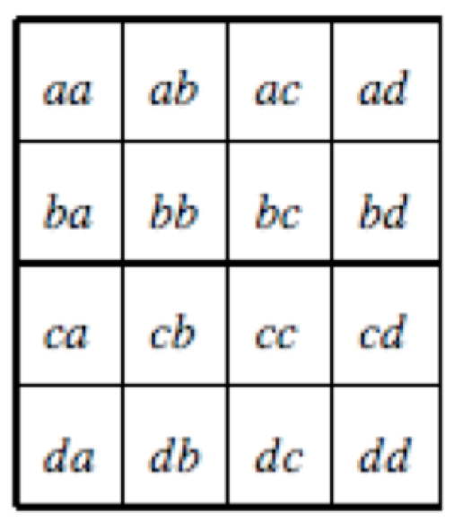
4-permutations with repetitions: 4² = 16 possible cases.

Slide 16
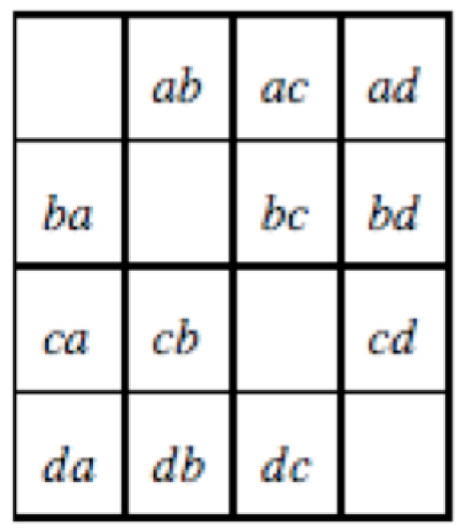
4-permutations without repetitions: P(4,2) = 12 possible cases.

Slide 17
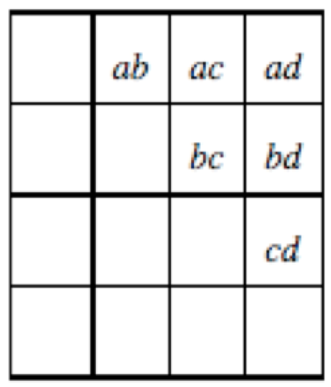
4-combinations without repetitions: C(4,2) = 6 possible cases.

Slide 18
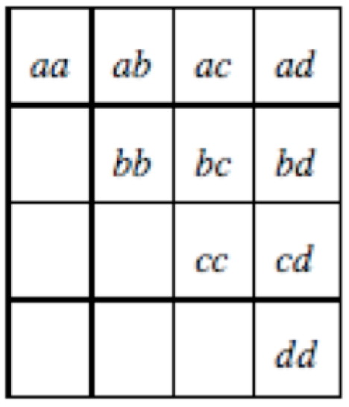
4-combinations with repetitions: C(5,3) = 10 possible cases.

Slide 19
4-combinations with repetitions: C(5,3) = 10 possible cases.
Note that combinations with repetitions do not correspond to subsets of a set.

Slide 20
Combinations with repetitions
Consider the following problem known as distribution of money.
We have n pennies that we want to distribute to k kids. Each child gets at least one penny. How many ways can we distribute the money?

Slide 21
Combinations with repetitions
Consider the following problem known as distribution of money.
We have n pennies that we want to distribute to k kids. Each child gets at least one penny. How many ways can we distribute the money?
Kids are distinct, but pennies are not.
For n=6 and k=3, (1,1,4), (2,3,1) are distinct ways.
All solutions: (1,1,4), (1,2,3), (1,3,2), (1,4,1),(2,1,3), (2,2,2), (2,3,1), (3,1,2), (3,2,1), (4,1,1)

Slide 22
Combinations with repetitions
Consider the following problem known as distribution of money.
We have n pennies that we want to distribute to k kids. Each child gets at least one penny. How many ways can we distribute the money?
Kids are distinct, but pennies are not.
For n=6 and k=3, (1,1,4), (2,3,1) are distinct ways.
All solutions: (1,1,4), (1,2,3), (1,3,2), (1,4,1),(2,1,3), (2,2,2), (2,3,1), (3,1,2), (3,2,1), (4,1,1)
There is only one way for kid 1 to get n₁ pennies, kid-2 to get n₂ pennies, ..... and so on where
n₁ + n₂ + … +n_{k} =n

Slide 23
Distribution of money
We have n pennies that we want to distribute to k kids. Each child gets at least one penny. How many ways can we distribute the money?
Let us consider the following experiment.
Line up the pennies (all are the same), order doesn’t matter.
x x x x x x x x x x x x x x x x x x x x x x x x x x x x x x x x
(n pennies)

Slide 24
Distribution of money
We have n pennies that we want to distribute to k kids. Each child gets at least one penny. How many ways can we distribute the money?
Let us consider the following experiment.
Line up the pennies (all are the same), order doesn’t matter.
x x x x x x x x x x x x x x x x x x x x x x x x x x x x x x x x
(n pennies)
Let the first child pick them from left to right. After a while we stop the kid.
x x x x x x x x x x |x x x x x x x x x x x x x x x x x x x x x x
(kid -1 gets these) (stop)

Slide 25
Distribution of money
Line up the pennies (all are the same), order doesn’t matter.
x x x x x x x x x x x x x x x x x x x x x x x x x x x x x x x x
(n pennies)
Let the first child pick them from left to right. After a while we stop the kid.
x x x x x x x x x x |x x x x x x x x x x x x x x x x x x x x x x
(kid -1 gets these) (stop)

Slide 26
Distribution of money
Line up the pennies (all are the same), order doesn’t matter.
x x x x x x x x x x x x x x x x x x x x x x x x x x x x x x x x
(n pennies)
Let the first child pick them from left to right. After a while we stop the kid.
x x x x x x x x x x |x x x x x x x x x x x x x x x x x x x x x x
(kid -1 gets these) (stop)
Let the second child pick pennies starting from where kid-1 stopped.
x x x x x x x x x x |x x x x x x x x x x x| x x x x x x x x x x x
(kid -1 gets these) (kid-2 gets these)

Slide 27
Distribution of money
Line up the pennies (all are the same), order doesn’t matter.
x x x x x x x x x x x x x x x x x x x x x x x x x x x x x x x x
(n pennies)
The distribution of money is determined by specifying where to start with a new child.
The first child starts from 1.
The other k-1 kids can enter at position 2, 3, 4, …, n-1.
This means that there are C(n-1,k-1) ways to chose an entry point.

Slide 28
Distribution of money
There are C(n-1,k-1) ways to distribute n pennies to k kids with the constraint that each kid gets at least one penny.

Slide 29
Distribution of money (no restriction)
Problem: Distribute n pennies to k kids with no restriction on whether a kid gets a penny or not.
We use the following trick:
We borrow one penny from each kid, and then distribute (n+k) pennies to k kids such that each kid gets at least one penny.
There are C(n+k-1,k-1) ways to distribute n pennies to k kids with no restriction.

Slide 30
Combinations with repetitions
Given n distinct objects, select k objects where repetitions are allowed and the order of selecting objects is not important. (Note that k could be larger than n.)
Here kids are n objects, and pennies are the k objects to be selected.
The number of possible k-combinations is C(#kids + #pennies -1, #kids -1) = C(k+n-1, n-1)

Slide 31
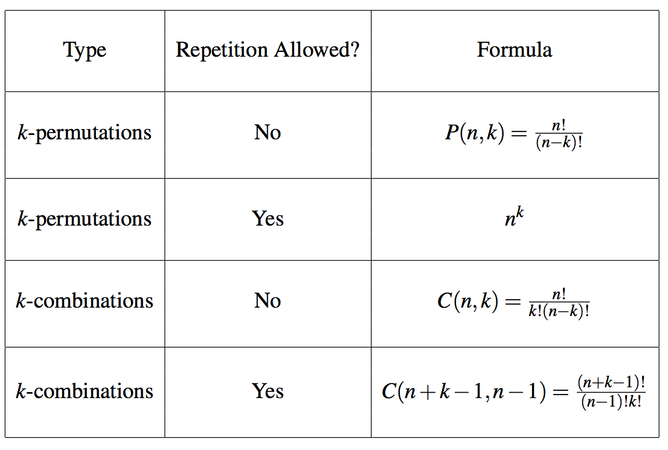
Permutations and combinations with and without repetitions.

Slide 32
Number of integer solutions
Problem: Let x_{i} , 1 ≤ i ≤ n be n nonnegative integer variables. Determine all integer solutions to the equation
x₁ + x₂ + … + x_{n} = m where x_{i} ≥ 0 for all 1 ≤ i ≤ n.
Suppose n=4, and m=7
x₁=3, x₂=3, x₃=0, x₄=1 is one solution to the equation.
x₁=1, x₂=0, x₃=3, x₄=3 is another different solution.
A possible interpretation for the solution x₁=3, x₂=3, x₃=0, x₄=1 is that we are distributing 7 pennies (identical) among 4 kids (distinct). We have given 3 pennies each to kid 1 and kid 2, nothing to the third kid, and kid 4 gets one penny.

Slide 33
Number of integer solutions
Problem: Let x_{i} , 1 ≤ i ≤ n be n nonnegative integer variables. Determine all integer solutions to the equation
x₁ + x₂ + … + x_{n} = m where x_{i} ≥ 0 for all 1 ≤ i ≤ n.
m = # of pennies; n = # of kids; no restriction (i.e. a kid can get no penny)
Total number of integral solutions = C(n+m-1, n-1)

Slide 34
It is important to recognize the equivalence of the following
The number of integer solutions of the equation
x₁ + x₂ + … + x_{n} = m where x_{i} ≥ 0 for all 1 ≤ i ≤ n.
The number of choices, with repetitions, of size m from a collection of n objects.
The number of choices of distributing m pennies to n kids with no restriction (i.e. a kid can get zero penny).
The number of ways of placing m balls in n distinct bins.

Slide 35
Example
A doughnut shop has plain doughnuts, cherry doughnuts, chocolate doughnuts, almond doughnuts, apple doughnuts, broccoli doughnuts. How many ways are there to choose:
a dozen doughnuts?

Slide 36
Example
A doughnut shop has plain doughnuts, cherry doughnuts, chocolate doughnuts, almond doughnuts, apple doughnuts, broccoli doughnuts. How many ways are there to choose:
a dozen doughnuts?
12 indistinguishable balls and 6 bins, or 12 pennies and 6 kids
Ans: C(6+12-1,6-1) = C(17,5) = C(17, 12)

Slide 37
Example
A doughnut shop has plain doughnuts, cherry doughnuts, chocolate doughnuts, almond doughnuts, apple doughnuts, broccoli doughnuts. How many ways are there to choose:
(b) three dozen doughnuts?

Slide 38
Example
A doughnut shop has plain doughnuts, cherry doughnuts, chocolate doughnuts, almond doughnuts, apple doughnuts, broccoli doughnuts. How many ways are there to choose:
(b) three dozen doughnuts? 36 doughnut
36 indistinguishable balls and 6 bins, or 36 pennies and 6 kids
Ans: C(6+36-1,6-1) = C(41,5) = C(41,36)

Slide 39
Example
A doughnut shop has plain doughnuts, cherry doughnuts, chocolate doughnuts, almond doughnuts, apple doughnuts, broccoli doughnuts. How many ways are there to choose:
(c) two dozen doughnuts with at least two of each kind?

Slide 40
Example
A doughnut shop has plain doughnuts, cherry doughnuts, chocolate doughnuts, almond doughnuts, apple doughnuts, broccoli doughnuts. How many ways are there to choose:
(c) two dozen doughnuts with at least two of each kind?
Pick first two of each kind . Thus the number is the number of ways of choosing the remaining dozen.
Same as question (a).

Slide 41
Example
A doughnut shop has plain doughnuts, cherry doughnuts, chocolate doughnuts, almond doughnuts, apple doughnuts, broccoli doughnuts. How many ways are there to choose:
(d) two dozen doughnuts with no more than two broccoli doughnuts?

Slide 42
Example
A doughnut shop has plain doughnuts, cherry doughnuts, chocolate doughnuts, almond doughnuts, apple doughnuts, broccoli doughnuts. How many ways are there to choose:
(d) two dozen doughnuts with no more than two broccoli doughnuts?
We will add up three cases: no broccoli doughnut, exactly one broccoli doughnut, exactly two broccoli doughnuts.
These numbers are: C(5 + 24 -1, 5-1) (0 broccoli doughnut);
C(5+23-1, 5-1) (1 broccoli doughnut); C(5+22-1,5-1) (2 broccoli doughnuts)

Slide 43
Example
A doughnut shop has plain doughnuts, cherry doughnuts, chocolate doughnuts, almond doughnuts, apple doughnuts, broccoli doughnuts. How many ways are there to choose:
(e) two dozen doughnuts at least five chocolate doughnuts and at least three almond doughnuts?

Slide 44
Example
A doughnut shop has plain doughnuts, cherry doughnuts, chocolate doughnuts, almond doughnuts, apple doughnuts, broccoli doughnuts. How many ways are there to choose:
(e) two dozen doughnuts at least five chocolate doughnuts and at least three almond doughnuts?
We have already chosen the first 8, so need to select the remaining 16. There are C(6+16-1,6-1) ways to do this.

Slide 45
Example
A doughnut shop has plain doughnuts, cherry doughnuts, chocolate doughnuts, almond doughnuts, apple doughnuts, broccoli doughnuts. How many ways are there to choose:
(e) two dozen doughnuts with at least one plain, at least two cherry, at least three chocolate, at least one almond, at least two apple, no more than three broccoli doughnuts?

Slide 46
Example
A doughnut shop has plain doughnuts, cherry doughnuts, chocolate doughnuts, almond doughnuts, apple doughnuts, broccoli doughnuts. How many ways are there to choose:
(e) two dozen doughnuts with at least one plain, at least two cherry, at least three chocolate, at least one almond, at least two apple, no more than three broccoli doughnuts?
We have already chosen the first nine doughnuts. We need determine the ways to distribute 15 doughnuts without choosing more than 3 broccoli doughnuts. The answer is
C(5+15-1,5-1) + C(5+14-1,5-1) + C(5+13-1,5-1) + C(5+12-1, 5-1).

Slide 47
Example
In bridge, the 52 cards are dealt to 4 players. How many different ways to deal bridge hands?

Slide 48
Example
In bridge, the 52 cards are dealt to 4 players. How many different ways to deal bridge hands?
The answer is: C(52,13)*C(39,13)*C(26,13)*C(13,13)

Slide 49
Example
How many terms are there in the expansion of (w + x + y + z)¹⁰⁰?

Slide 50
Example
How many terms are there in the expansion of (w + x + y + z)¹⁰⁰?
each term of in the expansion of (w + x + y + z)¹⁰⁰ is of the form wª x^{b} y^{c} z^{d} where a +b + c + d =100 where a, b, c, d are nonnegative integers.
Therefore, the answer is C(4 + 100 -1, 4 – 1).

Slide 51
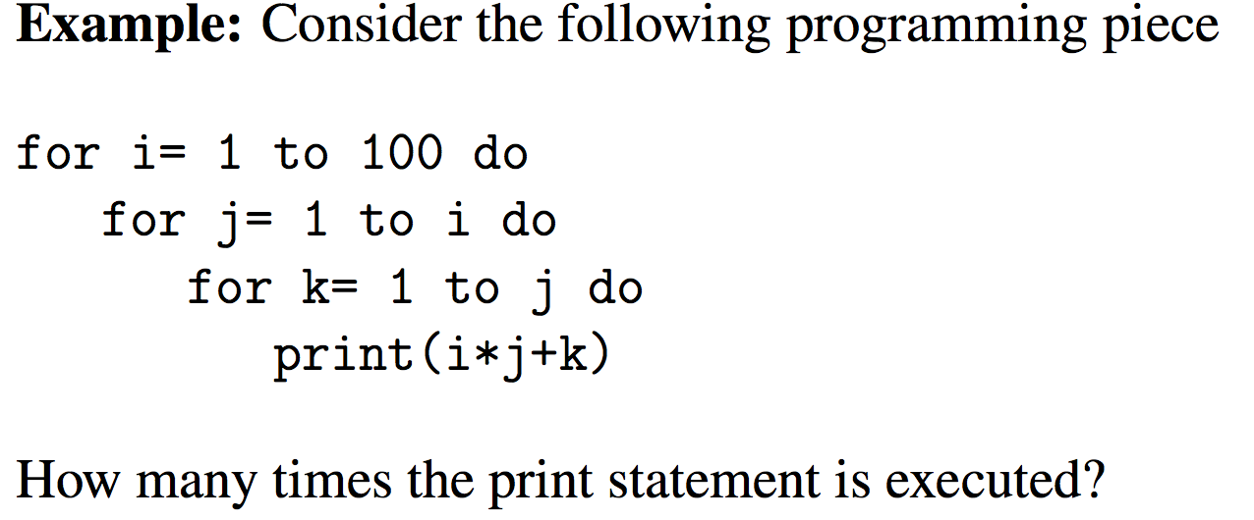

Slide 52
This is equivalent to selecting three integers from the set {1,2, …, 100} with repetitions. (Here pennies = 3; kids = 100)
The answer is C(3+100-1,100-1) = C(102,99).

Slide 53
Example
Find the number of non-negative integer solutions to
x₁ + x₂ + x₃ =20, x₁ ≤ 6, x₂ ≤ 7, x₃ ≤ 8.

Slide 54
Example
Find the number of non-negative integer solutions to
x₁ + x₂ + x₃ =20, x₁ ≤ 6, x₂ ≤ 7, x₃ ≤ 8.
U: set of integer solution with x_{i} ≥ 0, for all i.
A: a set of integer solutions with x₁ ≥ 7.
B: a set of integer solution with x₂ ≥ 8.
C: a set of integer solution with x₃ ≥ 9.
A ∩ B: a set of integer solution with x₁ ≥ 7, x₂ ≥ 8.
A ∩ C: a set of integer solution with x₁ ≥ 7, x₃ ≥ 9.
B ∩ C: a set of integer solution with x₂ ≥ 8, x₃ ≥ 9.
A ∩ B ∩ C: a set of integer solution with x₁ ≥ 7, x₂ ≥ 8, x₃ ≥ 9.
Answer: |U| - |A| - |B| - |C| + |A ∩ B| + |A ∩ C| + |B ∩ C|
-|A ∩ B ∩ C|.

Slide 55
Example
Find the number of non-negative integer solutions to
x₁ + x₂ + x₃ =20, x₁ ≤ 6, x₂ ≤ 7, x₃ ≤ 8.
U: set of integer solution with x_{i} ≥ 0, for all i. |U| = C(3+20-1,3-1)
A: a set of integer solutions with x₁ ≥ 7. |A| = C(3+13-1,3-1)
B: a set of integer solution with x₂ ≥ 8. |B| = C(3+12-1, 3-1)
C: a set of integer solution with x₃ ≥ 9. |C| = C(3+11-1,3-1)
A ∩ B: a set of integer solution with x₁ ≥ 7, x₂ ≥ 8.|A∩B|=C(3+5-1,2)
A ∩ C: a set of integer solution with x₁ ≥ 7, x₃ ≥ 9.|A∩C|=C(3+4-1,2)
B ∩ C: a set of integer solution with x₂ ≥ 8, x₃ ≥ 9.|B∩C|=C(3+3-1,2)
A ∩ B ∩ C: a set of integer solution with x₁ ≥ 7, x₂ ≥ 8, x₃ ≥ 9. Empty
Answer: |U| - |A| - |B| - |C| + |A ∩ B| + |A ∩ C| + |B ∩ C|
-|A ∩ B ∩ C| = 3

Slide 56
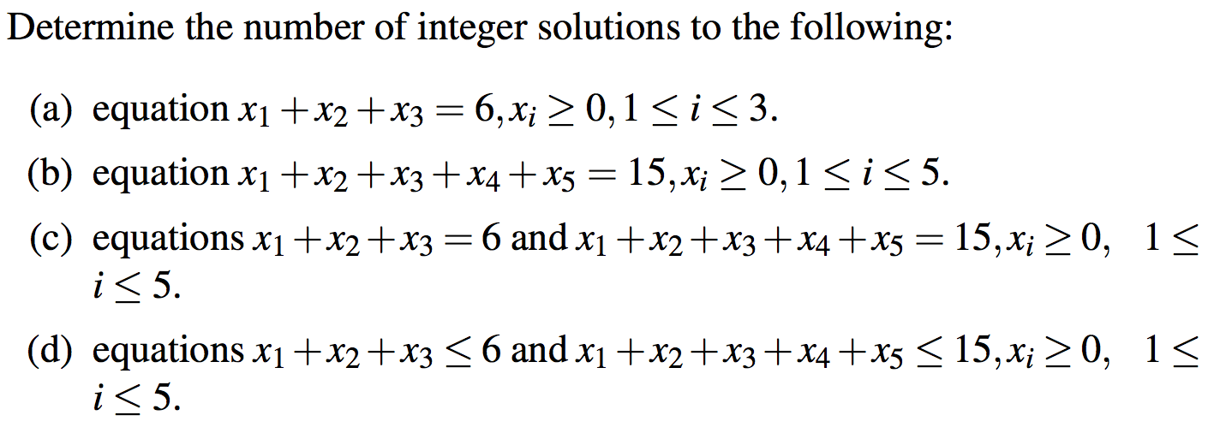
Example

Slide 57
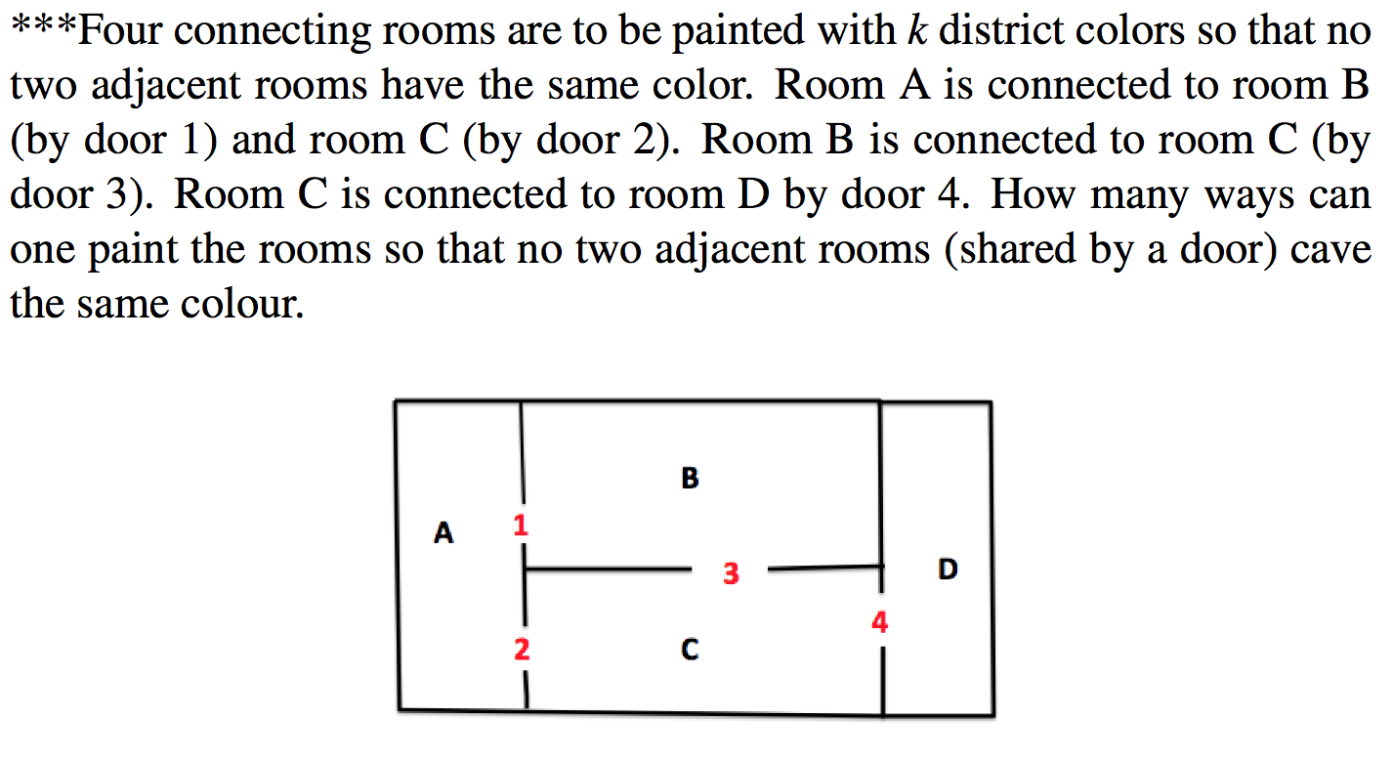
Example

Slide 58
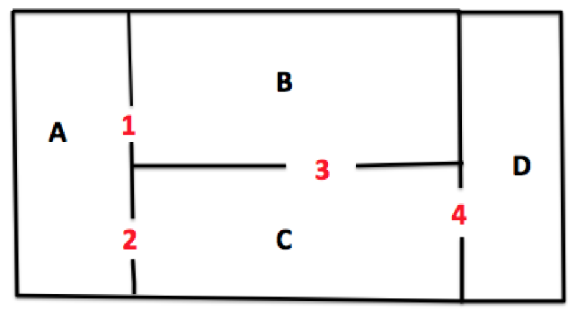
Example

