Slide 1
Counting
Chapter 3 of the text
A few slides have been taken from the sites
http://cse.unl.edu/~choueiry/S13-235/

Slide 2
Combinatorics
Combinatorics is the study of arrangement of objects. For example:
In how many ways can a convex polygon with n sides be divided into triangles by adding non-crossing diagonals?
For n=3, there is only one.

Slide 3
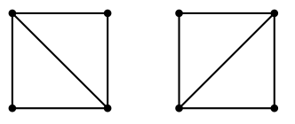
Combinatorics
For n=4, there are 2 such arrangements.

Slide 4
Combinatorics
For n=5, there are 5 such arrangements.

Slide 5
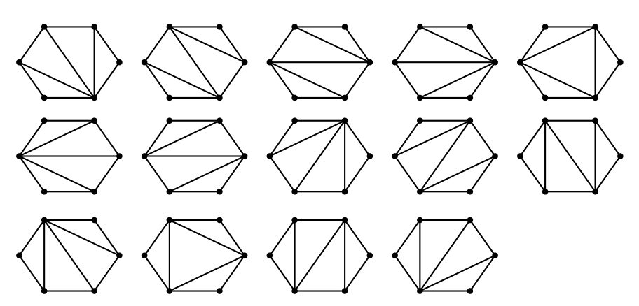
Combinatorics
For n=6, there are 14 such arrangements.

Slide 6
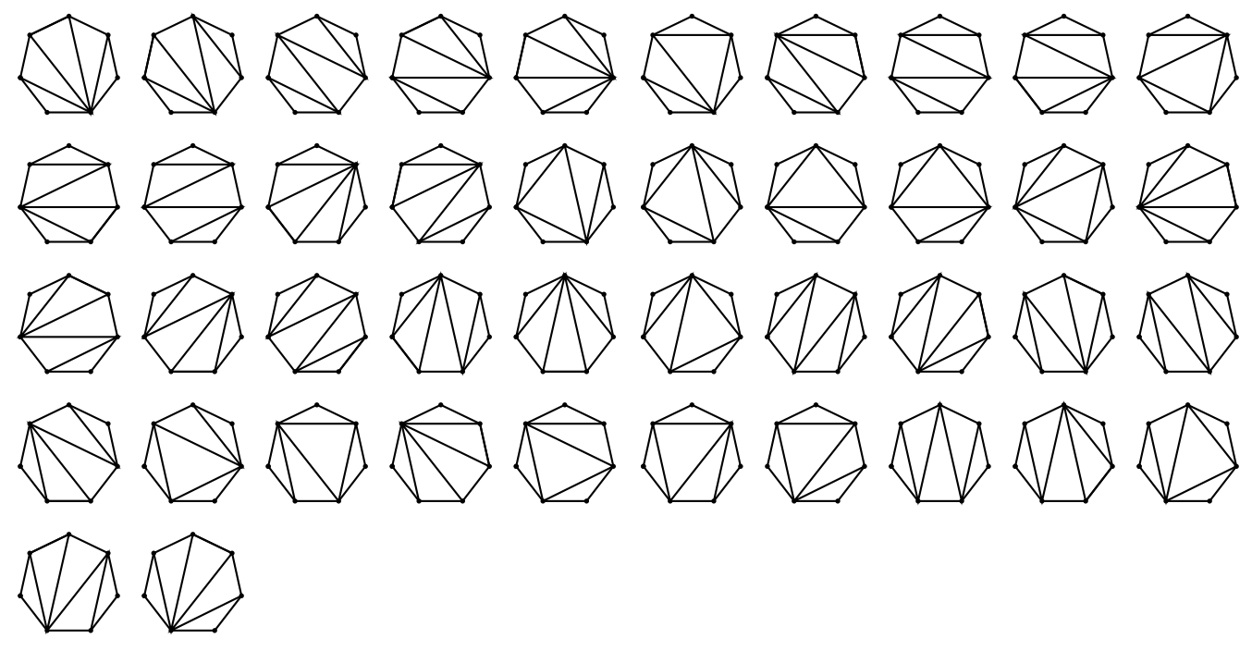
Combinatorics
For n=7, there are 42 such arrangements.

Slide 7
Combinatorics
Combinatorics is the study of arrangement of objects.
Counting of objects with certain properties is an important component of combinatorics.
We use counting to determine the complexity (running time) of algorithms.
Counting plays important role in determining probabilities of events.

Slide 8
Counting
In the class, the topic will be covered along the following lines.
First go through Chapter 3 of the text.
Next we will cover the materials of Chapter 6 of the book by Rosen. We will only cover the parts of this chapter not covered in the text.

Slide 9
Counting Lists (Section 3.1)
A list is an ordered sequence of objects.
Top 10 movies: A list of 10 movies which can be represented as (name 1, name 2, …, name 10).
The objects are ordered.
i^{th} element of the list is the i^{th} object.
(a,b) list different than (b,a).
The number of elements in the list is called its length.
Note the similarity with n-tuple we discussed earlier.

Slide 10
Counting Lists (Section 3.1)
Consider two sets:
A = MACM 101 students in the class; |A| = # of students
G = Set of possible grades ; |G| is the # of grades.
Consider a list with two objects: (name, grade) where the first object is name, an element of A, and the second object is grade, an element of G.
How many possible different 2-tuples are possible?
Note that it is nothing but the size of A x G.

Slide 11
Counting Lists (2)
Suppose we want to make a list of length three having the property that
the first entry must be an element of the set A = {a,b,c},
the second entry must be in B= {5,7} and
the third entry must be in C={a,x}.
How many such lists altogether?
Again it is |A x B x C|.
How do we generate these lists systematically?

Slide 12
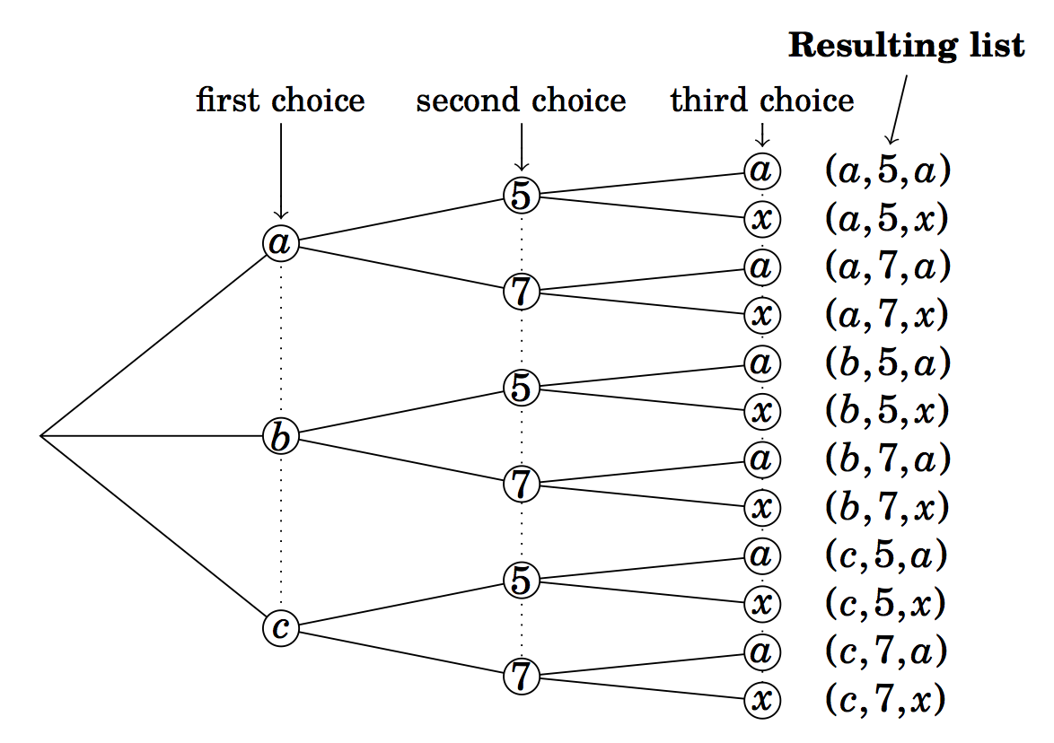
Counting Lists
Constructing lists of length three:

Slide 13
Multiplication Principle
In making a list of length n, suppose there are a₁ possible choices for first entry, a₂ possible choices for the second entry, a₃ possible choices for the third entry, and so on. Then the total number of different lists that can be made is the product a₁ x a₂ x a₃ x …. x a_{n}.

Slide 14
Example
In BC, the license plate of a car has either three letters followed by three digits, or 3 digits followed by three letters. For example ABC007, 007ABC are two standard license plates. How many different license plates are possible?
Note that any license plates such as ABC007 corresponds to a length-6 list (A, B, C, 0, 0, 7).
# of license plates of the type (letter,letter,letter, digit,digit,digit) is 26 x 26 x 26 x 10 x 10 x 10

Slide 15
Example
In BC, the license plate of a car has either three letters followed by three digits, or 3 digits followed by three letters. For example ABC007, 007ABC are two standard license plates. How many different license plates are possible?
Note that any license plates such as ABC007 corresponds to a length-6 list (A, B, C, 0, 0, 7).
# of license plates of the type (letter,letter,letter, digit,digit,digit) is 26 x 26 x 26 x 10 x 10 x 10
# of license plates of the type
(digit,digit,digit,letter,letter,letter) is 10 x 10 x 10 x 26 x 26 x 26

Slide 16
Example
In BC, the license plate of a car has either three letters followed by three digits, or 3 digits followed by three letters. For example ABC007, 007ABC are two standard license plates. How many different license plates are possible?
Note that any license plates such as ABC007 corresponds to a length-6 list (A, B, C, 0, 0, 7).
# of license plates of the type (letter,letter,letter, digit,digit,digit) is 26 x 26 x 26 x 10 x 10 x 10
# of license plates of the type
(digit,digit,digit,letter,letter,letter) is 10 x 10 x 10 x 26 x 26 x 26
Total = 2 x 26 x 26 x 26 x 10 x 10 x 10

Slide 17
Example
Consider making lists from the symbols A, B, C, D, E, F, G
How many length-4 lists are possible if repetition is allowed (i.e. a symbol may appear more than once)?
How many length-4 lists are possible if repetition is not allowed?
How many length-4 lists are possible if repetition is not allowed and the list must contain an E?
How many length-4 lists are possible if repetition is allowed and the list must contain an E?

Slide 18
Example
Consider making lists from the symbols A, B, C, D, E, F, G
How many length-4 lists are possible if repetition is allowed (i.e. a symbol may appear more than once)?
Ans:

Slide 19
Example
Consider making lists from the symbols A, B, C, D, E, F, G
How many length-4 lists are possible if repetition is allowed (i.e. a symbol may appear more than once)?
Ans:
There are 7 choices for each position of the list. Therefore, the number of length-4 lists in this case is 7 x 7 x 7 x 7.

Slide 20
Example
Consider making lists from the symbols A, B, C, D, E, F, G
(b) How many length-4 lists are possible if repetition is not allowed?
Ans

Slide 21
Example
Consider making lists from the symbols A, B, C, D, E, F, G
(b) How many length-4 lists are possible if repetition is not allowed?
Ans
Here repetition is not allowed.
Note that once the letter for position one of the list is chosen, the same letter cannot be chosen again.
Thus the choice for the first position is 7, and the choice for the second position is 6.
Once the second position of the list is filled, there only 5 choices for the third position of the list.
Therefore, the total number length-4 lists is 7 x 6 x 5 x 4

Slide 22
Example
Consider making lists from the symbols A, B, C, D, E, F, G
(c) How many length-4 lists are possible if repetition is not allowed and the list must contain an E?
Ans:

Slide 23
Example
Consider making lists from the symbols A, B, C, D, E, F, G
(c) How many length-4 lists are possible if repetition is not allowed and the list must contain an E?
Ans: There are four types of lists depending on whether E occurs as the first, second, third or fourth entry. These four types are shown below.

Slide 24
Example
Consider making lists from the symbols A, B, C, D, E, F, G
(c) How many length-4 lists are possible if repetition is not allowed and the list must contain an E?
Ans: There are four types of lists depending on whether E occurs as the first, second, third or fourth entry. These four types are shown below.
Total # =(6 x 5 x 4) + (6 x 5 x 4) + (6 x 5 x 4) + (6 x 5 x 4)

Slide 25
Example
Consider making lists from the symbols A, B, C, D, E, F, G
(d) How many length-4 lists are possible if repetition is allowed and the list must contain an E?
Ans:

Slide 26
Example
Consider making lists from the symbols A, B, C, D, E, F, G
(d) How many length-4 lists are possible if repetition is allowed and the list must contain an E?
Ans: Again there are four types of lists.

Slide 27
Example
Consider making lists from the symbols A, B, C, D, E, F, G
(d) How many length-4 lists are possible if repetition is allowed and the list must contain an E?
Ans: Again there are four types of lists.
The total number of lists is 4 x 7⁴ = 1372.

Slide 28
Example
Consider making lists from the symbols A, B, C, D, E, F, G
(d) How many length-4 lists are possible if repetition is allowed and the list must contain an E?
Ans: Again there are four types of lists.
The total number of lists is 4 x 7⁴ = 1372 which is substantially larger than the correct value of 1105.

Slide 29
Example
Consider making lists from the symbols A, B, C, D, E, F, G
(d) How many length-4 lists are possible if repetition is allowed and the list must contain an E?
Ans: Again there are four types of lists.
The total number of lists is 4 x 7⁴ = 1372 which is substantially larger than the correct value of 1105.
Note: The list (E,A,E,C,D) is counted twice, one as a type 1 and one as a type 3. Similarly (E,E,E,E) is counted 4 times.

Slide 30
Example
Consider making lists from the symbols A, B, C, D, E, F, G
(d) How many length-4 lists are possible if repetition is allowed and the list must contain an E?
Ans: Again there are four types of lists.
The total number of lists is 4 x 7⁴ = 1372 which is substantially larger than the correct value of 1105.
Note: The list (E,A,E,C,D) is counted twice, one as a type 1 and one as a type 3. Similarly (E,E,E,E) is counted 4 times.
Need to think it differently

Slide 31
Example
Consider making lists from the symbols A, B, C, D, E, F, G
(d) How many length-4 lists are possible if repetition is allowed and the list must contain an E?
Ans: Correct thinking:

Slide 32
Example
Consider making lists from the symbols A, B, C, D, E, F, G
(d) How many length-4 lists are possible if repetition is allowed and the list must contain an E?
Ans: Correct thinking:
We know that the number of length-4 lists with repetitions is 7⁴.

Slide 33
Example
Consider making lists from the symbols A, B, C, D, E, F, G
(d) How many length-4 lists are possible if repetition is allowed and the list must contain an E?
Ans: Correct thinking:
We know that the number of length-4 lists with repetitions is 7⁴.
There are many lists which contain no E. We subtract these lists (containing no E) from 7⁴ to obtain the number of lists that contain at least one E.
There are 6⁴ lists that do not have an E.

Slide 34
Example
Consider making lists from the symbols A, B, C, D, E, F, G
(d) How many length-4 lists are possible if repetition is allowed and the list must contain an E?
Ans: Correct thinking:
We know that the number of length-4 lists with repetitions is 7⁴.
There are many lists which contain no E. We subtract these lists (containing no E) from 7⁴ to obtain the number of lists that contain at least one E.
There are 6⁴ lists that do not have an E.
Therefore there are 7⁴ – 6⁴ = 1105 lists with repetition allowed that contain at least one E.

Slide 35
Example
Consider making lists from the symbols A, B, C, D, E, F, G
(d) How many length-4 lists are possible if repetition is allowed and the list must contain an E?
Ans: Correct thinking:
We know that the number of length-4 lists with repetitions is 7⁴.
There are many lists which contain no E. We subtract these lists (containing no E) from 7⁴ to obtain the number of lists that contain at least one E.
There are 6⁴ lists that do not have an E.
Therefore there are 7⁴ – 6⁴ = 1105 lists with repetition allowed that contain at least one E.
In solving counting problems, we must always be careful to avoid this kind of multiple counting.

Slide 36
Examples from text
3.1(4) Five cards are dealt off of a standard 52-card deck and lined up in a row. How many such line ups are there in which all 5 cards are of the same suit?
Ans:

Slide 37
Examples from text
3.1(4) Five cards are dealt off of a standard 52-card deck and lined up in a row. How many such line ups are there in which all 5 cards are of the same suit?
Ans: There are 4 suites: club, diamond, heart and spade. Each suite has 13 cards.
how many rows (lists) of 5-card club suite?

Slide 38
Examples from text
3.1(4) Five cards are dealt off of a standard 52-card deck and lined up in a row. How many such line ups are there in which all 5 cards are of the same suit?
Ans: There are 4 suites: club, diamond, heart and spade. Each suite has 13 cards.
how many rows (lists) of 5-card club suite?
first element has 13 choices
second element has 12 choices
third element has 11 choices
fourth element has 10 choices
fifth element has 9 choices.

Slide 39
Examples from text
3.1(4) Five cards are dealt off of a standard 52-card deck and lined up in a row. How many such line ups are there in which all 5 cards are of the same suit?
Ans: There are 4 suites: club, diamond, heart and spade. Each suite has 13 cards.
how many rows (lists) of 5-card club suite?
first element has 13 choices
second element has 12 choices
third element has 11 choices
fourth element has 10 choices
fifth element has 9 choices.
number of 5-card lists of club suites = 13.12.11.10.9
number of 5-card lists of four suites= 4.13.12.11.10.9

Slide 40
Examples from text
3.1(10) This problem concerns list made from the letters A, B, C, D, E, F, G, H, I, J.
How many length-5 lists can be made from these letters if repetition is not allowed, and the list must begin with a vowel?
How many length-5 lists can be made from these letters if repetition is not allowed, and the list must begin and end with a vowel?
How many length-5 lists can be made from these letters if repetition is not allowed, and the list must contain exactly one A.

Slide 41
Examples from text
3.1(10) This problem concerns list made from the letters A, B, C, D, E, F, G, H, I, J.
How many length-5 lists can be made from these letters if repetition is not allowed, and the list must begin with a vowel?
Ans: There are 3 vowels in the given letters: A, E and I.

Slide 42
Examples from text
3.1(10) This problem concerns list made from the letters A, B, C, D, E, F, G, H, I, J.
How many length-5 lists can be made from these letters if repetition is not allowed, and the list must begin with a vowel?
Ans: There are 3 vowels in the given letters: A, E and I.
There are three types of lists we need to count. One type that starts with A, the other two types that start with E and I.
Lists that start with A: Since no repetition is allowed, there are 9 choices for position 2, 8 choices for position 3, 7 choices for position 4 and 6 choices for position 5.
Total number of lists for this type: 9.8.7.6
Total number of lists of all types: 3x(9.8.7.6)

Slide 43
Examples from text
3.1(10) This problem concerns list made from the letters A, B, C, D, E, F, G, H, I, J.
How many length-5 lists can be made from these letters if repetition is not allowed, and the list must begin and end with a vowel?

Slide 44
Examples from text
3.1(10) This problem concerns list made from the letters A, B, C, D, E, F, G, H, I, J.
How many length-5 lists can be made from these letters if repetition is not allowed, and the list must begin and end with a vowel?
Ans: There are six types lists: one starts with A and ends with E.; one starts with A and ends in I; one starts with E and ends with A; one starts with E and ends with I; one starts with I and ends with A; and one starts with I and ends with E.
Lists that starts with A and ends in E: the choices for positions 2, 3, 4 are 8, 7, 6 respectively. Total such lists is 8.7.6.
Total number of lists of all types is 6x(8.7.6)
Note that 6 types of lists come from the fact there are 3 vowels enumerating lists with 2 positions.

Slide 45
Examples from text
3.1(10) This problem concerns list made from the letters A, B, C, D, E, F, G, H, I, J.
How many length-5 lists can be made from these letters if repetition is not allowed, and the list must contain exactly one A.
Very similar to a problem solved earlier.

Slide 46
Factorial (section 3.2)
For any positive integer n, n! means:
n(n-1)(n-2) ……. 3.2.1
0! is defined as equal to one.
Examples: 4! = 4.3.2.1 = 24.
Examples: 3.5! = 3.(5!)

Slide 47
Example
Consider the problem of counting lists of length seven from the symbols 0, 1, 2, 3, 4, 5, 6.
How many such lists if repetition is not allowed Ans: 7.6.5.4.3.2.1

Slide 48
Example
Consider the problem of counting lists of length seven from the symbols 0, 1, 2, 3, 4, 5, 6.
How many such lists if repetition is not allowed Ans: 7.6.5.4.3.2.1 which is 7!.

Slide 49
Example
Consider the problem of counting lists of length seven from the symbols 0, 1, 2, 3, 4, 5, 6.
How many such lists if repetition is not allowed Ans: 7.6.5.4.3.2.1 which is 7!.
How many such lists if repetition is not allowed, and the first three entries must be odd.

Slide 50
Example
Consider the problem of counting lists of length seven from the symbols 0, 1, 2, 3, 4, 5, 6.
How many such lists if repetition is not allowed Ans: 7.6.5.4.3.2.1 which is 7!.
How many such lists if repetition is not allowed, and the first three entries must be odd.
There are three odd numbers in the seven symbols. We therefore fill first three positions with odd numbers and the last four positions with even numbers. Thus the total number is 3.2.1.4.3.2.1 which is 3!4!. Thus we note that there 3! ways to form length-3 lists and 4! ways to form length-4 lists.

Slide 51
Example
Consider the problem of counting lists of length seven from the symbols 0, 1, 2, 3, 4, 5, 6
(c) How many such lists are there in which repetition is allowed, and the list must contain at least one repeated number.
Ans: 7⁷ – 7!
Why?

Slide 52
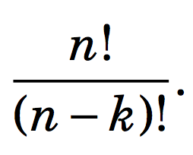
Theorem
The number of non-repetitive lists of length-k whose entries are chosen from a set of n possible entries is
Proof: Using the multiplication rule we see that the number of length-k lists is n.(n-1).(n-2). …. (n-k+1).
We can rewrite n.(n-1).(n-2). …. (n-k+1) this as

Slide 53
Examples
3.2(4) Using only pencil and paper, find the value of
3.2(6) There are two 0’s at the end of 10!=3,268,800. Using only paper and pencil, determine how many 0’s are at the end of 100!.
3.2(8) Compute how many 7-digit numbers can be made from the digits 1,2,3,4,5,6,7 if there is no repetition and the odd digits must appear in an unbroken sequence. (3571264, 2413576 are ok, but not 7234615)

Slide 54
Solution
3.2(4) Using only pencil and paper, find the value of
Easy.
3.2(6) There are two 0’s at the end of 10!=3,268,800. Using only paper and pencil, determine how many 0’s are at the end of 100!.

Slide 55
Solution
3.2(4) Using only pencil and paper, find the value of
Easy.
3.2(6) There are two 0’s at the end of 10!=3,268,800. Using only paper and pencil, determine how many 0’s are at the end od 100!.
Ans: The two zeros in 10! come from the fact that
(1) The number is divisible by 10, and
(2) The number is divisible by both 5 and 2.
Now 100! is divisible by 100*(95*92)* 90*(85*82)*
…..10*(5*2).
The number of trailing zeros in 100! is 21.

Slide 56
Solution
3.2(8) Compute how many 7-digit numbers can be made from the digits 1,2,3,4,5,6,7 if there is no repetition and the odd digits must appear in an unbroken sequence. (3571264, 2413576 are valid, but not 7234615)
Ans:

Slide 57
Solution
3.2(8) Compute how many 7-digit numbers can be made from the digits 1,2,3,4,5,6,7 if there is no repetition and the odd digits must appear in an unbroken sequence. (3571264, 2413576 are ok, but not 7234615)
Ans:
There are 4 odd digits. There are 4! length-4 lists of odd integers without repetition.
The 7-digit valid number can be visualized as a list of length 4 using symbols 2, 4, 6, and a length-4 list of odd integers. There are 4! different such lists.
The total number of valid 7-digit sequence is (4!)².

Slide 58
Counting Subsets (section 3.3)
In counting the number of length-k lists from a set of n possible objects, the order of the objects were very important.
What happens when the order is not important?
Now we select size-k subsets from a set of n possible objects.
How many such size-k subsets are there?

Slide 59
Counting Subsets (section 3.3)
In counting the number of length-k lists from a set of n possible objects, the order of the objects were very important.
What happens when the order is not important?
Now we select size-k subsets from a set of n possible objects.
How many such size-k subsets are there?
Suppose A = {a,b,c,d,e}
Size-2 subsets of A are: {a,b}, {a,c}, {a,d}, {a,e}, {b,c}, {b,d}, {b,e}, {c,d}, {c,e}, {d,e}.
Observe length-2 lists: (a,b), (b,a), (a,c), (c,a), (a,d), (d,a),(a,e), (e,a), (b,c), (c,b), (b,d), (d,b), (b,e), (e,b), (c,d), (d,c), (c,e), (e,c), (d,e), (e,d)

Slide 60
Counting Subsets
Suppose A = {a,b,c,d,e}
Size-2 subsets of A are: {a,b}, {a,c}, {a,d}, {a,e}, {b,c}, {b,d}, {b,e}, {c,d}, {c,e}, {d,e}.
Observe length-2 lists: (a,b), (b,a), (a,c), (c,d), (a,d), (d,a),(a,e), (e,a), (b,c), (c,b), (b,d), (d,b), (b,e), (e,b), (c,d), (d,c), (c,e), (e,c), (d,e), (e,d).
There is definitely some connection between the number of size-k subsets and the number of length-k lists.

Slide 61
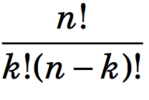
Counting Subsets
Consider a size-k subset {a₁,a₂, …, a_{k}}.
This size-k subsets generate k! length-k lists using the k symbols a₁,a₂, …, a_{k}.
These k! lists are present in length-k lists using n symbols.
Thus every size-k subset realizes k! length-k lists.
Therefore,
number of size-k subsets x k! = number of length-k lists
number of size-k subsets = C(n,k) =

Slide 62
Counting Subsets
In the text, C(n,k) is written as .
is read as ``n choose k’’
C(n,k) denotes the number of subsets that can be made by choosing k elements from a set of n elements.

Slide 63
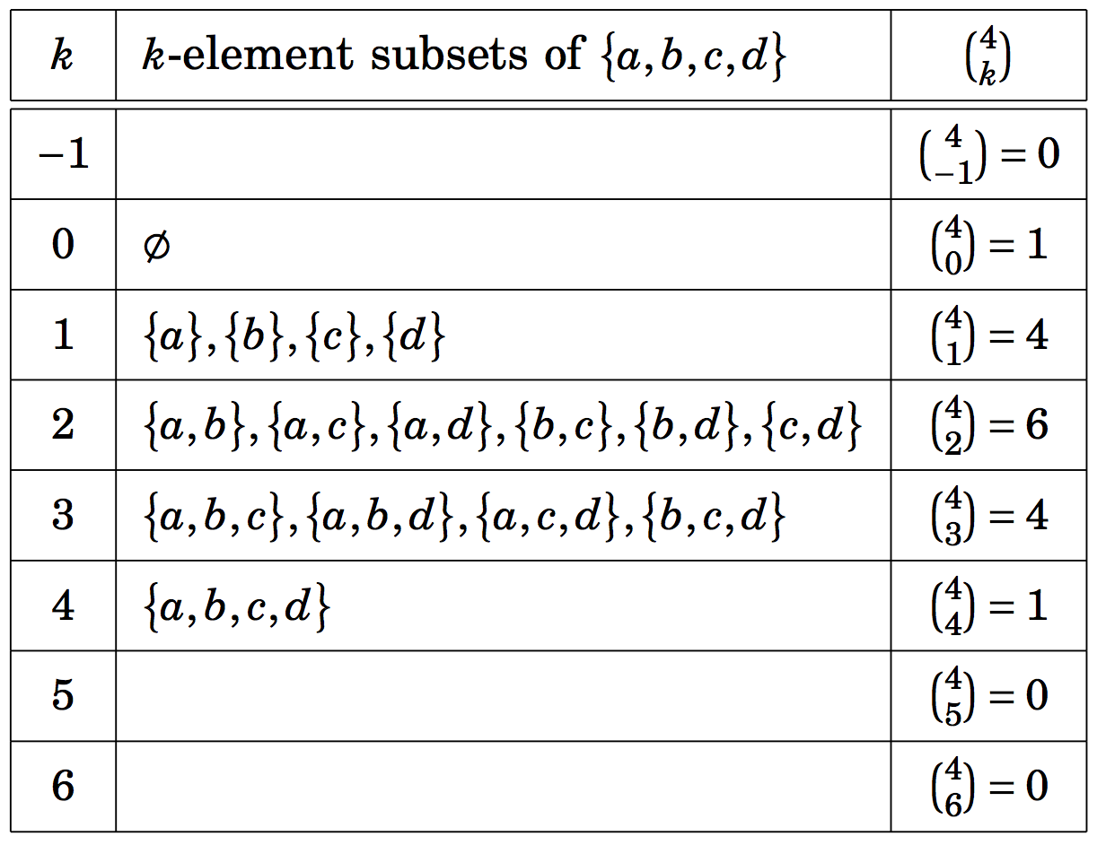
Counting Subsets

Slide 64
Example
How many 5-card hands are there in which two of the cards are clubs and three are hearts?
Ans: Note that order is not important.
How many ways can we select two club cards?
How many ways can we select three hearts?

Slide 65
Example
How many 5-card hands are there in which two of the cards are clubs and three are hearts?
Ans: Note that order is not important.
How many ways can we select two club cards?
The answer is: C(13,2) = =
How many ways can we select three hearts?
The answer is: C(13,3)
Total number = C(13,2). C(13,3) =

Slide 66
Example
3.3(4) Suppose a set B has the property that
Find |B|.
Ans:

Slide 67
Example
3.3(4) Suppose a set B has the property that
Find |B|.
Ans: Since
,
therefore
The above identity is valid when |B|=8.

Slide 68
Example
In how many ways a gambler draw five cards from a standard deck and get
(a) a flush (five card of the same suit)?
(b) four aces?
(c) four of a kind?
(d) three aces and two jacks?
(e) three aces and a pair?
(f) a full house (three of a kind and a pair)?
(g) thee of a kind?
(h) two pairs?

Slide 69
Example
In how many ways a gambler draw five cards from a standard deck and get
(a) a flush (five card of the same suit)? C(4,1).C(13,5)
(b) four aces?
(c) four of a kind?
(d) three aces and two jacks?
(e) three aces and a pair?
(f) a full house (three of a kind and a pair)?
(g) three of a kind?
(h) two pairs?

Slide 70
Example
In how many ways a gambler draw five cards from a standard deck and get
(a) a flush (five card of the same suit)? C(4,1).C(13,5)
(b) four aces? C(4,4).C(48,1)
(c) four of a kind?
(d) three aces and two jacks?
(e) three aces and a pair?
(f) a full house (three of a kind and a pair)?
(g) three of a kind?
(h) two pairs?

Slide 71
Example
In how many ways a gambler draw five cards from a standard deck and get
(a) a flush (five card of the same suit)? C(4,1).C(13,5)
(b) four aces? C(4,4).C(48,1)
(c) four of a kind? C(13,1).C(48,1)
(d) three aces and two jacks?
(e) three aces and a pair?
(f) a full house (three of a kind and a pair)?
(g) three of a kind?
(h) two pairs?

Slide 72
Example
In how many ways a gambler draw five cards from a standard deck and get
(a) a flush (five card of the same suit)? C(4,1).C(13,5)
(b) four aces? C(4,4).C(48,1)
(c) four of a kind? C(13,1).C(48,1)
(d) three aces and two jacks? C(4,3).C(4,2)
(e) three aces and a pair?
(f) a full house (three of a kind and a pair)?
(g) three of a kind?
(h) two pairs?

Slide 73
Example
In how many ways a gambler draw five cards from a standard deck and get
(a) a flush (five card of the same suit)? C(4,1).C(13,5)
(b) four aces? C(4,4).C(48,1)
(c) four of a kind? C(13,1).C(48,1)
(d) three aces and two jacks? C(4,3).C(4,2)
(e) three aces and a pair? C(4,3).C(12,1).C(4,2)
(f) a full house (three of a kind and a pair)?
(g) three of a kind?
(h) two pairs?

Slide 74
Example
In how many ways a gambler draw five cards from a standard deck and get
(a) a flush (five card of the same suit)? C(4,1).C(13,5)
(b) four aces? C(4,4).C(48,1)
(c) four of a kind? C(13,1).C(48,1)
(d) three aces and two jacks? C(4,3).C(4,2)
(e) three aces and a pair? C(4,3).C(12,1).C(4,2)
(f) a full house (three of a kind and a pair)? C(13,1).C(4,3).C(12,1).C(4,2)
(g) three of a kind?
(h) two pairs?

Slide 75
Example
In how many ways a gambler draw five cards from a standard deck and get
(a) a flush (five card of the same suit)? C(4,1).C(13,5)
(b) four aces? C(4,4).C(48,1)
(c) four of a kind? C(13,1).C(48,1)
(d) three aces and two jacks? C(4,3).C(4,2)
(e) three aces and a pair? C(4,3).C(12,1).C(4,2)
(f) a full house (three of a kind and a pair)? C(13,1).C(4,3).C(12,1).C(4,2)
(g) three of a kind? C(13,1)C(4,3).((C(48,1).C(44,1))/2)
(h) two pairs?

Slide 76
Example
In how many ways a gambler draw five cards from a standard deck and get
(a) a flush (five card of the same suit)? C(4,1).C(13,5)
(b) four aces? C(4,4).C(48,1)
(c) four of a kind? C(13,1).C(48,1)
(d) three aces and two jacks? C(4,3).C(4,2)
(e) three aces and a pair? C(4,3).C(12,1).C(4,2)
(f) a full house (three of a kind and a pair)? C(13,1).C(4,3).C(12,1).C(4,2)
(g) three of a kind? C(13,1)C(4,3).((C(48,1).C(44,1))/2)
(h) two pairs? C(13,2).C(4,2).C(4,2).C(44,1)

Slide 77
Example
In how many ways a gambler draw five cards from a standard deck and get
(a) a flush (five card of the same suit)? C(4,1).C(13,5)
(b) four aces? C(4,4).C(48,1)
(c) four of a kind? C(13,1).C(48,1)
(d) three aces and two jacks? C(4,3).C(4,2)
(e) three aces and a pair? C(4,3).C(12,1).C(4,2)
(f) a full house (three of a kind and a pair)? C(13,1).C(4,3).C(12,1).C(4,2)
(g) three of a kind? C(13,1)C(4,3).((C(48,1).C(44,1))/2)
C(13,1).C(4,3).C(12,2).C(4,1).C(4,1)
(h) two pairs? C(13,2).C(4,2).C(4,2).C(44,1)

Slide 78
Example
3.3(8) The problem concerns lists made from the symbols A,B,C,D,E,F,G,H,I.
How many length-5 lists can be made if repetition is not allowed and the list is in alphabetical order? (Example: BDEFI or ABCGH, but not BACGH)
Observe that size-5 subset realizes one length-5 list in alphabetical order, and one length-5 list realizes one size-5 subset. Therefore, the number od length-5 alphabetically ordered list is the same as the number of size-5 subsets. Hence the number is C(9,5).
How many length-5 lists can be made if repetition is not allowed and the list is not alphabetical order.
Ans: 9x8x7x6x5 – C(9,5).

Slide 79
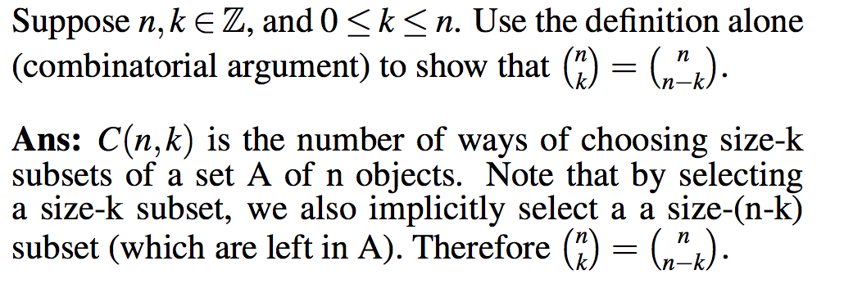
Example
3.3(14)

Slide 80
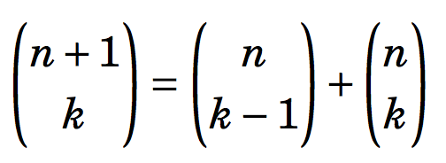
Pascal’s Triangle and the Binomial Theorem
We will focus on the pattern based on one equation (identity)
for any integers 1 ≤ n ≤ k.
For any integers 1 ≤ n ≤ k,
C(n+1,k) = C(n,k-1) + C(n,k)

Slide 81
Pascal’s Triangle and the binomial Theorem
For any integers 1 ≤ k ≤ n,
C(n+1,k) = C(n,k-1) + C(n,k)
It says that number of size-k subset of a set with n+1 elements is equal to the sum of the number of size-(k-1) subset of a set of n elements and the number of size-k subset of a set of n elements.
Consider a set with n+1 elements.
A={0,1,2, …,n).
All subsets of A of size k
= All subsets of size k with element 0 in it
+ All subsets of size k with no element 0.
C(n+1,k) = C(n,k-1) + C(n,k).

Slide 82
Pascal’s Triangle and the Binomial Theorem
For any integers 1 ≤ k ≤ n,
C(n+1,k) = C(n,k-1) + C(n,k)
It says that number of size-k subset of a set with n+1 elements is equal to the sum of the number of size-(k-1) subset of a set of n elements and the number of size-k subset of a set of n elements.
Consider a set with n+1 elements.
A={0,1,2, …,n).
All subsets of A of size k
= All subsets of size k with element 0 in it
+ All subsets of size k with no element 0.
C(n+1,k) = C(n,k-1) + C(n,k).
Note that k is at least 1 and k cannot be greater than n.

Slide 83
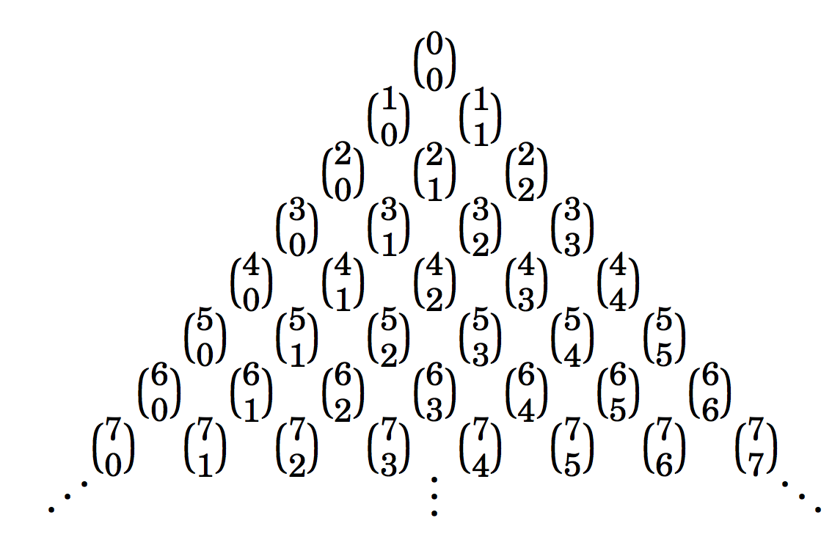
Pascal’s Triangle
Suppose we write C(n,k), 1 ≤ k ≤ n for n=0,1,2, … and for all feasible values of k, with a certain pattern as follows:
n=0 -----------------------------------------
n=1 -----------------------------------
n=2 ------------------------------
n=3 --------------------------
n=4 ---------------------
n=5 -----------------
n=6 ------------
n=7 --------

Slide 84
Pascal’s Triangle
Any number C(n+1,k) for 1 ≤ k ≤ n is immediately below and between the two numbers C(n,k-1) and C(n,k) in the previous row.

Slide 85
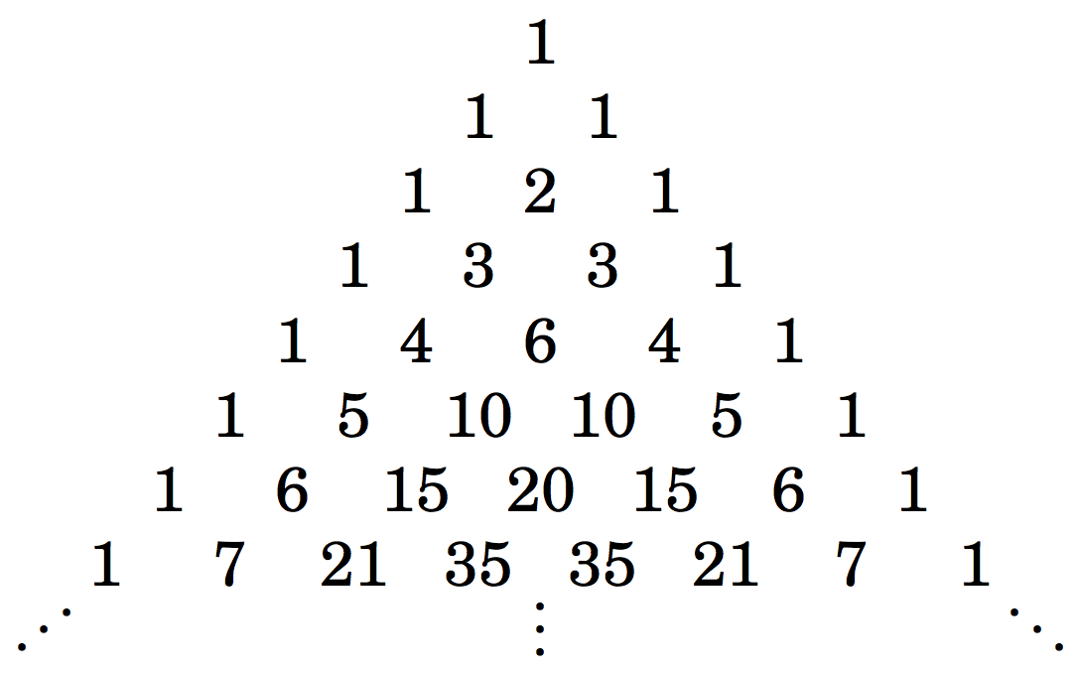
Pascal’s Triangle
When we evaluate C(n,k) for all n and k, we get the following triangle of numbers. For example C(6,4)=20.
The arrangement is called Pascal’s triangle (Pascal 1623-1660).
n=0 (Row 0)--------------------------------
n=1 (Row 1)---------------------------
n=2 (Row 2) ----------------------
n=3 (Row 3)----------------
n=4 (Row 4)------------
n=5 (Row 5)-------
n=6 (Row 6)---
n=7 (Row 7)

Slide 86
Pascal’s Triangle and Coefficients of (x+y)^{n}
n^{th} row of Pascal’striangle lists the coefficients of (x+y)^{n}.

Slide 87
Binomial Theorem

Slide 88
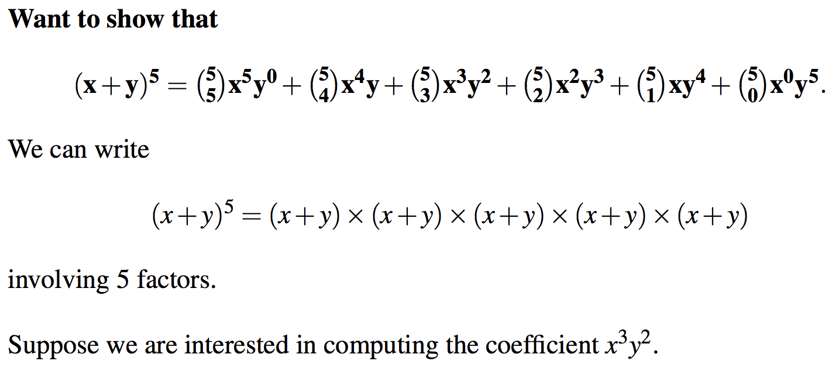
Binomial Theorem

Slide 89
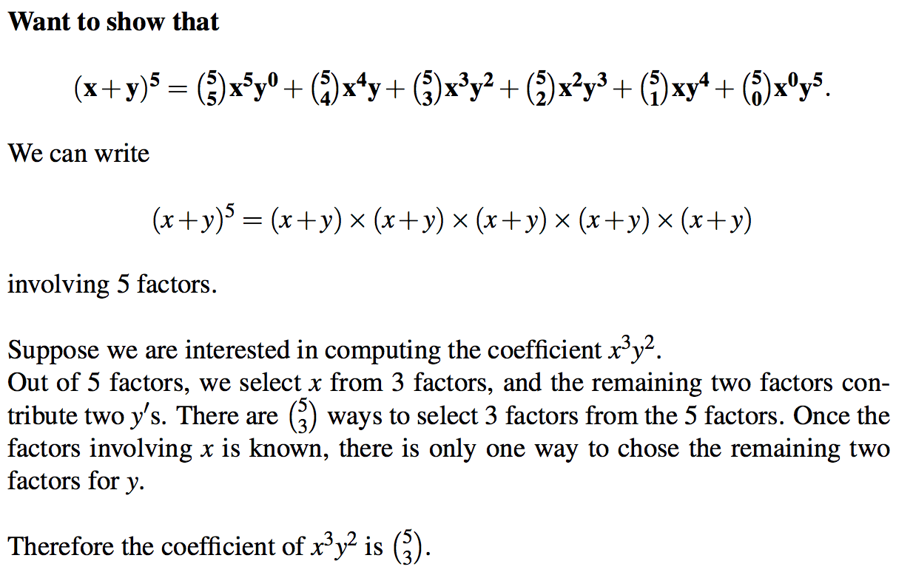
Binomial Theorem

Slide 90
Binomial Theorem (Example)
3.4(4) Use the binomial theorem to find the coefficient of x⁶y³ in (3x-2y)⁹.

Slide 91
Binomial Theorem (Example)
3.4(4) Use the binomial theorem to find the coefficient of x⁶y³ in (3x-2y)⁹.
We can write (3x – 2y)⁹ as (a + b)⁹ where a = 3x and b = -2y. Now the coefficient of a⁶b³ is C(9,6).
Now C(9,6).a⁶b³ = C(9,6) (3x)⁶ (-2y)³ = - C(9,6)3⁶ 2³ x⁶y³.

Slide 92
Inclusion-Exclusion (Section 3.5)
We have looked at the following two problems.
Consider making lists from the symbols A, B, C, D, E, F, G
(c) How many length-4 lists are possible if repetition is not allowed and the list must contain an E?
Ans: There are four types of lists depending on whether E occurs as the first, second, third or fourth entry. These four types are shown below.
Total # =(6 x 5 x 4) + (6 x 5 x 4) + (6 x 5 x 4) + (6 x 5 x 4)

Slide 93
Inclusion-Exclusion (Section 3.5)
We have looked at the following two problems.
Consider making lists from the symbols A, B, C, D, E, F, G
(d) How many length-4 lists are possible if repetition is allowed and the list must contain an E?
Ans: There are four types of lists depending on whether E occurs as the first, second, third or fourth entry. These four types are shown below.
Total # =(7x7x7) + (7x7x7) + (7x7x7) + (7x7x7)

Slide 94
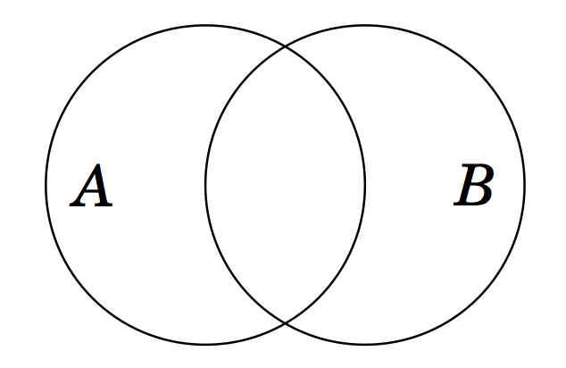
Principle of Inclusion-Exclusion (PIE)
It is not correct to say that |A ∪ B| must equal to |A| + |B| if A and B have some elements in common. In this case we have counted each element of A ∩ B twice.
Correct identity is |A ∪ B| = |A| + |B| - |A ∩ B|

Slide 95
PIE
More generally, we have the following
Lemma: Let A, B, be subsets of a finite set U. Then
|A∪B| = |A| + |B| - |A∩B|
|A ∩ B| ≤ min {|A|, |B|}
|A - B| = |A| - |A∩B|
|A⊕B| =|A∪B|-|A∩B|= |A|+|B|-2|A∩B|
|A × B| = |A|×|B|

Slide 96
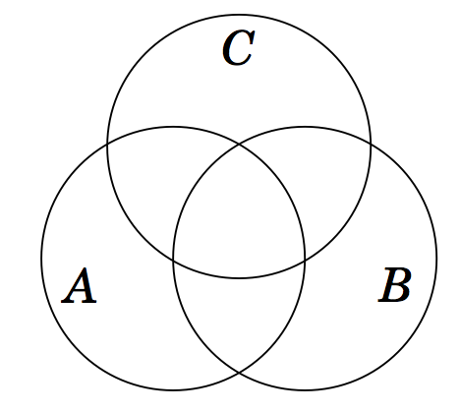
PIE
Consider three sets A, B, C as represented in the following Venn Diagram.
Using similar arguments as before we can write

Slide 97
PIE : Example
To illustrate, when n=4, we have
|A₁∪A₂∪A₃∪A₄|= |A₁|+|A₂|+|A₃|+|A₄|
- [|A₁∩A₂|+|A₁∩A₃|+|A₁∩A₄|
+|A₂∩A₃|+|A₂∩A₄|+|A₃∩A₄|]
+ [|A₁∩A₂∩A₃|+|A₁∩A₂∩A₄|
+|A₁∩A₃∩A₄|+|A₂∩A₃∩A₄|]
- |A₁ ∩A₂ ∩A₃ ∩A₄|

Slide 98
PIE: Theorem
Theorem: Let A₁,A₂, …,A_{n} be finite sets, then
|A₁∪ A₂ ∪...∪A_{n}|= Σ_{i}|A_{i}|
- Σ_{i<j}|A_{i} ∩ A_{j}|
+ Σ_{i<j<k}|A_{i} ∩ A_{j} ∩ A_{k}|
- …
+(-1)^{n+1} |A₁∩A₂∩...∩A_{n}|
Each summation is over
all i,
pairs i,j with i<j,
triples with i<j<k, etc.

Slide 99
Application of PIE: Example 1
How many integers between 1 and 300 (inclusive) are
Divisible by at least one of 3,5,7?
Divisible by 3 and by 5 but not by 7?
Divisible by 5 but by neither 3 or 7?

Slide 100
Application of PIE: Example 1
How many integers between 1 and 300 (inclusive) are
Divisible by at least one of 3,5,7?
Divisible by 3 and by 5 but not by 7?
Divisible by 5 but by neither 3 or 7?
Let
A = {n∈Z | (1 ≤ n ≤ 300)∧ (mod(n,3) = 0)}
B = {n∈Z | (1 ≤ n ≤ 300)∧ (mod(n,5) = 0)}
C = {n∈Z | (1 ≤ n ≤ 300)∧ (mod(n,7) = 0)}

Slide 101
Application of PIE: Example 1
How many integers between 1 and 300 (inclusive) are
Divisible by at least one of 3,5,7?
Divisible by 3 and by 5 but not by 7?
Divisible by 5 but by neither 3 or 7?
Let
A = {n∈Z | (1 ≤ n ≤ 300)∧ (mod(n,3) = 0)}
B = {n∈Z | (1 ≤ n ≤ 300)∧ (mod(n,5) = 0)}
C = {n∈Z | (1 ≤ n ≤ 300)∧ (mod(n,7) = 0)}
How big are these sets? We use the floor function
mod(n,3) is the remainder when n is divided by 3

Slide 102
Application of PIE: Example 1
How many integers between 1 and 300 (inclusive) are
Divisible by at least one of 3,5,7?
Divisible by 3 and by 5 but not by 7?
Divisible by 5 but by neither 3 or 7?
Let
A = {n∈Z | (1 ≤ n ≤ 300)∧ (mod(n,3) = 0)}
B = {n∈Z | (1 ≤ n ≤ 300)∧ (mod(n,5) = 0)}
C = {n∈Z | (1 ≤ n ≤ 300)∧ (mod(n,7) = 0)}
How big are these sets? We use the floor function
|A| = ⎣300/3⎦ = 100
|B| = ⎣300/5⎦ = 60
|C| = ⎣300/7⎦ = 42
mod(n,3) is the remainder when n is divided by 3

Slide 103
Application of PIE: Example 1
How many integers between 1 and 300 (inclusive) are
Divisible by at least one of 3,5,7?
Divisible by 3 and by 5 but not by 7?
Divisible by 5 but by neither 3 or 7?
Let
A = {n∈Z | (1 ≤ n ≤ 300)∧ (mod(n,3) = 0)}
B = {n∈Z | (1 ≤ n ≤ 300)∧ (mod(n,5) = 0)}
C = {n∈Z | (1 ≤ n ≤ 300)∧ (mod(n,7) = 0)}
How big are these sets? We use the floor function
|A| = ⎣300/3⎦ = 100
|B| = ⎣300/5⎦ = 60
|C| = ⎣300/7⎦ = 42
mod(n,3) is the remainder when n is divided by 3
⎣16.3⎦ = 16; ⎣42.857142….⎦ =42

Slide 104
Application of PIE: Example 1
How many integers between 1 and 300 (inclusive) are divisible by at least one of 3,5,7?
Answer:
How big are these sets? We use the floor function
|A| = ⎣300/3⎦ = 100
|B| = ⎣300/5⎦ = 60
|C| = ⎣300/7⎦ = 42

Slide 105
Application of PIE: Example 1
How many integers between 1 and 300 (inclusive) are divisible by at least one of 3,5,7?
Answer: |A∪B ∪C|

Slide 106
Application of PIE: Example 1
How many integers between 1 and 300 (inclusive) are divisible by at least one of 3,5,7?
Answer: |A∪B ∪C|
By the principle of inclusion-exclusion
|A∪B ∪C|= |A|+|B|+|C|-[|A∩B|+|A∩C|+|B∩C|]+|A∩B∩C|
How big are these sets? We use the floor function
|A| = ⎣300/3⎦ = 100 |A∩B| = ⎣300/15⎦ = 20
|B| = ⎣300/5⎦ = 60 |A∩C| = ⎣300/21⎦ = 14
|C| = ⎣300/7⎦ = 42 |B∩C| = ⎣300/35⎦ = 8
|A∩B∩C| = ⎣300/105⎦ = 2
Therefore:
|A∪B ∪C| = 100 + 60 + 42 - (20+14+8) + 2 = 162

Slide 107
Application of PIE: Example 1
How many integers between 1 and 300 (inclusive) are divisible by 3 and by 5 but not by 7?
Answer:
Knowing that
|A| = ⎣300/3⎦ = 100 |A∩B| = ⎣300/15⎦ = 20
|B| = ⎣300/5⎦ = 60 |A∩C| = ⎣300/21⎦ = 100
|C| = ⎣300/7⎦ = 42 |B∩C| = ⎣300/35⎦ = 8
|A∩B∩C| = ⎣300/105⎦ = 2

Slide 108
Application of PIE: Example 1
How many integers between 1 and 300 (inclusive) are divisible by 3 and by 5 but not by 7?
Answer: |(A ∩ B)-C|
By the definition of set-minus
|(A ∩ B)-C| = |A ∩ B| - |A ∩ B ∩ C| = 20 – 2 = 18
Knowing that
|A| = ⎣300/3⎦ = 100 |A∩B| = ⎣300/15⎦ = 20
|B| = ⎣300/5⎦ = 60 |A∩C| = ⎣300/21⎦ = 100
|C| = ⎣300/7⎦ = 42 |B∩C| = ⎣300/35⎦ = 8
|A∩B∩C| = ⎣300/105⎦ = 2

Slide 109
Application of PIE: Example 1
How many integers between 1 and 300 (inclusive) are divisible by 5 but by neither 3 or 7?
Answer:
Knowing that
|A| = ⎣300/3⎦ = 100 |A∩B| = ⎣300/15⎦ = 20
|B| = ⎣300/5⎦ = 60 |A∩C| = ⎣300/21⎦ = 14
|C| = ⎣300/7⎦ = 42 |B∩C| = ⎣300/35⎦ = 8
|A∩B∩C| = ⎣300/105⎦ = 2

Slide 110
Application of PIE: Example 1
How many integers between 1 and 300 (inclusive) are divisible by 5 but by neither 3 or 7?
Answer: |B - (A ∪C)| = |B| - |B ∩ (A ∪C)|
Distributing B over the intersection
|B ∩ (A ∪ C)| = |(B ∩ A) ∪ (B ∩ C)|
= |B ∩ A| + |B ∩ C| - | (B ∩ A) ∩ (B ∩ C) |
= |B ∩ A| + |B ∩ C| - | B ∩ A ∩ C |
= 20 + 8 – 2 = 26
Knowing that
|A| = ⎣300/3⎦ = 100 |A∩B| = ⎣300/15⎦ = 20
|B| = ⎣300/5⎦ = 60 |A∩C| = ⎣300/21⎦ = 14
|C| = ⎣300/7⎦ = 42 |B∩C| = ⎣300/35⎦ = 8
|A∩B∩C| = ⎣300/105⎦ = 2

Slide 111
Solution
3.2(6) There are two 0’s at the end of 10!=3,268,800. Using only paper and pencil, determine how many 0’s are at the end od 100!.
Ans: The two zeros in 10! come from the fact that
(1) The number is divisible by 10, and
(2) The number is divisible by both 5 and 2.
Now 100! is divisible by 100*(95*92)* 90*(85*82)*
…..10*(5*2).
The number of trailing zeros in 100! is 21.

Slide 112
Solution
3.2(6) There are two 0’s at the end of 10!=3,268,800. Using only paper and pencil, determine how many 0’s are at the end od 100!.
Ans: The two zeros in 10! come from the fact that
(1) The number is divisible by 10, and
(2) The number is divisible by both 5 and 2.
The number of trailing zeros in 100! is 21 24

Slide 113
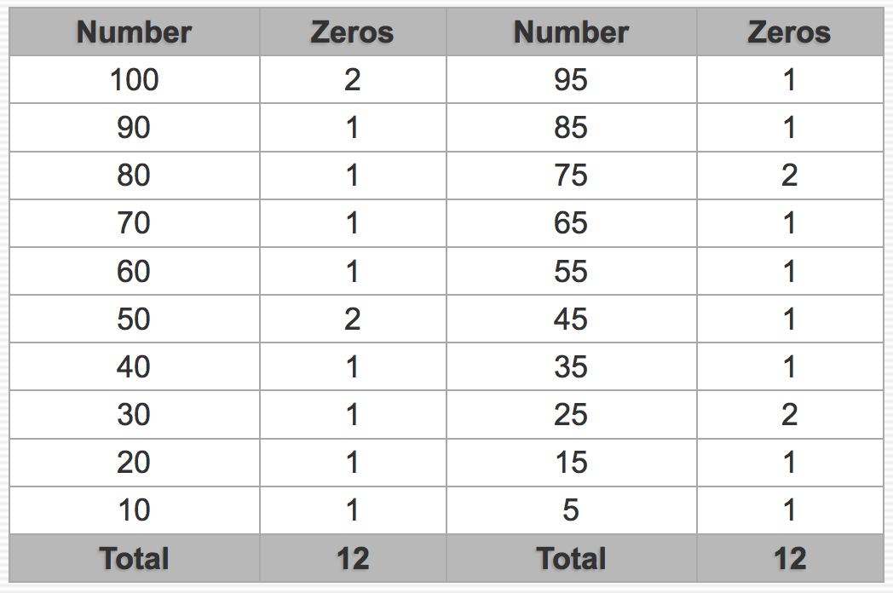
Solution
3.2(6) There are two 0’s at the end of 10!=3,268,800. Using only paper and pencil, determine how many 0’s are at the end od 100!.
Ans: The number of trailing zeros in 100! is 21 24
‘zeros’ columns indicate the number of factors of 5.

Slide 114
Solution
3.2(6) There are two 0’s at the end of 10!=3,268,800. Using only paper and pencil, determine how many 0’s are at the end od 100!.
Ans: The two zeros in 10! come from the fact that
(1) The number is divisible by 10, and
(2) The number is divisible by both 5 and 2.
Now 100! is divisible by 100*(95*92)* 90*(85*82)*
…..10*(5*2).
The number of trailing zeros in 100! is 21.
One of the students points out that there are 24 trailing zeros. I have counted two factors of 5 in 100, but didn’t count two factors of 5 in 75, 50 and 25. These extra three factors of 5 realize another 3 extra trailing zeros, when multiplied with a real number.

Slide 115
Example 2:
3.5(2) How many 4-digit positive integers are there for which there are no repeated digits, or for which there may be repeated digits, but all are odd.
A = set of length-4 lists of integers with no repeated digits.
B_{i} = set of length-4 lists ending with odd digit i, repetition is allowed, i=1, 3, 5, 7, 9
C_{i} = set of length-4 lists ending with odd digit i, repetition is not allowed, i=1, 3, 5, 7, 9
B_{i} – C_{i} is the set of length-4 odd numbered list where at least one digit is repeated.
Ans to the question is:

Slide 116
Example 2:
3.5(2) How many 4-digit positive integers are there for which there are no repeated digits, or for which there may be repeated digits, but all are odd.
A = set of length-4 lists of integers with no repeated digits.
B_{i} = set of length-4 lists ending with odd digit i, repetition is allowed, i=1, 3, 5, 7, 9
C_{i} = set of length-4 lists ending with odd digit i, repetition is not allowed, i=1, 3, 5, 7, 9
B_{i} – C_{i} is the set of length-4 odd numbered list where at least one digit is repeated.
Ans to the question is:
|A| + |B₁ – C₁| + |B₃ – C₃| + |B₅ – C₅| +|B₇ – C₇| + |B₉ – C₉| .

Slide 117
Practice problems from the text:
Section 3.1
1, 2, 3, 4, 5, 8, 9, 12
Section 3.2
3, 5, 7
Section 3.3
1, 3, 5, 7, 9, 10, 11, 12
Section 3.4
3, 5, 6, 8, 9, 11, 13
Section 3.5
1, 3, 4, 5, 6, 8

