Slide 1
Cardinality of Sets

Slide 2
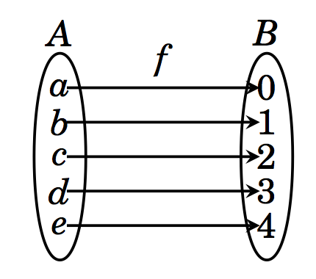
Sets with equal cardinalities
Definition: Two sets A and B have the same cardinality, written |A| = |B|, if there exists a bijective function f: A → B. If no such bijective function exists, then the sets have unequal cadinalities, i.e. |A| ≠ |B|.

Slide 3
Finite set
When A and B are finite, and |A| = |B|, it is easy to design a bijective function f: A → B.
Let A = {a₁, a₂, …., a_{k}} and B = {b₁, b₂, …, b_{k}}.
Define f = {(a₁, b₁), (a₂,b₂), …, (a_{k}, b_{k})}.
f is bijective.

Slide 4
Infinite sets
Are there more natural numbers N than there are integers Z?
Let f: N → Z be a function defined by
Now f is one to one and onto. (Why? Exercise)
Some values of the function.
Therefore, |N| = |Z|.

Slide 5
Does |N| = |Q|?
Note that
Another approach.
Since N is a subset of Q, |N| ≤ |Q|.
Consider the following one-to-one function f : Q → N.
Since f is one-to-one, |Q| ≤ |N|
Therefore, |Q| = |N|

Slide 6
Countable and Uncountable Sets
Definitions: Suppose A is a set. Then A is countably infinite if |N|=|A|, that is, there exists a bijection f: N → A. The set A is uncountable if A is infinite and |N| ≠ |A|, that is, if A is infinite and there exists no bijection f: N → A.

Slide 7
Countable and Uncountable Sets
Theorem: A set is countably infinite if and only if its elements can be arranged in an infinite list a₁, a_{2,} a_{3,} ….. Here f(i) = a_{i}.
Prove that the set of natural numbers N= {1,2,3,4,…} has the same cardinality as the set E={2,4,6,8, …} of positive even integers.
Define f: N → Z by f(n) = 2n
f⁻¹(n) = n/2

Slide 8
Does |N| = |R|?
We have established that N, Z and Q all have the same cardinalities.
Fact: between any two real numbers, there is always a rational number.
Surprising that there are more real numbers than rationals!
We now show that even the real numbers in the interval [0,1] are not countable.
Recall that a real number can be written out in an infinite decimal expansion.
A real number in the interval [0,1] can be written as 0.d₁d₂d₃….; 1 = 0.999999…….

Slide 9
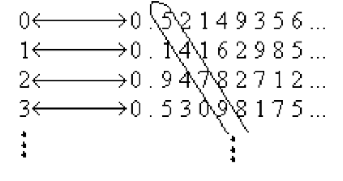
Showing that f: N → R(0,1) is not onto.
Proof by contradiction.
Suppose that f is onto. We can then enumerate the infinite list as follows:
The number circles in the diagonal is some real number r, since it is an infinite decimal expansion.
Consider a real number s obtained by modifying every digit of r, say by replacing each digit d with d+5 mod 10.

Slide 10
Showing that f: N → R(0,1) is not onto.
The number circles in the diagonal is some real number r, since it is an infinite decimal expansion.
Consider a real number s obtained by modifying every digit of r, say by replacing each digit d with d+5 mod 10.
We claim that s does not occur in our infinite list of real numbers. This is due to the fact that the n^{th} digit of s is different from the n^{th} digit of the n^{th} number from the list.
Therefore, s is not in range(f).
Therefore, f is not onto. Hence R is not countable.

Slide 11
Showing that f: N → R(0,1) is not onto.
The number circles in the diagonal is some real number r, since it is an infinite decimal expansion.
Consider a real number s obtained by modifying every digit of r, say by replacing each digit d with d+5 mod 10.
We claim that s does not occur in our infinite list of real numbers. This is due to the fact that the n^{th} digit of s is different from the n^{th} digit of the n^{th} number from the list.
Therefore, s is not in range(f).
Therefore, f is not onto. Hence R is not countable.
Cantor’s Diagonalization

Slide 12
Example
|(0, 1)| = |(1, ∞)|
Let f: (0,1) → (1, ∞) be defined by f(x) = 1/x.
f⁻¹(x) = 1/x

Slide 13
Some results
Any subset of a countable set is countable.
If A and B are countable, A ∪ B is a countable set.
list the elements a₁, b₁, a₂, b₂, …
Let X be an uncountable set. If there is a bijective function f : A → X, then A is uncountable.

