Slide 1
Applications of Logic

Slide 2
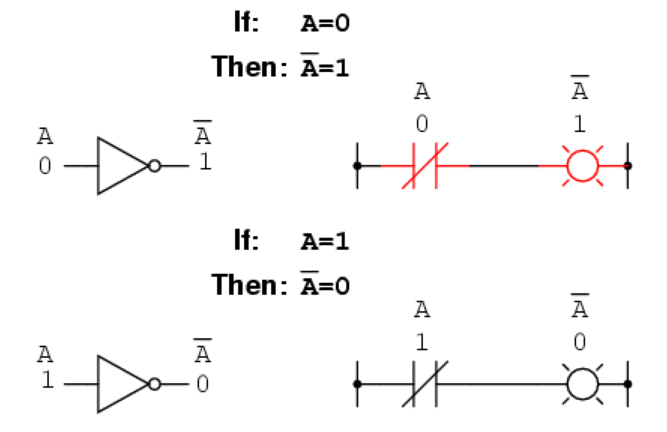
Logical circuits are built using ¬, ∧, ∨ gates.
NOT (¬) gate

Slide 3
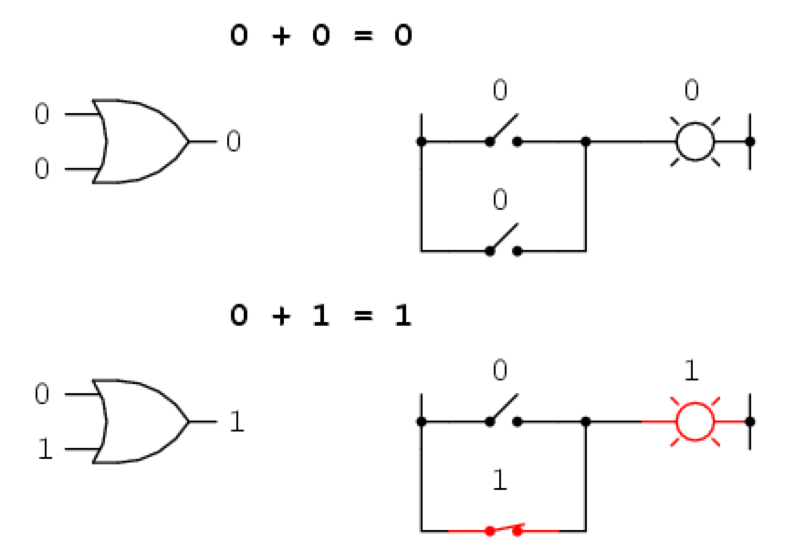
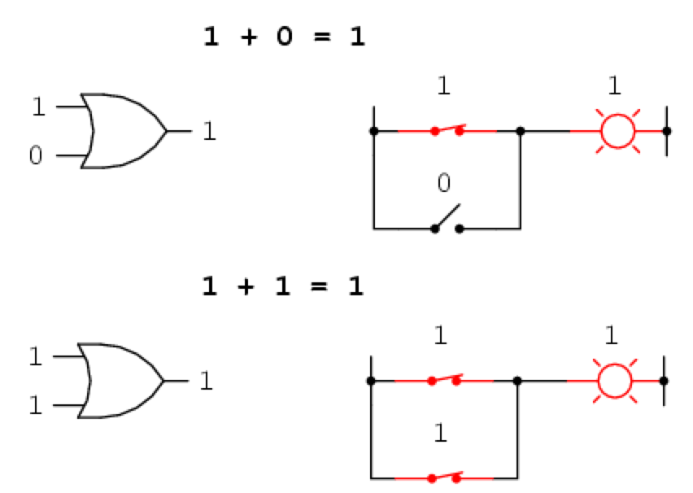
OR (∨) gate

Slide 4
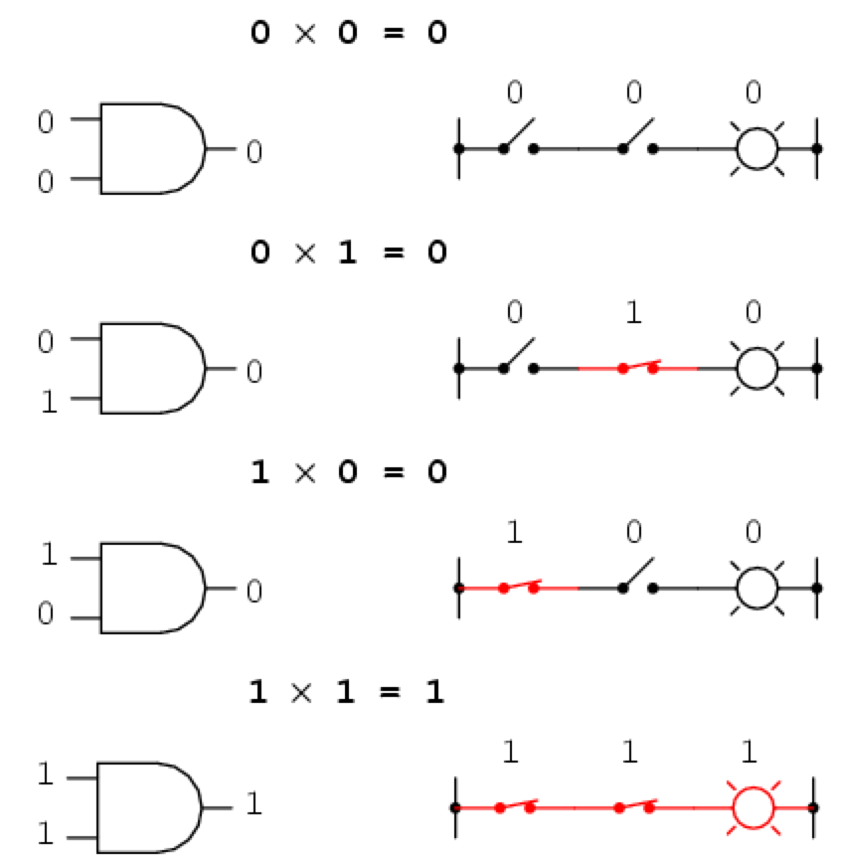
AND (∧) gate

Slide 5
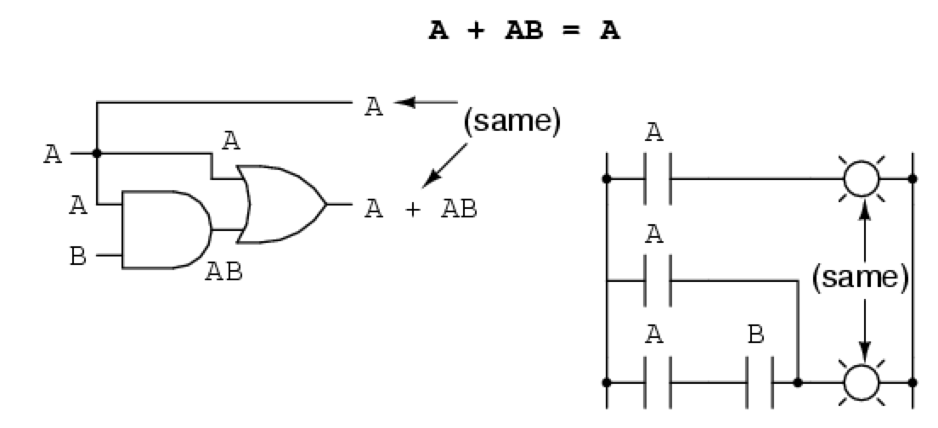
Boolean Simplification

Slide 6
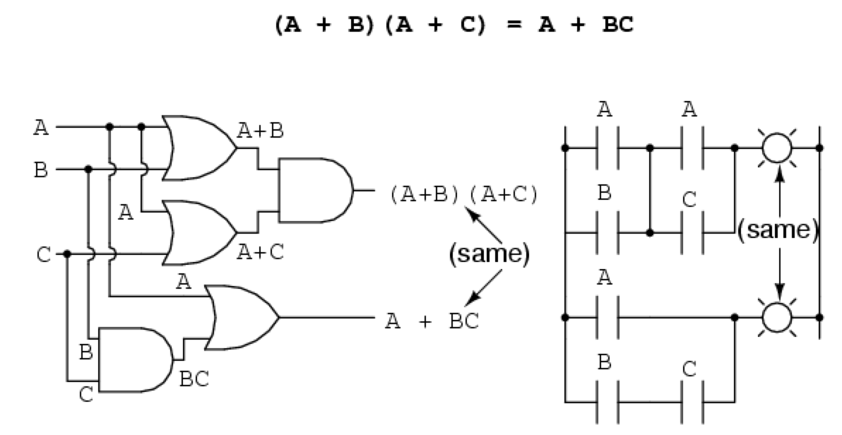
Boolean Simplification
Distributive Law: p ∨ ( q ∧ r) = (p ∨ q) ∧ (p ∨ r)

Slide 7
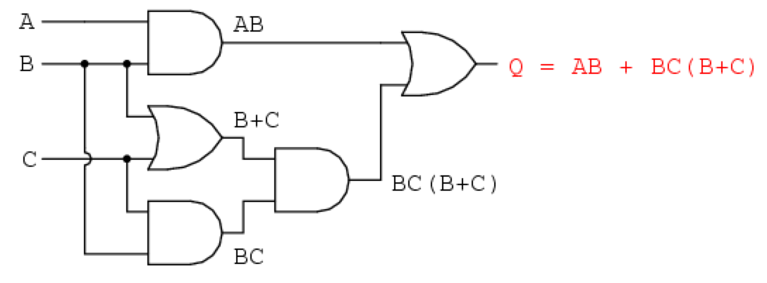
Boolean Simplification (two equivalent circuits)

Slide 8
Boolean Simplification (two equivalent circuits)
(A ∧ B) ∨ ( B ∧ C) ∧ (B ∨ C) = (A ∧ B) ∨ (( B ∧ C) ∧ B) ∨ ((B ∧ C) ∧ B)
= (A ∧ B) ∨ ( B ∧ C) ∨ ( B ∧ C)
= (A ∧ B) ∨ ( B ∧ C) = B ∧ ( A ∨ C)

Slide 9
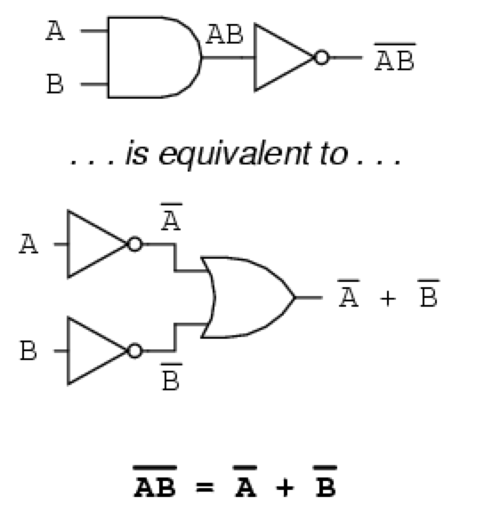
DeMorgan’s Law

Slide 10
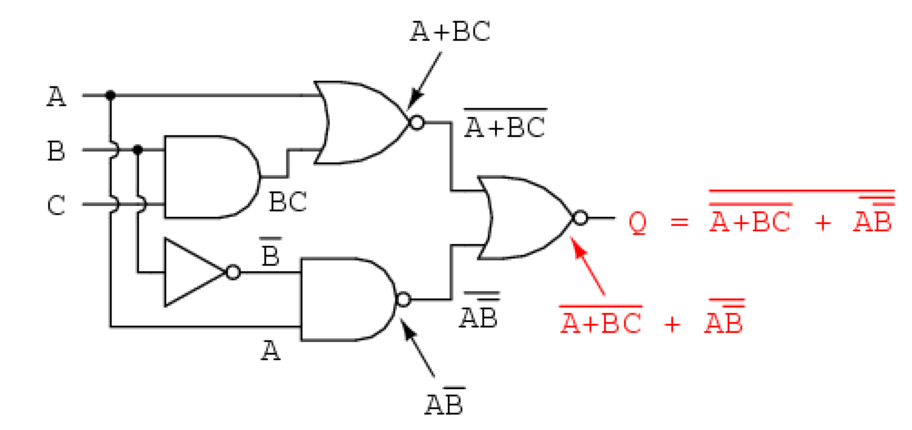
Boolean Simplification (two equivalent circuits)

Slide 11
Automated Theorem Proving
Deals with the development of computer programs that show that some statement is a logical consequence of a set of statements.

Slide 12
An example
Determine whether the following argument is valid.
She is a math major or cs major
If she doesn’t know discrete math, she is not a math major.
If she knows discrete math, she is smart.
She is not a cs major.
She is smart.

Slide 13
An example
p: She is a math major
q: She is a cs major
r : She knows discrete math
s : She is smart
p ∨ q is true
¬r ¬p is true
r s is true
¬q is true
Therefore, s

Slide 14
Logical Inference (section 2.11)
Suppose we know that the statement p q is true.
This tells us whenever p is true, q is true.
It does not tell us whether p or q is true. (They both could be false, or p is false and q is true.)
Suppose in addition we know that p is true.
In this case we can infer that q is true.
This is called logical inference.

Slide 15
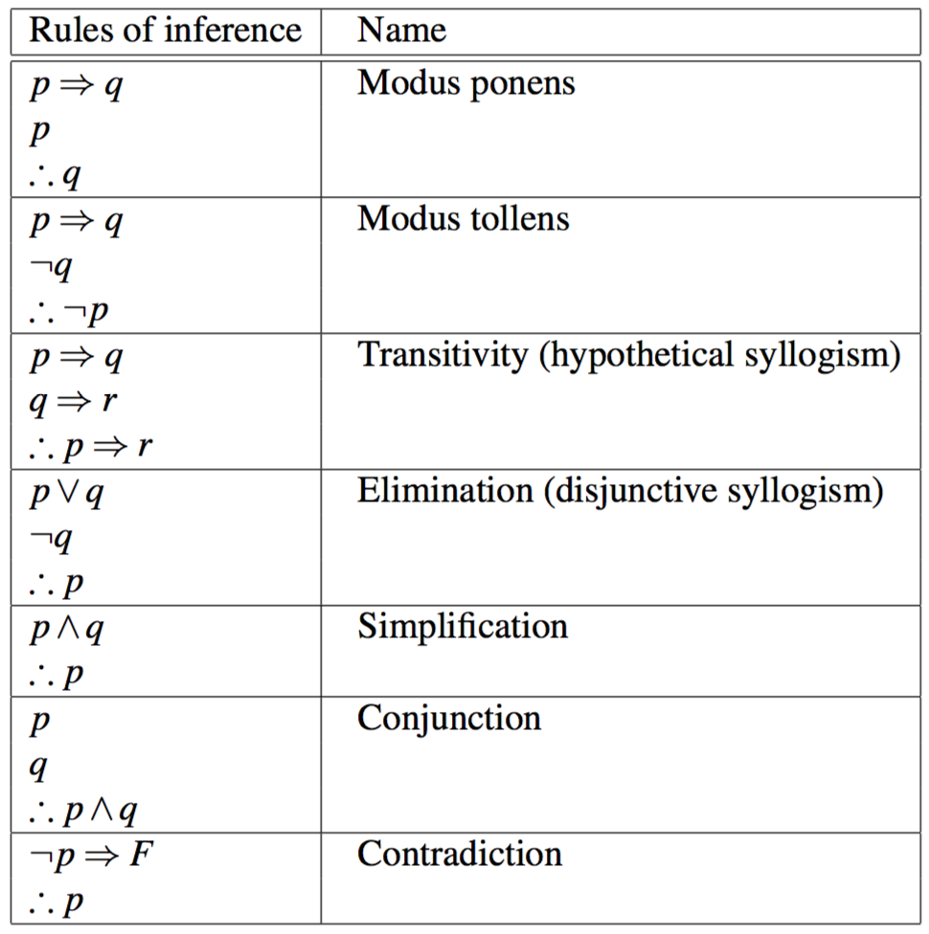
Rules of Inference

Slide 16
Theoretical Computer Science
Problem SAT (Satisfiability problem)
Given a formula involving n boolean variables, determine if it is possible to make the formula true by assigning truth values to the propositions.

Slide 17
Theoretical Computer Science
A Boolean variable is a variable that can have a value 1 or 0. Thus, Boolean variable is a proposition.
A term is a Boolean variable
A literal is a term or its negation
A clause is a disjunction of literals
A sentence in PL is a conjunction of clauses
Example of a formula
(a ∨ b ∨ ¬c ∨ ¬d) ∧ (¬b ∨ c) ∧ (¬a ∨ c ∨ d)
A formula is satisfiable iff
we can assign a truth value
to each Boolean variables
such that the sentence evaluates to true (i.e., holds)

Slide 18
Theoretical Computer Science
A Boolean variable is a variable that can have a value 1 or 0. Thus, Boolean variable is a proposition.
A term is a Boolean variable
A literal is a term or its negation
A clause is a disjunction of literals
A sentence in PL is a conjunction of clauses
Example of a formula
(a ∨ b ∨ ¬c ∨ ¬d) ∧ (¬b ∨ c) ∧ (¬a ∨ c ∨ d)
A formula is satisfiable iff
we can assign a truth value
to each Boolean variables
such that the sentence evaluates to true (i.e., holds)
This problem is extremely hard to solve

