Slide 1
File Input/Output

Slide 2
Data Types
Primary data type in MATLAB is the array or matrix.
  numeric
  Integer
  4 bytes/element: single
  8 bytes/element: double
  Floating point
  4 bytes/element: single
  8 bytes/element: double

Slide 3
Data Types
Primary data type in MATLAB is the array or matrix.
  logical A=[1 0 0 1] or A=[true false false true]
  1 byte/element
  character
  2 bytes/element

Slide 4
Characters and strings
H=‘binay’; % is stored as an array
H=[‘b’, ‘i’, ‘n’, ‘a’, ‘y’]; % each element is a character
length(H) = 5
H(4) % prints the character a
Each character uses 2 bytes (ASCII)
str2num(‘9’) will return numerical number 9.

Slide 5
Characters and strings
Character arrays
Q=[‘binay’; ‘john’; ‘bishnu’] will produce an error.
The number of characters in every string must be the same.
The correct way is
Q =[‘binay ‘; ‘john ‘; ‘bishnu’] will create 2-dimensional matrix of character type with 3 rows and 6 columns.

Slide 6
Reading and writings from files
Suppose that we have a file containing the student records.
The name of the file is ‘students.dat’
It is stored in the current directory

Slide 7
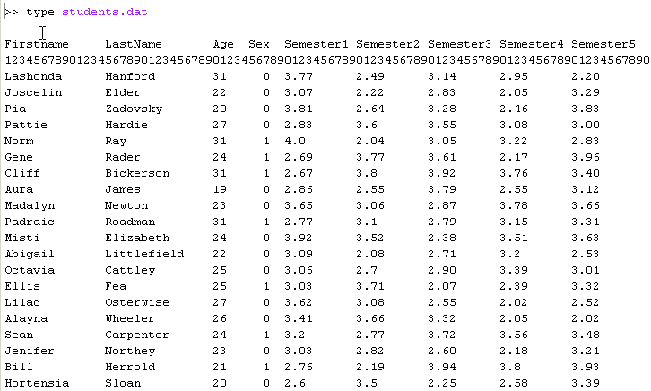
students.dat

Slide 8
students.dat
Each line (except the first two) contains a student record
  FirstName string columns 1-14
  LastName string columns 15-29
  Age integer columns 30-31
  Sex logical column 37
  Semester(1:5)numerical %f10.9f (5 times)

Slide 9
What is a file?
File:
  Contains information (data): text, audio, video, images, tables etc
  has attributes: filename, data, size, creation time, last modification time, owner (user-id) etc

Slide 10
File operations
(from programmers point of view)
File Read (Input from an existing file)
  reads line by line top down
  random reads
File Write (Output to a file)
  create a file and write data to it
  modify existing file (Re-write or append)
File Seek (Move the file pointer)
  rewind
File Identifiers are integers when a file is opened.

Slide 11
File Input/Output Functions in MATLAB
Operations:
  Open: Open a file (fopen)
  fid = fopen (filename, permission)
  where permission can be (‘r’ for reading the file; ‘w’ for writing on the file; ‘a’ for appending the file (create if necessary)
  If fopen cannot open the file, it returns -1
  Close: Close the file; prevent future access to this file
    fclose(fid)
  3. Input: Reading data from a file
  line_data=fgetl(fid)
  %Will read a line of the file. line_data is a character array

Slide 12
What is a File?
A specific organization of data
In matlab it is identified with a fid
Location is specified with a pointer that can be moved around
fid
file_name
Pointer

Slide 13
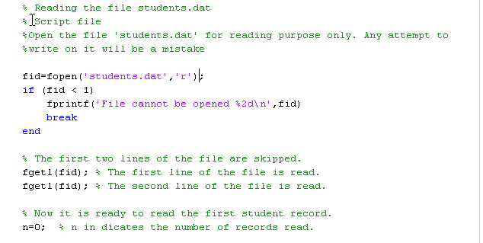
Reading the data file students.dat and printing them on the command window with last name first

Slide 14
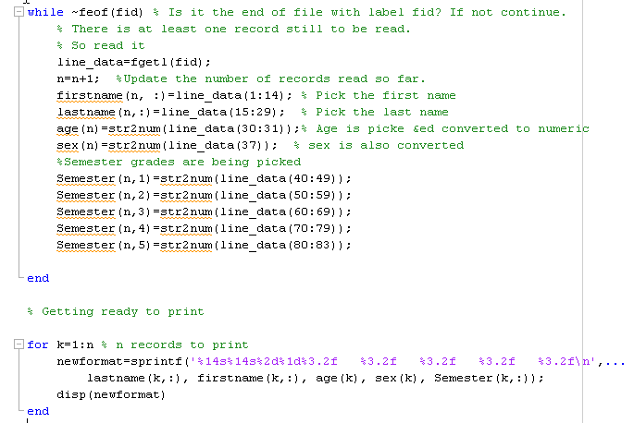
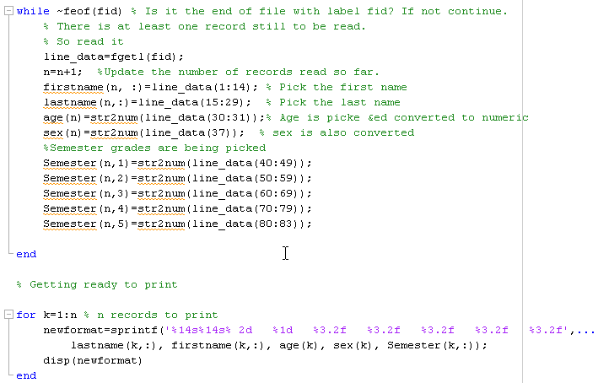

Slide 15
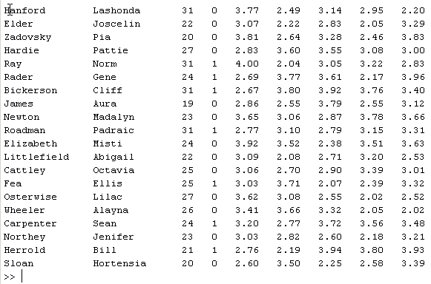
Output (on the terminal)

Slide 16
Would like to perform the following operations:
Compute the semester averages
Averages = mean(Semester’); % row vector
Averages = Averages’; % column vector
Sort the record by their averages
[Averages_sort, Index]=sortrows(Averages,-1);
Print the sorted records on to the file
fid=fopen(‘Output_file.dat’,’w’)
for k=1:n %n records to print
Next = Index(k); % Next largest element
% All printing is done on the same line
fprintf(fid,’%14s%14s ’, lastname(Next), firstname(Next));
fprintf(fid,’%3d %2d’, age(Next), sex(Next));
fprintf(fid,’%6.2f’,Semester(Next,:));
fprintf(fid’,%6.2f’, Averages(Next);
% Printing of the line is finished. Next printing will be in a new line.
fprintf(fid,’\n’);
end
fclose(fid);

