Slide 1
Chapter 11
Other kinds of Arrays

Slide 2
There are a variety of array types to store the data
MATLAB Array Types
Character Arrays
Logical Arrays
Numeric Arrays
Cell Arrays
Structure Arrays
Integer
Floating Point
single precision
double precision
single precision
double precision

Slide 3
There are a variety of array types to store the data
MATLAB Array Types
Character Arrays
Logical Arrays
Numeric Arrays
Cell Arrays
Structure Arrays
Most of these arrays can only hold information of one data type
Integer
Floating Point
signed integer
double integer
single precision
double precision
Cell and Structure arrays can store different types of data in the same array

Slide 4
Numeric Data Types
Numeric data is stored in numeric arrays
The default data type is double precision floating point
Every time you enter a number into MATLAB, the program assumes you’ve entered a double

Slide 5
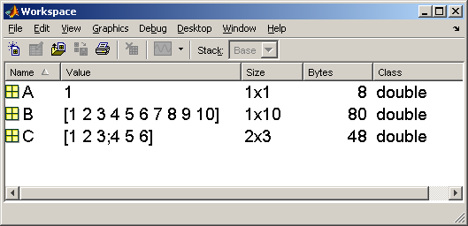
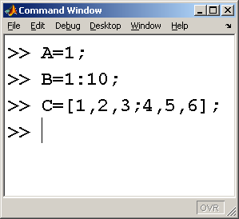
Each value in a double array needs 8 bytes of memory to store
There are 6 values in the C array – therefore it requires 6 x 8 = 48 bytes of memory

Slide 6
When would you use the short data type instead of double values?
In some numerical analysis applications you may be able to improve the run time of a long problem by changing from double to single precision
However, round off error becomes more of a problem.

Slide 7
Consider the harmonic series
Shorthand for the harmonic series
This series diverges -it just keeps getting bigger the more terms you add

Slide 8
For large numbers of steps the results are different using double and single data types
double
single

Slide 9
Character and String Data
Character arrays store character information
A character array is produced from a string

Slide 10
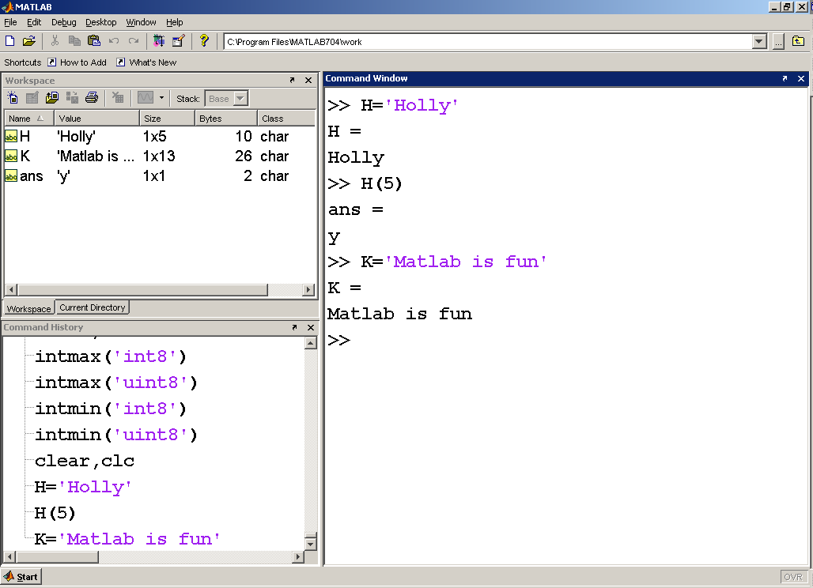
The ‘abc’ symbol indicates a character array
Spaces are characters too

Slide 11
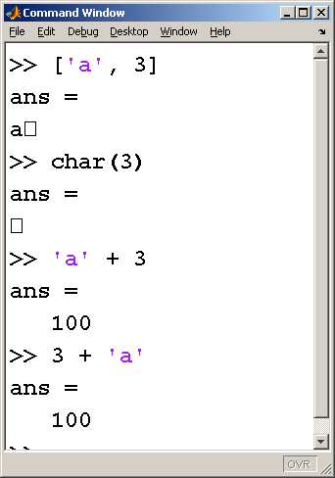
If you try to perform arithmetic with a combination of character and numeric data, MATLAB converts the character to its decimal equivalent
Remember that a has a decimal equivalent of 97

Slide 12
Logical Data Types
Logical data can have only one of two values
  True
  False
MATLAB uses
  0 to represent false and
  1 to represent true

Slide 13
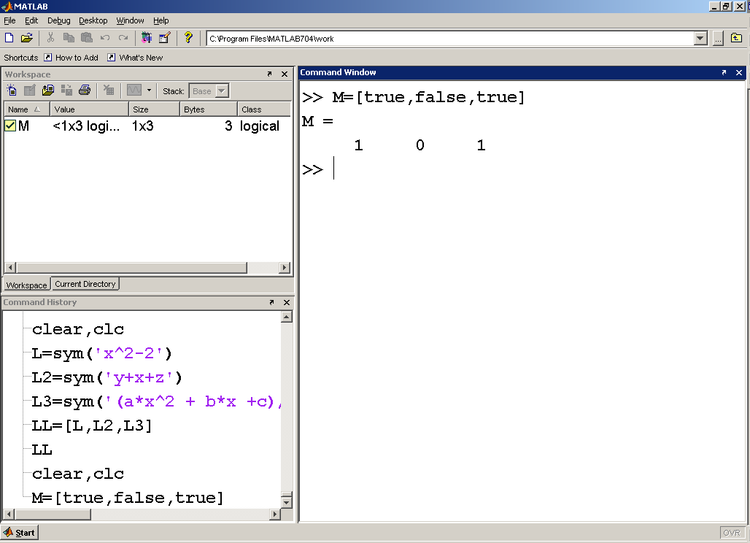
The check mark indicates a logical array
Although a logical array contains the information true and false, MATLAB represents it as 0 and 1

Slide 14
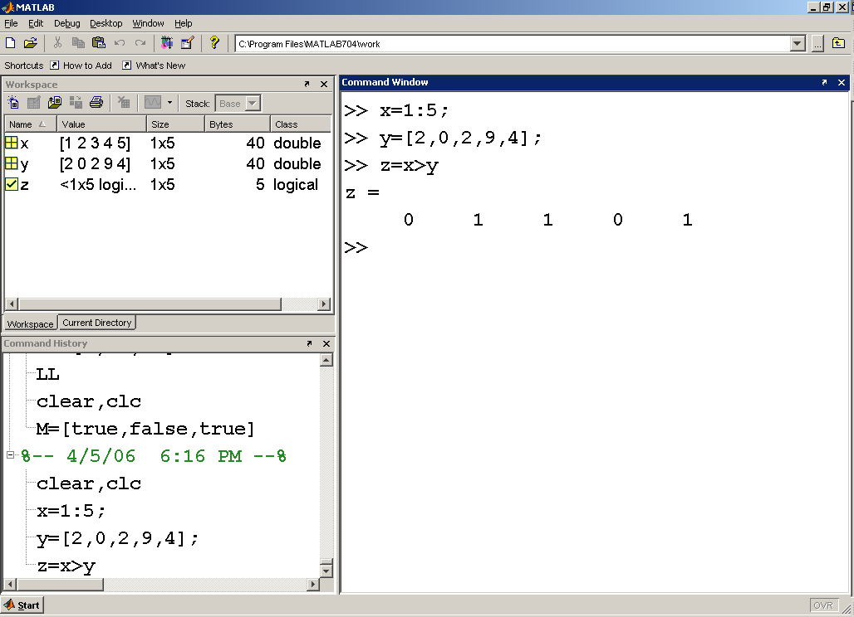
Notice that x and y are numeric arrays and z is a logical array
We can interpret this result to mean that x>y is false for elements 1 and 3, and true for elements 2,3 and 5

Slide 15
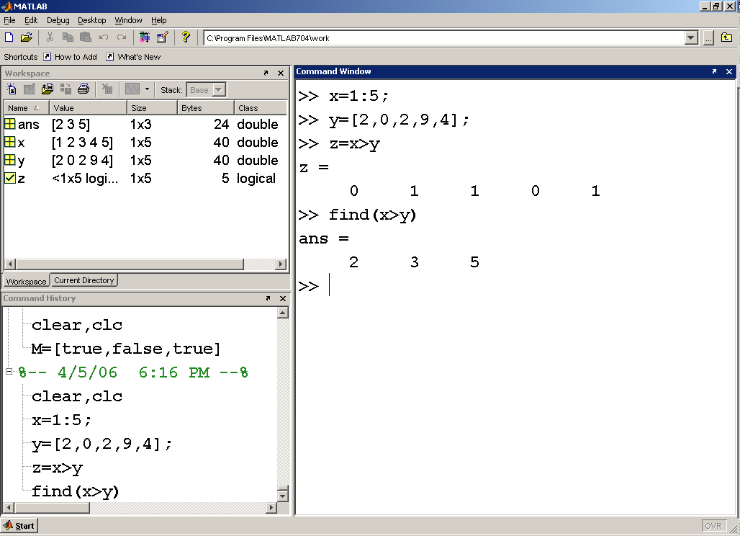
In this example the find command used the result of the comparison x>y to determine that elements 2, 3, and 4 met the criteria

Slide 16
Section 10.3
Creating Character Arrays
We can create two dimensional character arrays only if the number of elements in each row is the same

Slide 17
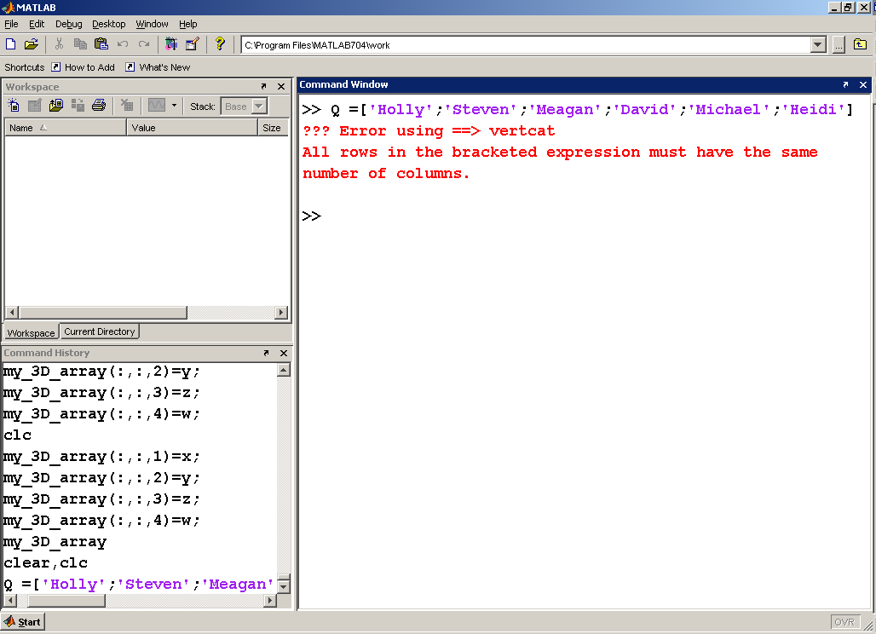
This statement doesn’t work, because the number of characters in each line is different

Slide 18
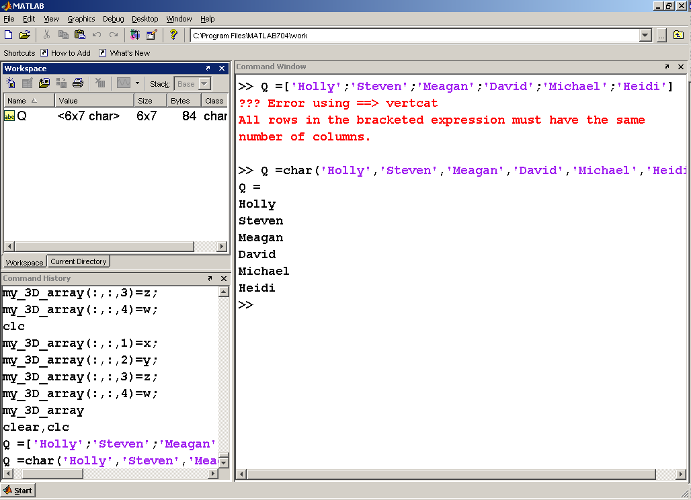
The char functions “pads” the array with blanks. Notice that the array size is 6 rows by 7 columns
Character arrays can store any of the characters defined in the ASCII coding scheme – including the symbols for numbers

Slide 19
Character arrays can only hold character data
We can take advantage of this to create tables that look like they include both character and numeric information, but really are composed of just characters
The number 1 is different from the character 1

Slide 20
Let’s combine an array of test scores and names
Test scores
  98
  84
  73
  88
  95
  100
Names
  Holly
  Steven
  Meagan
  David
  Michael
  Heidi
Numeric information
Character information

Slide 21
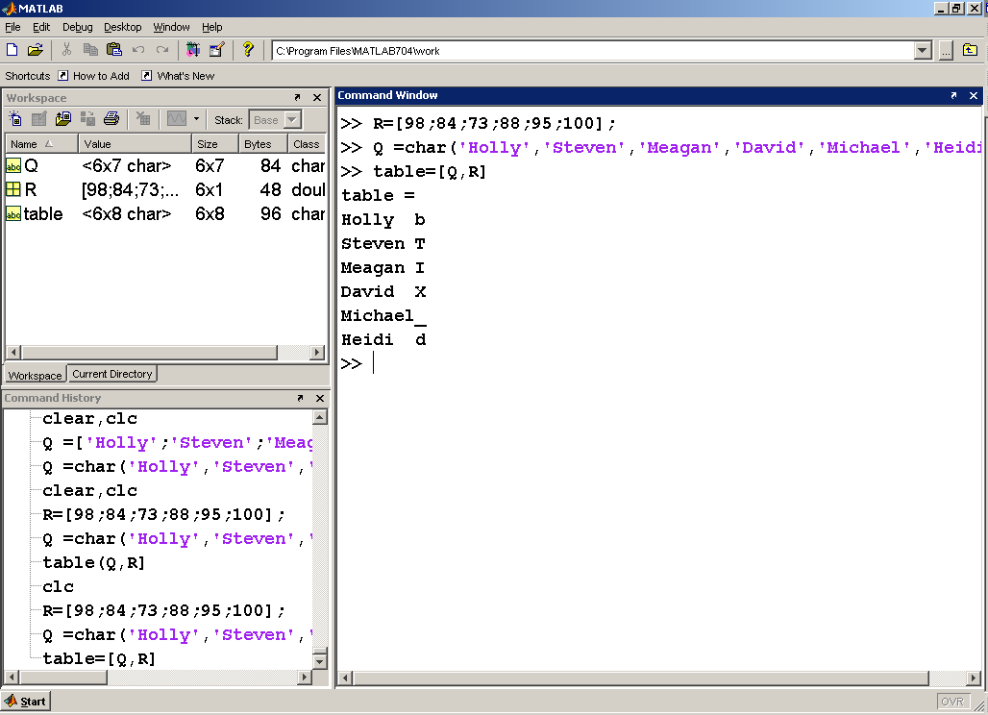
Notice that table is a character array
When we tried to store the two different data types into the same array, MATLAB interpreted the numbers as the ASCII equivalent of characters

Slide 22
In order to store the two different data types in the same array, we’ll need to convert the numbers into the corresponding characters
num2str

Slide 23
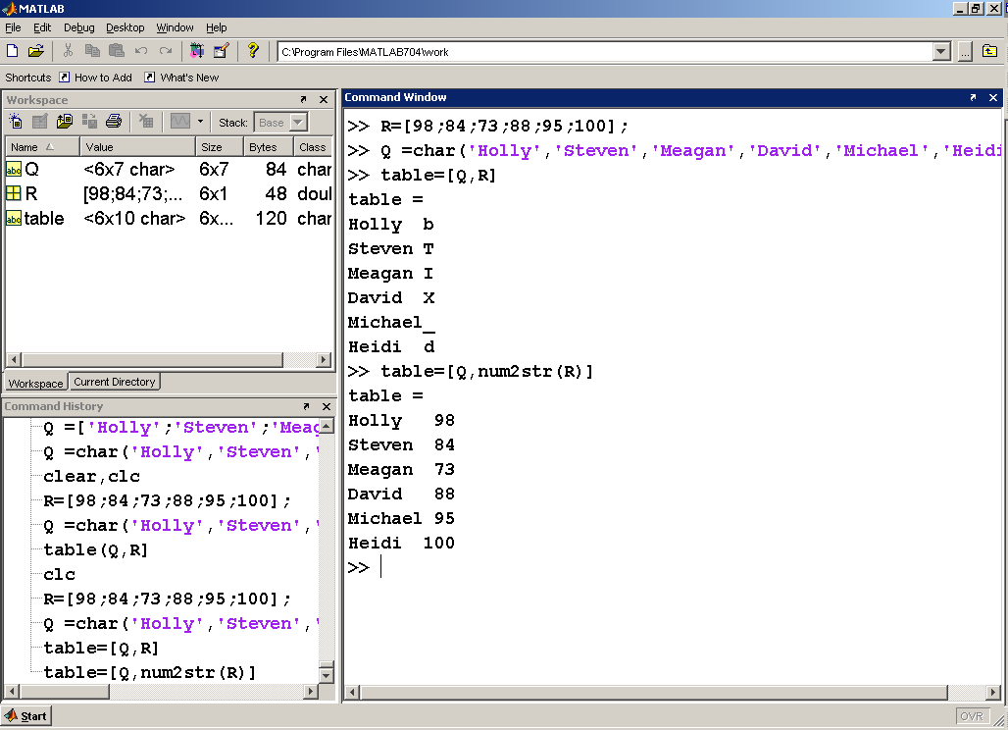
The num2str function converted the array of scores into the corresponding characters

Slide 24
Creation of file names
A useful application of character arrays and the num2str function is the creation of file names
There are occasions when you may want to save data into .dat or .mat files, but you don’t know ahead of time how many files will be required
my_data1.dat
my_data2.dat
my_data3.dat
Etc.

Slide 25
Sample problem
Load a file of unknown size called some_data
Create a number of new files, one for each column from the input file

Slide 26
For example
Output files
Data from input file
Data in File1
Data in File2
1 | 2 | 3
4 | 5 | 6
7 | 8 | 9
10 | 11 | 12
1
4
7
10
2
5
8
11
Data in File3
3
6
9
12

Slide 27
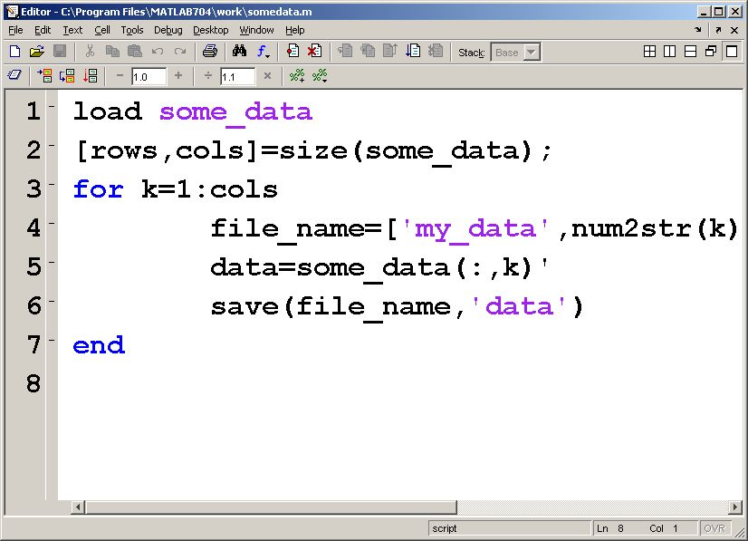
Load the input file
Determine the number of rows and columns
Extract the data
Save the data into the new files
Create the file names

Slide 28
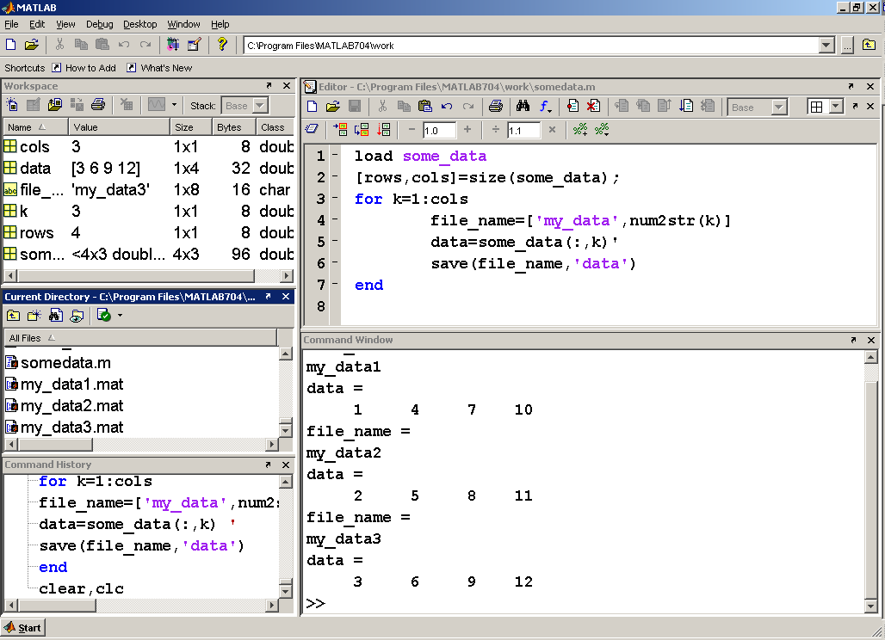

Slide 29
Section 10.4
Cell Arrays
The cell array can store different types of data inside the same array
Each element in the array is also an array

Slide 30
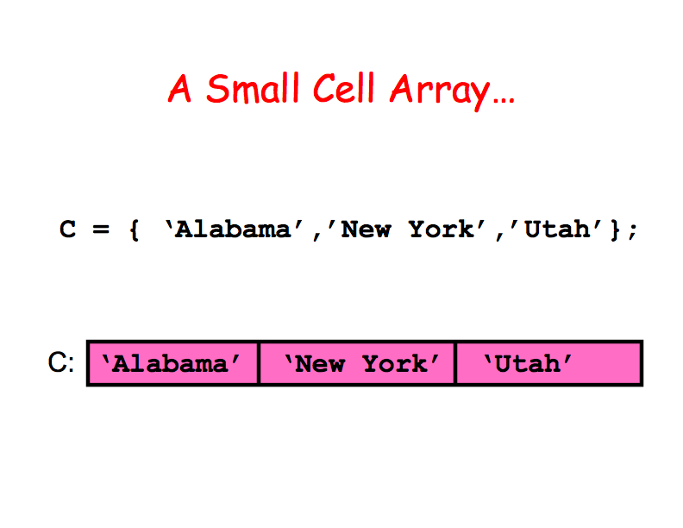

Slide 31
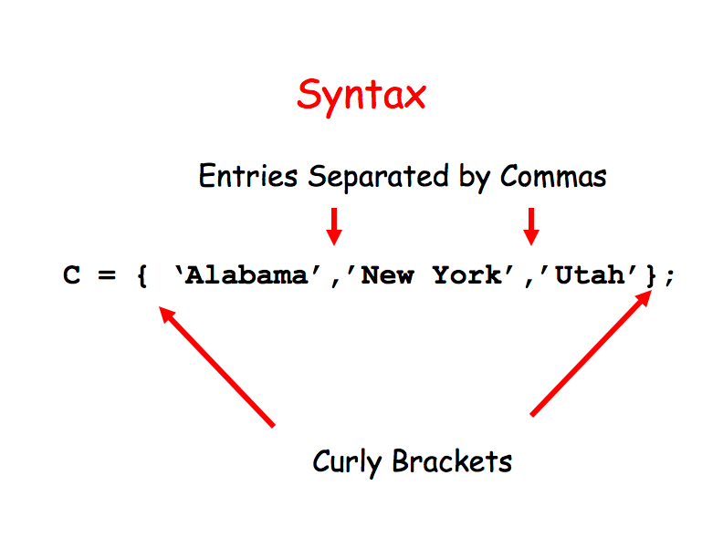

Slide 32
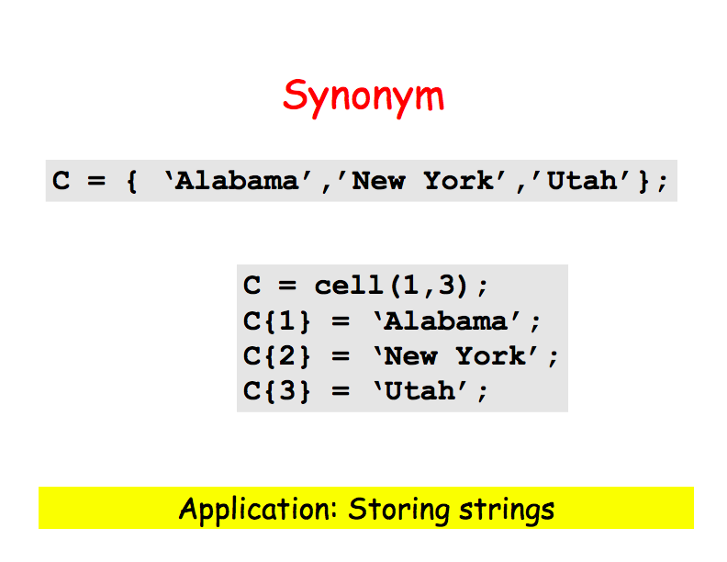

Slide 33
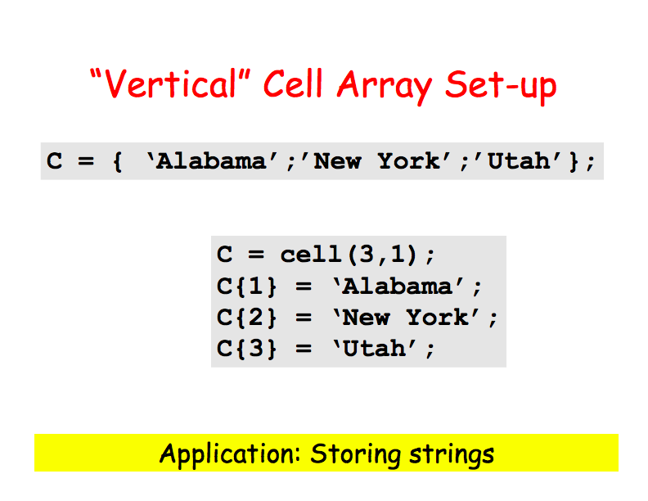

Slide 34
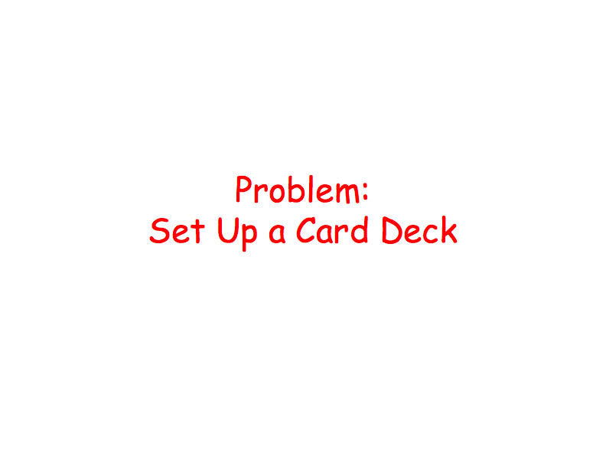

Slide 35
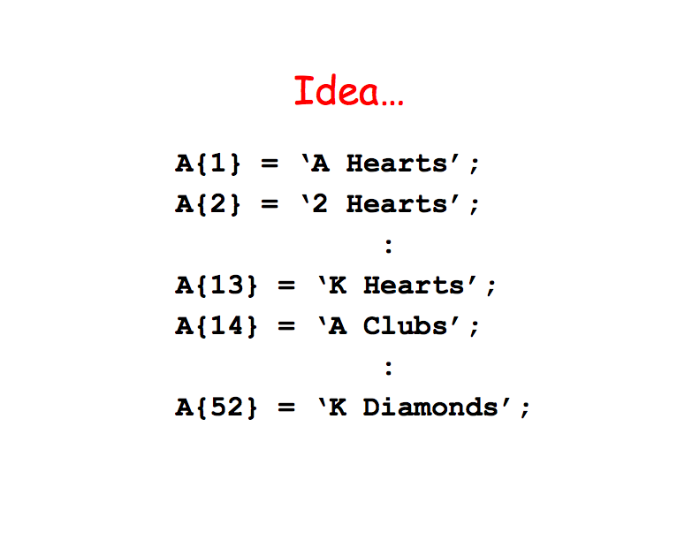

Slide 36
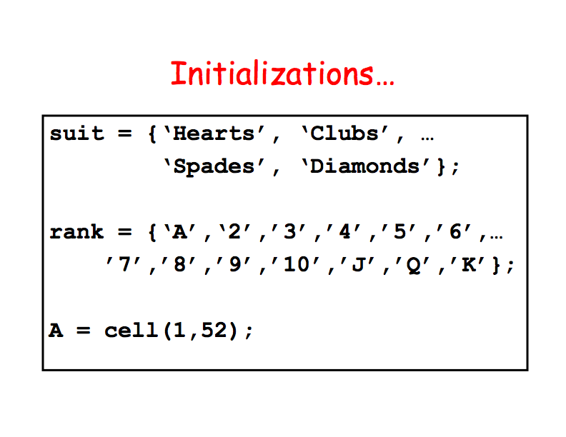

Slide 37
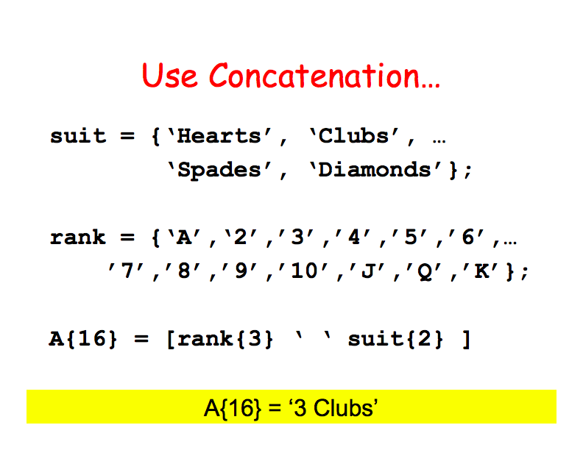

Slide 38
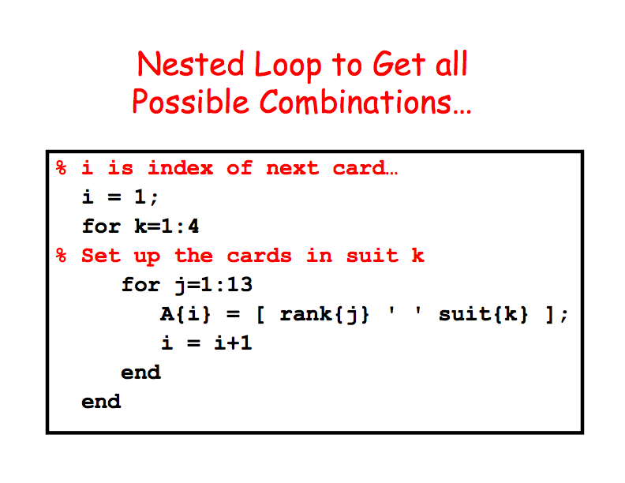

Slide 39


Slide 40
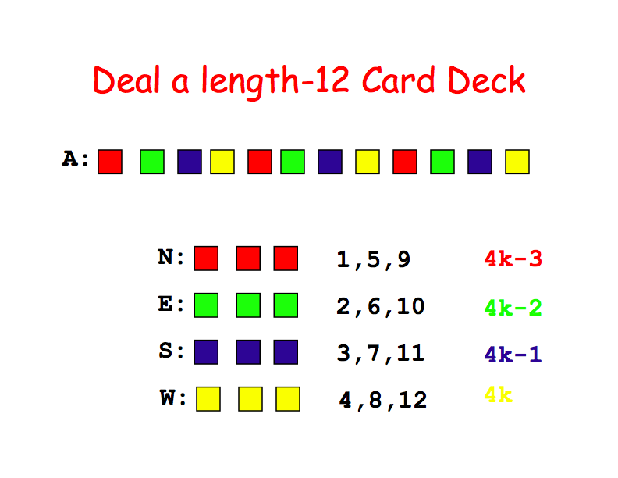

Slide 41
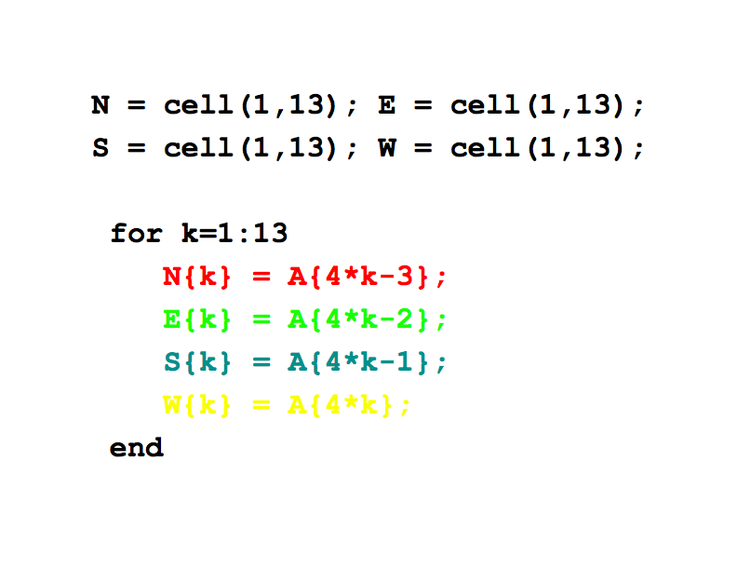

Slide 42
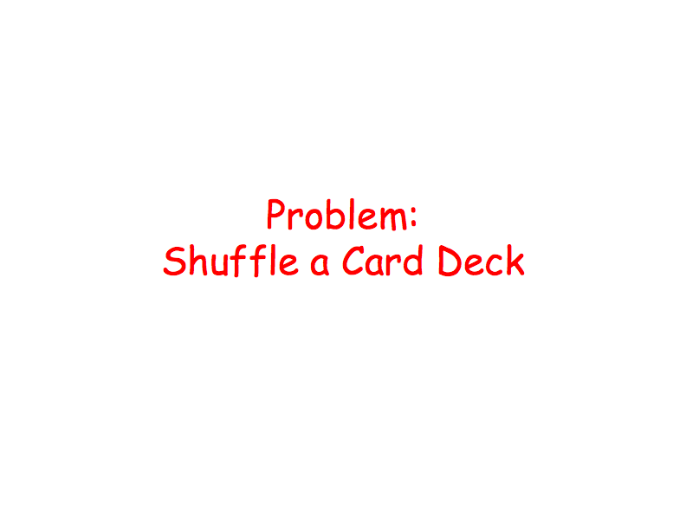

Slide 43
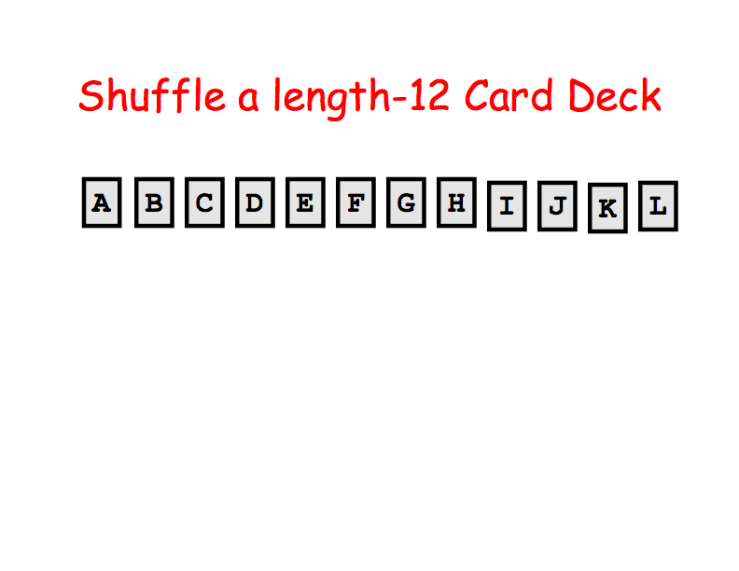

Slide 44
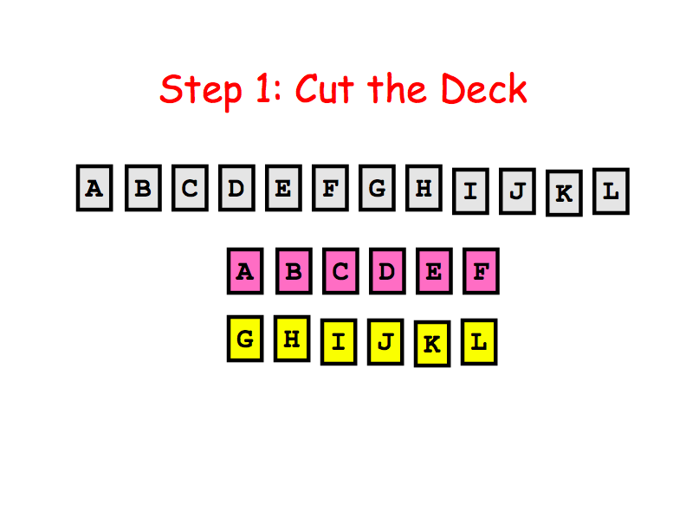

Slide 45
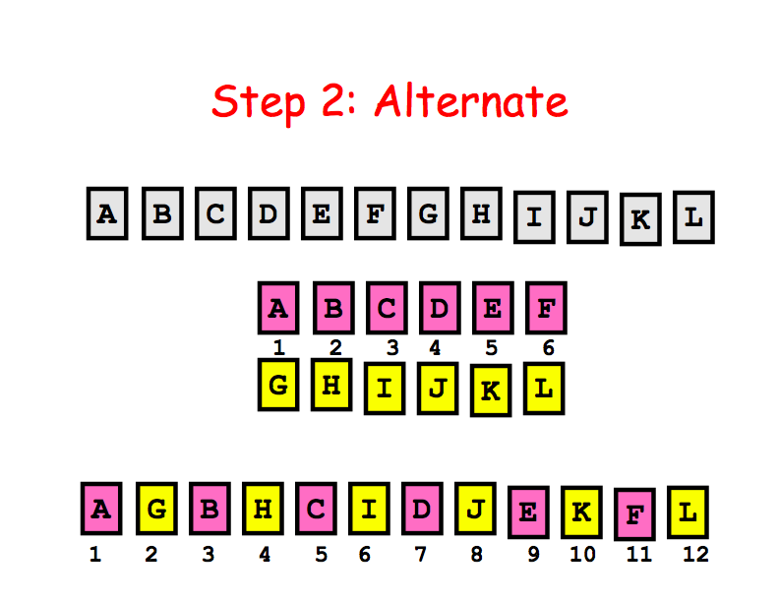

Slide 46
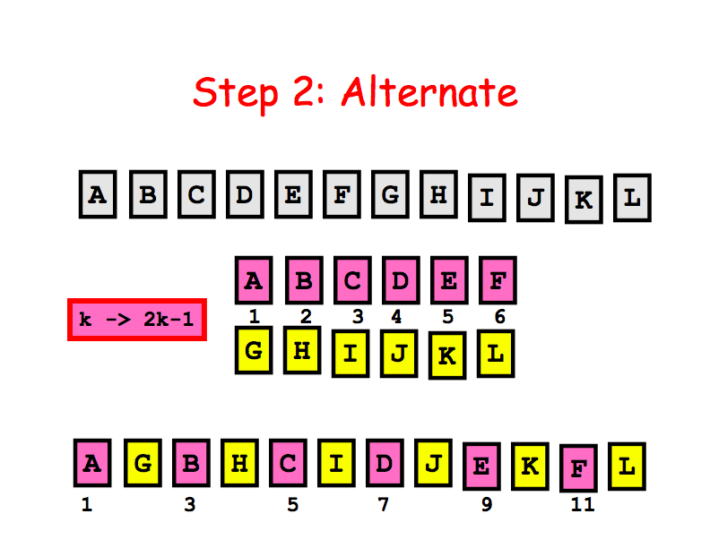

Slide 47
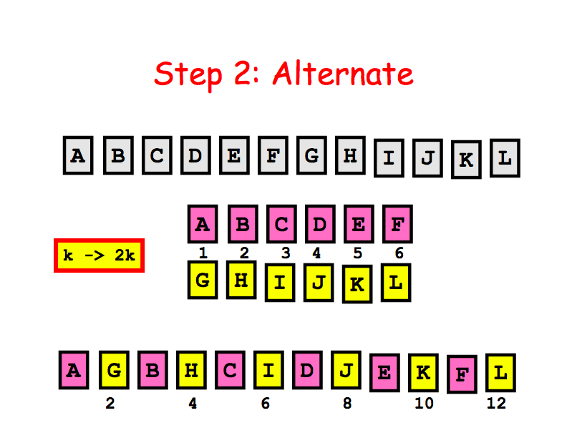

Slide 48
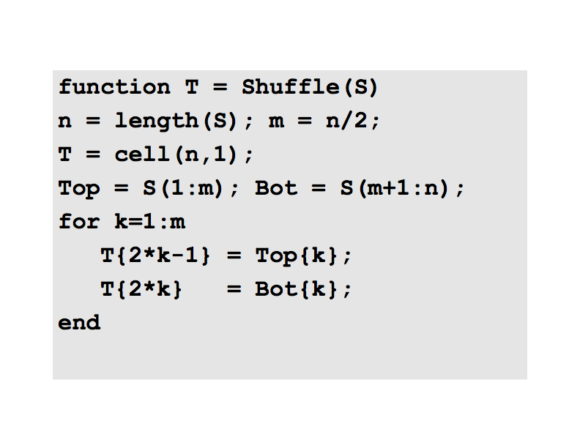

Slide 49
Top=S{1:m}; Bot=S{m+1:m}; also work

Slide 50
An Example

Slide 51
Read the file ‘students.dat’ and store the lines in a cell array.
function C=file2cell(fName)
% reads the lines from file fName
fid=fopen(fName,’r’);
% First two lines are read and discarded
fgetl(fid); % line 1
fgetl(fid); % line 2
lineNumber=1; % First data line
while ~feof(fid)
s=fgetl(fid);
C{lineNumber}=s;
lineNumber=lineNumber+1; %next line index
end
fclose(fid);

Slide 52
Extract the information on each line and store them in arrays. (Structure data types are used for elegance)
function StudentData=extract(C)
% Extracting information in cell array C.
for i=1:length(C)
StudentData(i).Firstname=C{i}(1:10); %first 10 characters contains Firstname
StudentData(i).Lastname=C{i}(15:24); % Lastname is extracted
StudentData(i).Age=str2num(C{i}(30:31)); %Age is extracted and converted to numeric
StudentData(i).Sex=str2num(C{i}(37)); % Sex field
StudentData(i).Grade(1)=str2num(C{i}(40:43)); %Grades are picked & convertedd
StudentData(i).Grade(2)=str2num(C{i}(50:53));
StudentData(i).Grade(3)=str2num(C{i}(60:63));
StudentData(i).Grade(4)=str2num(C{i}(70:73));
StudentData(i).Grade(5)=str2num(C{i}(80:end));
end

Slide 53
Remove every 8th record from the student data.
function NewC=Delete(C)
% Removing every 8th record. Three new records are added.
N=length(StudentData);
newCount=1; % line count of the reduced data
for i=1:N % line count of the current data
if rem(i,8) ~= 0 % if it is not the 8th record, copy. NewC{newCount}=C{i};
newCount=newCount+1;
end
end

Slide 54
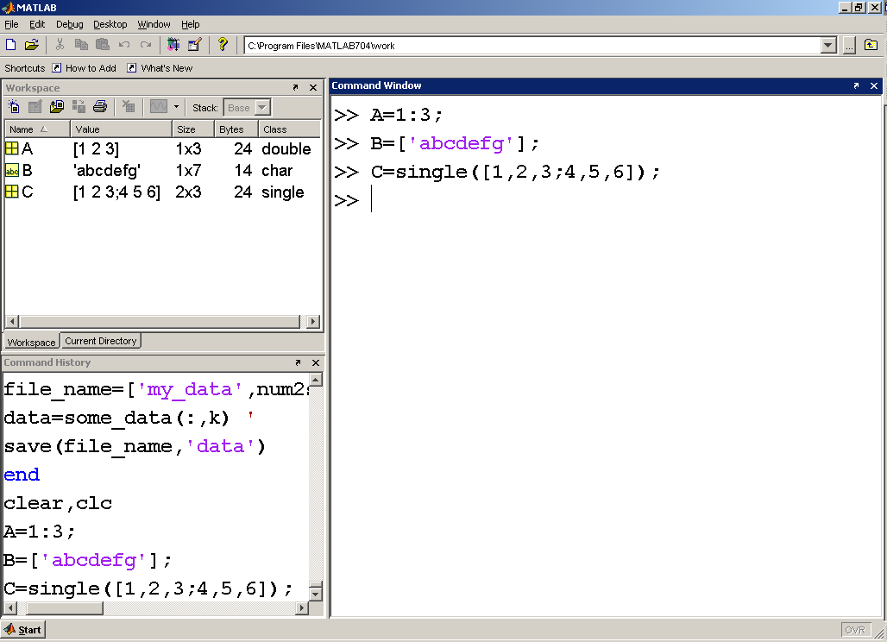
These three arrays all store different data types

Slide 55
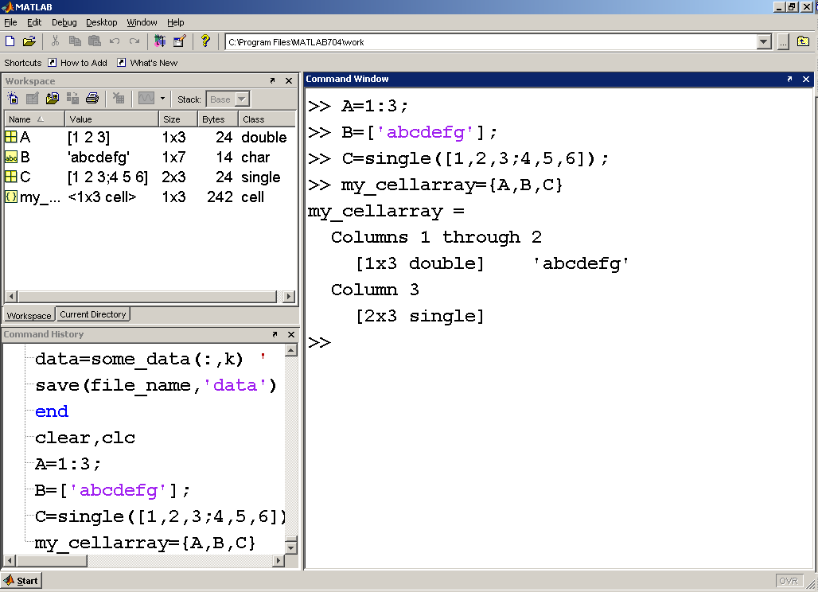
Create a cell array using curly braces

Slide 56
The indexing system used for cell arrays is the same as that used in other arrays.
You may either use a single index, or a row and column indexing scheme.
There are two approaches to retrieving information from cell arrays.
  Parentheses – results in a description
  Curly braces – results in the values

Slide 57
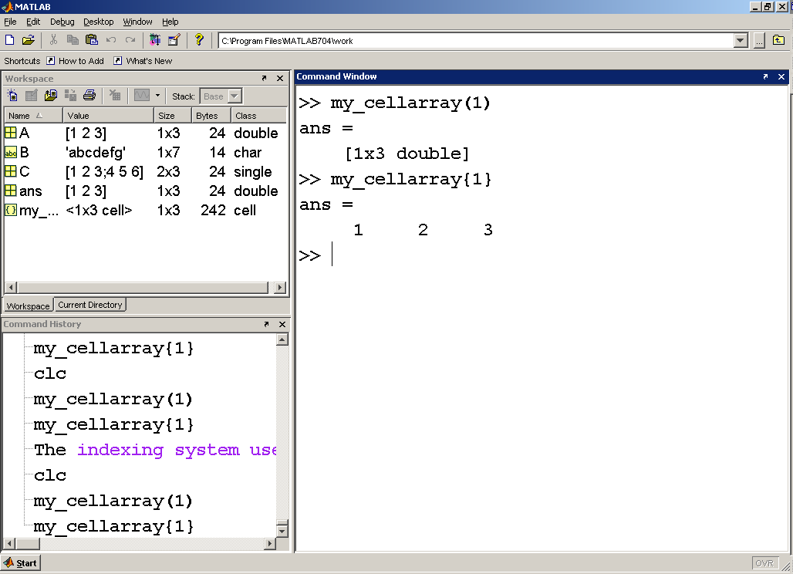

Slide 58
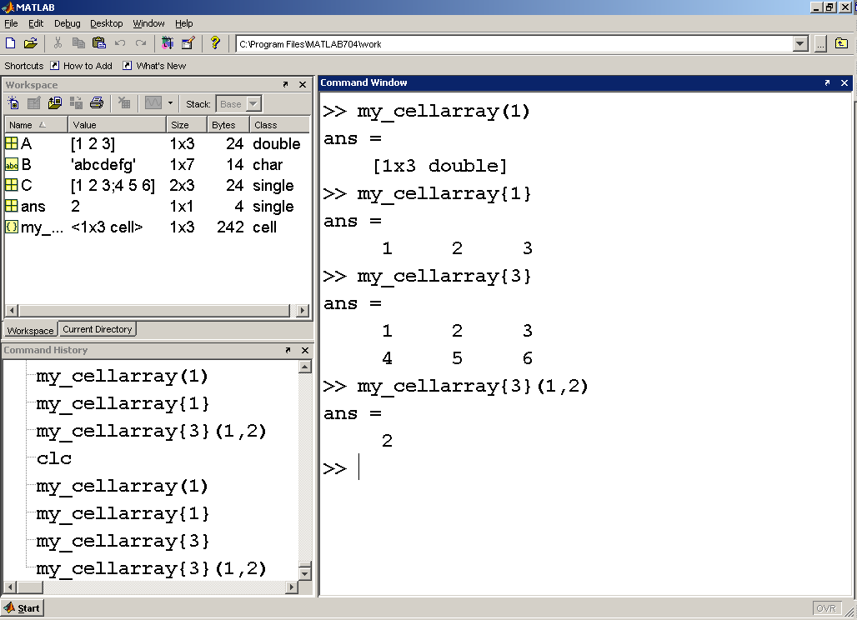
To access a particular element inside an array stored in a cell array, you must use a combination of curly brackets and parentheses

Slide 59
Section 10.5
Structure Arrays
Similar to Cell Arrays
Multiple arrays of differing data types can be stored in structure arrays
Instead of using content indexing each of the matrices is given a location called a field

Slide 60
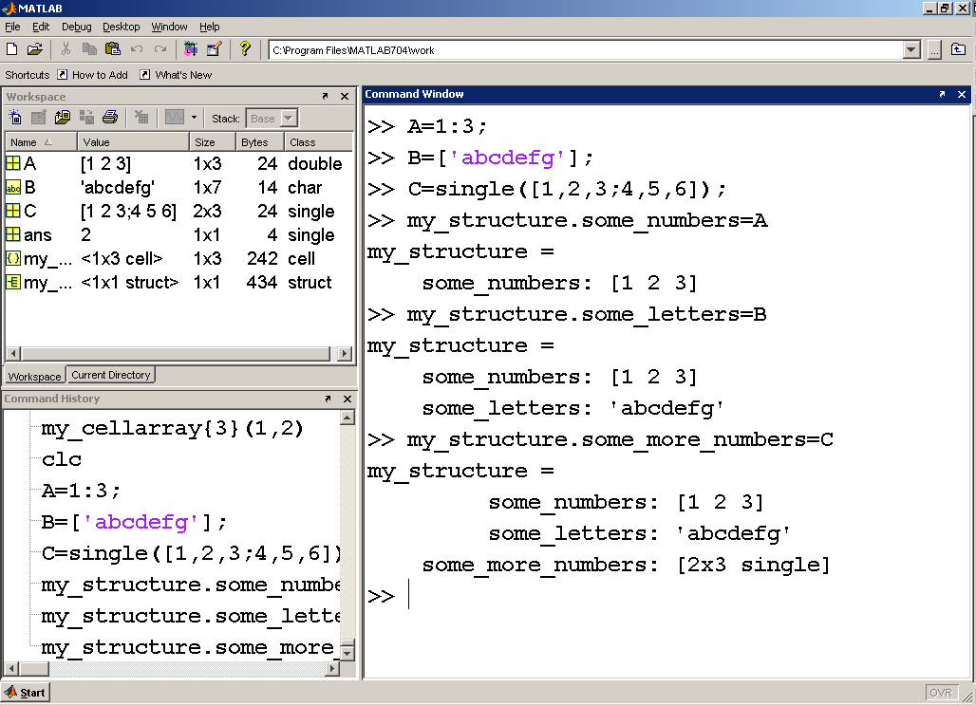
This is still a 1x1 structure array – however it has three fields
This structure array (struct) contains three fields

Slide 61
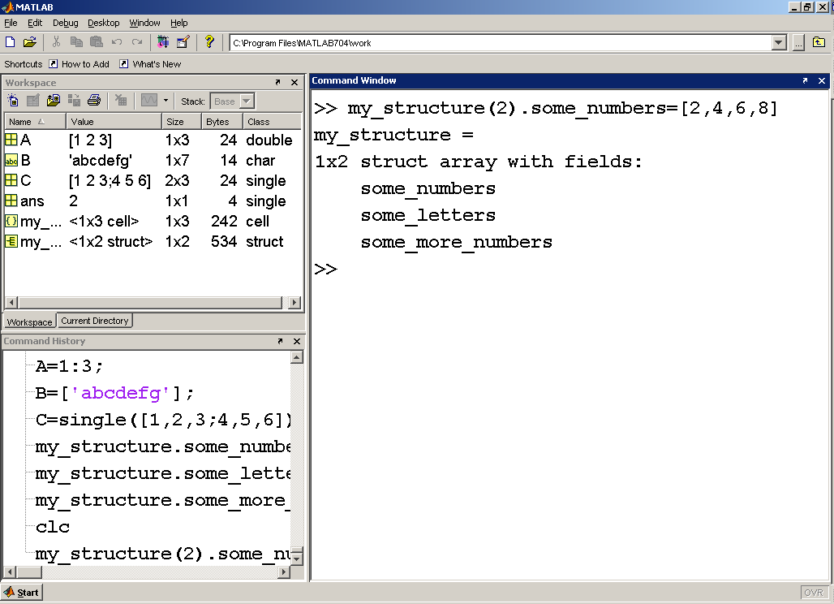
We can add more content to the structure, and expand its size, by adding more matrices to the fields we’ve defined.

Slide 62
You can access the information using…
Matrix name
Field name
Index numbers

Slide 63
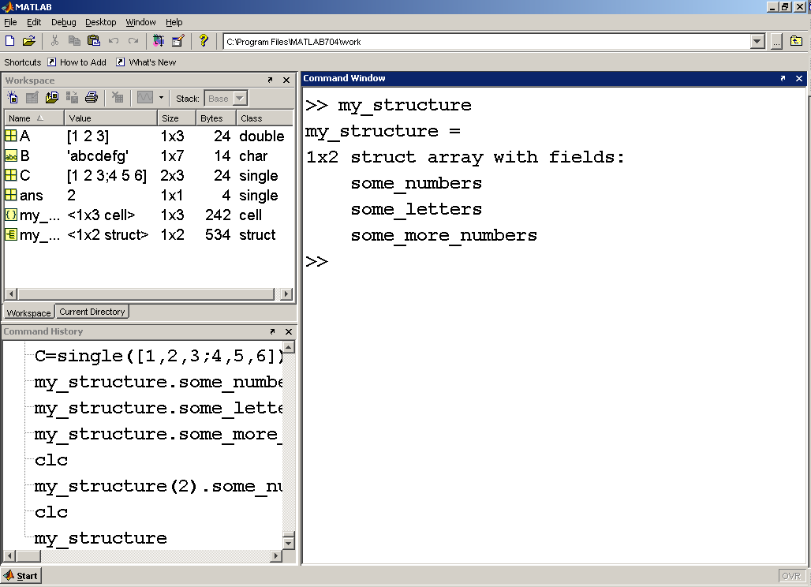
Just calling the matrix name returns a description of the array

Slide 64
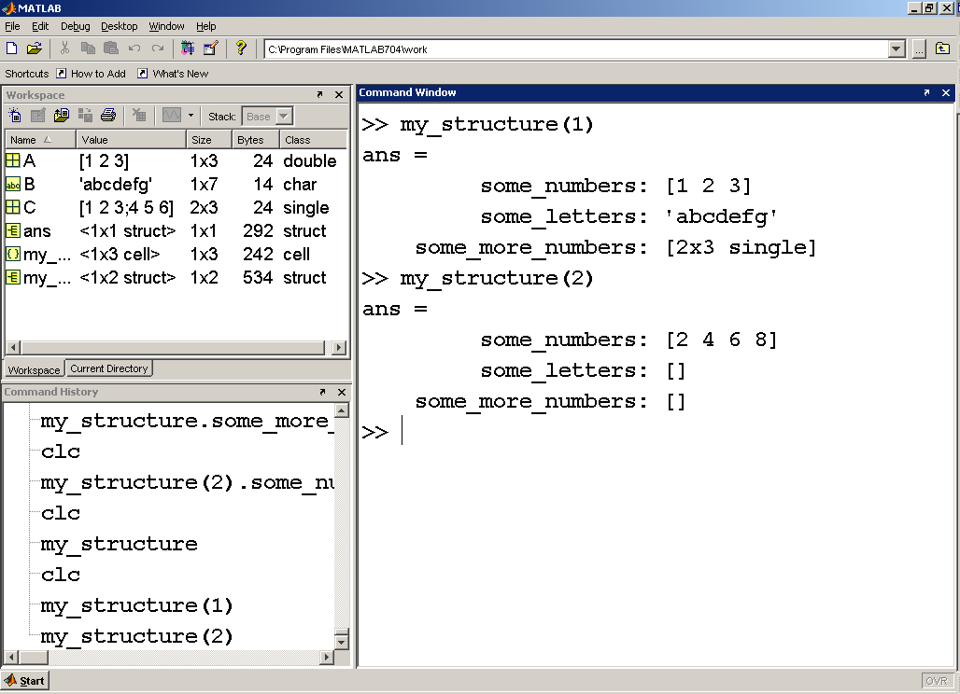
You can access the actual arrays you’ve stored in the structure by using an index number to identify which set of data you’re interested in

Slide 65
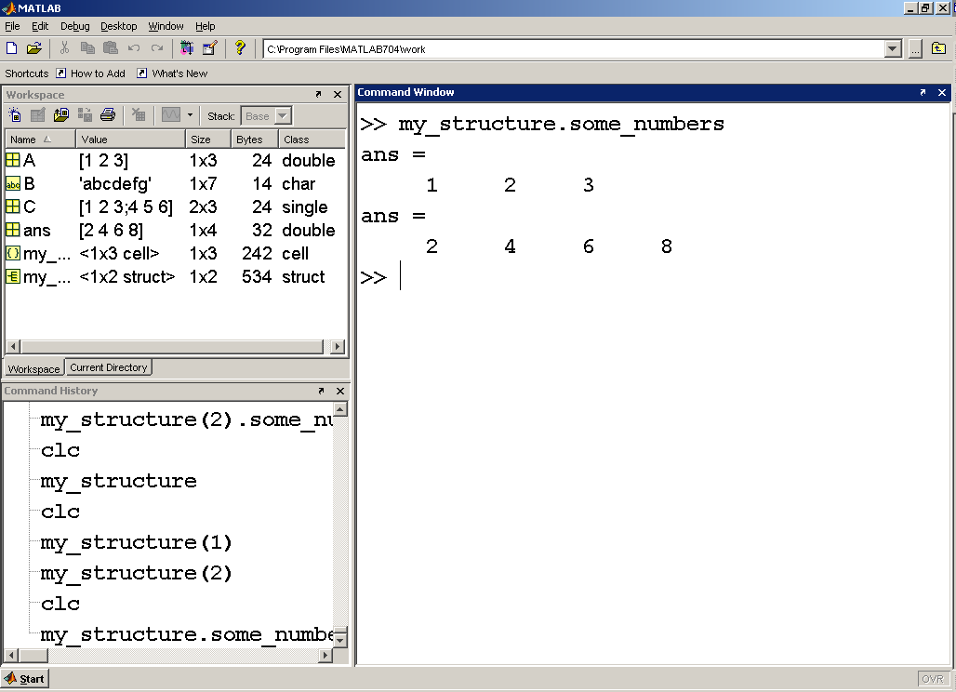
You can use the field name to access just the data in certain fields. This example returns the arrays in the first field of each member of the structure

Slide 66
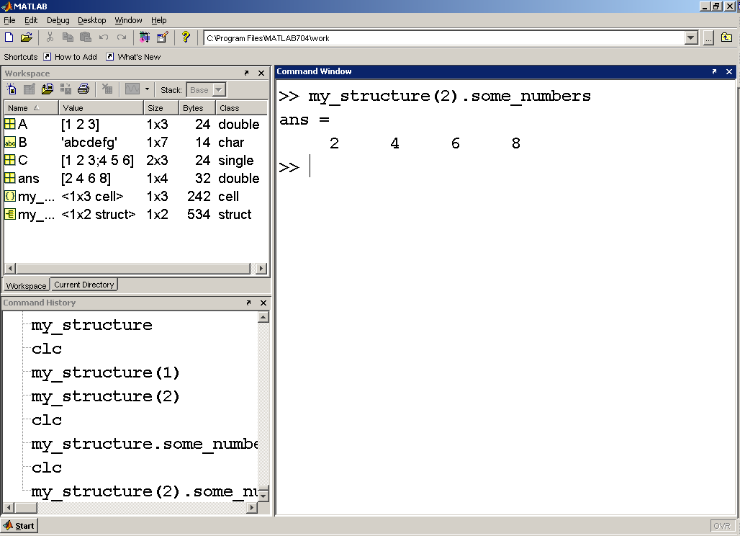
Combining an index number and the field name allows you to access one particular array

Slide 67
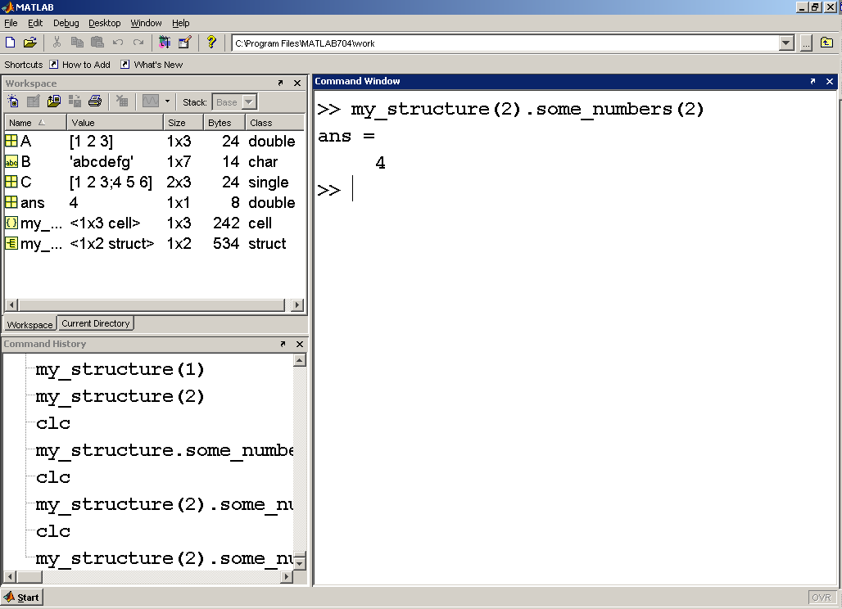
Finally, if you want to know the content of one particular element in a field you must specify the element index number after the field name.

Slide 68
Summary
MATLAB’s primary data structure is the array
MATLAB supports a number of different array types, each of which can store a particular type of data
Cell and structure arrays can store more than one data type in the same array

