Slide 1
Logical Functions and Control Structures
Chapter 8

Slide 2
Acknowledgement
Some slides are taken from
www.cs.cornell.edu/courses/cs100m/2007fa

Slide 3
Structures
Sequence
Selection
Repetition
Sequence
Selection
Repetition (Loop)

Slide 4
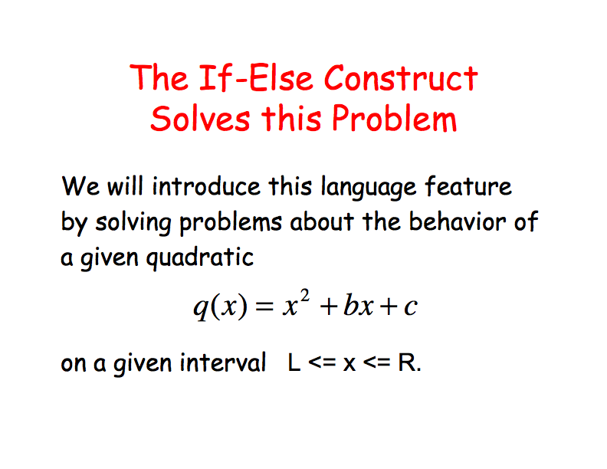

Slide 5
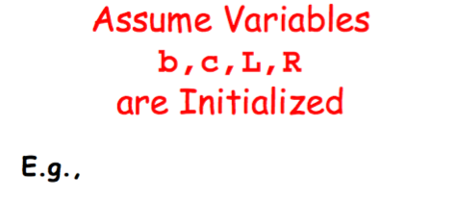
b = input(‘Enter b:’)
c = input(‘Enter c:’)
L = input(‘Enter L:’)
R= input(‘Enter R:’)

Slide 6
Problem 1
Write a function that accepts b, c, L and R and prints “yes” if the quadratic function increases across the interval and “no” if it does not.

Slide 7
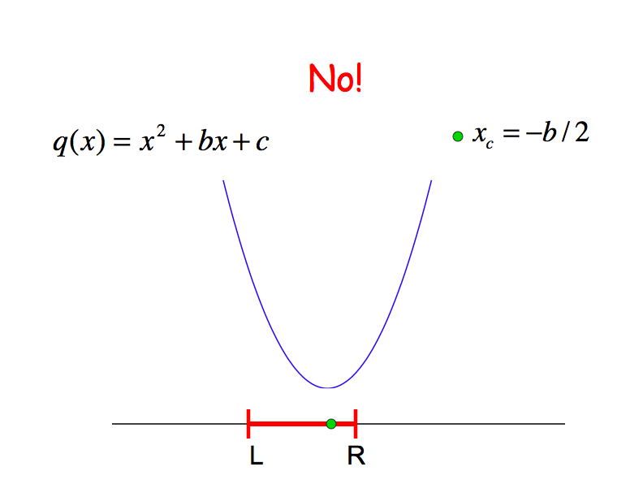

Slide 8
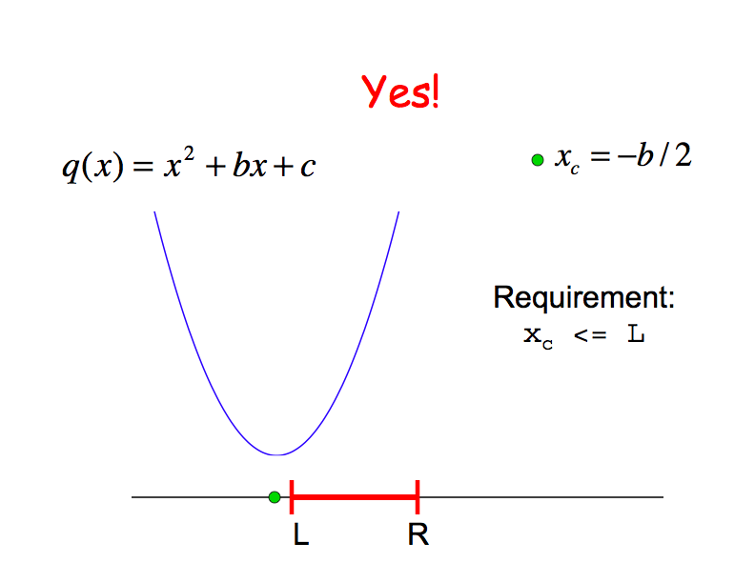

Slide 9
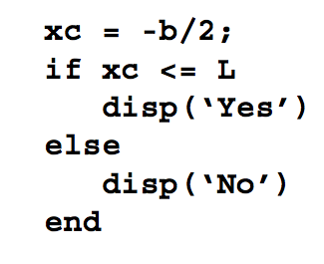
Function Fragment
function Problem1(b,c,L,R)

Slide 10
Problem 2
Write a function that accepts b, c, L and R and prints the maximum value that the quadratic function q(x)=x² + bx +c on the interval L <= x <= R.

Slide 11
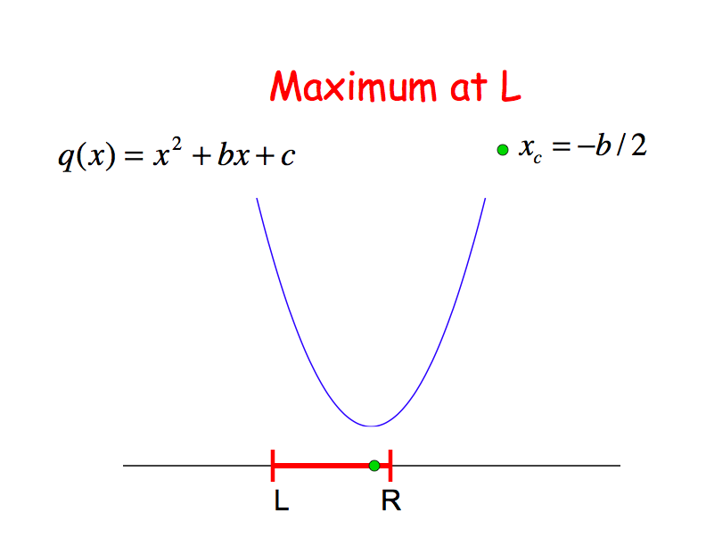

Slide 12
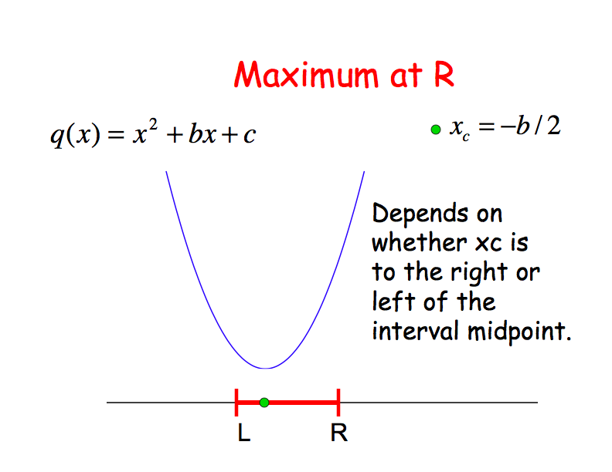

Slide 13
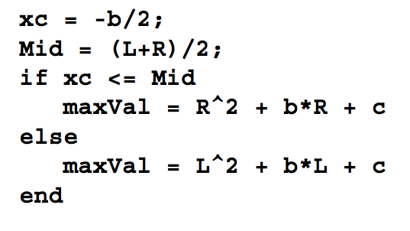
Function Fragment
function maxVal = Problem2(b,c,L,R)

Slide 14
Problem 3
Write a function that accepts b, c, L and R and prints “yes” if xc is in the interval and “no” if xc is not in the interval.

Slide 15
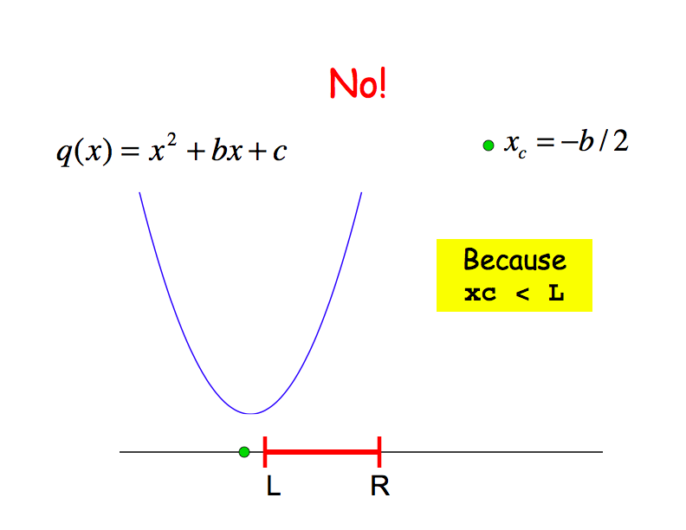

Slide 16
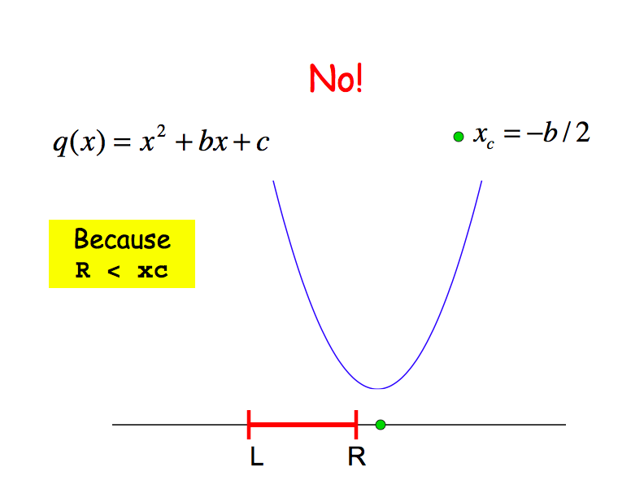

Slide 17
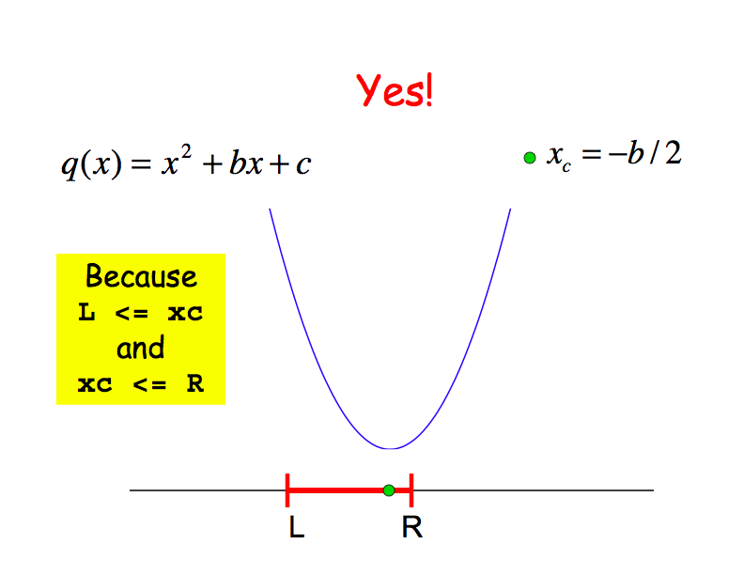

Slide 18
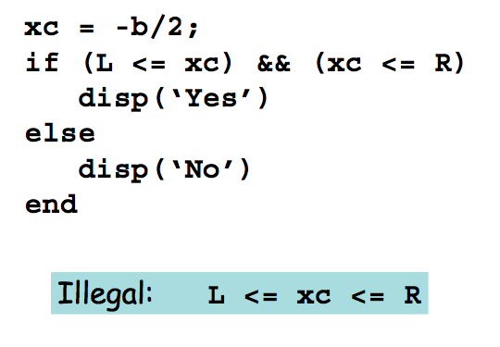
Function Fragment
function Problem3(b,c,L,R)

Slide 19
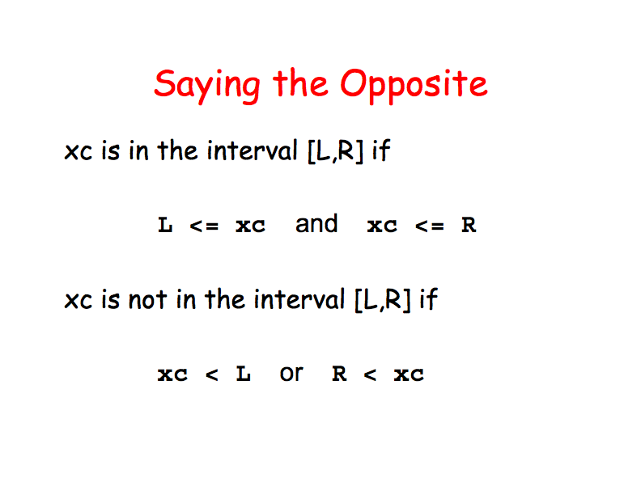

Slide 20
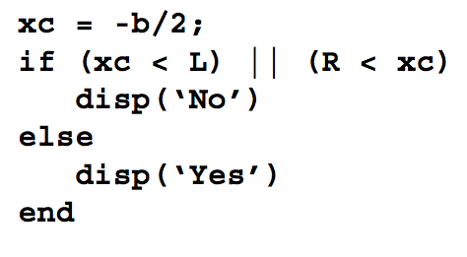
Another Function Fragment
function Problem3(b,c,L,R)

Slide 21
Relational Operators
< Less than
<= Less than or equal to
> Greater than
>= Greater than or equal to
== Equal to
~= Not equal to

Slide 22
Logical Operators
& and
~ not
| or
xor exclusive or

Slide 23
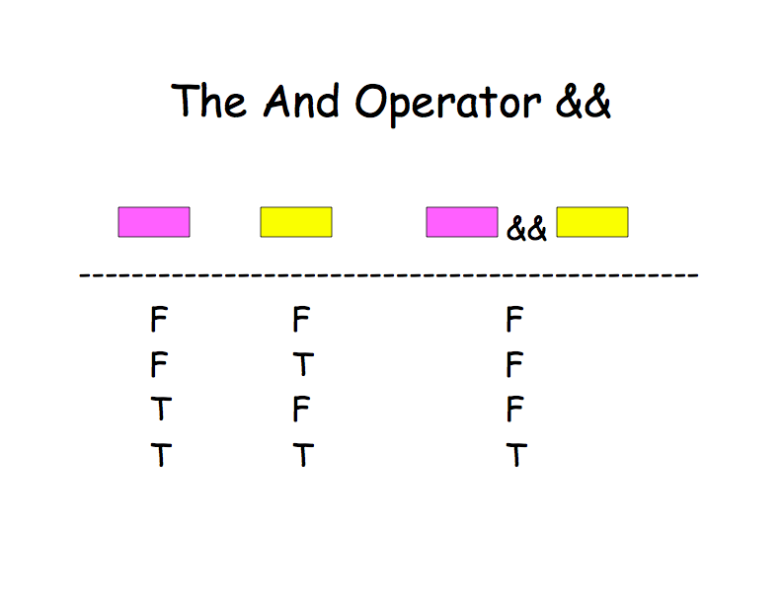

Slide 24
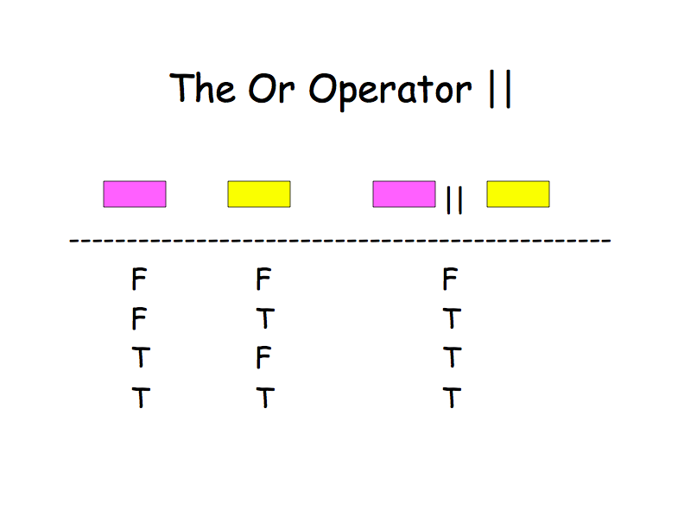

Slide 25
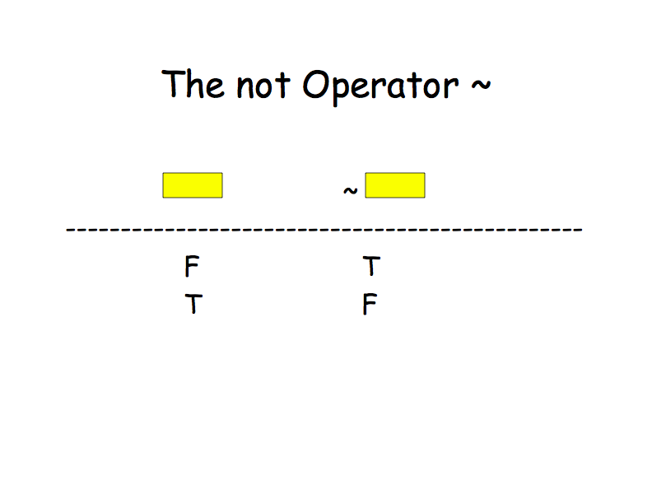

Slide 26
Pseudo-code Example
You’ve been asked to create a program to convert miles/hr to ft/s. The output should be a table, complete with title and column headings

Slide 27
Outline the steps
Define a vector of mph values
Convert mph to ft/s
Combine the mph and ft/s vectors into a matrix
Create a table title
Create column headings
Display the table

Slide 28
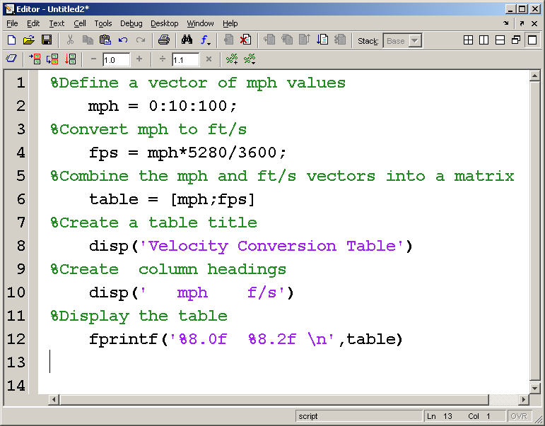
Insert the MATLAB code between the comments

Slide 29
Flow Charting
Create a big picture graphically
Convert to pseudo-code

Slide 30
Start
Define a vector of miles/hour
Calculate the ft/sec vector
This flowchart represents the mph to ft/s problem
Combine into a table
Create an output table using disp and fprintf
End

Slide 31
Simple Flow Chart Symbols
An oval indicates the beginning of a section of code
A parallelogram indicates an input or output
A diamond indicates a decision point
Calculations are placed in rectangles

Slide 32
Another Example
Naval Academy requires applicants to be at least 5’6” tall
Consider this list of applicant heights
63”, 67”, 65”, 72”, 69”, 78”, 75”
Which applicants meet the criteria?

Slide 33
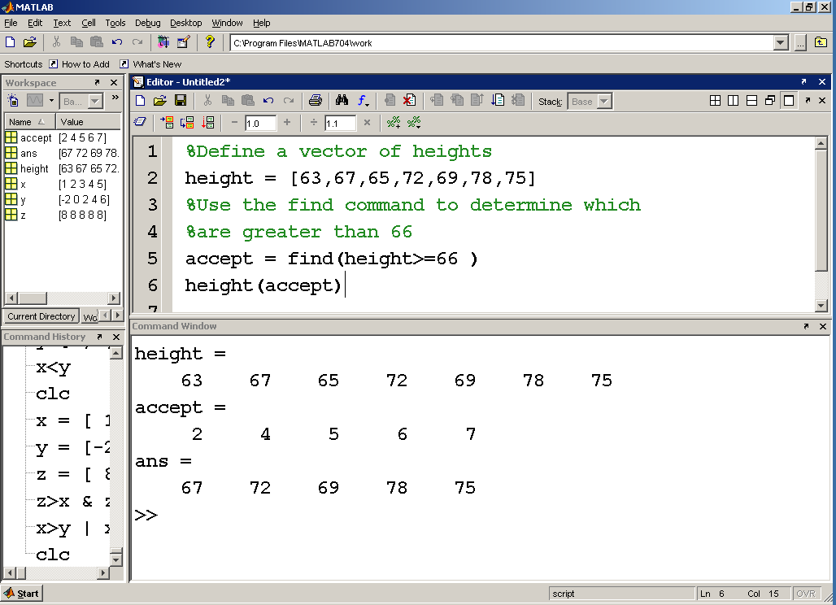
index numbers
element values

Slide 34
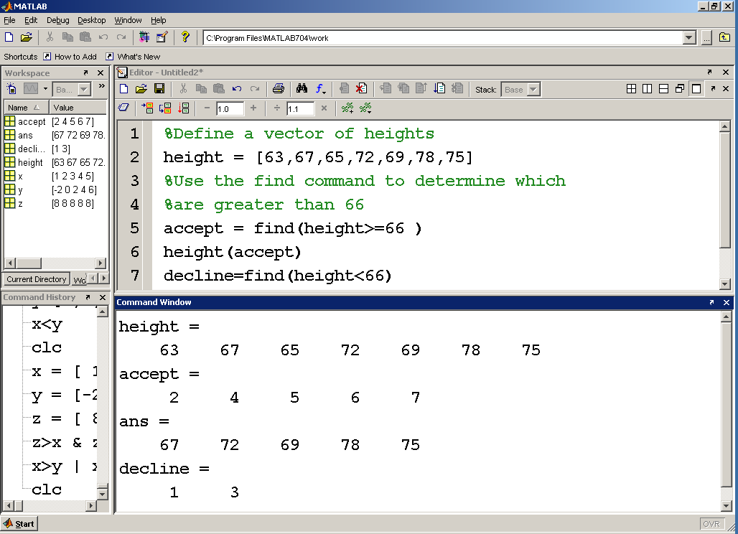

Slide 35
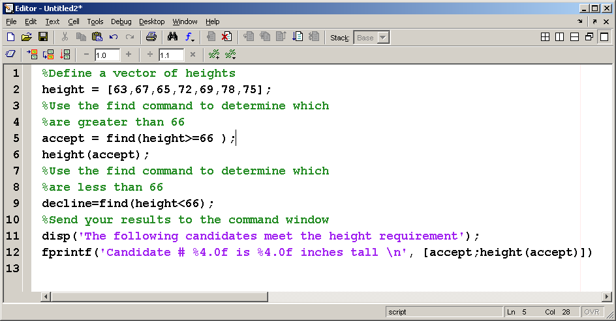
More readable report

Slide 36
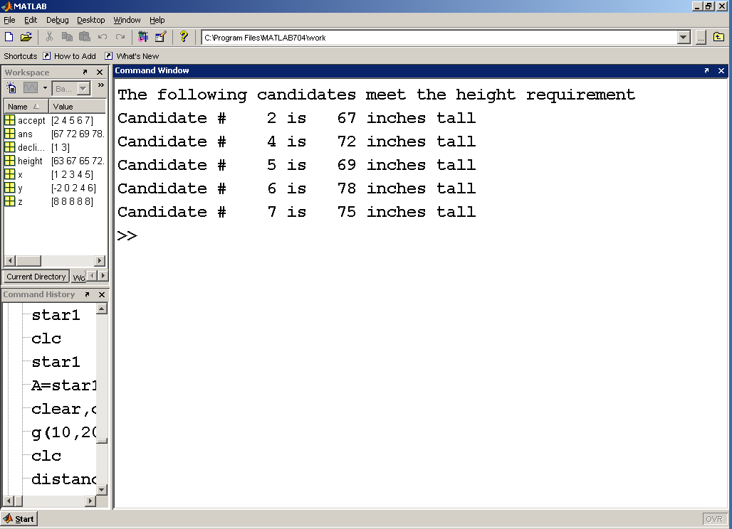

Slide 37
By combining relational and logical operators you can create fairly complicated search criteria
Assume applicants must be at least 18 years old and less than 35 years old
They must also meet the height requirement

Slide 38
Applicant pool
Height Age
Inches years
63 18
67 19
65 18
72 20
69 36
78 34
75 12

Slide 39
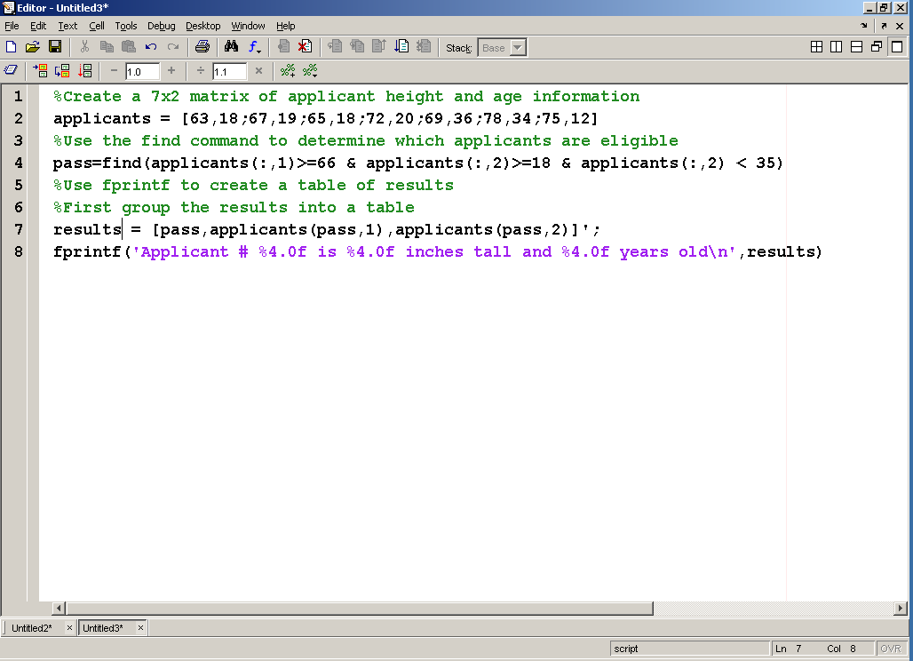
This is the M-file program to determine who is eligible

Slide 40
Driving Eligibility

Slide 41
Start
Sorry – You’ll have to wait
if age<16
True
elseif
You may have a youth license
age<18
True
elseif
True
You may have a standard license
age<70
else
Drivers over 70 require a special license
End

Slide 42
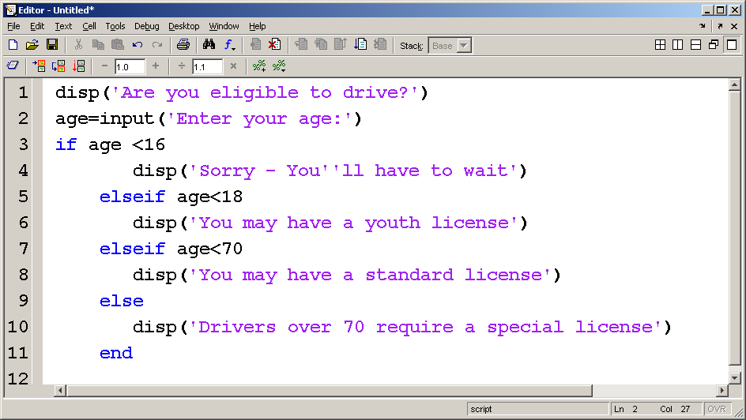

Slide 43
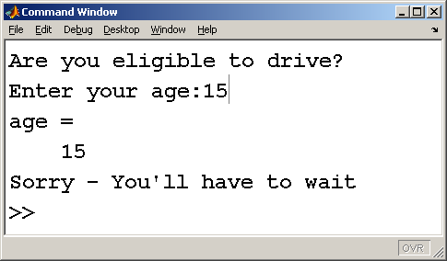

Slide 44
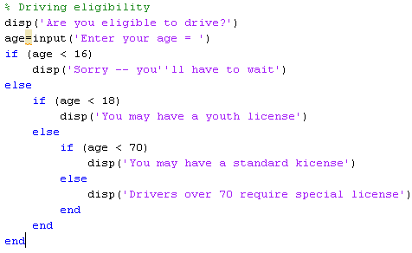
Another way (safer)

Slide 45
Section 8.5 Repetition Structures - Loops
Loops are used when you need to repeat a set of instructions multiple times
MATLAB supports two types of loops
for
while

Slide 46
You’ve run out of values in the index matrix
Check to see if the index has been exceeded
Flow chart for a for loop
Calculations

Slide 47
For Loops
for index = 1:n % index=[matrix]
commands to be executed
end
The loop is executed once for each element of the index matrix identified in the first line

Slide 48
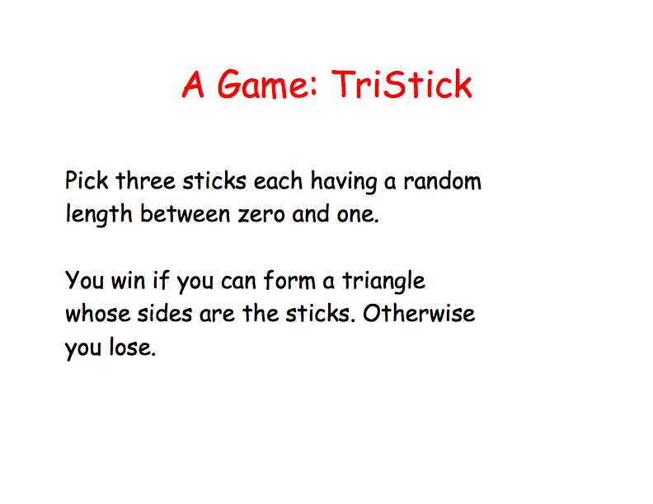

Slide 49
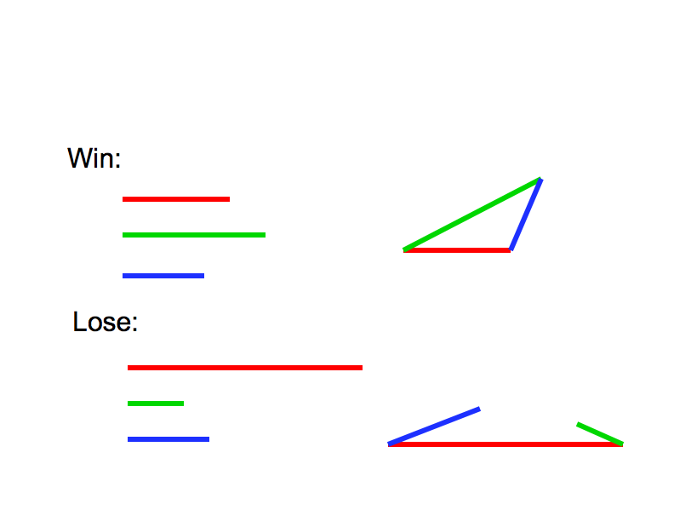

Slide 50
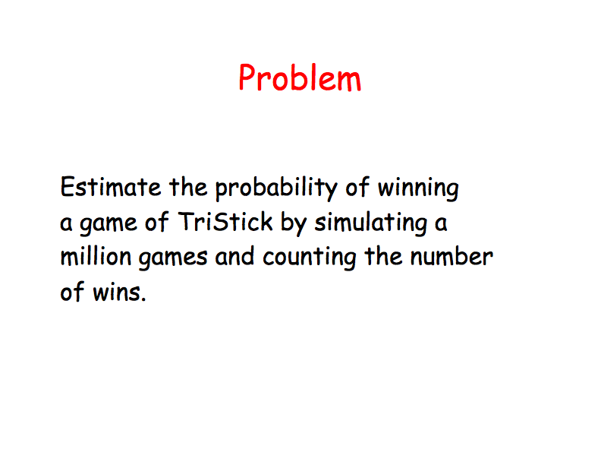

Slide 51
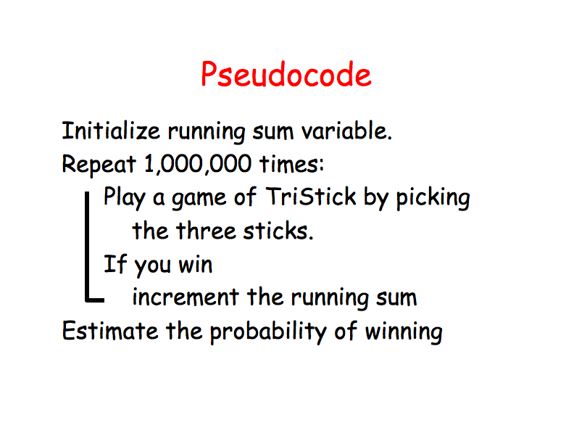

Slide 52
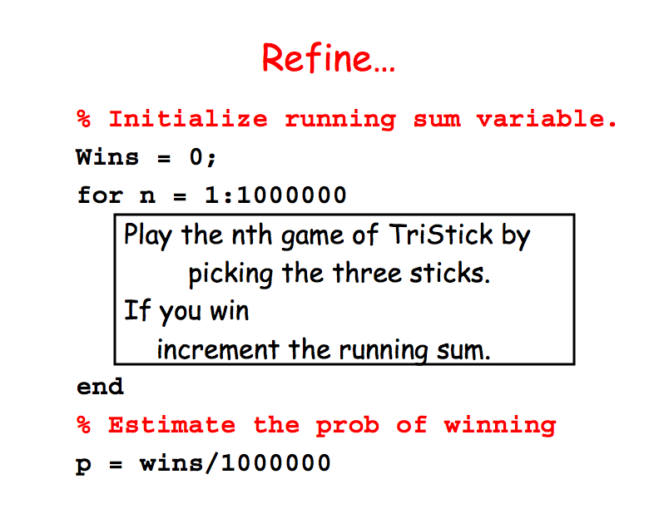

Slide 53
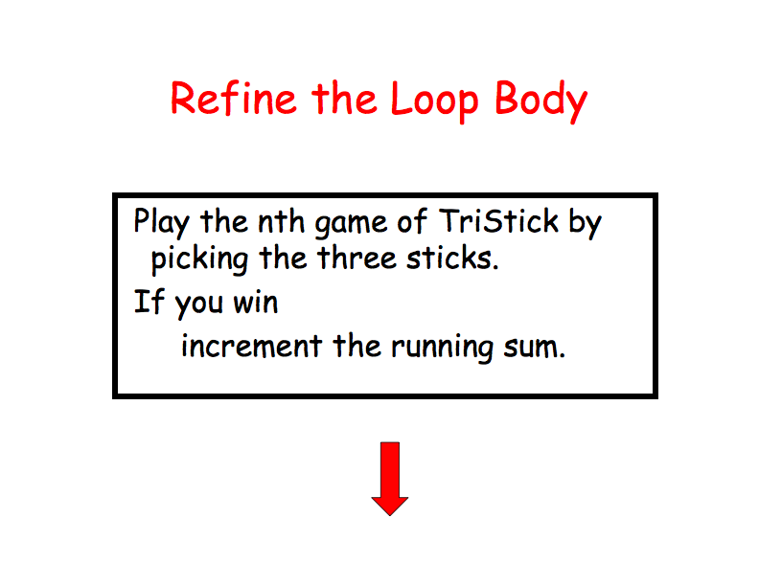

Slide 54
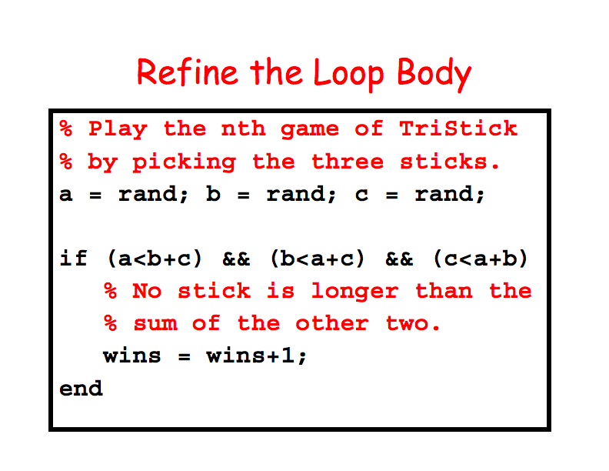

Slide 55
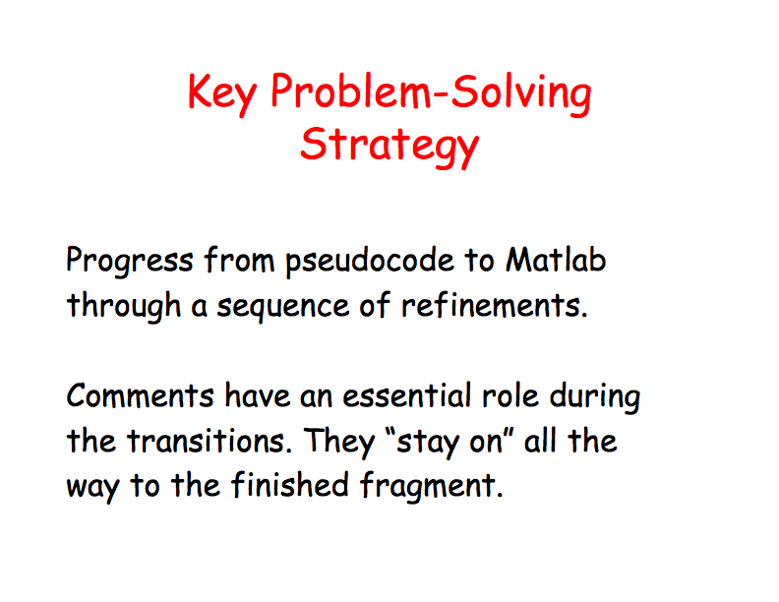

Slide 56
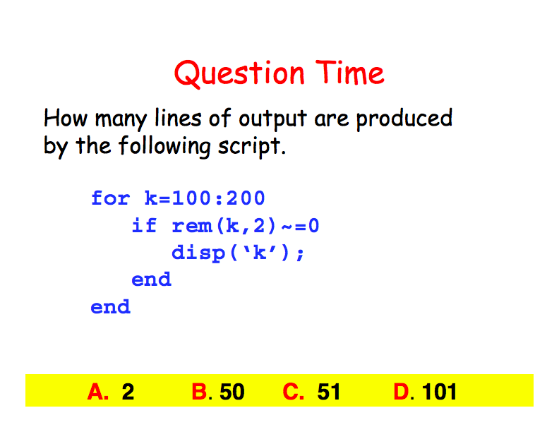

Slide 57
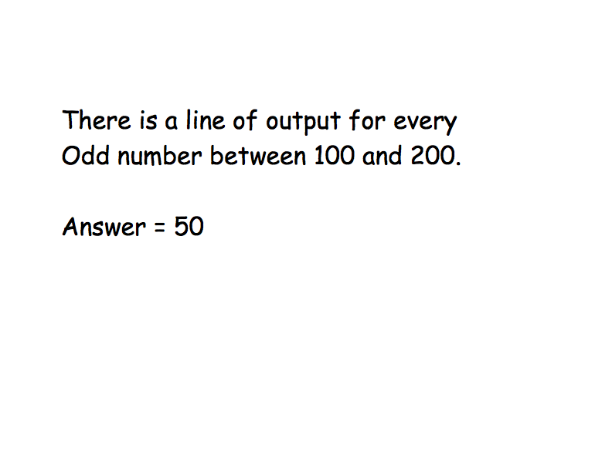

Slide 58
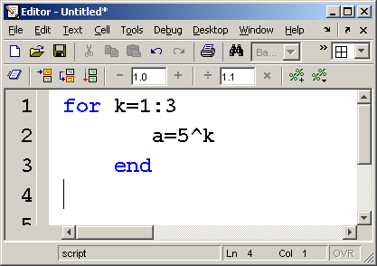
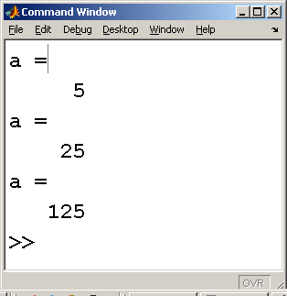
Here’s a simple example
In this case k is the index – the loop is repeated once for each value of k

Slide 59
Here’s a simple example
In this case k is the index – the loop is repeated once for each value of k
the index can be defined using any of the techniques we’ve learned

Slide 60
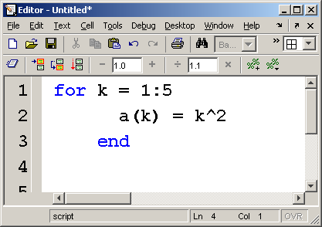
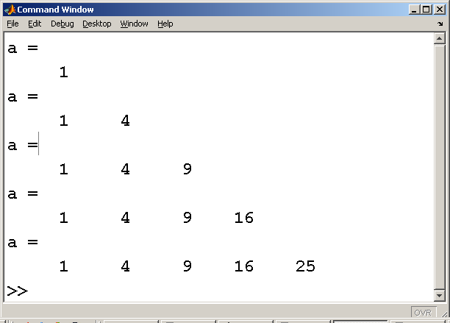
One of the most common ways to use a loop is to define a matrix

Slide 61
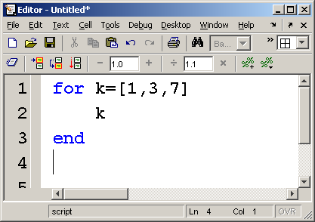
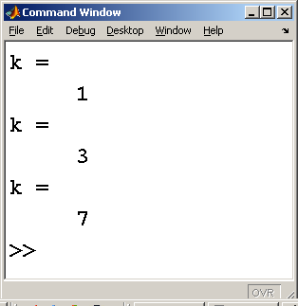
Here’s a simple example
In this case k is the index – the loop is repeated once for each value of k

Slide 62
Here’s a simple example
In this case k is the index – the loop is repeated once for each value of k
the index can be defined using any of the techniques we’ve learned

Slide 63
While Loops
While loops are very similar to for loops.
The big difference is the way MATLAB decides how many times to repeat the loop.
While loops continue until some criterion is met.

Slide 64
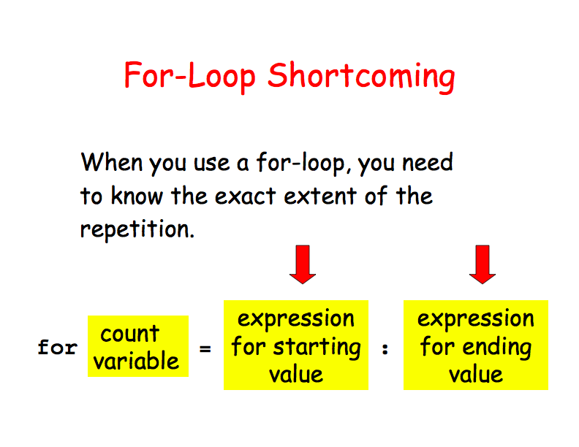

Slide 65
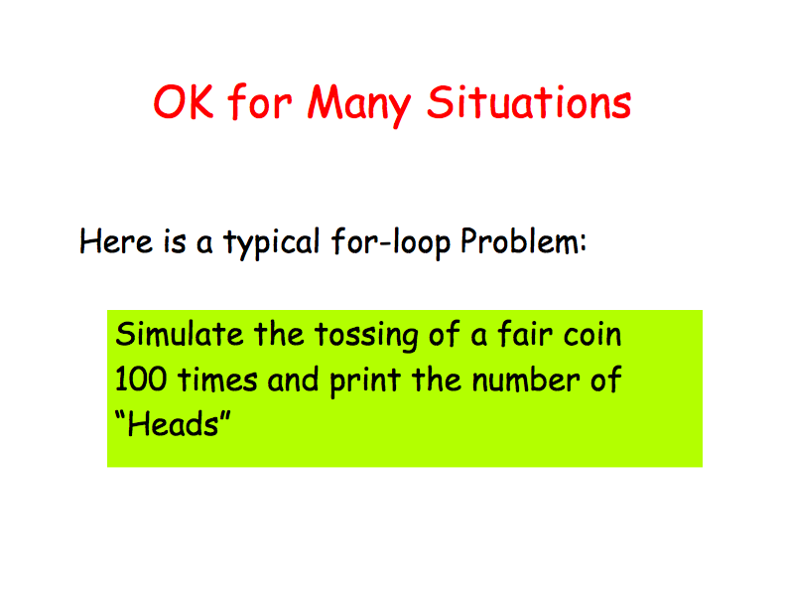

Slide 66
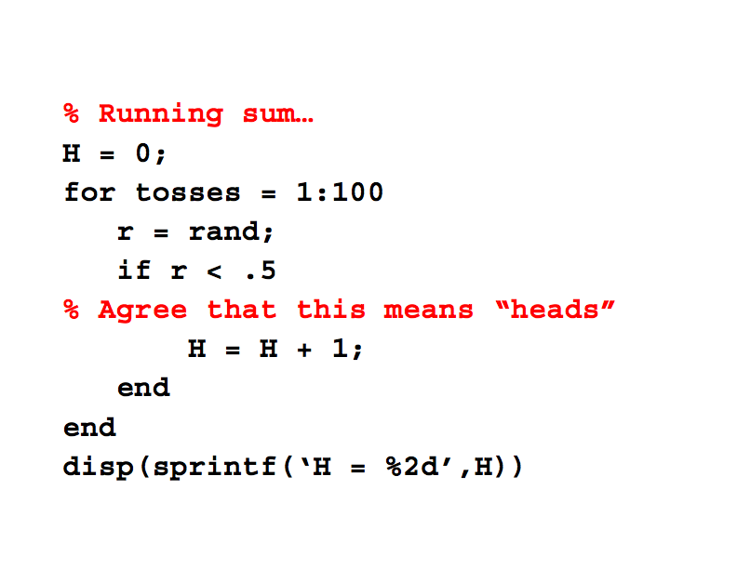

Slide 67
While Loops
While loops are very similar to for loops.
The big difference is the way MATLAB decides how many times to repeat the loop.
While loops continue until some criterion is met.
while criterion
commands to be executed
end

Slide 68
The criterion is no longer true and the program exits the loop
Check to see if the criterion is still true
Calculations
Flow Chart for a while loop

Slide 69
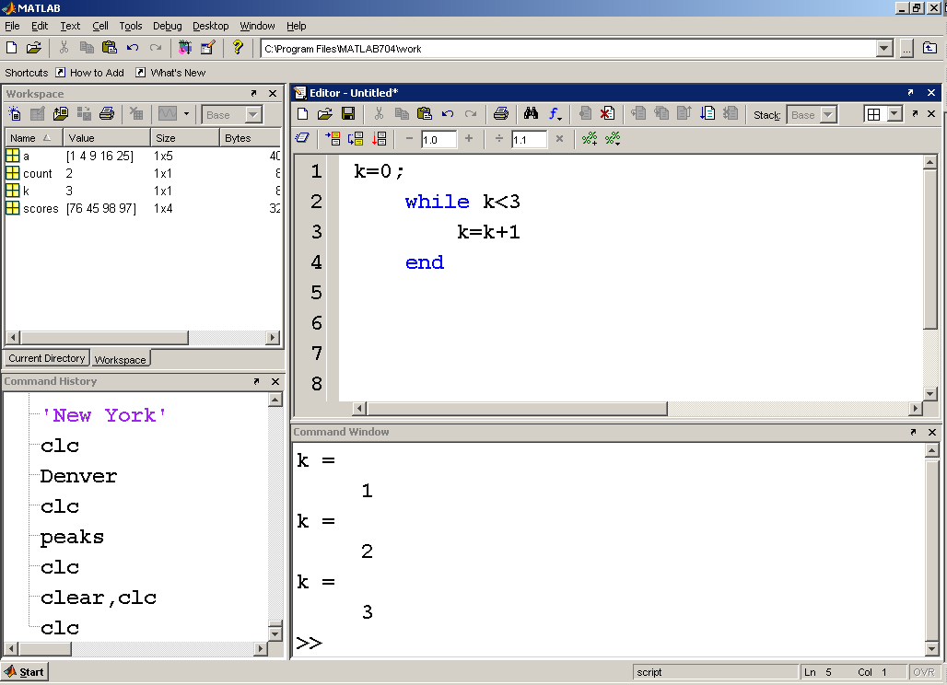
We have to increment the counter (in this case k) every time through the loop – or the loop will never stop!!

Slide 70
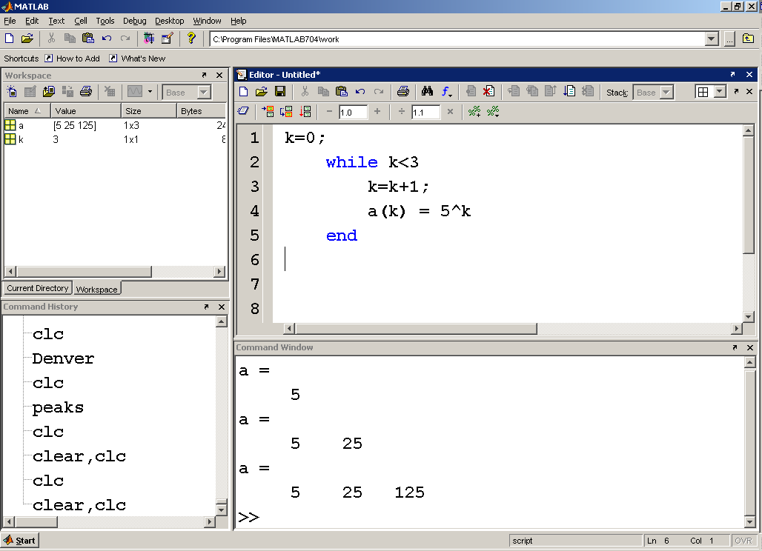
This loop creates the matrix a, one element at a time

Slide 71
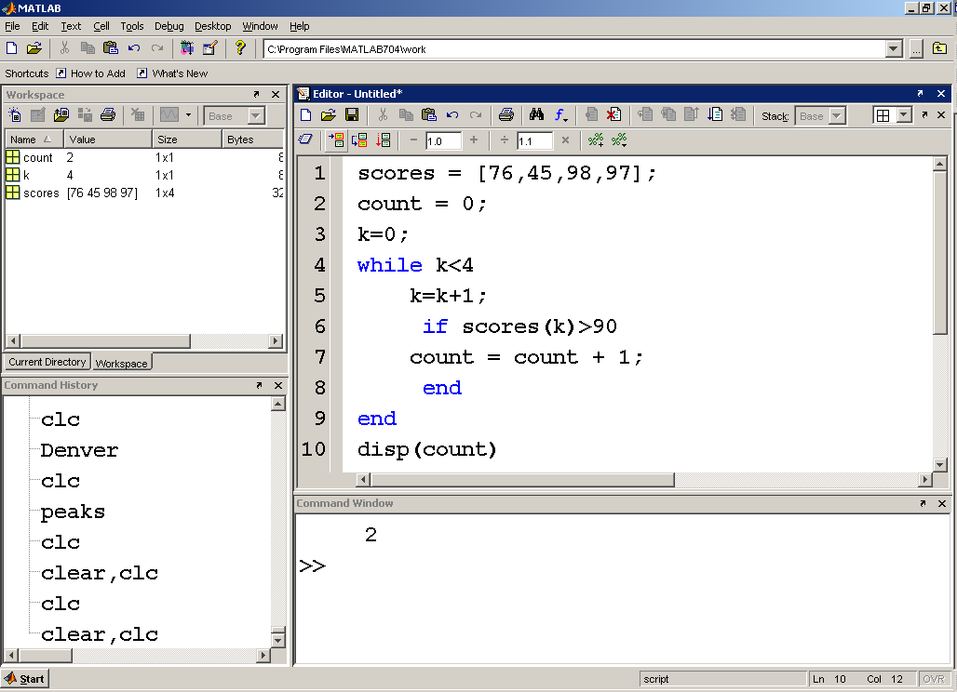
This program counts how many scores in the array are greater than 90, and displays the result in the command window

Slide 72
Hint
If you accidentally create a loop that just keeps running you should
Exit the calculation manually with ctrl c

Slide 73
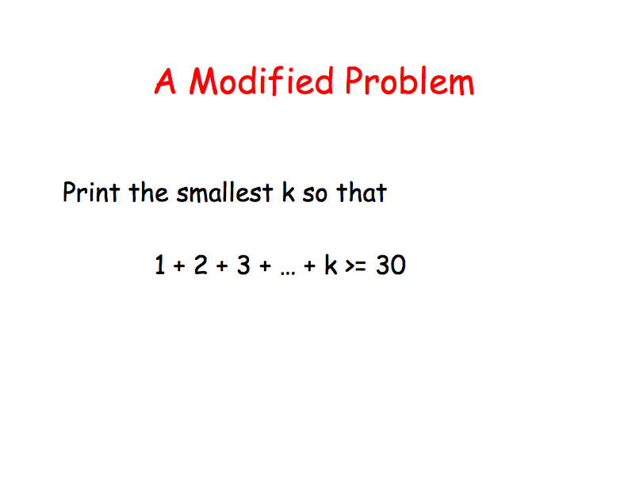

Slide 74
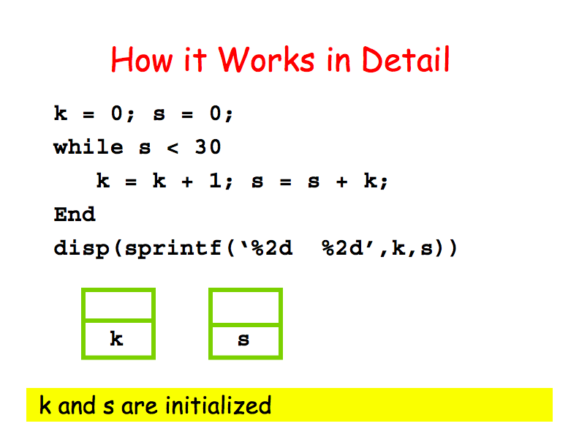

Slide 75


Slide 76


Slide 77


Slide 78


Slide 79


Slide 80


Slide 81


Slide 82


Slide 83


Slide 84


Slide 85
break and continue
break causes the loop to terminate prematurely
continue causes MATLAB to skip a pass through the loop, but continue on until the criteria for ending is met
both are used in conjunction with an if statement

Slide 86



Slide 87
This program prompts the user 10 times to enter a value.
If a negative value is entered, the break command causes MATLAB to exit the loop

Slide 88



Slide 89

Programming Question1
Compute the value of pi using the following series
How many terms are needed to obtain an accuracy where two consecutive terms differ by 1e-12?
What is the value of the computed Pi?

Slide 90
Solution to Question 1
function [value n]=computePi(delta)
%Compute the value of Pi using the equation given in question 1
% till two successive values during the iteration differ by less than delta.
format long e
previousValue=realmax;
current=0;
finish=false;
n=1;
while ~finish
current= current+1/((2*n-1)^2*(2*n+1)^2);
if abs(current-previousValue) < delta
value=sqrt(current*16+8);
finish=true;
end
previousValue=current;
n=n+1;
end
end

Slide 91
Solution to Question 1
function [value n]=computePi(delta)
%Compute the value of Pi using the equation given in question 1
% till two successive values during the iteration differ by less than delta.
format long e
previousValue=realmax;
current=0;
finish=false;
n=1;
while ~finish
current= current+1/((2*n-1)^2*(2*n+1)^2);
if abs(current-previousValue) < delta
value=sqrt(current*16+8);
finish=true;
end
previousValue=current;
n=n+1;
end
end
>> [a,b]=computePi(1e-12)
a =
3.141592653169178e+000
b =
502

Slide 92
Programming Question 2
The Fibonacci numbers are computed according to the following relation: F_{n} = F_{n-1} + F_{n-2} with F₀ = F₁ = 1.
a. Compute the first n Fibonacci numbers.
b. For the first n Fibonacci numbers, compute the ratio F_{n} / F_{n-1}
It is claimed that this ratio approaches the value of the golden mean ( (1 + sqrt(5))/2 ). What do your results show?

Slide 93
Solution to Question 2
function [firstN firstNRatio goldenRatio]=Fibonacci(n)
% Solving Question 2
% First few Fibonacci numbers: 0 1 1 2 3 5 8 13 ....
% firstN: vector of length n: firstN(i) contains the ith Fibonacci value
% firstNRatio: vector of length n:firstNRatio(i) contains F(i)/F(i-1).
firstN(1)=1;
firstN(2)=1;
% firstNRatio(1) is undefined
firstNRatio(2)=1; % matlab will assign value 0 to firstNRatio(1)
for k=3:n
firstN(k)=firstN(k-1)+firstN(k-2);
firstNRatio(k)=firstN(k)/firstN(k-1);
end
goldenRatio=(1+sqrt(5))/2;
end

Slide 94



Slide 95

Here’s an example. This code creates a 40,000 element matrix of ones, then multiplies each element in the matrix by pi
These two lines of code start a timer to measure the elapsed time required to run the lines of MATLAB code between them
The amount of time it takes to run this code will depend on your computer, and how much else you have installed on it

Slide 96

This code accomplishes the same thing with a for loop

Slide 97

Most of the time required to run the previous problem was used to create the B matrix one element at a time
If we predefine the B matrix and then replace each element one at a time with the new value, the run time is significantly reduced

Slide 98

An alternate syntax for timing uses the tic and toc functions

Slide 99
Summary
Sections of computer code can be categorized as
sequences
selection structures
repetition structures

Slide 100
Summary – Relational Operators
MATLAB uses the standard mathematical relational operators
<
<=
>
>=
==
~=
Recall that = is the assignment operator, and can not be used for comparisons

Slide 101
Summary – Logical Operators
MATLAB uses the standard logical operators
&& and
|| or
~ not
xor exclusive or

Slide 102
Summary – Logical Functions
The find command is unique to MATLAB, and should be the primary logical function used in your programming
It allows the user to specify a condition using both logical and relational operators, which is then used to identify elements of a matrix that meet the condition.

Slide 103
Summary - Vectorization
Vectorization of MATLAB code allows it to execute much more efficiently, and therefore more quickly.
Loops in particular should be avoided in MATLAB, although this is not always possible
When loops are unavoidable they can be improved by defining “dummy” variables with placeholder values, such as ones or zeros.
These placeholders can then be replaced in the loop resulting in significant improvements in execution time, which can be confirmed with timing experiments.

Slide 104
Summary – timing functions
The clock and etime functions are used to poll the computer clock, and then determine the time required to execute pieces of code
The time calculated is the “elapsed” time. During this time the computer has not only been running MATLAB code, but has also been executing background jobs and housekeeping functions.
The tic and toc functions perform a similar task.

