Slide 1
Roofline Model

Slide 2
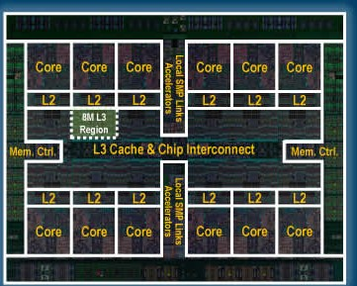
The Roofline Model
DATA
CALCULATIONS (+, -, /, *, ....)
DATA

Slide 3
The Roofline Model
The roofline model was introduced in 2009 by Williams et.al.
Samuel Williams, Andrew Waterman, and David Patterson. 2009. Roofline: an insightful visual performance model for multicore architectures. Commun. ACM 52, 4 (April 2009), 65-76. DOI=10.1145/1498765.1498785 http://doi.acm.org/10.1145/1498765.1498785
It provides an easy way to get performance bounds for compute and memory bandwidth bound computations.
It relies on the concept of Computational Intensity (CI) – sometimes also called Arithmetic or Operational Intensity.
The Roofline Model provides a relatively simple way for performance estimates based on the computational kernel and hardware characteristics.
Performance [GF/s] = function (hardware and software characteristics)

Slide 4
FLOPS : Bytes
Balance
DATA
FLOPS:Bytes ratio is the basic variable of the Roofline model
CALCULATIONS
(+, -, /, *, ....)
DATA
for (i=0; i < N; i=i+1) a[i] = b[i]
for (i=0; i < N; i=i+1) a[i] = b[i]*b[i]+b[i]
for (i=0; i < N; i=i+1)
a[i] = b[i]*b[i]+sin(b[i])+exp(b[i])
DATA TRANSFER, NO FLOPS
DATA TRANSFER,
ADDs and MULs
DATA TRANSFER, FLOPS

Slide 5
The Roofline Model: Principal Components to Performance
Performance can be estimated
Compute
from hardware and kernel characteristics
Communication
Locality
Kernels can be Compute bounded (DGEMM) or Communication bounded (DAXPY) (kernels are rarely well balanced)
Some hardware is more communication oriented than another (high memory BW) Some hardware is more computation oriented than another (high FLOPs)
Mapping kernel characteristics to hardware characteristics (or vice-versa) → performance

Slide 6

Performance Limiting Factors
DATA
MEMORY BANDWIDTH (READ)
CALCULATIONS (+, -, /, *, ....)
MEMORY BANDWIDTH (WRITE)
FLOPS
DATA

Slide 7
The Roofline Model
The Roofline Model - is a tool to understand the kernel/hardware limitation and it is also a tool for kernel optimization
Performance is upper bounded by:
1) the peak flop rate
BW
limited
FLOP
limited
Performance [GF/s]
2) the streaming bandwidth
Arithmetic Intensity (FLOPS/BYTE)

Slide 8
The Roofline Model
for (i=0; i < N; i=i+1) a[i] = 2.3*b[i]
Performance [GF/s]
for (i=0; i < N; i=i+1) a[i] = b[i]*b[i]+b[i]
for (i=0; i < N; i=i+1)
a[i] = b[i]*b[i]+sin(b[i])+exp(b[i])
Arithmetic Intensity (FLOPS/BYTE)

Slide 9
The Roofline Model: Arithmetic Intencity (AI)
FLOPS / Bytes ratio – one of the basic characteristics of a kernel
for (i = 0; i < N; ++i) z[i] = x[i]+y[i]
ADD
(8 byte) loads
1 (8 byte) write
AI = 1 / (2*8 + 8) = 1/24*
for (i = 0; i < N; ++i) z[i] = x[i]+y[i]*x[i]
1 ADD
MUL
(8 byte) loads
1 (8 byte) write
AI = 2 / (2*8 + 8) = 1/12*
for (i = 0; i < N; ++i){
I1 = A_offset[i]; I2 = A_offset[i+1]; sum = 0.0
for (j = 0; j < (I2-I1); ++j)
sum += A[I1+j] * x[col_index [I2+j]]; y[i] = sum;
}
1 ADD
1 MUL
2 (8 byte) + 1 (4 bytes) loads
1 (8 byte) write
AI = 2 / (2*8 + 4 + 8) = 1/14
* because of write-allocate traffic on cache-based systems kernel would actually requires an extra read for Z and have even lower AI.

Slide 10

The Roofline Model: Arithmetic Intencity (AI)
Arithmetic Intensity
Particle methods
BLAS L3
FFT
stencil
BLAS L1,
SpMv

Slide 11
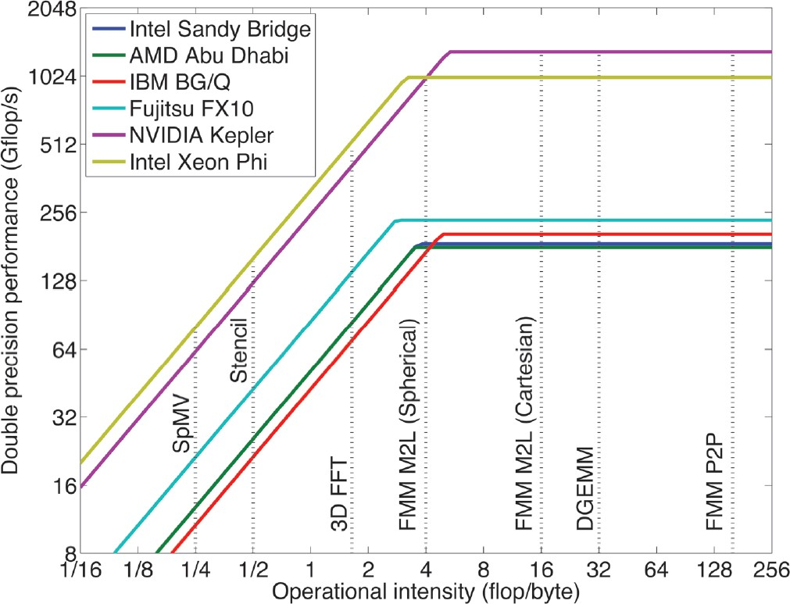
The Roofline Model: Kernel-Hardware mapping
 The trend is for architectures to have ever decreasing machine balance (the point where the bandwidth roof meets the ceiling moves to the right).
 More and more algorithms are going to find themselves memory bound.
 Even DGEMM can run into trouble depending on the blocking factor chosen.
 A “balanced” architecture can also be a “crippled” one, e.g. low-end GPUs with 1/24th the DP peak performance.
➢➢You can achieve a higher percentage of a lower peak.
How Will the Fast Multipole Method Fare in the Exascale Era? SIAM News, Volume 46, Number 6, July/August 2013
By Lorena A. Barba and Rio Yokota (Boston University & KAUST)

Slide 12
It is an art to find a perfect match between kernel and hardware characteristics
In another words it requires a lot of work to create a kernel that will exhaust both, the memory BW and FLOPs capacity at the same time. (many times it is even impossible ….)
Performance [GF/s]
Computational Intensity (FLOPS/BYTE)

Slide 13
The Roofline Model: Performance Limiting Factors
Performance depends on how well a given kernel fits node/processor architecture,
Performance [GF/s]
SIMD ILP
TLP
and/or how well a given kernel is translated by a compiler.
Recall: hardware-kernel characteristics mapping.
Arithmetic Intensity (FLOPS/BYTE)

Slide 14
The Roofline Model: Performance Limiting Factors
Data prefetch
NUMA
Performance depends on how well a given kernel fits node/processor architecture,
Stride access
Performance [GF/s]
and/or how well a given kernel is translated by a compiler.
Recall: hardware-kernel characteristics mapping.
Arithmetic Intensity (FLOPS/BYTE)

Slide 15
The Roofline Model: Performance limiting factors
N – is large, i.e., buffer does not fit cache
----------------------------------------
for (i=0; i < N; ++i) a[i] = buffer[i] + b[i];
for (i=0; i < N; ++i) c[i] = buffer[i] + d[i];
Performance [GF/s]
AI_total = 2 / (2 * 3 * 8) = 1/24;
Computational Intensity (FLOPS/BYTE)
----------------------------------------
for (i=0; i < N; ++i){ a[i] = buffer[i] + b[i];
c[i] = buffer[i] + d[i];
}
AI = 2/(5*8) = 1 / 20;
----------------------------------------

Slide 16
The Roofline Model: Performance Limiting Factors -
Instruction Level Parallelism (ILP)
sum = 0;
for (i=0; i < N; ++i) sum = sum + a[i];
sum0 = sum1 = sum2 = sum3 = 0; for (i=0; i < N; i+=4){
sum0 = sum0 + a[i ];
sum1 = sum1 + a[i+1]; sum2 = sum2 + a[i+2]; sum3 = sum3 + a[i+3];
}
sum0 = sum0+sum1; sum2 = sum2+sum3; sum = sum0+sum2;
Performance [GF/s]
Arithmetic Intensity (FLOPS/BYTE)
16
ICSC 2014, Shanghai, China
© 2014 IBM Corporation

Slide 17
EXAMPLES and EXERCISES
April 22, 2014
© 2014 IBM Corporation

Slide 18
Example 1: DAXPY
Consider DAXPY : for (i = 0; i < N; ++i) y[i] = a*x[i]+y[i]
For each “i” : 1 addition , 1 multiplication
2 loads of 8 bytes each
1 store
Execution on BlueGene/Q (Peak 204.8 GFLOP/node )
Performance estimates:
AI = 2/(3*8) = 1 / 12
Performance [GF/s]
1/12 < 7.11 →
We are in the memory BW limited area on the Roofline plot
7.11 / (1 / 12) = 85.32
204.8 / 85.32 = 2.4 GF/s
204.8
7.11
Arithmetic Intensity (FLOPS/BYTE)

Slide 19
Example 1: DAXPY
Consider DAXPY : for (i = 0; i < N; ++i)
y[i] = a*x[i]+y[i]
For each “i” : 1 addition , 1 multiplication
2 loads of 8 bytes each
1 store
Execution on BlueGene/Q (Peak 204.8 GFLOP/node ):
Performance estimates:
# threads | Time [s] | GFLOPS | DDR traffic per node (Bytes/cycle)
 | 1 0.0879111 | 0.455 | 3.519
 | 2 0.044039 | 0.907 | 7.022
 | 4 0.022151 | 1.801 | 13.94
 | 8 0.0174019 | 2.284 | 17.686
 | 16 0.017447 | 2.287 | 17.719
AI = 2/(3*8) = 1 / 12
1/12 < 7 →
We are in the memory BW limited area on the roofline plot
7.11 / (1 / 12) = 85.32
204.8 / 85.32 = 2.4 GF/s

Slide 20
Example 2
Consider DAXPY : for (i = 0; i < N; ++i)
y[i] = a*x[i]+y[i] + x[i]*x[i]
For each “i” : 2 addition , 2 multiplication
2 loads of 8 bytes each
1 store
Execution on BlueGene/Q (Peak 204.8 GFLOP/node ):
Performance estimates:
AI = 4/(3*8) = 1 / 6
Performance [GF/s]
1/6 < 7 →
We are in the memory BW limited area on the roofline plot
7.11 / (1 / 6) = 42.66
204.8 / 42.66 = 4.8 GF/s
204.8
7.11
Arithmetic Intensity (FLOPS/BYTE)

Slide 21
Example 2
Consider : for (i = 0; i < N; ++i)
y[i] = a*x[i]+y[i] +x[i]*x[i]
For each “i” : 2 addition , 2 multiplication
2 loads of 8 bytes each
1 store
Execution on BlueGene/Q (Peak 204.8 GFLOP/node ):
Performance estimates:
AI = 4/(3*8) = 1 / 6
# threads
Time [s]
GFLOPS
DDR traffic per node
1/6 < 7 →
We are in the memory BW limited area on the roofline plot
7.11 / (1 / 6) = 42.66
204.8 / 42.66 = 4.8 GF/s
1 | 0.106501 | 0.751 | 2.906
2 | 0.053323 | 1.499 | 5.802
4 | 0.0267339 | 2.989 | 11.566
8 | 0.0176179 | 4.532 | 17.545
16 | 0.0174541 | 4.573 | 17.712

Slide 22
Example 3
Consider
for (i = 0; i < N; ++i)
y[i] = a*x[i]+y[i] + x[i]*x[i] + SIN(x[i])
Execution on BlueGene/Q (Peak 204.8 GFLOP/node ):
# threads | Time [s] | GFLOPS | DDR traffic per node
 | 1 0.615393 | 1.755 | 0.503
 | 2 0.307695 | 3.51 | 1.006
 | 4 0.153861 | 7.018 | 2.244
 | 8 0.076983 | 14.023 | 4.02
 | 16 0.0385199 | 28.008 | 8.034
 | 32 0.0217798 | 49.461 | 14.202
 | 64 0.018496 | 58.137 | 16.73

Slide 23
Examples 1 and 3
y[i] = a*x[i]+y[i]
Loads that hit in L1 d-cache = 50.01 %
L1P buffer = 49.98 % L2 cache = 0.00 % DDR = 0.01 %
We spend too much time
moving data:
2.284 GF/s
y[i] = a*x[i]+y[i] + x[i]*x[i] + SIN(x[i])
We spend less time moving data
than computing
58.137 GF/s
Loads that hit in L1 d-cache = 97.30 %
L1P buffer = 2.70 % L2 cache = 0.00 % DDR = 0.00 %

Slide 24
Examples 1 and 3
y[i] = a*x[i]+y[i]
Loads that hit in L1 d-cache = 50.01 %
L1P buffer = 49.98 % L2 cache = 0.00 % DDR = 0.01 %
We spend too much time
moving data:
2.284 GF/s solve time: 17.5 ms
y[i] = a*x[i]+y[i] + x[i]*x[i] + SIN(x[i])
We spend less time moving data
than computing
58.137 GF/s solve time: 18.5 ms
Loads that hit in L1 d-cache = 97.30 %
L1P buffer = 2.70 % L2 cache = 0.00 % DDR = 0.00 %

Slide 25
Example: 2D stencil
Consider two arrays A, and B, both have dimension of NxN
B is computed from:
B[i][j] = A[i-2][j] + A[i-1][j] + C*A[i][j] + A[i+1][j] + A[i+2][j] + A[i][j-2] + A[i][j-1] + A[i][j+1] + A[i][j+2]
Arithmetic intensity: 7 adds, 1 mul, 1 load and 1 store →
AI = 8 / (2*8) = 1 / 2
Estimated performance on BG/Q: 7.11 / (½) = 14.22;
204.8 / 14.22 = 14.4 GF/s

Slide 26
2D Stencil: Algorithm No. 1
#pragma omp parallel for private(row,col)
We run on a single BGQ node 1 mpi rank, 64 threads
for (row = 2; row < (N-2); ++row){ for (col = 2; col < (N-2); ++col) { B[row][col] = C*A[row][col] +
A[row][col-1] + A[row][col+1] +
A[row][col-2] + A[row][col+2] +
A[row-1][col] + A[row+1][col] +
A[row-2][col] + A[row+2][col] ;
}
}
HPM info:
Total weighted GFlops = 4.922
Loads that hit in L1 d-cache = 93.05 % L1P buffer = 5.08 %
L2 cache = 0.00 %
We estimated 14.4GF/s
What have we done wrong?
DDR = 1.86 %
Average DDR traffic per node: ld = 13.680, st = 2.757, total = 16.437 (Bytes/cycle)

Slide 27
2D Stencil: Algorithm No. 2
#pragma omp parallel for private(rb,cb,row,col)
for (rb = 2; rb < N; rb = rb + row_block_size){ //ROW BLOCKING
for (cb = 2; cb < N; cb = cb + col_block_size){ // COLUMN BLOCKING
for (row = rb; row < MIN(N-2,rb + row_block_size+1); ++row){ for (col = cb; col < MIN(N-2,cb + col_block_size+1); ++col){ B_rcb[row][col] = C*A[row][col] +
A[row][col-1] + A[row][col+1] +
A[row][col-2] + A[row][col+2] +
A[row-1][col] + A[row+1][col] +
A[row-2][col] + A[row+2][col] ;
}
}
}
}
We estimated 14.4GF/s We got 12.264GF/s …
HPM info:
Total weighted GFlops = 12.264
Loads that hit in L1 d-cache = 97.69 % L1P buffer = 1.26 %
L2 cache = 0.34 %
DDR = 0.70 %
Average DDR traffic per node: ld = 7.599, st = 6.746, total = 14.346 (Bytes/cycle)

Slide 28
Exercise No 1.
Copy /lustre/home/ibmleopold/FOR_STUDENTS/DAXPY/ex0.c
Compile and execute daxpy
Use 1 to 16 threads to run the program
Estimate performance.
Find the crossover point.
Calculate the location (x-coordinate) of the crossover point based on hardware
(2-socket Intel(R) Xeon(R) CPU E5-2670 @2.6GHz node) and kernel characteristics

Slide 29
Exercise No 2.
Compile and execute 2D stencil code
Use 1 to 16 threads to run the program
Estimate performance for 2-socket Intel(R) Xeon(R) CPU E5-2670 @2.6GHz
Compare to the achieved performance

Slide 30
Questions ?

Slide 31
How to compile
ssh
Type MODULEPATH=/lustre/utility/modulefiles:$MODULEPATH
Load module
module load icc/13.1.1
Now we can use compiler icc or icpc
April 22, 2014

Slide 32
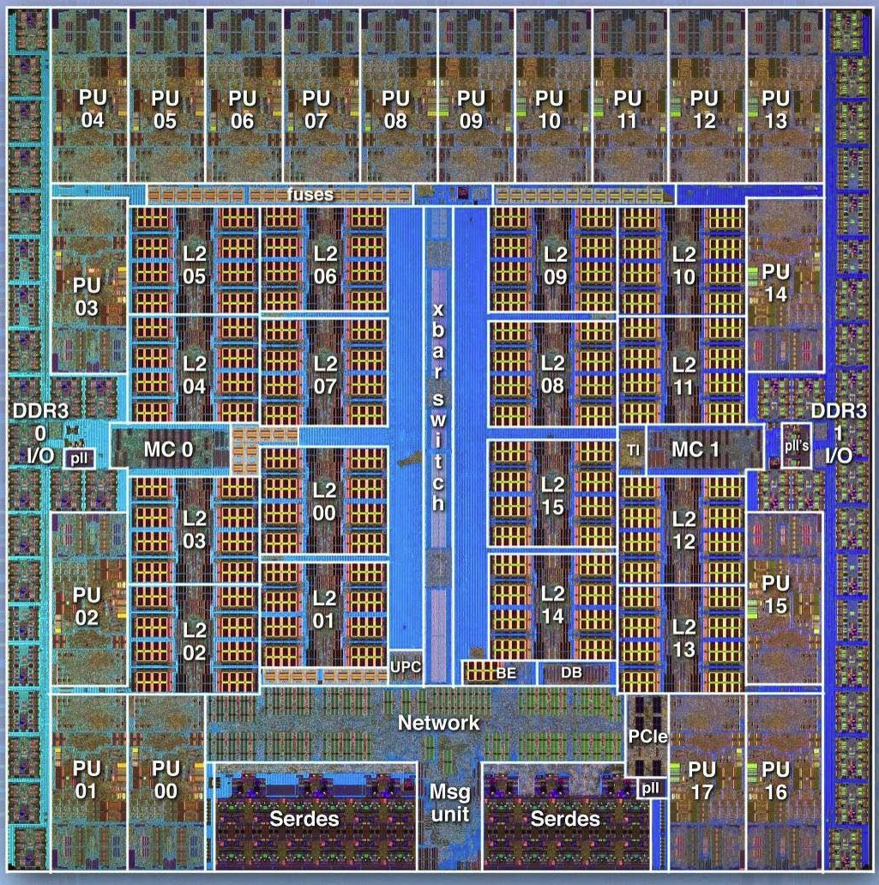
The Roofline Model: Principal Components to Performance
Computation [GF/s]
18 cores BGQ chip
Communication [GB/s]
Locality
32

