Slide 1
School of Computing Science
Simon Fraser University
CMPT 300: Review
Chapters 8-14
Keval Vora

Slide 2
Memory Management
Address spaces
  Logical (virtual): generated by the CPU
  Physical: seen by the memory unit
User program deals with logical addresses;
never sees physical addresses
Mapping from logical to physical addresses
  Static: done at compile-time
  Dynamic: done at load or execution time

Slide 3
Memory Allocation
Memory is usually divided into two partitions for:
  Kernel: usually held in low memory
  User processes: usually held in high memory
  Typically, the two partitions are managed differently
Memory allocation
  Contiguous
    First-fit, Best-fit, Worst-fit
    Fragmentation: external and internal
  Paging, segmentation, virtual memory

Slide 4
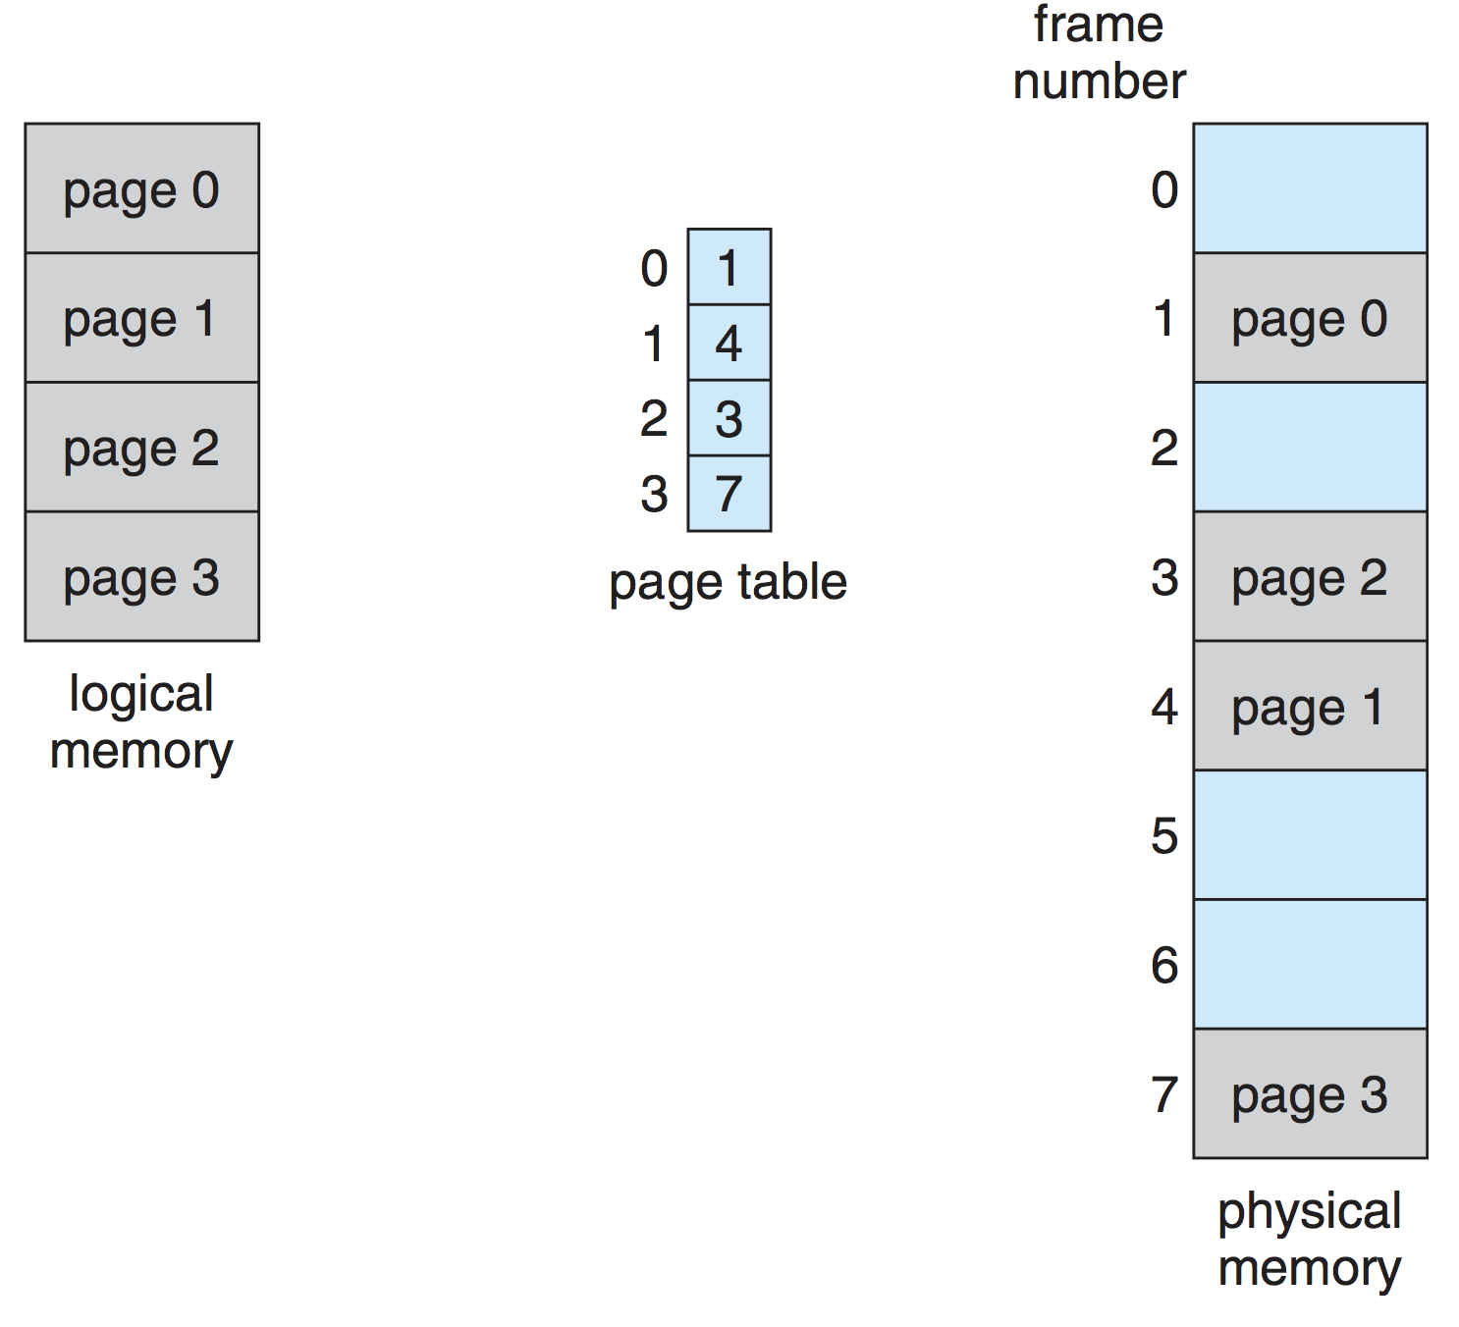
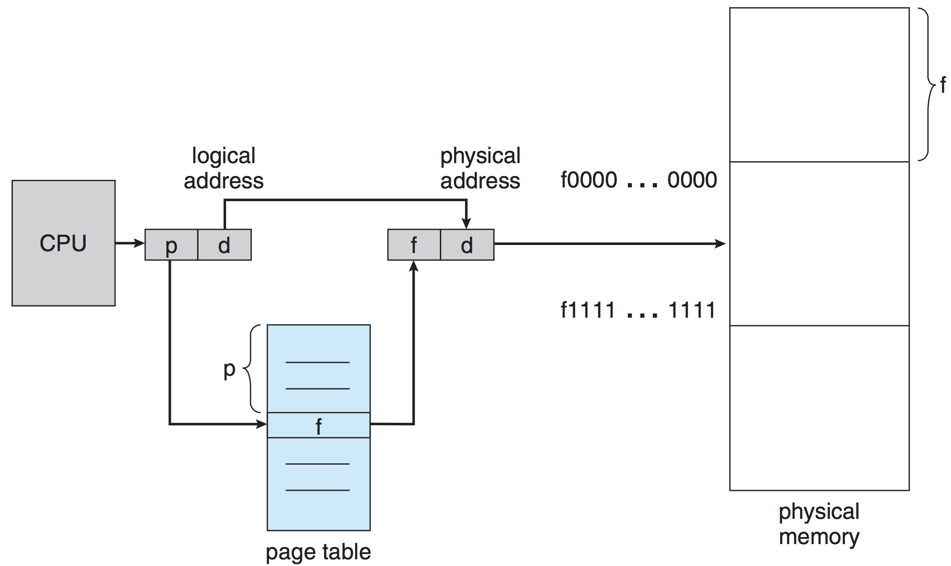
Paging
Every process has its own
page table
  Stored in memory as well
  But accelerated with TLB (cache)

Slide 5
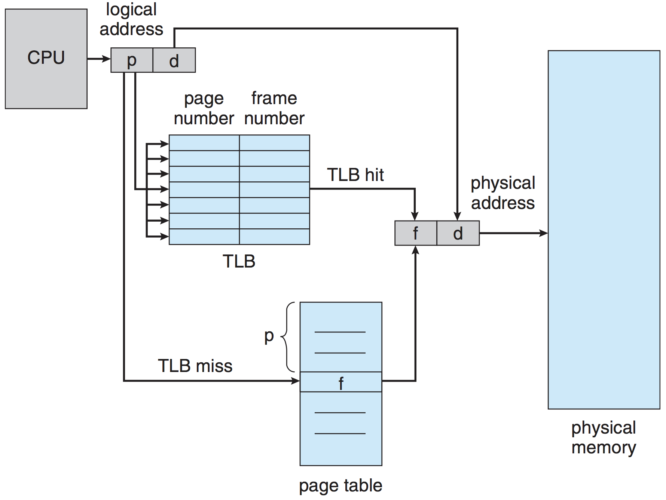
Paging Hardware With TLB
EAT = (ε + t_{m}) α + (ε + t_{m} + t_{m}) (1 – α)
= ε + (2 – α) t_{m}

Slide 6
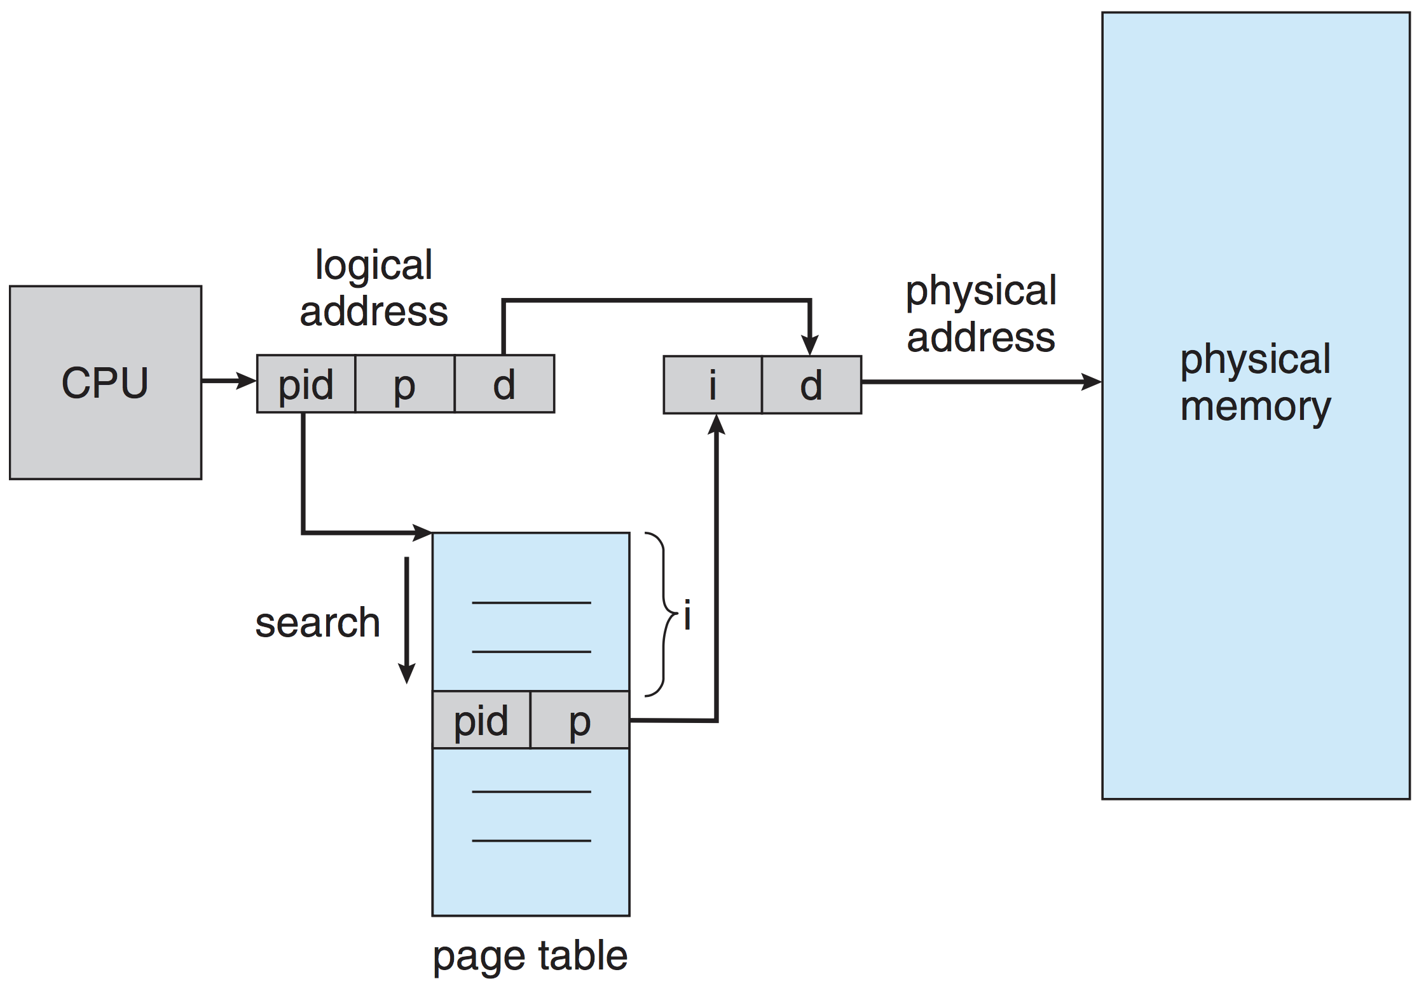
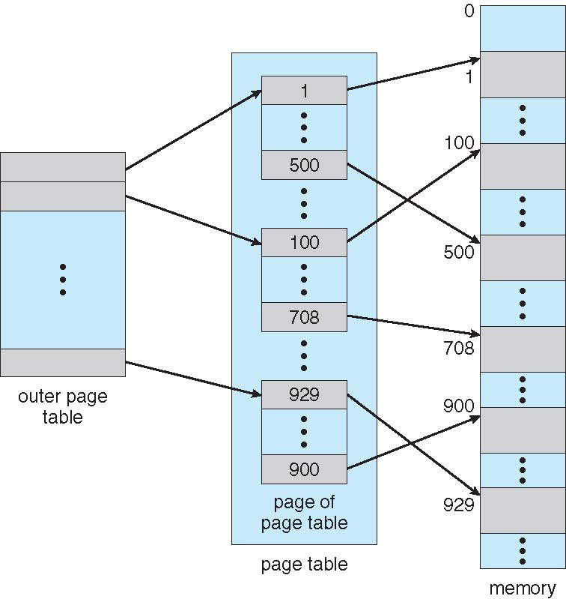
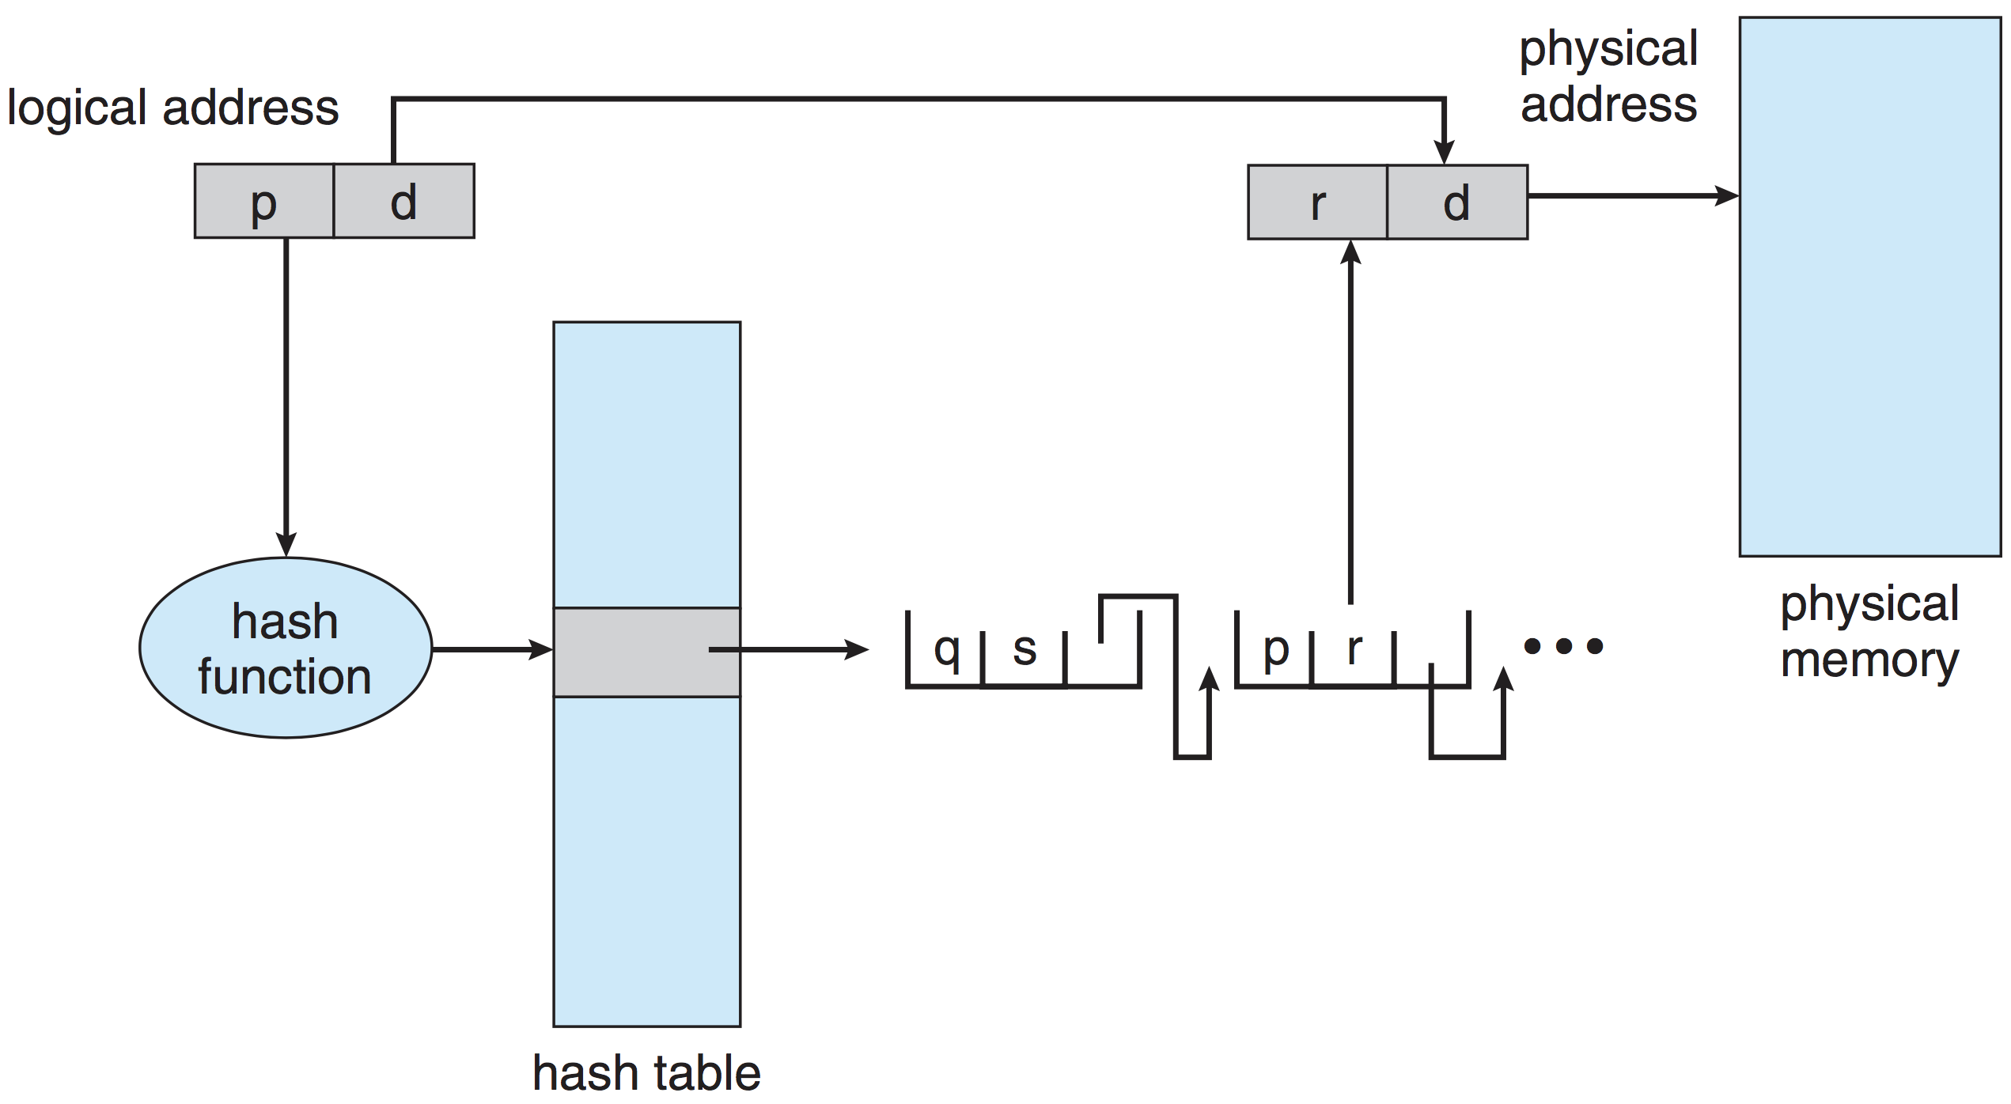
Structure of the Page Table
Assume 32-bit address space, page size 4 KB
  #pages in PT = 2³² / 2¹² = 2²⁰ ➔ needs large (contiguous) memory

Slide 7
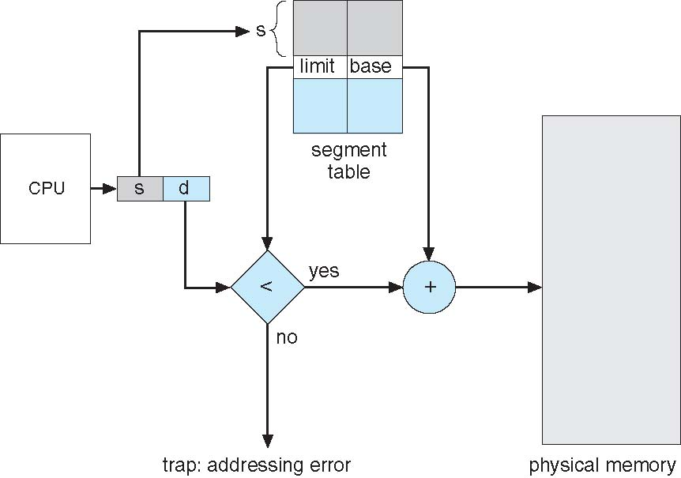
Segmentation
1
1
4
2
3
4
2
3
user space
physical space

Slide 8
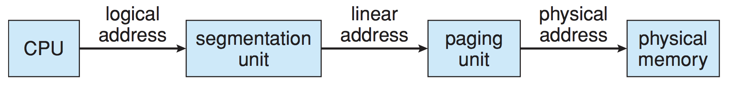
Intel Pentium (32 bits)
Supports segmentation with paging
CPU generates logical address
  Given to segmentation unit ➔ produces linear address
  Linear address given to paging unit ➔ generates physical address in main memory

Slide 9
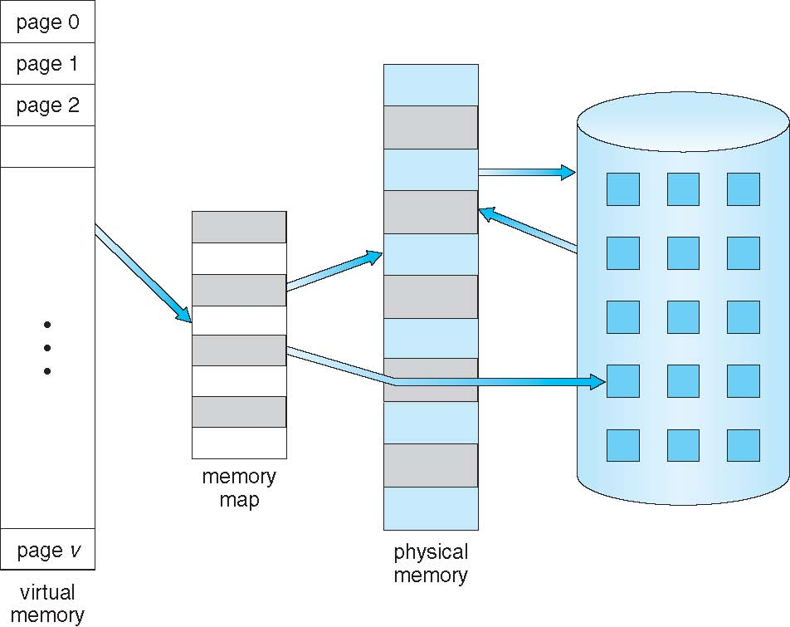
Virtual Memory
Page is brought to memory on demand
(only when needed)

Slide 10
Handling Page Fault
OS looks at table to figure out:
  Invalid reference
  ➔ abort process
  Just not in memory ➔ bring page in
Locate page on disk
Find a free frame
Swap page from disk to frame (I/O operation)
Reset page table, set validation bit = v
Restart the instruction that caused page fault
3
Page is on backing store
OS
2
Restart instruction
Trap
…
Load x
…
6
i
1
v
Program
4
Page Table
Bring in missing page
(I/O)
5
Free Frame
Reset page table
Physical Memory

Slide 11
Performance of Demand Paging
Page Fault Rate 0 ≤ p ≤ 1.0
  0 = no page faults; 1 = every reference is a fault
Effective Access Time?
= (1 – p) x memory access time
+ p x page fault time
page fault time = service page-fault interrupt (~microseconds)
+ read in requested page (~milliseconds)
+ restart process (~microseconds)
Note: Reading in requested page may require writing another page to disk if there is no free frame

Slide 12
Page Replacement
When we need to bring a page from disk and there is no free frame:
  Find a victim page to evict from memory
Objective: minimize number of page faults
(they are very costly)
Replacement algorithms
  FIFO, OPT, LRU, second-chance, …

Slide 13
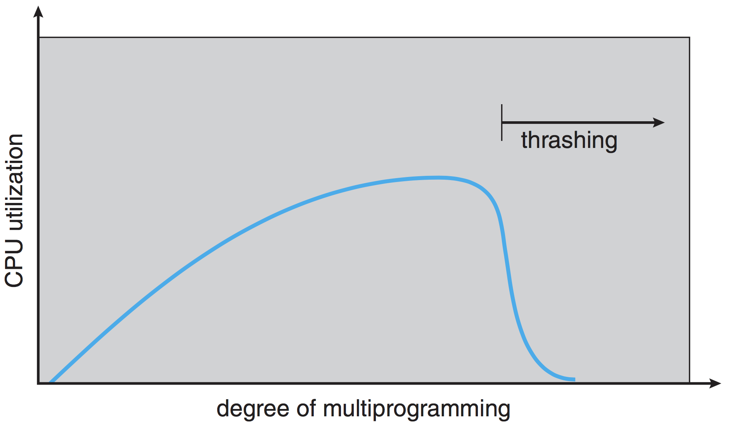
Thrashing
Thrashing ≡ a process is busy swapping pages in and out more than executing

Slide 14
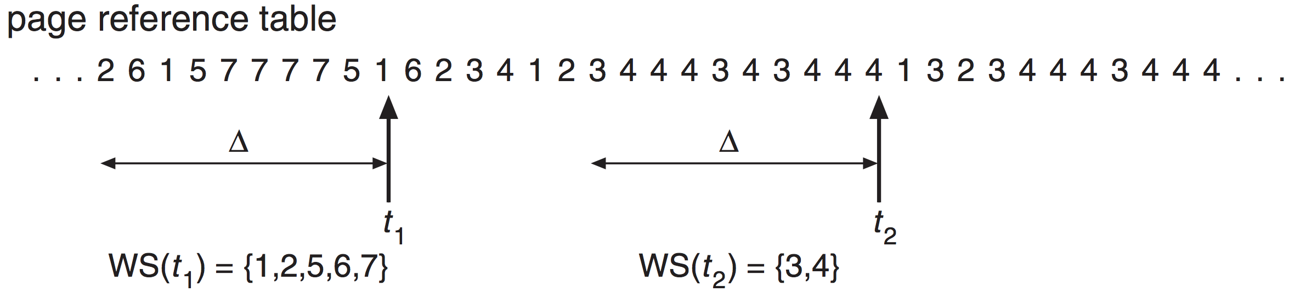
Locality Model
As process executes, it moves from locality to locality
Locality is a set of pages actively used together
  Locality could be: function, segment of code, …
Helps us to estimate the working set of a process
Working set is a moving window
  At each reference, a new reference is added at one end,
  and another is dropped off the other

Slide 15
Allocating Kernel Memory
Treated differently from user memory.
  Kernel requests memory for structures of varying sizes
    Process descriptors (PCB), semaphores, file descriptors, …
  Some kernel memory needs to be contiguous
    Some hardware devices interact directly with physical memory
  Virtual memory may just be too expensive for the kernel (cannot afford a page fault)
Examples (Unix/Linux)
  Buddy system
  Slab allocation

Slide 16
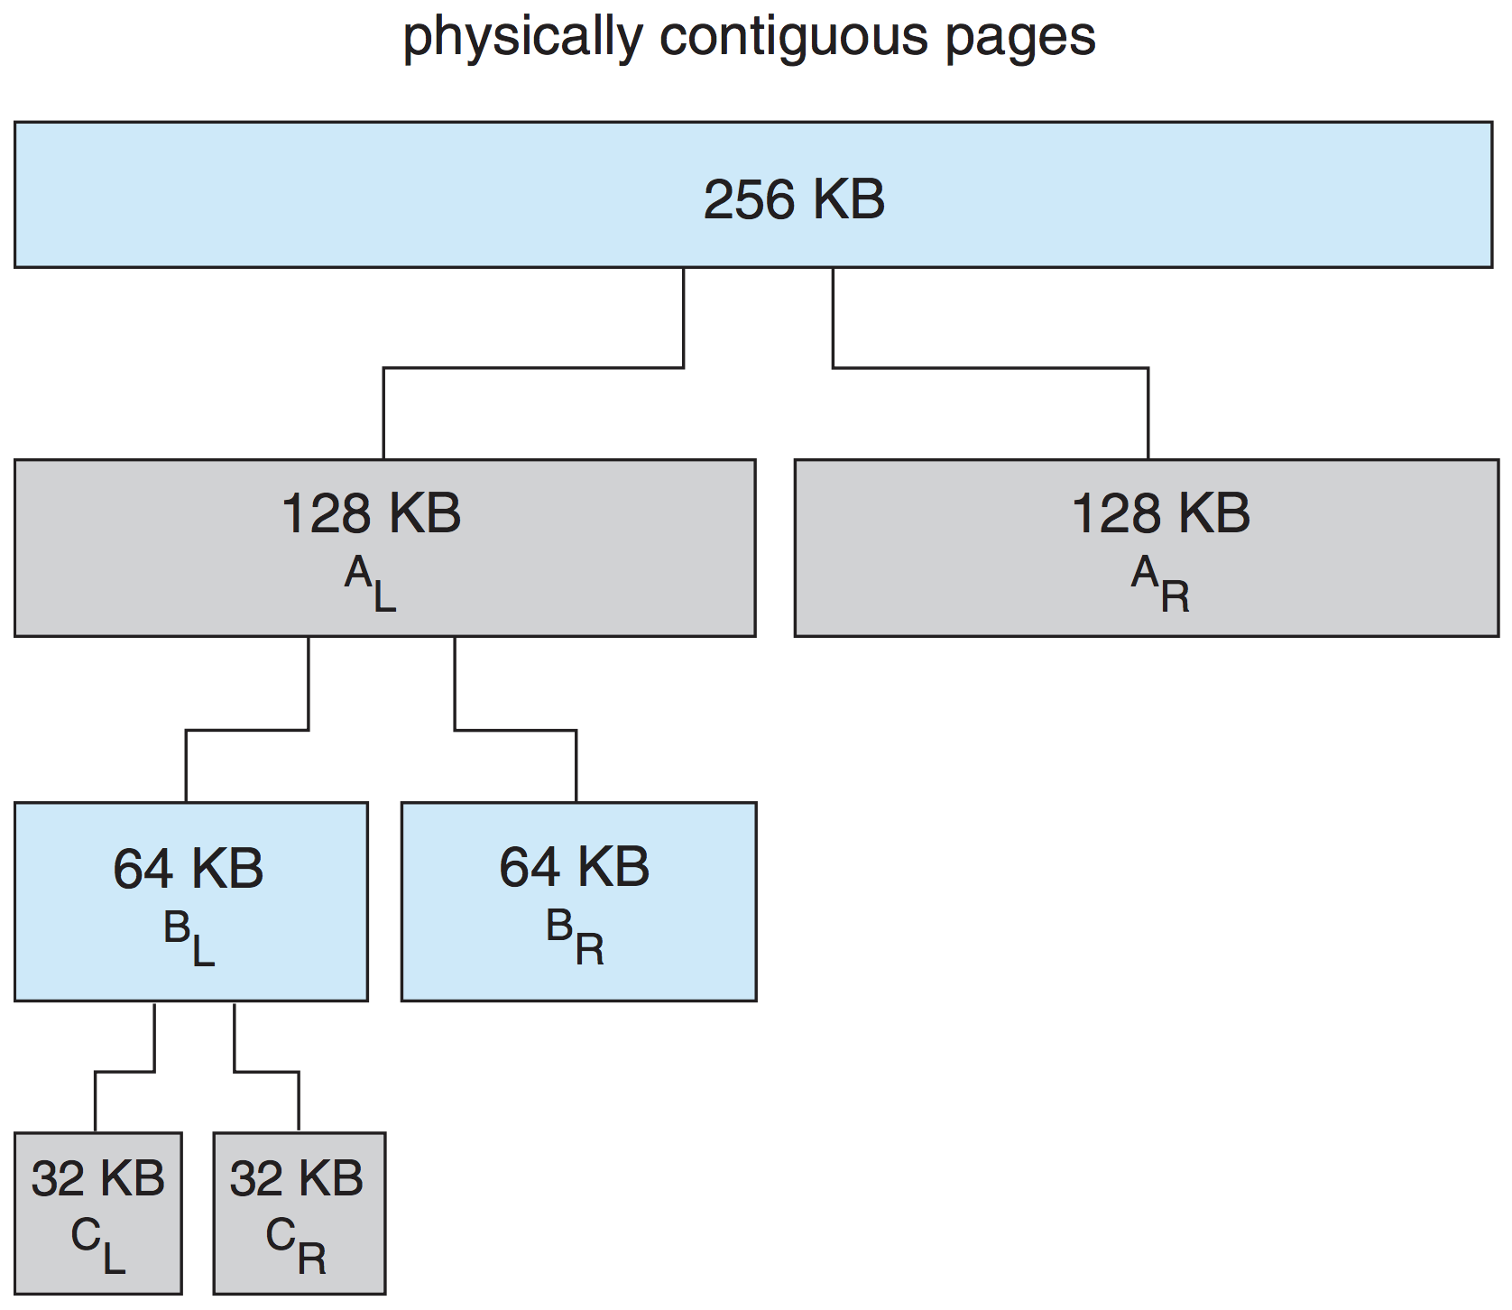
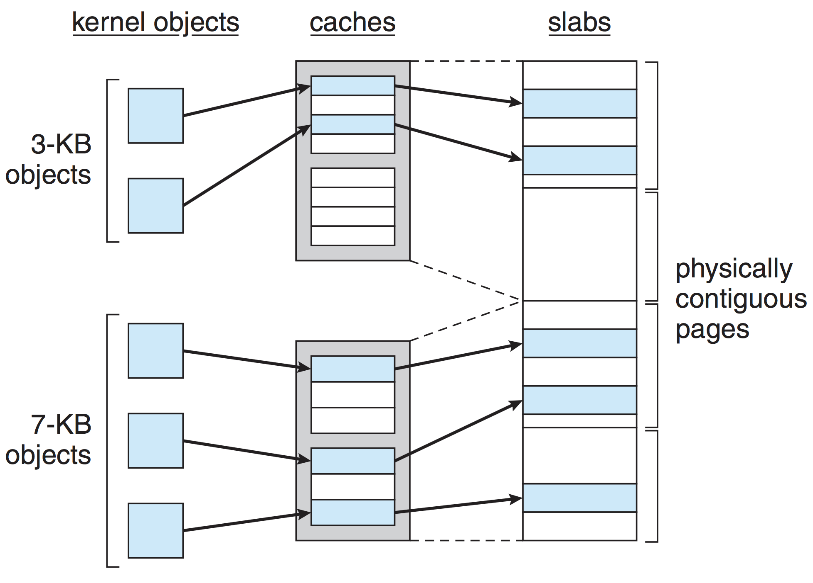
Kernel Memory

Slide 17
VM Issues: Page size and Pre-paging
Page size selection impacts
  fragmentation
  page table size
  I/O overhead
  locality
Pre-paging
  Bring to memory some (or all) of the pages a process
  will need, before they are referenced
  Tradeoff
    Reduce number of page faults at process startup
    But, may waste memory and I/O because some of the prepaged pages may not be used

Slide 18
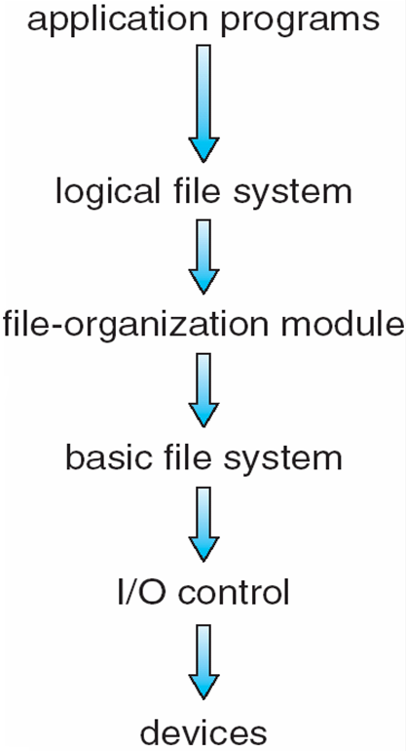
File System: Layered Structure
Goal: Efficiently support different types of devices and file systems
View files as logical blocks
Maintain metadata
Maps logical blocks to physical blocks
View data as physical blocks present in devices
Device drivers and device-specifc instructions
Read/write bit patterns to device controller

Slide 19
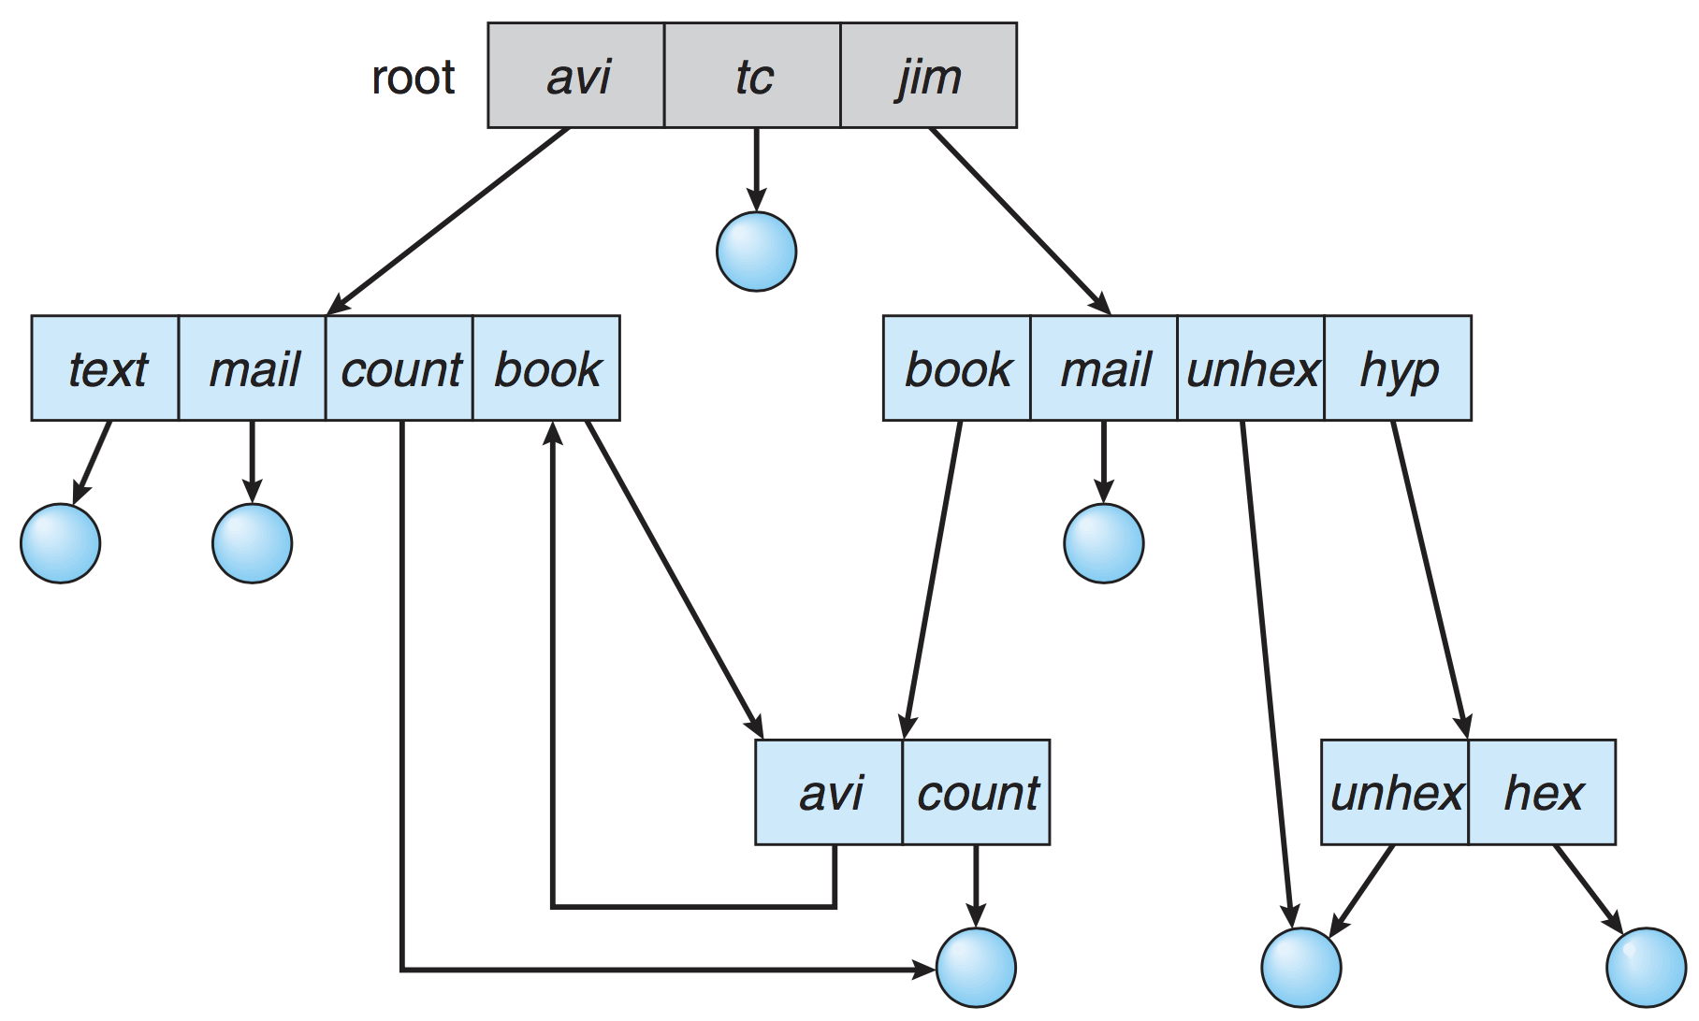
File System Interface
Files
  The smallest storage unit from the user’s perspective
  A collection of blocks on the disk
Directory structure
  Tree-structured with links (general graphs)
  Each file has an entry in the directory

Slide 20
File System Implementation
To implement a file system, we need
  On-disk structures, e.g.,
    directory structure, number of blocks, location of free blocks, boot information, …
    (In addition to data blocks, of course)
  In-memory structures to:
    improve performance (caching)
    manage file system

Slide 21
On-disk Structures
Free block
Boot block
Superblock
Directory structure
File control block
Data block

Slide 22
Block Allocation
Allocate free blocks to files to achieve efficient disk space utilization, and fast file access
Three common allocation methods
  Contiguous
  Linked
  Indexed
OS keeps track of free blocks using
  Bitmaps
  Linked lists

Slide 23
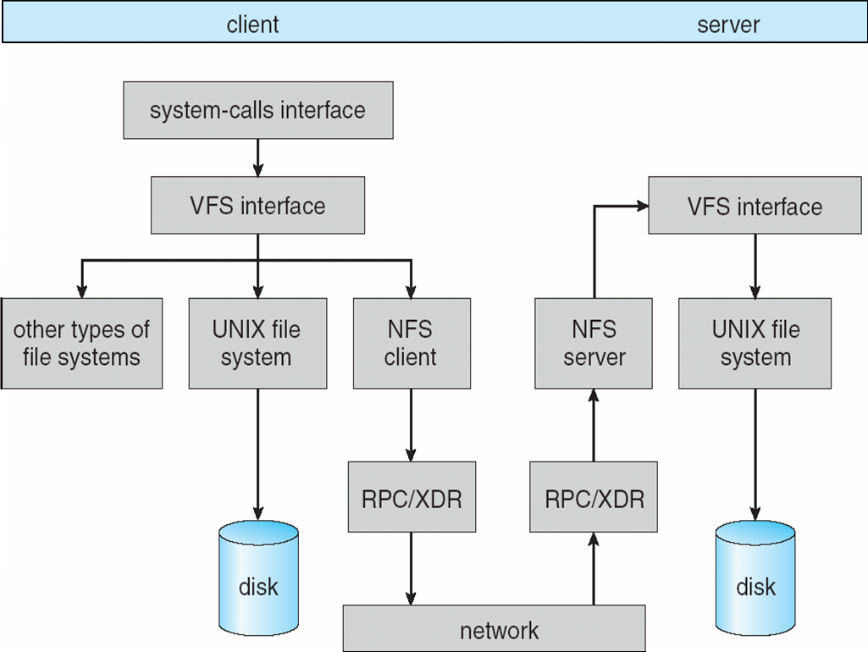
NFS Architecture
Notes:
Each machine acts as client and server
Link this to CSIL lab and their home directories.

Slide 24
Disk Structure and Scheduling
Disk structure
  Cylinders, tracks, sectors, logical blocks
Disk operation
  Move the head to desired track (seek time)
  Wait for desired sector to rotate under the head (rotational latency time)
  Transfer the block to a local buffer, then to main memory (transfer time)
Disk scheduling
  To minimize seek time (head movements)
  Algorithms: FCFS, SSTF, SCAN, LOOK

Slide 25
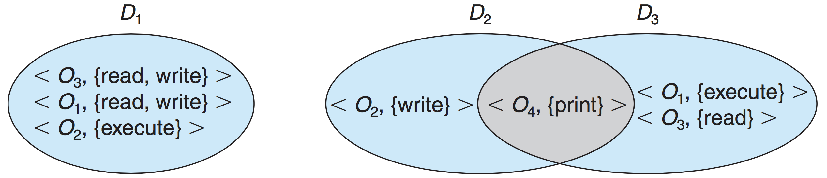
Protection
Ensure that each object is accessed correctly and only by those processes that are allowed to do so
A process operates within a protection domain
Domain = set of access rights (e.g., user-id in UNIX)

Slide 26
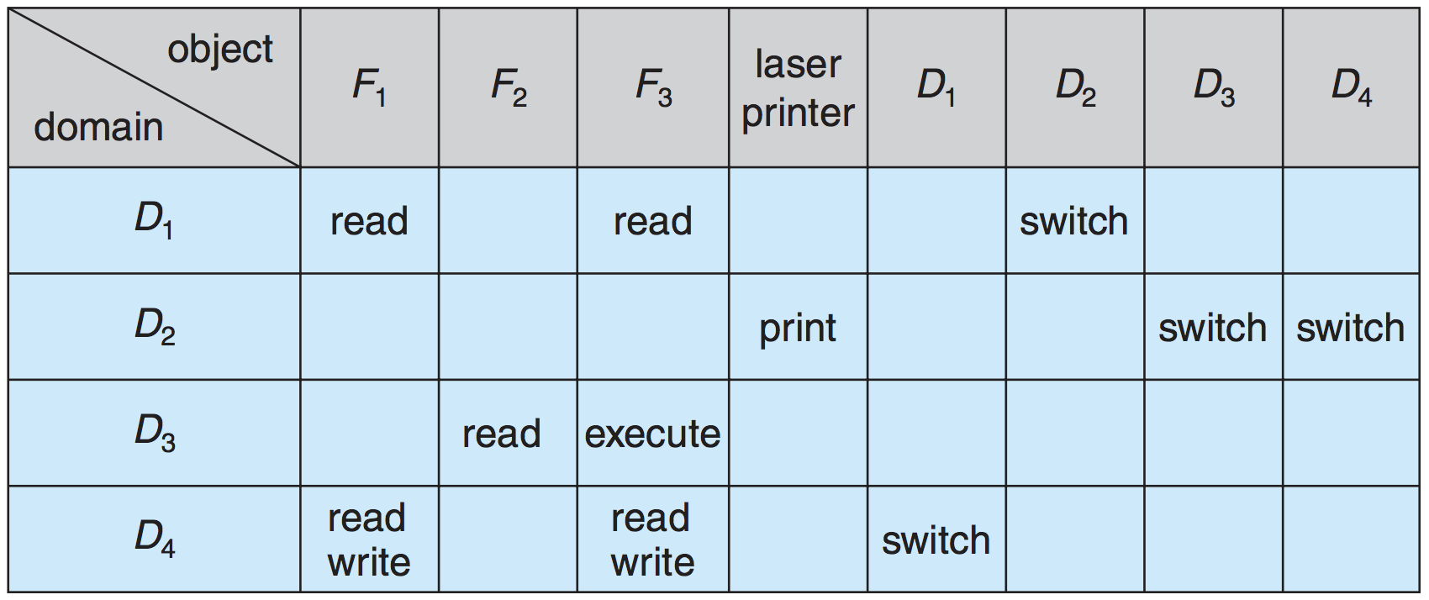
Access Matrix
Protection as a matrix
  Implemented as Access Control List (columns), or Capability List (rows)

Slide 27
Protection in UNIX
Default: Coarse-grained protection using 9 bits
  rwx rwx rwx
  Owner group all_others
Optional: fine-grained protection using
Access Control List
setuid, setgid for temporary domain switching

Slide 28



trust
yourself.
you know
more than you
think you do.

