Slide 1
School of Computing Science
Simon Fraser University
CMPT 300: Operating Systems I
Review: Chapters 1—7
Keval Vora

Slide 2
Chapter 1: Introduction
OS is a layer between user and hardware to make life easier for user and use hardware efficiently
  Control program or resource allocator
Computer organization
  CPU(s), memory, I/O devices common bus
  Devices request CPU attention through interrupts
OS is interrupt driven
  Interrupts are generated by devices (hardware)
  Traps (exceptions) are software-generated interrupts

Slide 3
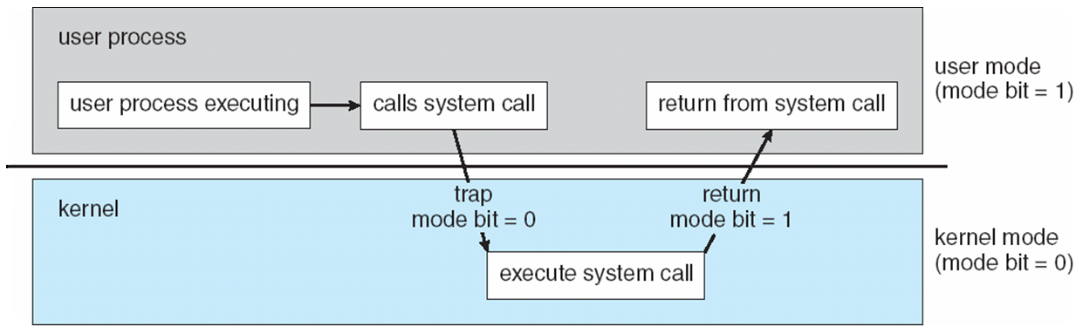
Operating-System Operations
Dual mode operation: user and kernel modes
  Protect OS and users from each other
  Privileged instructions executed only in kernel mode
Mode bit provided by hardware
  Distinguish when system is running user code or kernel code
  Some instructions designated as privileged, only executable in kernel mode
  System call changes mode to kernel, return from call resets mode back to user
Timer to prevent processes from holding resources forever

Slide 4
Chapter 2: OS Services and Structures
OS provides two sets of services for
  User convenience
  Efficient resource utilization
System calls: programming interface to OS services
  Typically used through APIs for portability and ease
OS structures
  Monolithic
  Layered
  Microkernel
  Modular
  Hybrid

Slide 5
Chapter 3: Processes
Process is a program in execution
  OS maintains process info in PCB
  Process State diagram
  Creating and terminating processes (fork)
Process scheduling
  Long-, short-, and medium-term schedulers
  Scheduling queues

Slide 6
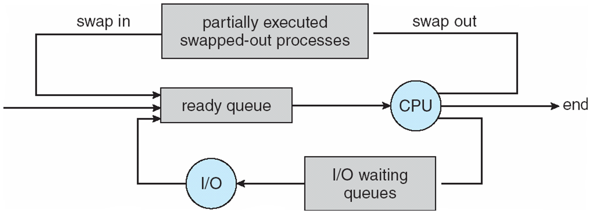
Scheduling: The Big Picture
Midterm sched.
Jobs
Disk
Job sched.
CPU sched.

Slide 7
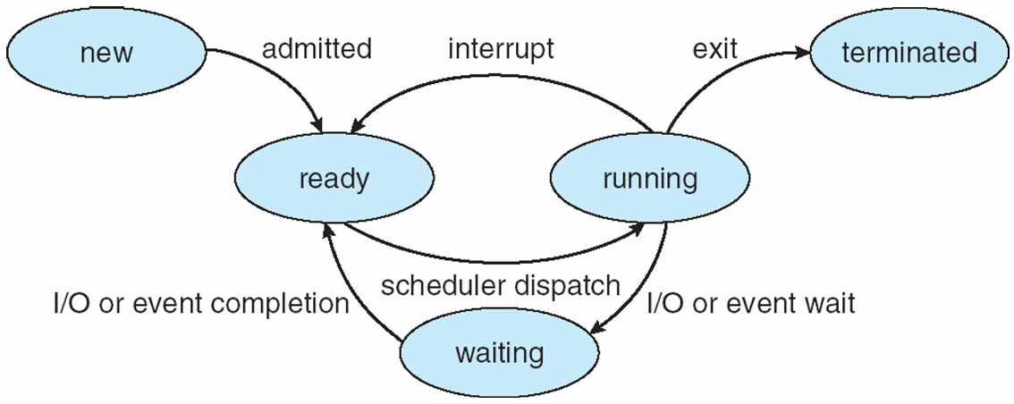
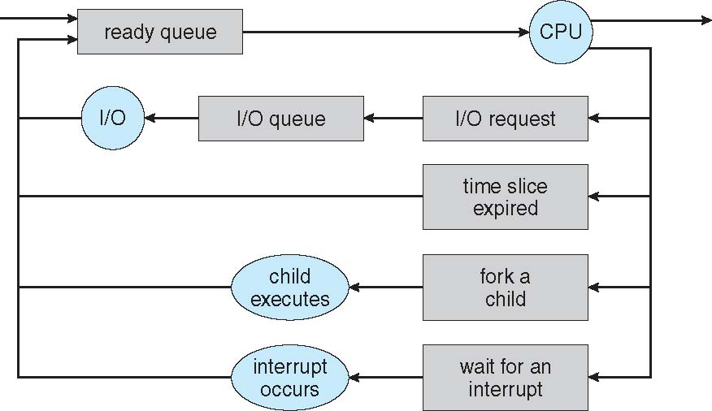
Process Lifetime

Slide 8
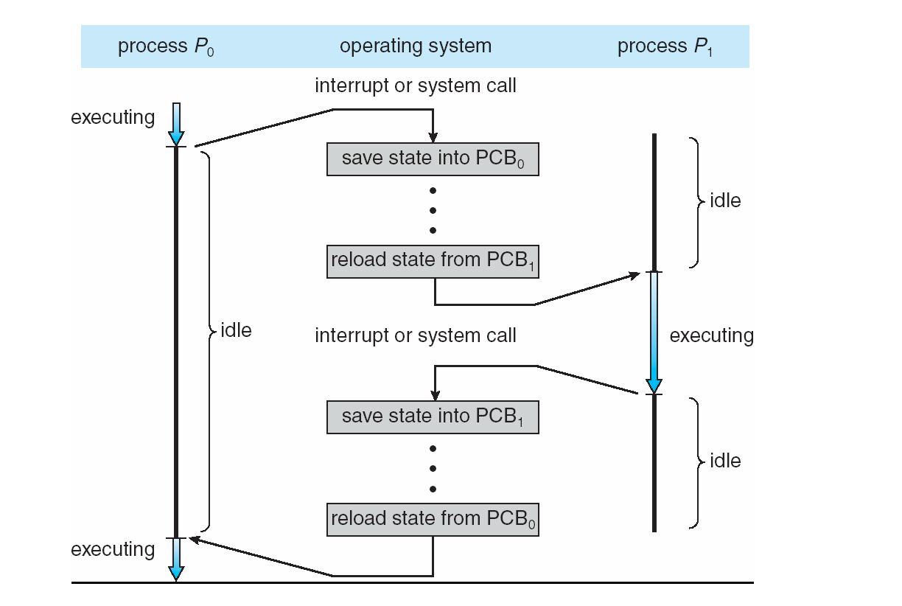
CPU Switch From Process to Process
(Context Switch)
When switching occurs, kernel
  Saves state of P₀ in PCB₀
  (in memory)
  Loads state of P₁ from PCB₁ into registers
State = values of the CPU registers, including the program counter, stack pointer
Notes:
Objective is to maximize CPU utilization
- Have some processing running at all times

Slide 9
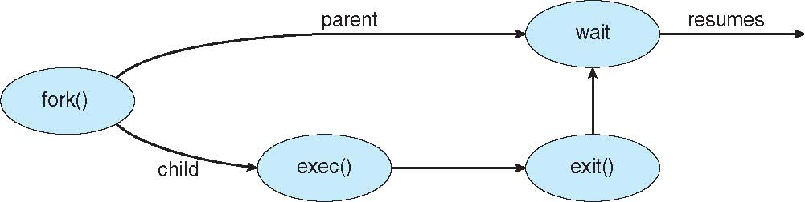
Process Creation: Unix Example
Process creates another process (child)
using fork system call
  Child is a copy of the parent
  Typically, child loads another program into its address space using exec system call
  Parent waits for its children to terminate
Notes:
- Exec loads a binary and overwrites the memory space

Slide 10
Interprocess Communications Models
Message Passing
Shared Memory

Slide 11
Chapter 4: Threads
A thread is a basic unit of CPU utilization
A process is composed of one or more threads
Each thread has
  Program counter, stack, registers
Threads share
  Code, data, OS resources (e.g., open files)

Slide 12
Single and Multithreaded Processes
Shared among threads
Notes:
QUESTION: WHY MULTITHREADING?

Slide 13
User Level Threads vs. Kernel Level Threads

Slide 14
Chapter 5: CPU Scheduling
Process execution contains cycles of
CPU bursts and I/O bursts
Scheduler selects one process
from ready queue to run
  Dispatcher performs switching
Scheduling criteria (usually conflicting)
  CPU utilization, waiting time,
  response time, throughput, …
Scheduling Algorithms
  FCFS, SJF, Priority, RR,
  Multilevel Queues, …

Slide 15
First-Come, First-Served (FCFS) Scheduling
Process Burst Time
P₁ 24
P₂ 3
P₃ 3
Suppose processes arrive in order: P₁ , P₂ , P₃
The Gantt Chart for the schedule is:
Waiting time?
  P₁ = 0; P₂ = 24; P₃ = 27
Average waiting time: (0 + 24 + 27) / 3 = 17
P₁
P₂
P₃
0
24
27
30

Slide 16
Shortest-Job-First (SJF) Scheduling
Schedule the process with the shortest time
Process Arrival Time Burst Time
P₁ 0 7
P₂ 2 4
P₃ 4 1
P₄ 5 4
Average waiting time = (0 + 6 + 3 + 7) / 4 = 4
Gantt Chart
P₁
P₃
P₂
P₄
0
3
7
8
12
16

Slide 17
Burst Length Prediction
Exponential Average
τ_{n+1} = α t_{n} + (1 - α) τ_{n}
  τ_{n+1} : predicted burst length at time n+1
  t_{n} : actual burst length at time n
τ_{n+1} = α t_{n} + α (1 - α) t_{n -1} + α (1 - α )² t_{n} ₋₂ + … + (1 - α )^{n +1} τ₀
Assigns smaller weights for older values
Notes:
τ_{n} captures history
α is typically 1/2

Slide 18
CPU Scheduling
Multiprocessor Scheduling
  Processor affinity vs. load balancing
Real-time scheduling
  Hard and soft
Evaluation of Algorithms
  Modeling, queuing theory, simulation, implementation

Slide 19
Chapter 6: Synchronization
Processor Synchronization
  Techniques to coordinate access to shared data
  Eliminate race conditions
Critical section problem
  Three requirements:
  mutual exclusion, progress, bounded waiting
  Software solution: Peterson’s Algorithm
  Hardware support: TestAndSet(), CompareAndSwap()
  Semaphores
    No busy waiting implementation
  Monitors
    High-level (programming language) constructs
Some classical synchronization problems
  Consumer-producer
  Dining philosopher
  Readers-writers

Slide 20
Chapter 7: Deadlock
Deadlock: A set of processes each holding a resource and waiting for a resource held by another process in the set
Four necessary conditions
  Mutual exclusive, no preemption, hold and wait, circular wait
  If they all hold, deadlock may (or may not) occur
Deadlock handling
  Prevention: ensure that at least one of the necessary conditions does not hold (may yield low utilization)
  Avoidance: decide for each request whether the process should wait, to avoid leaving the system in unsafe state
    Resource-allocation graph: single instance of each resource
    Banker’s algorithm: multiple instances of each resource
  Detection and Recovery
    Detection algorithms
    Recovery: process termination or resource preemption

Slide 21

Knock ‘em out
with your
GENIUS!

