Slide 1



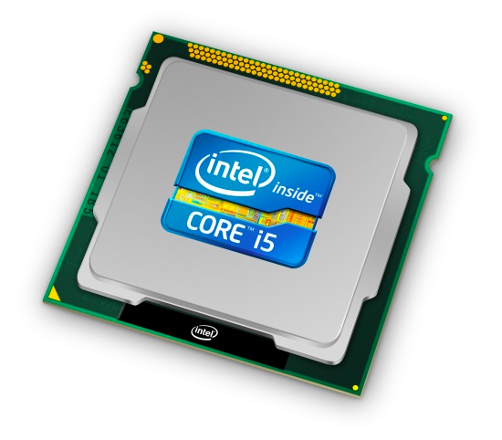
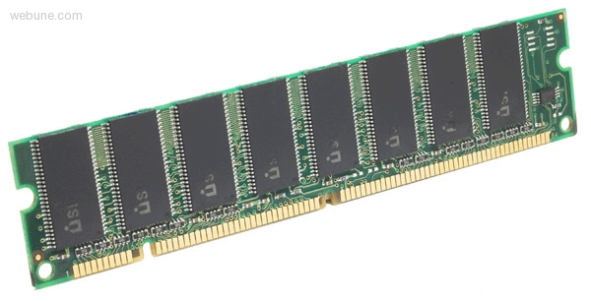
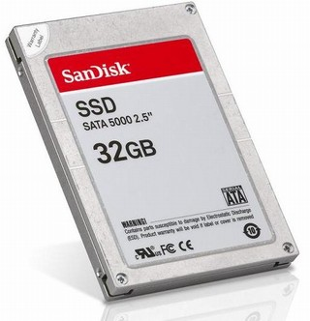
Roadmap
C:
Java:
Memory & data
Arrays and Structs
Integers & floats
RISC V assembly
Procedures & stacks
Executables
Memory & caches
Processor Pipeline
Performance
Parallelism
car *c = malloc(sizeof(car));
c->miles = 100;
c->gals = 17;
float mpg = get_mpg(c);
free(c);
Car c = new Car();
c.setMiles(100);
c.setGals(17);
float mpg = c.getMPG();
Assembly language:
OS:
Machine code:
0111010000011000
100011010000010000000010
1000100111000010
110000011111101000011111
Computer system:

Slide 2
From Writing to Running
Compiler
Assembler
Linker
executable
program
gcc -S
gcc -c
gcc -o
sum.c
sum.s
sum.o
sum
C source
files
assembly
files
obj files
exists on
disk
loader
“It’s alive!”
When most people say “compile” they mean
the entire process:
compile + assemble + link
Executing
in
Memory
process
Notes:
C compiler produces assembly files (contain MIPS assembly, pseudo-instructions, directives, etc.)
MIPS assembler produces object files (contain MIPS machine code, missing symbols, some layout information, etc.)
MIPS linker produces executable file (contains MIPS machine code, no missing symbols, some layout information)
OS loader gets it into memory and jumps to first instruction (machine code)

Slide 3
Example: sum.c
Compiler output is assembly files
Assembler output is obj files
Linker joins object files into one executable
Loader brings it into memory and starts execution

Slide 4
Example: sum.c
#include <stdio.h>
int n = 100;
int main (int argc, char* argv[ ]) {
int i;
int m = n;
int sum = 0;
for (i = 1; i <= m; i++) {
sum += i;
}
printf ("Sum 1 to %d is %d\n", n, sum);
}

Slide 5
Example: sum.c
# Compile
[VM] riscv32-unknown-elf-gcc –S sum.c
# Assemble
[VM] riscv32-unknown-elf-gcc –c sum.s
# Link
[VM] riscv32-unknown-elf-gcc –o sum sum.o
# Load
[VM] qemu-riscv32 sum
Sum 1 to 100 is 5050
RISC-V program exits with status 0 (approx. 2007 instructions in 143000 nsec at 14.14034 MHz)

Slide 6
Compiler
Input: Code File (.c)
Source code
#includes, function declarations & definitions, global variables, etc.
Output: Assembly File (RISC-V)
RISC-V assembly instructions
(.s file)
for (i = 1; i <= m; i++) {
sum += i;
}
li x2,1
lw x3,fp,28
slt x2,x3,x2

Slide 7
sum.s (abridged)
$L2: lw $a4,-20($fp)
lw $a5,-28($fp)
blt $a5,$a4,$L3
lw $a4,-24($fp)
lw $a5,-20($fp)
addu $a5,$a4,$a5
sw $a5,-24($fp)
lw $a5,-20($fp)
addi $a5,$a5,1
sw $a5,-20($fp)
j $L2
$L3: la $4,$str0
lw $a1,-28($fp)
lw $a2,-24($fp)
jal printf
li $a0,0
mv $sp,$fp
lw $ra,44($sp)
lw $fp,40($sp)
addiu $sp,$sp,48
jr $ra
i=1
m=100
.globl n
.data
.type n, @object
n: .word 100
.rdata
$str0: .string "Sum 1 to %d is %d\n"
.text
.globl main
.type main, @function
main: addiu $sp,$sp,-48
sw $ra,44($sp)
sw $fp,40($sp)
move $fp,$sp
sw $a0,-36($fp)
sw $a1,-40($fp)
la $a5,n
lw $a5,0($a5)
sw $a5,-28($fp)
sw $0,-24($fp)
li $a5,1
sw $a5,-20($fp)
if(m < i)
100 < 1
0(sum)
1(i)
1=(0+1)
sum=1
a5=i=1
i=2=(1+1)
i=2
$a0
str
call
printf
$a1
m=100
prologue
$a0
$a2
sum
$a1
n=100
main returns 0
m=n=100
sum=0
epilogue
i=1
Notes:
note:
funny label names
alignment directives
.data versus .rdata
frame pointer equals stack pointer
totally unoptimized
use of LA
Actual compiled code below
.file "sum.c"
.option nopic
.text
.globl n
.section .sdata,"aw"
.align 2
.type n, @object
.size n, 4
n:
.word 100
.section .rodata
.align 2
.LC0:
.string "Sum 1 to %d is %d\n"
.text
.align 1
.globl main
.type main, @function
main:
addi sp,sp,-48
sw ra,44(sp)
sw s0,40(sp)
addi s0,sp,48
sw a0,-36(s0)
sw a1,-40(s0)
lui a5,%hi(n)
lw a5,%lo(n)(a5)
sw a5,-28(s0) # m
sw zero,-24(s0) # sum
li a5,1
sw a5,-20(s0) # i
j .L2
.L3:
lw a4,-24(s0) # sum
lw a5,-20(s0) # i
add a5,a4,a5 # add sum + i
sw a5,-24(s0) # sum store
lw a5,-20(s0) # i
addi a5,a5,1 # i++
sw a5,-20(s0) # store i
.L2:
lw a4,-20(s0) # i
lw a5,-28(s0) # m
ble a4,a5,.L3 # if (i < m) brant to L3
lui a5,%hi(n)
lw a5,%lo(n)(a5)
lw a2,-24(s0) # sum
mv a1,a5 # n
lui a5,%hi(.LC0)
addi a0,a5,%lo(.LC0) # string
call printf
li a5,0
mv a0,a5
lw ra,44(sp)
lw s0,40(sp)
addi sp,sp,48
jr ra
.size main, .-main
.ident "GCC: (GNU) 8.2.0"

Slide 8
Assembler
Input: Assembly File (.s)
assembly instructions, pseudo-instructions
program data (strings, variables), layout directives
Output: Object File in binary machine code RISC-V instructions in executable form
(.o file in Unix, .obj in Windows)
addi r5, r0, 10
muli r5, r5, 2
addi r5, r5, 15
00000000101000000000001010010011
00000000001000101000001010000000
00000000111100101000001010010011

Slide 9
RISC-V Assembly Instructions
Arithmetic/Logical
ADD, SUB, AND, OR, XOR, SLT, SLTU
ADDI, ANDI, ORI, XORI, LUI, SLL, SRL, SLTI, SLTIU
MUL, DIV
Memory Access
LW, LH, LB, LHU, LBU,
SW, SH, SB
Control flow
BEQ, BNE, BLE, BLT, BGE
JAL, JALR
Special
LR, SC, SCALL, SBREAK

Slide 10
Pseudo-Instructions
Assembly shorthand, technically not machine instructions, but easily converted into 1+ instructions that are
Pseudo-Insns Actual Insns Functionality
NOP ADDI x0, x0, 0 # do nothing
MV reg, reg ADD r2, r0, r1 # copy between regs
LI reg, 0x45678 LUI reg, 0x4 #load immediate
ORI reg, reg, 0x5678
LA reg, label # load address (32 bits)
B label BEQ x0, x0, label # unconditional branch
+ a few more…
Notes:
Pseudo-Instructions
NOP # do nothing
ADDI x0, x0, 0
MV reg, reg # copy between regs
ADDI x2, x0, x1 # copies contents of x1 to x2
LI reg, imm # load immediate (up to 32 bits)
LA reg, label # load address (32 bits)
B label # unconditional branch

Slide 11
Program Layout
Programs consist of segments used for different purposes
Text: holds instructions
Data: holds statically allocated program data such as variables, strings, etc.
“sfu cs”
13
25
data
add x1,x2,x3
ori x2, x4, 3
...
text

Slide 12
Assembling Programs
Assembly files consist of a mix of
+ instructions
+ pseudo-instructions
+ assembler (data/layout) directives
(Assembler lays out binary values
in memory based on directives)
Assembled to an Object File
Header
Text Segment
Data Segment
Relocation Information
Symbol Table
Debugging Information
.text
.ent main
main: la $4, Larray
li s5, 15
...
li s4, 0
jal exit
.end main
.data
Larray:
.long 51, 491, 3991
Notes:
A program is made up by code and data from several object files
Each object file is generated independently
Assembler starts at some PC address, e.g. 0, in each object file, generates code as if the program were laid out starting out at location 0x0
It also generates a symbol table, and a relocation table
In case the segments need to be moved

Slide 13
Symbols and References
math.c
int pi = 3;
int e = 2;
static int randomval = 7;
extern int usrid;
extern int printf(char *str, …);
int square(int x) { … }
static int is_prime(int x) { … }
int pick_prime() { … }
int get_n() {
return usrid;
}
Global labels: Externally visible “exported” symbols
Can be referenced from other object files
Exported functions, global variables
Examples: pi, e, userid, printf, pick_prime, pick_random
Local labels: Internally visible only
Only used within this object file
static functions, static variables, loop labels, …
Examples: randomval, is_prime
(extern == defined in another file)

Slide 14
Producing Machine Language (1/3)
Simple Cases
Arithmetic and logical instructions, shifts, etc.
All necessary info contained in the instruction
What about Branches and Jumps?
Branches and Jumps require a relative address
Once pseudo-instructions are replaced by real ones, we know by how many instructions to branch, so no problem

Slide 15
Producing Machine Language (2/3)
“Forward Reference” problem
Branch instructions can refer to labels that are “forward” in the program:
Solution: Make two passes over the program
or s0, x0, x0 L1: slt t0, x0, a1 beq t0, x0, L2 addi a1, a1, -1 j L1 L2: add t1, a0, a1
Notes:
This is a problem because the program is read sequentially from top to bottom.
Flesh the two passes out

Slide 16
Two Passes Overview
Pass 1:
Expands pseudo instructions encountered
Remember position of labels
Take out comments, empty lines, etc
Error checking
Pass 2:
Use label positions to generate relative addresses (for branches and jumps)
Outputs the object file, a collection of instructions in binary code
Notes:
This is a problem because the program is read sequentially from top to bottom

Slide 17
Handling forward references
Example:
bne x1, x2, L sll x0, x0, 0
L: addi x2, x3, 0x2
The assembler will change this to
bne x1, x2, +8 sll x0, x0, 0 addi x2, x3, 0x2
Final machine code
0X00208413 # bne 0x00001033 # sll 0x00018113 # addi
Looking for L
Found L
actually: 0000 0000 0010...
0000 0000 0000...
0000 0000 0000...
Notes:
0x00208413 = 0000000 00010 00001 000 00100 0010011 #bne x1, x2, 0x4
0x00001033 = 0000000 00000 00000 001 00000 0110011 # sll x0, x0, x0
0x00018113 = 0000 0000 0000 00011 000 00010 0010011 # addi x2, x3, 0x2

Slide 18
Object file
Header
Size and position of pieces of file
Text Segment
instructions
Data Segment
static data (local/global vars, strings, constants)
Debugging Information
line number → code address map, etc.
Symbol Table
External (exported) references
Unresolved (imported) references
Object File

Slide 19
Object File Formats
Unix
a.out
COFF: Common Object File Format
ELF: Executable and Linking Format
Windows
PE: Portable Executable
All support both executable and object files

Slide 20
Objdump disassembly
> riscv32-unknown-elf--objdump --disassemble math.o
Disassembly of section .text:
00000000 <get_n>:
0: 27bdfff8 addi sp,sp,-8
4: afbe0000 sw fp,0(sp)
8: 03a0f021 mv fp,sp
c: 3c020000 lui a0,0x0
10: 8c420008 lw a0,8(a0)
14: 03c0e821 mv sp,fp
18: 8fbe0000 lw fp,0(sp)
1c: 27bd0008 addi sp,sp,8
20: 03e00008 jr ra
elsewhere in another file: int usrid = 41;
int get_n() {
return usrid;
}
prologue
unresolved symbol
(see symbol table next slide)
body
epilogue
Notes:
something suspicious: a lot of zero constants in this code

Slide 21
Objdump symbols
[F]unction
[O]bject
[l]ocal
[g]lobal
> riscv-unknown-elf--objdump --syms math.o
SYMBOL TABLE:
00000000 l df *ABS* 00000000 math.c
00000000 l d .text 00000000 .text
00000000 l d .data 00000000 .data
00000000 l d .bss 00000000 .bss
00000008 l O .data 00000004 randomval
00000060 l F .text 00000028 is_prime
00000000 l d .rodata 00000000 .rodata
00000000 l d .comment 00000000 .comment
00000000 g O .data 00000004 pi
00000004 g O .data 00000004 e
00000000 g F .text 00000028 get_n
00000028 g F .text 00000038 square
00000088 g F .text 0000004c pick_prime
00000000 *UND* 00000000 usrid
00000000 *UND* 00000000 printf
segment
size
static local fn
@ addr 0x60
size = 0x28 bytes
external references (undefined)
Notes:
notice: pick_random, square, other functions; pi, e, randomval; some undefined symbols

Slide 22
Separate Compilation & Assembly
Compiler
Assembler
Linker
executable
program
gcc -S
gcc -c
gcc -o
sum.c
sum.s
sum.o
sum
math.c
math.s
math.o
exists on
disk
source files
assembly files
obj files
loader
small change ?
→ recompile one
module only
Executing
in
Memory
process
http://xkcd.com/303/
Notes:
C compiler produces assembly files (contain RISC-V assembly, pseudo-instructions, directives, etc.)
RISC-V assembler produces object files (contain RISC-V machine code, missing symbols, some layout information, etc.)
RISC-V linker produces executable file (contains RISC-V machine code, no missing symbols, some layout information)
OS loader gets it into memory and jumps to first instruction (machine code)

Slide 23
Linker (1/3)
Input: Object Code files, information tables (e.g. foo.o,lib.o for RISC-V)
Output: Executable Code (e.g. a.out for RISC-V)
Combines several object (.o) files into a single executable (“linking”)
Enables separate compilation of files
Changes to one file do not require recompilation of whole program
Old name “Link Editor” from editing the “links” in jump and link instructions

Slide 24
Linker (2/3)
object file 1
text 1
a.out
data 1
Relocated text 1
info 1
Linker
Relocated text 2
object file 2
Relocated data 1
text 2
Relocated data 2
data 2
info 2

Slide 25
Linker (3/3)
Take text segment from each .o file and put them together
Take data segment from each .o file, put them together, and concatenate this onto end of text segments
Resolve References
Go through Relocation Table; handle each entry
i.e. fill in all absolute addresses

Slide 26
Resolving References (1/2)
Linker assumes the first word of the first text segment is at 0x10000 for RV32.
More later when we study “virtual memory”
Linker knows:
Length of each text and data segment
Ordering of text and data segments
Linker calculates:
Absolute address of each label to be jumped to (internal or external) and each piece of data being referenced

Slide 27
Resolving References (2/2)
To resolve references:
Search for reference (data or label) in all “user” symbol tables
If not found, search library files (e.g. printf)
Once absolute address is determined, fill in the machine code appropriately
Output of linker: executable file containing text and data (plus header)

Slide 28
Three Types of Addresses
PC-Relative Addressing (beq, bne, jal)
never relocate
External Function Reference (usually jal)
always relocate
Static Data Reference (often auipc and addi)
always relocate
RISC-V often uses auipc rather than lui so that a big block of stuff can be further relocated as long as it is fixed relative to the pc

Slide 29
Static Libraries
Static Library: Collection of object files (think: like a zip archive)
Q: Every program contains the entire library?!?
A: No, Linker picks only object files needed to resolve undefined references at link time
e.g. libc.a contains many objects:
printf.o, fprintf.o, vprintf.o, sprintf.o, snprintf.o, …
read.o, write.o, open.o, close.o, mkdir.o, readdir.o, …
rand.o, exit.o, sleep.o, time.o, ….

Slide 30
Linker Example: Resolving an External Fn Call
main.o
math.o
...
000000EF
21035000
1b80050C
8C040000
21047002
000000EF
...
...
21032040
000000EF
1b301402
00000B37
00028293
...
40
44
48
4C
50
54
24
28
2C
30
34
.text
20 T get_n
00 D pi
*UND* printf
*UND* usrid
00 T main
00 D usrid
*UND* printf
*UND* pi
*UND* get_n
Symbol table
28,JAL, printf
Relocation info
40,JAL, printf
...
54,JAL, get_n
JAL printf → JAL ???
Unresolved references to printf and get_n
Notes:
main.o
0x000000EF = 00000000000000000000 0000 1110 1111 (JAL)
0x10000B37 = 00010000000000000000 00101 0110111 # LUI x5, 0x10000
0x00428293 = 0000 0000 0100 0010 1000 0010 1001 0011 # ADDI x5, x5, 0x4
0C000000 = 0000 1100 (JAL)
21035000 = 001000 01000 00011 0101 0000 0000 0000 (ADDI $3,$8, 0x5000)
1B80050C = 000110 11100 00000 0000 0101 0000 1100 (BLEZ $28, 0x050C)
3C040000 = 001111 00000 00100 0000 0000 0000 0000 (LUI, $4, 0)
21047002 = 001000 01000 00100 0111 0000 0000 0010 (ADDI $4, $8, 0x7002)
math.o
21032040 = 001000 01000 00011 0010 0000 0100 0000 (ADDI $3,$8, 0x2040)
0C000000 = 0000 1100 (JAL)
1B301402 = 000110 11001 10000 0001 0100 0000 0010 (BLEZ $23, 0x1402)
3C040000 = 001111 000000 0100 0000 0000 0000 0000 (LUI, $4, 0)
34040000 = 001101 000000 0100 0000 0000 0000 0000 (ORI, $4, 0)
1111 f
1110 e
1101 d
1100 c
1011 b
1010 a

Slide 31
main.o
math.o
Which symbols are undefined according to both main.o and math.o’s symbol table?
printf
pi
get_n
usr
printf & pi
...
000000EF
21035000
1b80050C
8C040000
21047002
000000EF
...
...
21032040
000000EF
1b301402
00000B37
00028293
...
40
44
48
4C
50
54
24
28
2C
30
34
.text
20 T get_n
00 D pi
*UND* printf
*UND* usrid
00 T main
00 D usrid
*UND* printf
*UND* pi
*UND* get_n
Symbol table
28,JAL, printf
40,JAL, printf
...
54,JAL, get_n
Relocation info
printf.o
JAL printf → JAL ??? Unresolved references to
printf and get_n
...
3C T printf
Notes:
main.o
0x000000EF = 00000000000000000000 0000 1110 1111 (JAL)
0x10000B37 = 00010000000000000000 00101 0110111 # LUI x5, 0x10000
0x00428293 = 0000 0000 0100 0010 1000 0010 1001 0011 # ADDI x5, x5, 0x4
0C000000 = 0000 1100 (JAL)
21035000 = 001000 01000 00011 0101 0000 0000 0000 (ADDI $3,$8, 0x5000)
1B80050C = 000110 11100 00000 0000 0101 0000 1100 (BLEZ $28, 0x050C)
3C040000 = 001111 00000 00100 0000 0000 0000 0000 (LUI, $4, 0)
21047002 = 001000 01000 00100 0111 0000 0000 0010 (ADDI $4, $8, 0x7002)
math.o
21032040 = 001000 01000 00011 0010 0000 0100 0000 (ADDI $3,$8, 0x2040)
0C000000 = 0000 1100 (JAL)
1B301402 = 000110 11001 10000 0001 0100 0000 0010 (BLEZ $23, 0x1402)
3C040000 = 001111 000000 0100 0000 0000 0000 0000 (LUI, $4, 0)
34040000 = 001101 000000 0100 0000 0000 0000 0000 (ORI, $4, 0)
1111 f
1110 e
1101 d
1100 c
1011 b
1010 a

Slide 32
main.o
math.o
sum.exe
0040 0000
...
21032040
40023CEF
1b301402
3C041000
34040004
...
40023CEF
21035000
1b80050c
8C048004
21047002
400020EF
...
10201000
21040330
22500102
...
...
000000EF
21035000
1b80050C
8C040000
21047002
000000EF
...
...
21032040
000000EF
1b301402
00000B37
00028293
...
40
44
48
4C
50
54
24
28
2C
30
34
JAL printf
math
.text
0040 0100
JAL printf
20 T get_n
00 D pi
*UND* printf
*UND* usrid
00 T main
00 D usrid
*UND* printf
*UND* pi
*UND* get_n
main
.text
Symbol table
28,JAL, printf
JAL get_n
0040 0200
40,JAL, printf
...
54,JAL, get_n
printf
Relocation info
printf.o
1000 0000
global variables
go here (later)
...
JAL printf → JAL ???
Unresolved references to
printf and get_n
.data
Entry:0040 0100
text: 0040 0000
data: 1000 0000
3C T printf
Notes:
main.o
0x000000EF = 00000000000000000000 0000 1110 1111 (JAL)
0x10000B37 = 00010000000000000000 00101 0110111 # LUI x5, 0x10000
0x00428293 = 0000 0000 0100 0010 1000 0010 1001 0011 # ADDI x5, x5, 0x4
0C000000 = 0000 1100 (JAL)
21035000 = 001000 01000 00011 0101 0000 0000 0000 (ADDI $3,$8, 0x5000)
1B80050C = 000110 11100 00000 0000 0101 0000 1100 (BLEZ $28, 0x050C)
3C040000 = 001111 00000 00100 0000 0000 0000 0000 (LUI, $4, 0)
21047002 = 001000 01000 00100 0111 0000 0000 0010 (ADDI $4, $8, 0x7002)
math.o
21032040 = 001000 01000 00011 0010 0000 0100 0000 (ADDI $3,$8, 0x2040)
0C000000 = 0000 1100 (JAL)
1B301402 = 000110 11001 10000 0001 0100 0000 0010 (BLEZ $23, 0x1402)
3C040000 = 001111 000000 0100 0000 0000 0000 0000 (LUI, $4, 0)
34040000 = 001101 000000 0100 0000 0000 0000 0000 (ORI, $4, 0)
1111 f
1110 e
1101 d
1100 c
1011 b
1010 a

Slide 33
Question 2
main.o
math.o
...
000000EF
21035000
1b80050C
8C040000
21047002
000000EF
...
...
21032040
000000EF
1b301402
00000B37
00028293
...
40
44
48
4C
50
54
24
28
2C
30
34
Which which 2 symbols are currently assigned the same location?
main & printf
usrid & pi
get_n & printf
main & usrid
main & pi
.text
20 T get_n
00 D pi
*UND* printf
*UND* usrid
00 T main
00 D usrid
*UND* printf
*UND* pi
*UND* get_n
Symbol table
28,JAL, printf
40,JAL, printf
...
54,JAL, get_n
Relocation info
printf.o
JAL printf → JAL ???
Unresolved references to
printf and get_n
...
3C T printf
Notes:
main.o
0x000000EF = 00000000000000000000 0000 1110 1111 (JAL)
0x10000B37 = 00010000000000000000 00101 0110111 # LUI x5, 0x10000
0x00428293 = 0000 0000 0100 0010 1000 0010 1001 0011 # ADDI x5, x5, 0x4
0C000000 = 0000 1100 (JAL)
21035000 = 001000 01000 00011 0101 0000 0000 0000 (ADDI $3,$8, 0x5000)
1B80050C = 000110 11100 00000 0000 0101 0000 1100 (BLEZ $28, 0x050C)
3C040000 = 001111 00000 00100 0000 0000 0000 0000 (LUI, $4, 0)
21047002 = 001000 01000 00100 0111 0000 0000 0010 (ADDI $4, $8, 0x7002)
math.o
21032040 = 001000 01000 00011 0010 0000 0100 0000 (ADDI $3,$8, 0x2040)
0C000000 = 0000 1100 (JAL)
1B301402 = 000110 11001 10000 0001 0100 0000 0010 (BLEZ $23, 0x1402)
3C040000 = 001111 000000 0100 0000 0000 0000 0000 (LUI, $4, 0)
34040000 = 001101 000000 0100 0000 0000 0000 0000 (ORI, $4, 0)
1111 f
1110 e
1101 d
1100 c
1011 b
1010 a

Slide 34
main.o
math.o
sum.exe
0040 0000
...
21032040
40023CEF
1b301402
10000B37
00428293
...
40023CEF
21035000
1b80050c
8C048004
21047002
400020EF
...
10201000
21040330
22500102
...
...
000000EF
21035000
1b80050C
8C040000
21047002
000000EF
...
...
21032040
000000EF
1b301402
00000B37
00028293
...
40
44
48
4C
50
54
24
28
2C
30
34
LA num:
LUI 10000
ADDI 004
math
.text
0040 0100
20 T get_n
00 D pi
*UND* printf
*UND* usrid
00 T main
00 D usrid
*UND* printf
*UND* pi
*UND* get_n
main
.text
Symbol table
28,JAL, printf
30,LUI, usrid
34,LA, usrid
0040 0200
40,JAL, printf
...
54,JAL, get_n
Notice: usrid gets relocated due to collision with pi
printf
Relocation info
1000 0000
pi
00000003
0077616B
LA = LUI/ADDI ”usrid” → ???
Unresolved references to userid
Need address of global variable
.data
usrid
Entry:0040 0100
text: 0040 0000
data: 1000 0000
Notes:
main.o
0x000000EF = 00000000000000000000 0000 1110 1111 # JAL
0x10000B37 = 00010000000000000000 00101 0110111 # LUI x5, 0x10000
0x00428293 = 0000 0000 0100 0010 1000 0010 1001 0011 # ADDI x5, x5, 0x4
0C000000 = 0000 1100 (JAL)
21035000 = 001000 01000 00011 0101 0000 0000 0000 (ADDI $3,$8, 0x5000)
1B80050C = 000110 11100 00000 0000 0101 0000 1100 (BLEZ $28, 0x050C)
3C040000 = 001111 00000 00100 0000 0000 0000 0000 (LUI, $4, 0)
21047002 = 001000 01000 00100 0111 0000 0000 0010 (ADDI $4, $8, 0x7002)
math.o
21032040 = 001000 01000 00011 0010 0000 0100 0000 (ADDI $3,$8, 0x2040)
0C000000 = 0000 1100 (JAL)
1B301402 = 000110 11001 10000 0001 0100 0000 0010 (BLEZ $23, 0x1402)
3C040000 = 001111 000000 0100 0000 0000 0000 0000 (LUI, $4, 0)
34040000 = 001101 000000 0100 0000 0000 0000 0000 (ORI, $4, 0)
1111 f
1110 e
1101 d
1100 c
1011 b
1010 a

Slide 35
Question
Where does the assembler place the following symbols in the object file that it creates?
A. Text Segment B. Data Segment C. Exported reference in symbol table
D. Imported reference in symbol table
E. None of the above
#include <stdio.h>
#include heaplib.h
#define HEAP SIZE 16
static int ARR SIZE = 4;
int main() {
char heap[HEAP SIZE]; hl_init(heap, HEAP SIZE * sizeof(char)); char* ptr = (char *) hl alloc(heap, ARR SIZE * sizeof(char));
ptr[0] = ’h’;
ptr[1] = ’i’;
ptr[2] = ’\0’;
printf(%s\n, ptr); return 0;
}
Q1: HEAP_SIZE
Q2: ARR_SIZE
Q3: hl_init

Slide 36
Loader
Input:Executable Code (e.g. a.out for RISC-V)
Output: <program is run>
Executable files are stored on disk
When one is run, loader’s job is to load it into memory and start it running
In reality, loader is the operating system (OS)
loading is one of the OS tasks

Slide 37
Loader
Reads executable file’s header to determine size of text and data segments
Creates new address space for program large enough to hold text and data segments, along with a stack segment <more on this later>
Copies instructions and data from executable file into the new address space

Slide 38
Loader
Copies arguments passed to the program onto the stack
Initializes machine registers
Most registers cleared, but stack pointer assigned address of 1st free stack location
Jumps to start-up routine that copies program’s arguments from stack to registers and sets the PC
If main routine returns, start-up routine terminates program with the exit system call

Slide 39
Shared Libraries
Q: Every program contains parts of same library?!?
A: No, they can use shared libraries
Executables all point to single shared library on disk
final linking (and relocations) done by the loader
Optimizations:
Library compiled at fixed non-zero address
Jump table in each program instead of relocations
Can even patch jumps on-the-fly
Notes:
fixed address: drawbacks? advantages?
(makes linking trivial: few relocations needed)

Slide 40
Static and Dynamic Linking
Static linking
Big executable files (all/most of needed libraries inside)
Don’t benefit from updates to library
No load-time linking
Dynamic linking
Small executable files (just point to shared library)
Library update benefits all programs that use it
Load-time cost to do final linking
But dll code is probably already in memory
And can do the linking incrementally, on-demand
Notes:
cost of loading big executables
dll hell, versioning problems

Slide 41
Compiler
Assembler
Linker
sum.c
sum.s
sum.o
executable
program
math.c
math.s
math.o
C source
files
sum.exe
io.s
io.o
exists on
disk
assembly
files
libc.o
loader
libm.o
Executing
in
Memory
obj files
process
Notes:
C compiler produces assembly files (contain MIPS assembly, pseudo-instructions, directives, etc.)
MIPS assembler produces object files (contain MIPS machine code, missing symbols, some layout information, etc.)
MIPS linker produces executable file (contains MIPS machine code, no missing symbols, some layout information)
OS loader gets it into memory and jumps to first instruction (machine code)

Slide 42
Summary
Compiler produces assembly files
(contain RISC-V assembly, pseudo-instructions,
directives, etc.)
Assembler produces object files
(contain RISC-V machine code, missing symbols,
some layout information, etc.)
Linker joins object files into one executable file
(contains RISC-V machine code, no missing symbols, some layout information)
Loader puts program into memory, jumps to
1st insn, and starts executing a process
(machine code)

Slide 43
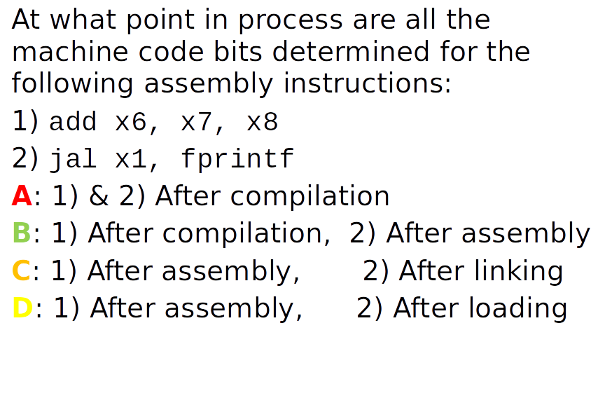
Peer Question

Slide 44
Peer Question

