Slide 1
Combinational Logic Sequential Logic CPU Datapath
CMPT 295 Week 10

Slide 2
Synchronous Digital Systems (SDS)
Hardware of a processor (e.g., RISC-V) is an example of a Synchronous Digital System
Synchronous:
All operations coordinated by a central clock
“Heartbeat” of the system (processor frequency)
Digital:
Represent all values with two discrete values
Electrical signals are treated as 1’s and 0’s
High/Low voltage represent True/False, 1/0

Slide 3
Combinational vs. Sequential Logic
Digital Systems consist of two basic types of circuits:
Combinational Logic (CL)
Output is a function of the inputs only, not the history of its execution
Example: add A, B (ALUs)
Sequential Logic (SL)
Circuits that “remember” or store information
Also called “State Elements”
Example: Memory and registers

Slide 4



Simple Logic Gates
Truth Table
Special names and symbols:
Circle means NOT!
a | NOT a
0 | 1
1 | 0
NOT
= NOT a
True if input is false
a | b | a AND b
0 | 0 | 0
0 | 1 | 0
1 | 0 | 0
1 | 1 | 1
AND
= a AND b
True if both inputs are true
a | b | A OR b
0 | 0 | 0
0 | 1 | 1
1 | 0 | 1
1 | 1 | 1
OR
= a OR b
True if at least one input is true
4

Slide 5



More Simple Logic Gates
Inverted versions are easier to implement in CMOS
a | b | a NAND b
0 | 0 | 1
0 | 1 | 1
1 | 0 | 1
1 | 1 | 0
NAND
= a NAND b
True if at least one input is false
a | b | a NOR b
0 | 0 | 1
0 | 1 | 0
1 | 0 | 0
1 | 1 | 0
NOR
= a NOR b
True if both inputs are false
a | b | a XOR b
0 | 0 | 0
0 | 1 | 1
1 | 0 | 1
1 | 1 | 0
XOR
= a XOR b
True if exactly one input is true
(or if odd number of inputs are true for > 2 inputs)

Slide 6
Computing with Combinational Circuits
Definition: A combinational circuit computes a pure function, i.e., its outputs react only based on its inputs. There are no feedback loops and no state information (memory) is maintained.
Theorem: Every Boolean function can be implemented with NAND and NOT. Circuits are modular
… a 4-bit ripple carry adder!
Adds by columns
Propagation delay
A₃
B₃
A₂
B₂
A₁
B₁
A₀
B₀
A
B
4
4
C₃
C₂
C₁
= 9
C₄
FA
FA
FA
FA
C₀
(2n + 1)
Adder-4
C
C
4
S₃
S₂
S₁
S₀
S
Notes:
Orally: We used to spend ⅔ of CMPT 150 on the design techniques to minimize circuit size, gate delay, etc …
The point in CMPT 295 is only that it is possible to do so, and that gate delay is a thing
Orally: This is why additions is slow. And why mul is even slower.
Orally: How to make an Adder-8?

Slide 7
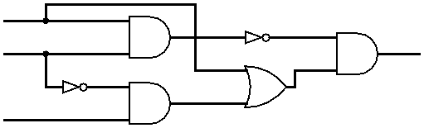
Combining Multiple Logic Gates
D = (NOT(A AND B)) AND (A OR (NOT B AND C))
A
B
D
C

Slide 8
How to Represent Combinational Logic?
Text Description
Circuit Diagram
Transistors and wires
Logic Gates
Truth Table
Boolean Expression
All are equivalent

Slide 9
Useful Combinational Circuits

Slide 10
Data Multiplexor (MUX)
Multiplexor (“MUX”) is a selector
Place one of multiple inputs onto output (N-to-1)
Shown below is an n-bit 2-to-1 MUX
Input S selects between two inputs of n bits each
A
This input is passed to output if selector bits match shown value
‘n
0
C
‘n
B
‘n
1
Represents that this input has n bits
S

Slide 11
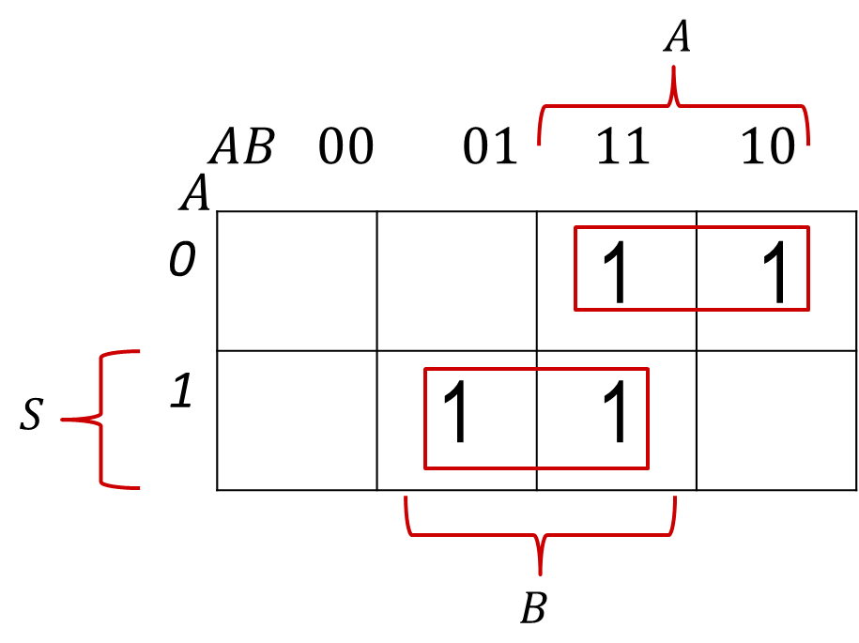
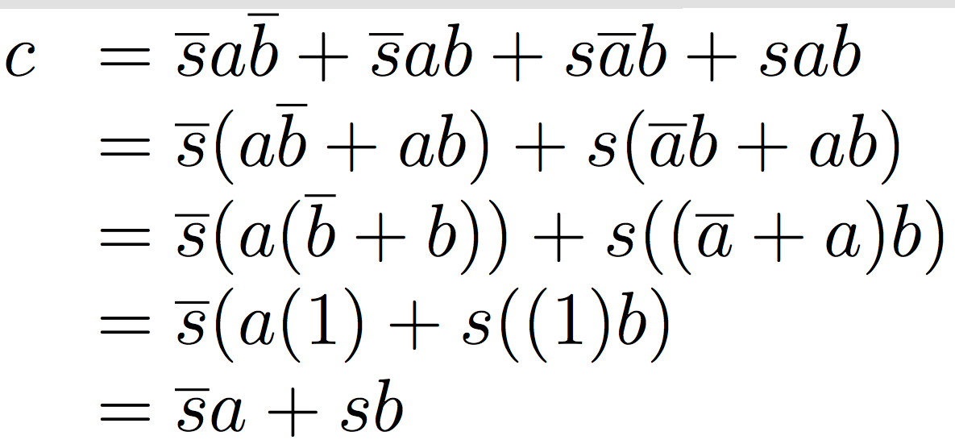
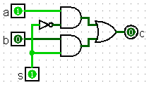
Implementing a 1-bit 2-to-1 MUX
s
Schematic:
Truth Table:
Boolean Algebra:
Circuit Diagram:
A
‘n
0
C
‘n
B
‘n
1
s | a | b | c
0 | 0 | 0 | 0
0 | 0 | 1 | 0
0 | 1 | 0 | 1
0 | 1 | 1 | 1
1 | 0 | 0 | 0
1 | 0 | 1 | 1
1 | 1 | 0 | 0
1 | 1 | 1 | 1
S

Slide 12
1-bit 4-to-1 MUX
Schematic:
Truth Table: How many rows?
Boolean Expression: E = S₁S₀A + S₁S₀B + S₁S₀C + S₁S₀D
A
00
B
01
E
C
10
D
11
‘2
S= S₁S₀
2⁶

Slide 13
Another Design for 4-to-1 MUX
Can we leverage what we’ve previously built?
Alternative hierarchical approach:
A
0
B
1
0
E
C
1
0
D
1
S₁
S₀

Slide 14
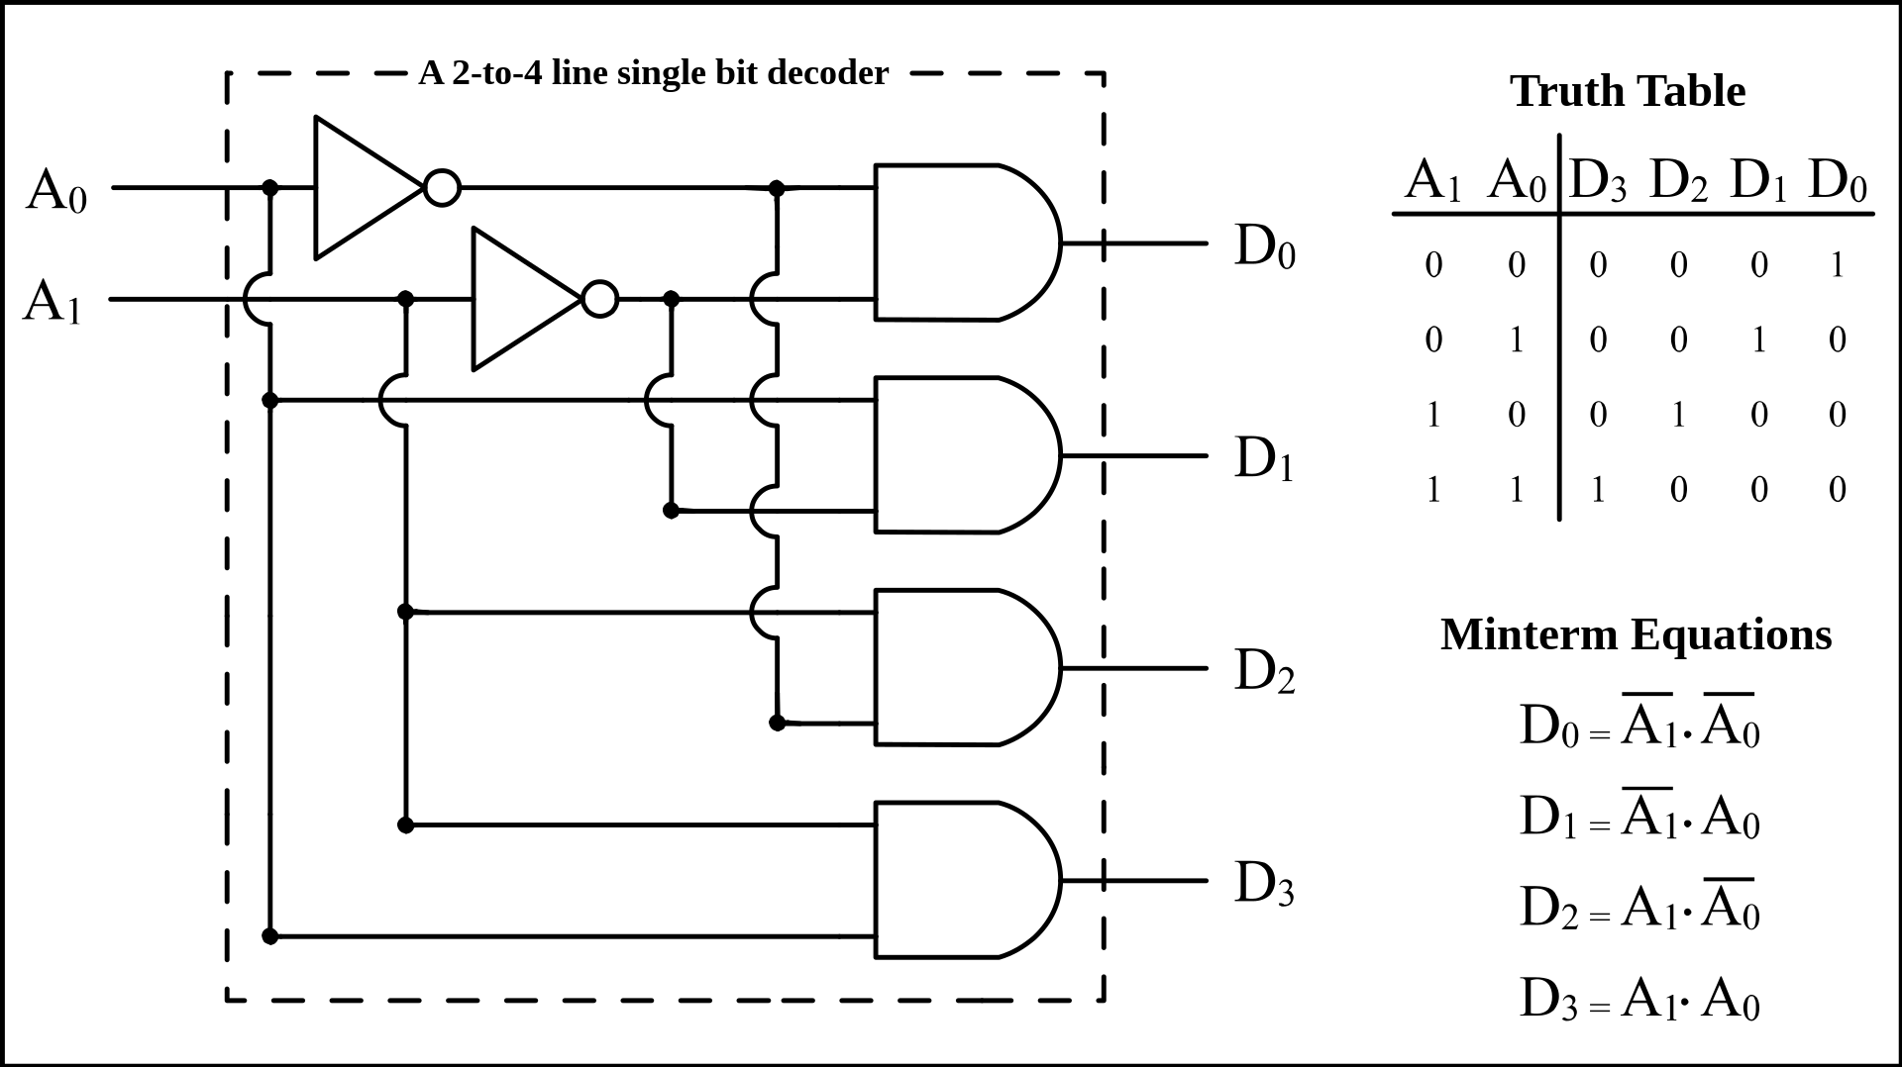
Decoder
Enable one of 2^{N} outputs based on N input
Example: 2-to-4 decoder
Use case: Choose ALU operation based on instruction op-code
By BlueJester0101, CC BY-SA 3.0, https://commons.wikimedia.org/w/index.php?curid=3668293

Slide 15
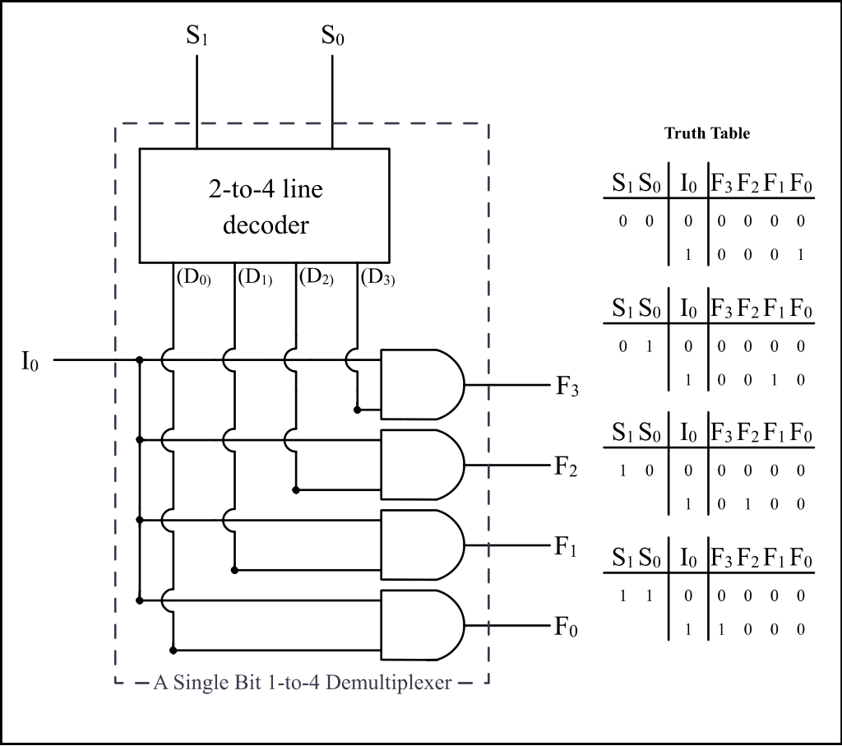
Demultiplexer (Demux)
Similar to decoder with an enable signal
By BlueJester0101, CC BY-SA 3.0, https://commons.wikimedia.org/w/index.php?curid=3668293

Slide 16
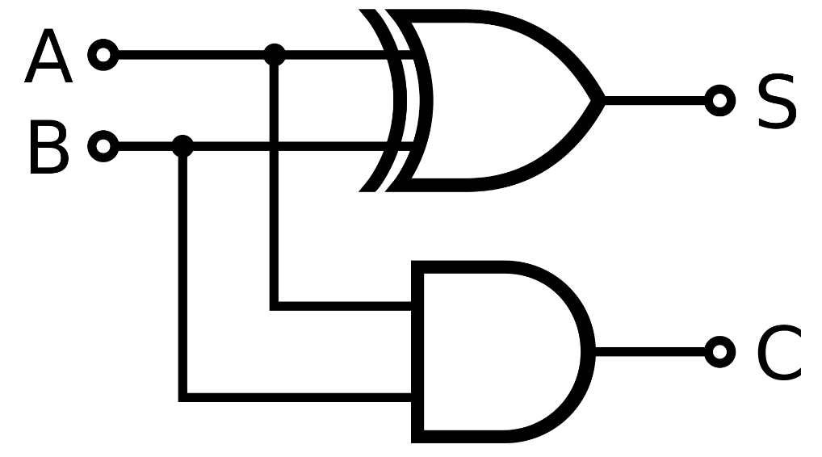
Single-Bit Binary Adder (Half Adder)
Add A + B to get Sum (S) and Carry (C)
Truth Table:
Boolean Expressions:
S = A⊕B; C = AB
Circuit:
A | B | S | C
0 | 0 | 0 | 0
0 | 1 | 1 | 0
1 | 0 | 1 | 0
1 | 1 | 0 | 1
By inductiveload - Own work, Public Domain, https://commons.wikimedia.org/w/index.php?curid=1023090

Slide 17
What is this Circuit?
Truth table:
A
B
S
A B C
C S
0 0 0
0 0 1
0 1 0
0 1 1
1 0 0
1 0 1
1 1 0
1 1 1
0
0
0
1
0
1
1
1
0
1
1
0
1
0
0
1
Half Adder
Half Adder
C
3-bit
Addition!
C
Q. What’s the propagation delay?
Full Adder
A
B
3 gate delays (highlighted)
Q. What does the circuit accomplish?
Algebra:
FA
C
C
S = A ⊕ B ⊕ C; C = AB + C(A ⊕ B)
S
S = A ⊕ B ⊕ C

Slide 18
Functional Unit
Hardware circuits are fixed
Can’t adjust wires / gates while running
Build control wires to parametrize its function
Function Unit:
Function Select:
FS func
0001 A + B
0010 A − B
1000 A * B
0100 A ^ B
0101 A + 1
1101 B
32
32
opA
opB
FS
4
res
32

Slide 19
Functional Unit: Adder-Subtractor
A
B
32
FS
if FS == 0 then
S = A + B
if FS == 1 then
32
32
C
Adder-32
S = A + B + 1
32
= A − B
S

Slide 20
Combinational vs. Sequential Logic
Digital Systems consist of two basic types of circuits:
Combinational Logic (CL)
Output is a function of the inputs only, not the history of its execution
Example: add A, B (ALUs)
Sequential Logic (SL)
Circuits that “remember” or store information
Also called “State Elements”
Example: Memory and registers

Slide 21
Sequential Logic

Slide 22
Digital State Machines
inputs
Memory holds state information
memory
current
state
combinational
circuit
outputs
next state
compute next state based on (current state, inputs)
compute outputs based on (current state, inputs)
Q. What does this imply about the clock period?
clock period must exceed (t_{pd} of combinational circuit + t_{pd} of registers) where t_{pd} is propagational delay

Slide 23
Accumulator Example
An example of why we would need sequential logic
SUM
X_{i}
S
Want: S=0;
for X₁,X₂,X₃ over time...
S = S + X_{i}
Assume:
Each X value is applied in succession, one per cycle
The sum since time 1 (cycle) is present on S

Slide 24
First Try: Does this work?
X
+
S
Feedback
No!
How to control the next iteration of the ‘for’ loop?
How do we say: ‘S=0’?

Slide 25
Second Try: How About This?
X_{i}
+
S
A Register is the state element that is used here to hold up the transfer of data to the adder
register
Load/Clk
reset

Slide 26
Accumulator Revisited: Proper Timing
X_{i}
Reset signal shown
In practice X_{i} might not arrive to the adder at the same time as S_{i-1}
S_{i} temporarily is wrong, but register always captures correct value
In good circuits, instability never happens around rising edge of CLK
+
S_{i}
S_{i-1}
register
Clk
reset
Reset
“Undefined” (unknown) signal
CLK
S_{i-1}
0
X0
X0+X1
X0+X1 +X2
X_{i}
X0
X1
X2
X3
S_{i}
X0
X0+X1
X0+X1+X2
X0+X1+X2+X3

Slide 27
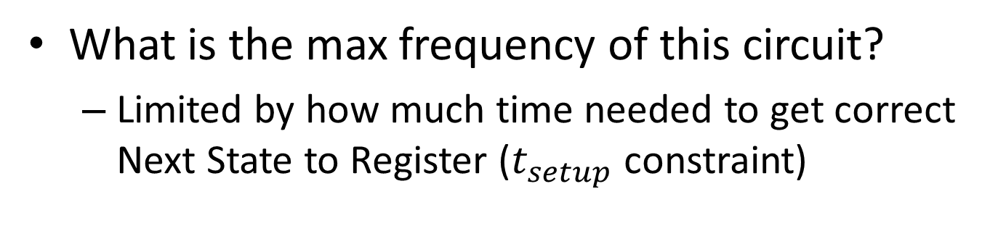
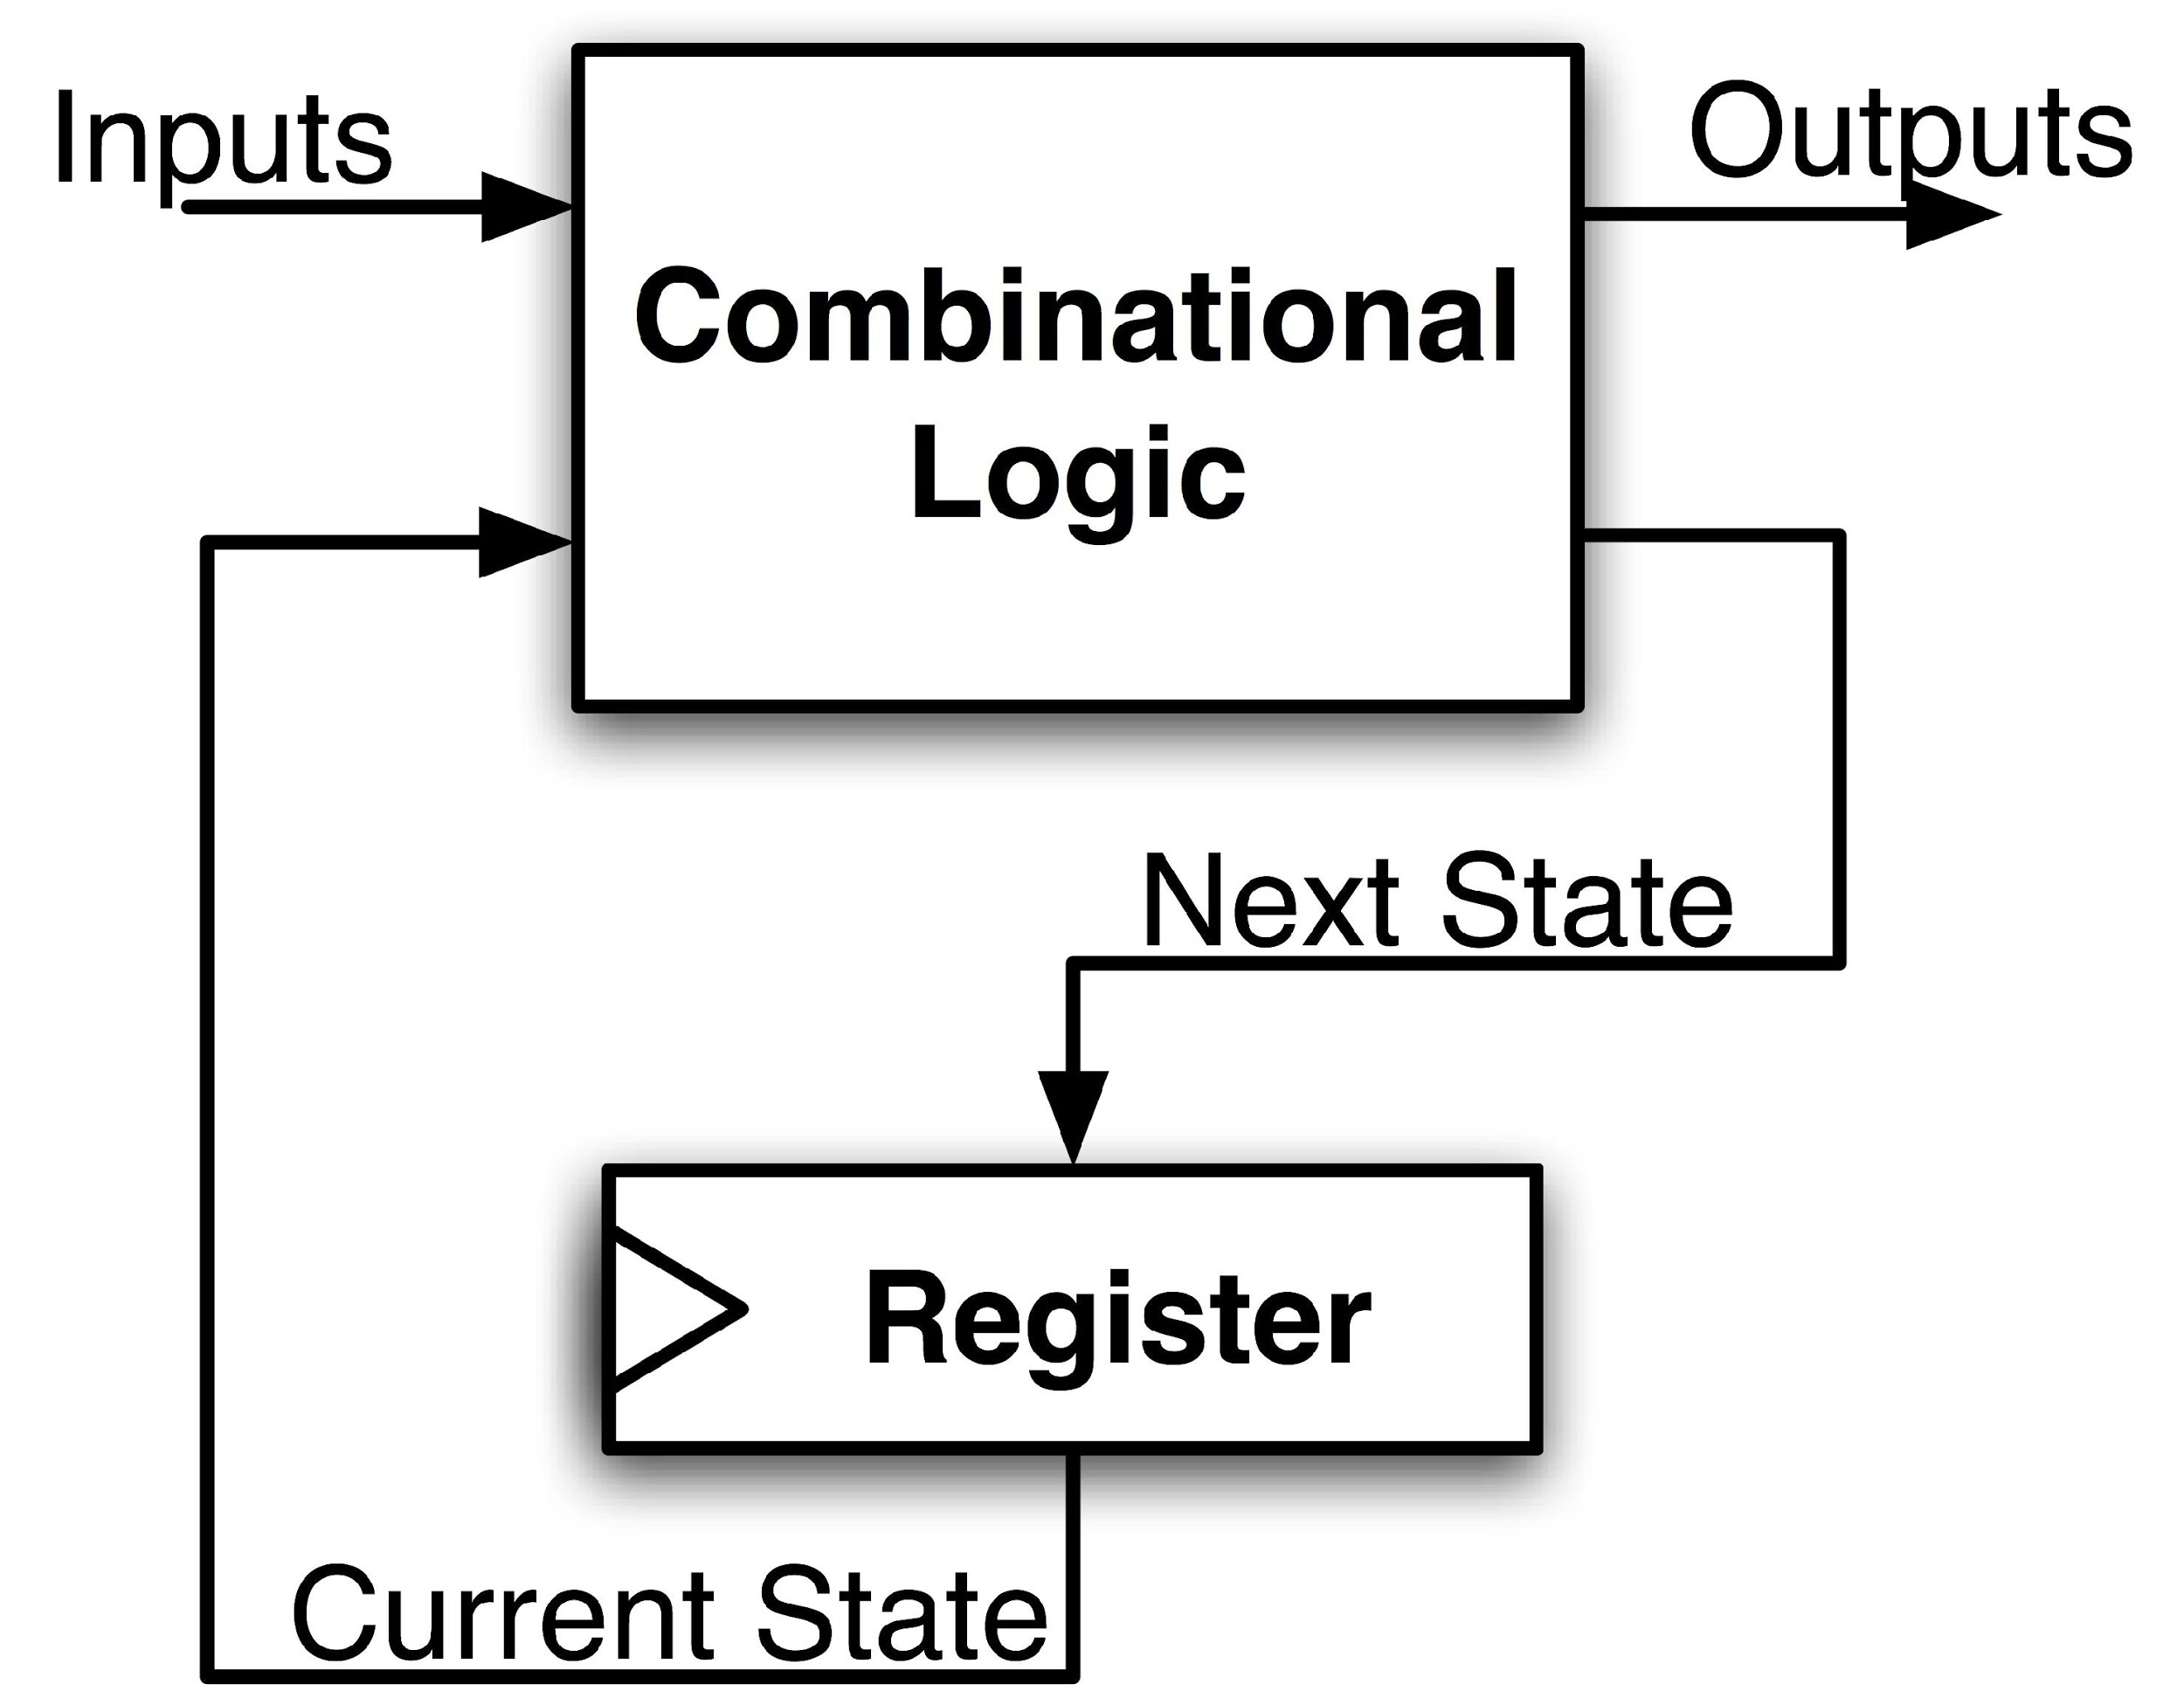
Maximum Clock Frequency
Assumes Max Delay > Hold Time
Max Delay =
Min Period = Max Delay
Max Freq = 1/Min Period
CLK-to-Q Delay
+ CL Delay
+ Setup Time
Notes:
Hold time is included in CLK-to-Q delay.
Make sure to shift thinking for setup time for next clock trigger (one clock cycle).

Slide 28
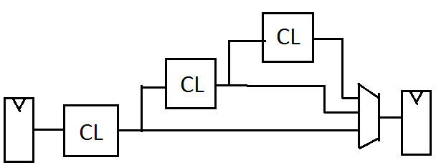
The Critical Path
The critical path is the longest delay between any two registers in a circuit
The clock period must be longer than this critical path, or the signal will not propagate properly to that next register
+
Reg
Reg

Slide 29
How do we go faster?
Pipelining!
Split operation into smaller parts and add a register between each one.

Slide 30
Uses for State Elements
Place to store values for some amount of time:
Register files (like in RISCV)
Memory (caches and main memory)
Help control flow of information between combinational logic blocks
State elements are used to hold up the movement of information at the inputs to combinational logic blocks and allow for orderly passage

Slide 31
RISC-V CPU Datapath, Control Intro
Notes:
Podcast link: https://gimletmedia.com/tags/6dug/super-tech-support

Slide 32
Design Principles
Five steps to design a processor:
Analyze instruction set → datapath requirements
Select set of datapath components & establish clock methodology
Assemble datapath meeting the requirements
Analyze implementation of each instruction to determine setting of control points that effects the register transfer
Assemble the control logic
Formulate Logic Equations
Design Circuits
Processor
Input
Control
Memory
Datapath
Output

Slide 33
Summary !
Universal datapath
Capable of executing all RISC-V instructions in one cycle each
Not all units (hardware) used by all instructions
5 Phases of execution
IF (Instruction Fetch), ID (Instruction Decode), EX (Execute), MEM (Memory), WB (Write Back)
Not all instructions are active in all phases (except for loads!)
Controller specifies how to execute instructions
Worth thinking about: what new instructions can be added with just most control?

Slide 34
Your CPU in two parts
Central Processing Unit (CPU):
Datapath: contains the hardware necessary to perform operations required by the processor
Reacts to what the controller tells it! (ie. “I was told to do an add, so I”ll feed these arguments through an adder)
Control: decides what each piece of the datapath should do
What operation am I performing? Do I need to get info from memory? Should I write to a register? Which register?
Has to make decisions based on the input instruction only!

Slide 35
Design Principles
Determining control signals
Any time a datapath element has an input that changes behavior, it requires a control signal (e.g. ALU operation, read/write)
Any time you need to pass a different input based on the instruction, add a MUX with a control signal as the selector (e.g. next PC, ALU input, register to write to)
Your control signals will change based on your exact datapath
Your datapath will change based on your ISA

Slide 36
Storage Element: Register File
RW
RA
RB
Write Enable
5
5
5
Register File consists of 31 registers:
Output ports portA and portB
Input port portW
Register selection
Place data of register RA (number) onto portA
Place data of register RB (number) onto portB
Store data on portW into register RW (number) when Write Enable is 1
Clock input (CLK)
CLK is passed to all internal registers so they can be written to if they match RW and Write Enable is 1
portA
portW
32 x 32-bit
Registers
32
32
portB
Clk
32

Slide 37
Implementing R-Types
31
25 24
20 19
15 14
12 11
7 6
0
func7(7)
rs2(5)
rs1(5)
Func3(3)
rd(5)
opcode(7)
New hardware: ALU (Arithmetic Logic Unit)
Abstraction for adders, multipliers, dividers, etc.
How do we know what operation to execute?
Our first control bit! ALUSel(ect)
+4
Reg[]
pc
IMEM
inst[11:7]
AddrD
ALU
R[rs1]
inst[19:15]
AddrA
DataA
inst[24:20]
R[rs2]
AddrB
DataB
inst[31:0]
Control
ALUSel

Slide 38
Inst[31:0] |  |  |  |  |  |  |  |  | ALUSel
add |  |  |  |  |  |  |  |  | Add
sub |  |  |  |  |  |  |  |  | Sub
(R-R Op) |  |  |  |  |  |  |  |  | (Op)

Slide 39
Adding addi to datapath
+4
Reg[]
pc
DataD
ALU
IMEM
inst[11:7]
AddrD
Reg[rs1]
alu
pc+4
0
inst[19:15]
AddrA
DataA
Reg[rs2]
inst[24:20]
AddrB
DataB
1
Also works for all other I-format arithmetic instruction (slti,sltiu,andi,ori,xori,slli,srli,srai) just by changing ALUSel
inst[31:20]
Imm.
Gen
imm[31:0]
Control Logic
inst[31:0]
ImmSel=I
RegWEn=1
BSel=1
ALUSel=Add

Slide 40
Inst[31:0] |  | ImmSel |  |  |  |  | BSel |  | ALUSel
add |  | * |  |  |  |  | Reg |  | Add
sub |  | * |  |  |  |  | Reg |  | Sub
(R-R Op) |  | * |  |  |  |  | Reg |  | (Op)
addi |  | I |  |  |  |  | Imm |  | Add

Slide 41
Adding lw to datapath
+4
Reg[]
alu
pc
wb
DataD
Reg[rs1]
ALU
DMEM
1
IMEM
inst[11:7]
AddrD
Reg[rs2]
Addr
wb
pc+4
inst[19:15]
AddrA
DataA
0
DataR
0
1
mem
inst[24:20]
AddrB
DataB
inst[31:20]
Imm.
Gen
imm[31:0]
inst[31:0]
ImmSel=I
RegWEn=1
Bsel=1
ALUSel=Add
MemRW=Read
WBSel=0

Slide 42
Inst[31:0] |  | ImmSel |  |  |  |  | BSel | ASel | ALUSel | MemRW | WBSel
add |  | * |  |  |  |  | Reg | Reg | Add | Read | ALU
sub |  | * |  |  |  |  | Reg | Reg | Sub | Read | ALU
(R-R Op) |  | * |  |  |  |  | Reg | Reg | (Op) | Read | ALU
addi |  | I |  |  |  |  | Imm | Reg | Add | Read | ALU
lw |  | I |  |  |  |  | Imm | Reg | Add | Read | Mem

Slide 43
Storage Element: Idealized Memory
Memory (idealized)
One input port: Data In
One output port: Data Out
Memory access:
Read: Write Enable = 0, data at Address is placed on Data Out
Write: Write Enable = 1, Data In written to Address
Clock input (CLK)
CLK input is a factor ONLY during write operation
During read, behaves as a combinational logic block: Address valid → Data Out valid after “access time”
Write Enable
Address
Data In
DataOut
32
32
CLK

Slide 44
Current Datapath
+4
Reg[]
ALU
pc
wb
DataD
Reg[rs1]
ALU
1
DMEM
IMEM
inst[11:7]
AddrD
Addr
pc+4
Reg[rs2]
DataR
wb
inst[19:15]
AddrA
DataA
0
0
mem
inst[24:20]
AddrB
DataB
1
inst[31:20]
Imm.
Gen
imm[31:0]
inst[31:0]
ImmSel
BSel
ALUSel
MemRW
WBSel

Slide 45
Adding sw to datapath
+4
Reg[]
alu
pc
wb
DataD
Reg[rs1]
ALU
DMEM
pc+4
IMEM
inst[11:7]
AddrD
Reg[rs2]
Addr
1
wb
inst[19:15]
AddrA
DataA
0
DataR
0
1
DataW
mem
inst[24:20]
AddrB
DataB
inst[31:7]
Imm.
Gen
imm[31:0]
inst[31:0]
ImmSel=S
RegWEn=0
Bsel=1
ALUSel=Add
MemRW=Write
WBSel=*
*= “Don’t Care”

Slide 46
Inst[31:0] | PCSel | ImmSel | RegWEn | BrUn | BrEq | BrLT | BSel | ASel | ALUSel | MemRW | WBSel
add | +4 | * | 1 (Y) | * | * | * | Reg | Reg | Add | Read | ALU
sub | +4 | * | 1 | * | * | * | Reg | Reg | Sub | Read | ALU
(R-R Op) | +4 | * | 1 | * | * | * | Reg | Reg | (Op) | Read | ALU
addi | +4 | I | 1 | * | * | * | Imm | Reg | Add | Read | ALU
lw | +4 | I | 1 | * | * | * | Imm | Reg | Add | Read | Mem
sw | +4 | S | 0 (N) | * | * | * | Imm | Reg | Add | Write | *

Slide 47
Inst[31:0] | PCSel | ImmSel | RegWEn | BrUn | BrEq | BrLT | BSel | ASel | ALUSel | MemRW | WBSel
add | +4 | * | 1 (Y) | * | * | * | Reg | Reg | Add | Read | ALU
sub | +4 | * | 1 | * | * | * | Reg | Reg | Sub | Read | ALU
(R-R Op) | +4 | * | 1 | * | * | * | Reg | Reg | (Op) | Read | ALU
addi | +4 | I | 1 | * | * | * | Imm | Reg | Add | Read | ALU
lw | +4 | I | 1 | * | * | * | Imm | Reg | Add | Read | Mem
sw | +4 | S | 0 (N) | * | * | * | Imm | Reg | Add | Write | *
beq | +4 | B | 0 | * | 0 | * | Imm | PC | Add | Read | *
beq | ALU | B | 0 | * | 1 | * | Imm | PC | Add | Read | *
bne | ALU | B | 0 | * | 0 | * | Imm | PC | Add | Read | *
bne | +4 | B | 0 | * | 1 | * | Imm | PC | Add | Read | *
blt | ALU | B | 0 | 0 | * | 1 | Imm | PC | Add | Read | *
bltu | ALU | B | 0 | 1 | * | 1 | Imm | PC | Add | Read | *
jalr | ALU | I | 1 | * | * | * | Imm | Reg | Add | Read | PC+4
jal | ALU | J | 1 | * | * | * | Imm | PC | Add | Read | PC+4
auipc | +4 | U | 1 | * | * | * | Imm | PC | Add | Read | ALU

Slide 48
Adding branches to datapath
alu
+4
Reg[]
pc
alu
pc
wb
DataD
1
1
Reg[rs1]
ALU
DMEM
IMEM
inst[11:7]
AddrD
0
1
0
Branch Comp.
Reg[rs2]
Addr
DataR
0
wb
pc+4
inst[19:15]
AddrA
DataA
0
DataW
mem
inst[24:20]
AddrB
DataB
1
inst[31:7]
Imm.
Gen
imm[31:0]
PCSel=taken/not-taken
inst[31:0]
ImmSel=B
RegWEn=0
BrUn
BrEq
BrLT
Bsel=1
ASel=1
MemRW=Read
WBSel=*
ALUSel=Add

Slide 49
Adding jalr to datapath
+4
Reg[]
pc
alu
pc+4
alu
pc
wb
1
1
DataD
Reg[rs1]
ALU
DMEM
2
IMEM
inst[11:7]
AddrD
0
1
pc+4
0
Branch Comp.
Reg[rs2]
Addr
DataR
0
wb
inst[19:15]
AddrA
DataA
0
DataW
mem
inst[24:20]
AddrB
DataB
1
inst[31:7]
Imm.
Gen
imm[31:0]
PCSel
inst[31:0]
ImmSel=B
RegWEn=1
Bsel=1
Asel=0
MemRW=Read
WBSel=2
BrEq=*
ALUSel=Add
BrUn=*
BrLT=*

Slide 50
Adding jal to datapath
+4
Reg[]
pc
alu
pc+4
alu
pc
wb
1
1
DataD
Reg[rs1]
ALU
DMEM
2
IMEM
inst[11:7]
AddrD
0
1
pc+4
0
Branch Comp.
Reg[rs2]
Addr
DataR
0
wb
inst[19:15]
AddrA
DataA
0
DataW
mem
inst[24:20]
AddrB
DataB
1
inst[31:7]
Imm.
Gen
imm[31:0]
PCSel
inst[31:0]
ImmSel=J
RegWEn=1
Bsel=1
Asel=1
MemRW=Read
WBSel=2
BrEq=*
ALUSel=Add
BrUn=*
BrLT=*

Slide 51
Implementing lui
+4
Reg[]
pc
pc+4
pc
wb
1
alu
alu
1
DataD
Reg[rs1]
ALU
DMEM
2
IMEM
inst[11:7]
AddrD
0
1
pc+4
0
Branch Comp.
Reg[rs2]
Addr
DataR
0
wb
inst[19:15]
AddrA
DataA
0
DataW
mem
inst[24:20]
AddrB
DataB
1
inst[31:7]
Imm.
Gen
imm[31:0]
PCSel=pc+4
inst[31:0]
ImmSel=U
RegWEn=1
Bsel=1
Asel=*
ALUSel=B
MemRW=Read
WBSel=1
BrUn=*
BrE=*
BrLT=*

Slide 52
Implementing auipc
+4
Reg[]
pc
pc+4
pc
wb
1
alu
alu
1
DataD
Reg[rs1]
ALU
DMEM
2
IMEM
inst[11:7]
AddrD
0
1
pc+4
0
Branch Comp.
Reg[rs2]
Addr
DataR
0
wb
inst[19:15]
AddrA
DataA
0
DataW
mem
inst[24:20]
AddrB
DataB
1
inst[31:7]
Imm.
Gen
imm[31:0]
PCSel=pc+4
inst[31:0]
ImmSel=U
RegWEn=1
Bsel=1
Asel=1
ALUSel=Add
MemRW=0
WBSel=1
BrUn=*
BrE=*
BrLT=*

