Slide 1
Tutorial on Matlab and OpenCV
Rui Ma
TA of CMPT 414
May 14, 2013
Office hours: Fridays 11:00-12:00, CSIL TA Office 1 (ASB 9838)

Slide 2

What is Matlab
MATLAB is a high-level language and interactive environment for numerical computation, visualization, and programming. http://www.mathworks.com/products/matlab/
MATLAB = Matrix Laboratory
Designed for fast numerical matrix calculations

Slide 3
Why Matlab
Matlab integrates computation, visualization, and programming in a easy ­to­ use environment
Matlab has been widely used for:
  Math and computation
  Algorithm development
  Modeling, simulation, and prototyping
  Scientific and engineering graphics

Slide 4
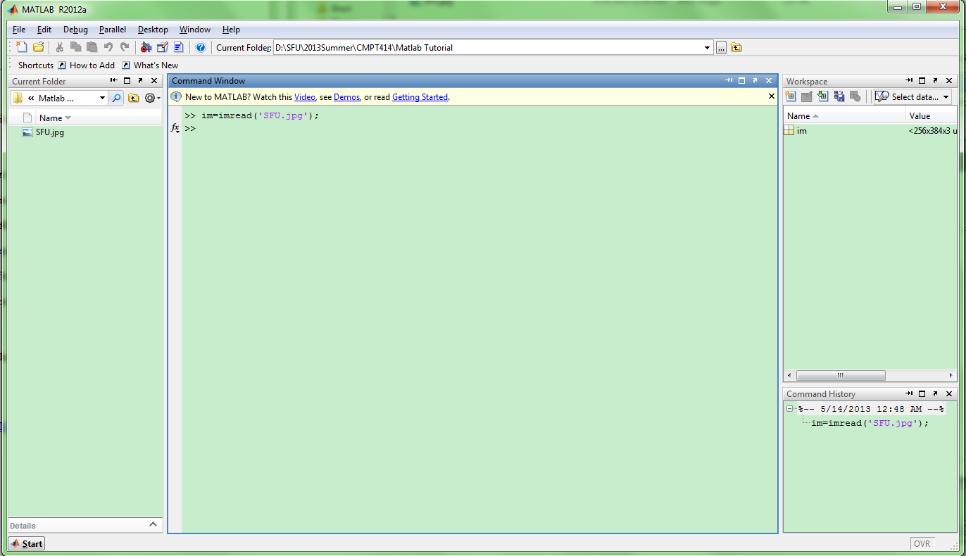
Matlab Environment
Workspace
Command window
History

Slide 5
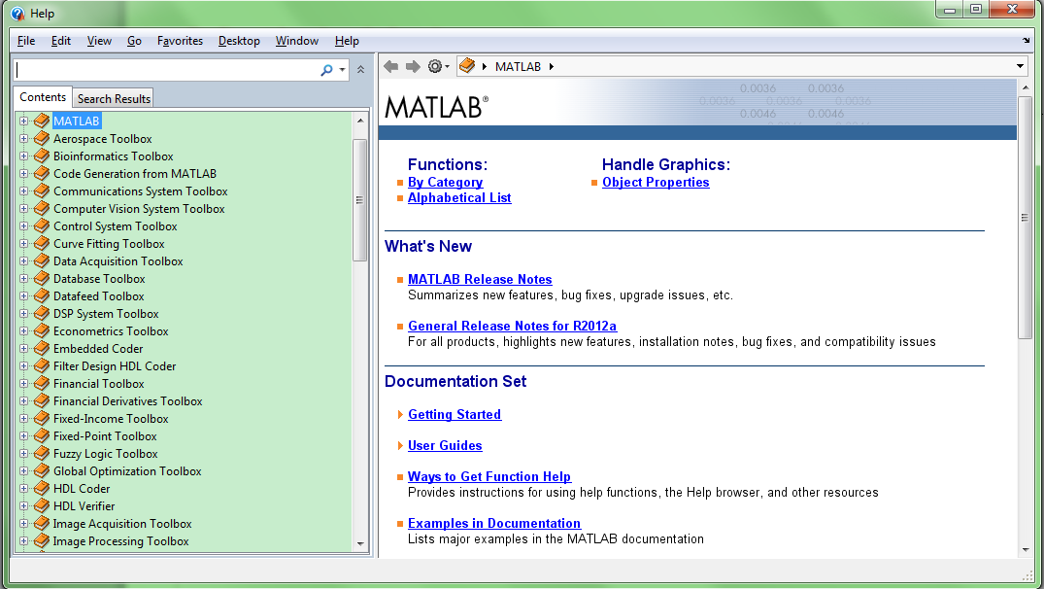
Matlab Help
A powerful guide to learn Matlab
Not only contains command definition, but also examples and demos

Slide 6

Matrices in Matlab
Matrix is the main MATLAB data type
How to build a matrix?
  A=[1 2 3; 4 5 6; 7 8 9];
Special matrices:
  zeros(n,m), ones(n,m), eye(n,m), rand()

Slide 7
Matrix Operations
All operators in Matlab have definition on matrices: +, -, *, /, ^, sqrt, sin, cos, etc.
Element-wise operators defined with a preceding dot: .*, ./, .^
  A*B and A.*B is different
Others: size(A), A’, inv(A), Eig(A)

Slide 8
Accessing matrix elements
If A=[1 2 3; 4 5 6; 7 8 9], then
  % get value
  a = A(2,1);
  b = A(1,:);
  c = A(:,:);
  d = A(:);
  % assign value
  A(2,1) = 10;
  A(1,:) = [11,12,13];
  A(:,1) = [14,15,16]’;

Slide 9
Flow Control in Matlab
The if conditional block
if condition
…
end
●The for loop block
for n = list
…
end
The while block
while condition
…
end

Slide 10
Script and Function
Script
  does not have arguments and return values
  just a group of commands
Function
  has arguments and usually with a return list
  Function rt_val_list = f(param_list)
  … (function body)
  Usually function is stored as a m file named as *.m

Slide 11
M-file
A script file or a simple text file where you can place MATLAB commands
Be organized and effective when writing complicated codes
Create: File->New->Script
Run: for test.m, type test in Matlab command window

Slide 12
Data I/O
A native file format mat to save and load workspaces
Use keywords load and save
save test
  % creates test.mat with all variables
save test a b
  % save only variables a and b
load test
  % load session
clear all
  % clear all variables
clear a b
  % clear variables a and b

Slide 13
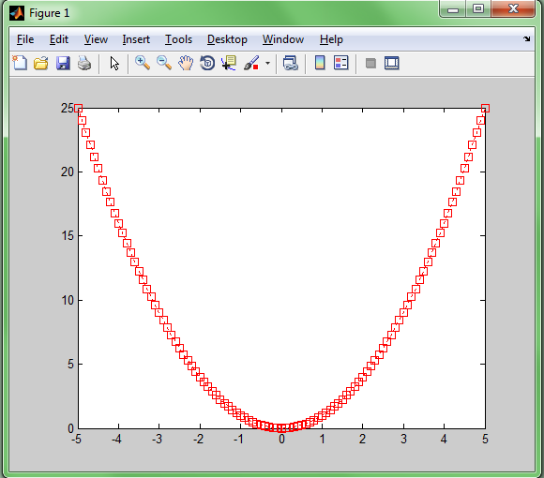
Graphics - 2D Plots
plot(xdata, ydata, ‘marker_style’);
For example
  x=-5:0.1:5;
  sqr=x.^2;
  pl1=plot(x, sqr, 'r:s');

Slide 14
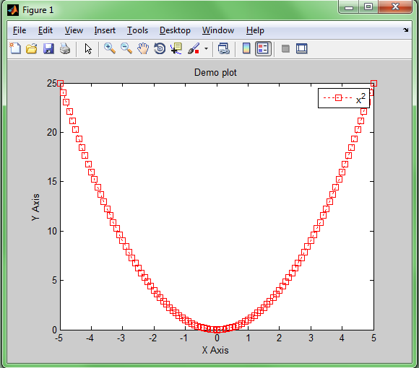
Graphics - Annotation
title('Demo plot');
xlabel('X Axis');
ylabel('Y Axis');
legend(pl1,'x^2');

Slide 15
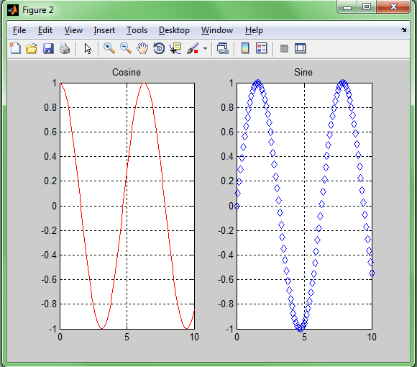
Subplots
Use subplot to divide a plotting window into several panes
  x=0:0.1:10;
  figure;
  subplot(1,2,1);
  plot(x,cos(x),'r');
  grid on;
  title('Cosine')
  subplot(1,2,2);
  plot(x,sin(x),'d');
  grid on;
  title('Sine');

Slide 16
Image Processing using Matlab
Image Processing Toolbox
  A collection of image processing functions
  supports a wide range of image processing operations, including:
  Geometric operations
  Neighborhood and block operations
  Linear filtering and filter design
  Transforms
  Image analysis and enhancement
  Binary image operations
  Region of interest operations

Slide 17
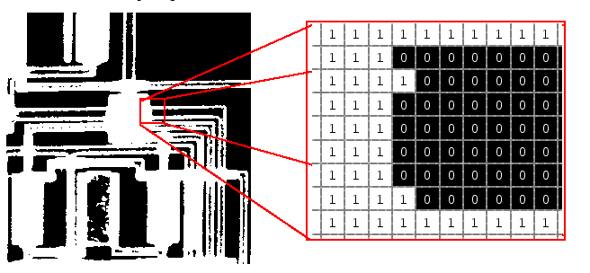
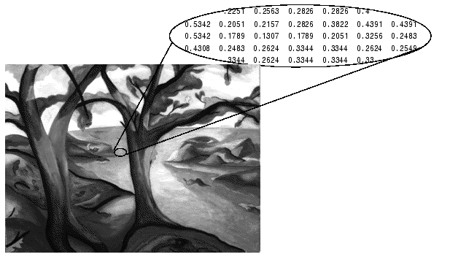
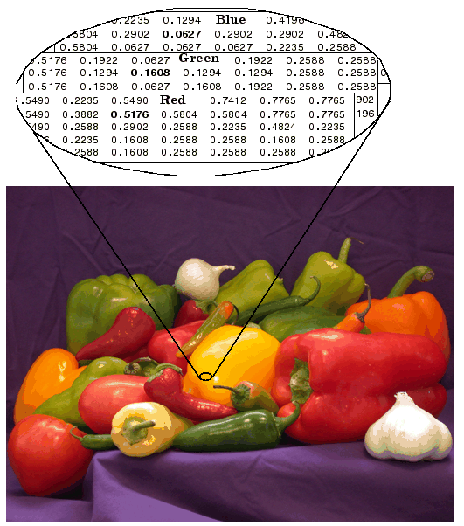
Images in MATLAB
Binary images : {0,1}
Intensity images : [0,1] or uint8, double etc.
RGB images : m × n × 3
Multidimensional images: m × n × p (p is the number of layers)

Slide 18

Images and Matrices
How to build a matrix
(or image)?
Intensity Image:
  row = 256;
  col = 256;
  img = zeros(row,col);
  img(100:105,:) = 0.5;
  img(:, 100:105) = 1;
  figure;
  imshow(img);
[0, 0]
o
Row 1 to 256
o
Column 1 to 256
[256, 256]

Slide 19
Image I/O
Read and write images in Matlab
  img = imread(‘sfu.jpg');
  imwrite(img, ‘sfu.bmp', 'bmp');
Show the image
  figure; %show image in a new figure window
  imshow(img);

Slide 20
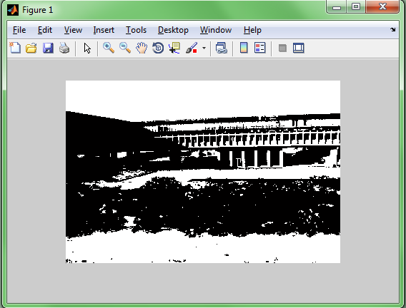
An example
im = imread('SFU.jpg');
im = rgb2gray(im);
ciThres = 160;
im2 = zeros(size(im));
im2(logical(im > ciThres)) = 255;
imshow(im2);
imwrite(im2, 'SFU_2.bmp', 'bmp');

Slide 21
Summary
MATLAB is a high-level language and interactive environment for numerical computation, visualization, and programming.
However, Matlab is slow while doing iterations:
  try to vectorize the process instead of using iterations
  Pre­allocate memory for a matrix
  Rewrite bottleneck procedures using c

Slide 22



What is OpenCV
OpenCV is an open source C/C++ library for image processing and computer vision.
In 2006, Intel released the first stable version of OpenCV
In 2008, OpenCV obtained corporate support from Willow Garage

Slide 23
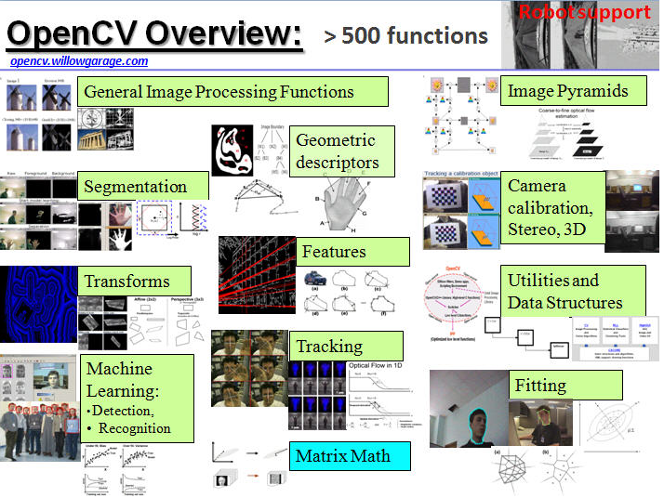
What can OpenCV do
Basic data structures for matrix operation and image processing
A bunch of functions to process visual data and extract information for images/videos

Slide 24
Where to get OpenCV
Download and installation
http://opencv.willowgarage.com/wiki/InstallGuide
Versions for Windows, Mac or Linux
Both source code and pre-built version(for Windows) are available

Slide 25
Pros and Cons about OpenCV
Pros:
  Highly optimized, very fast and efficient
  A good tool if you want to implement realtime systems
  Well supported, ready-to-use algorithms
Cons:
  Not easy of use, C or C++ coding
  Memory management, may crash

Slide 26
A VERY Simple OpenCV Program
#include "cv.h"
#include "highgui.h"
void main()
{
IplImage *image = cvLoadImage("SFU.jpg");
cvNamedWindow("SFU Image", CV_WINDOW_AUTOSIZE);
cvShowImage("SFU Image", image);
cvWaitKey(0);
cvReleaseImage(&image);
}

Slide 27
More about Matlab and OpenCV
Matlab
  Matlab Help
  http://www.mathworks.com/matlabcentral/
OpenCV
  http://opencv.willowgarage.com/wiki/
  OpenCV Cheatsheet

