Slide 1
Some Shape Descriptors for 3D Visual Objects
Extracted from P. Huang, A. Hilton and J. Stark, “Shape similarity for 3D video sequences of people”, Int. Journal of Computer Vision, 89(2-3):362-381, 2010

Slide 2
Shape Descriptors for 3D Video Sequences
Static
Temporal
Shape Distribution
Shape Histogram
Spin Image
Spherical Harmonics
Notes:
Evaluation of shape similarity is restricted here to local feature distributions. Global features provide only a coarse descriptor that is insufficient to distinguish similarity in a time varying sequence where an object can have the same global
properties for a relatively large proportion of the time.

Slide 3
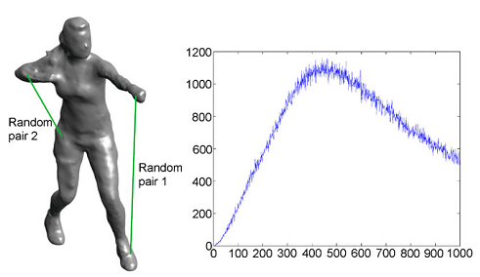
Shape Distribution
Notes:
Shape Distribution (SD) provides a shape signature as a probability distribution of a shape function that measures some geometric properties of a 3D model.
Here we adopt the D2 measure, the distance between two random points on the surface.
This figure illustrates the Shape Distribution representation computed for a single frame of a 3D video sequence
of a person.

Slide 4
Shape Distribution
1
Distance is iteratively measured between two random points on the surface.
A 1D histogram is created to count the number of point-pairs at different distances.
2
3
The final histogram is normalised.

Slide 5
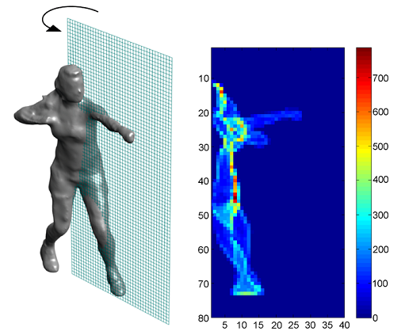
Spin Image
Notes:
A Spin Image (SI) is a 2D histogram which encodes the density of mesh vertices projected onto an object-centred space.
This figure illustrates the Spin Image for a single frame of a 3D video sequence, showing the histogram distribution resulting from a plane rotated about a vertical axis through the centroid of the shape.

Slide 6
Spin Image
1
An object-centred coordinate (α, β) is computed for each vertex according to the distance α along and the distance β from the principal axis of the object.
A 2D accumulator indexed by (α, β) is created and the accumulator is incremented for each vertex within the support of the spin image.
2
3
The final histogram is normalised.

Slide 7
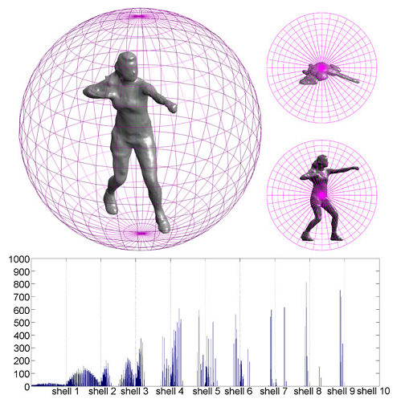
Shape Histogram
Notes:
A Shape Histogram (SH) partitions the space containing an object into disjoint cells corresponding to the bins of a histogram.
The spherical coordinate histogram is compared invariant of rotation by testing similarity for all feasible rotations.
Human models are assumed to have an upright direction and instead of rotating 3D mesh, we generate a fine histogram
first, then shift the histogram with 1◦ resolution, and re-bin to a coarse histogram. A similarity measure is computed as
the minimal of L2 distance between the coarse histograms.

Slide 8
Shape Histogram
1
Volumetric representation is built by rasterising the surface into a set of voxels lying inside the model.
Space is transformed to a spherical coordinate system (r, φ, θ) around the centre of mass for the model.
2
3
The final histogram is normalised.
4
A 3D spherical histogram is constructed in order to accumulate the voxels in the volume representation.

Slide 9
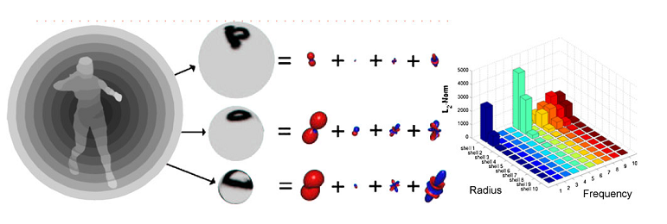
Spherical Harmonics
Notes:
The Spherical Harmonic Representation (SHR) describes an object by a set of spherical basis functions. A descriptor is
constructed by measuring the energy contained in different frequency bands, where the frequency components are rotation invariant.
This figure illustrates the SHR functions and coefficient distribution for the single 3D video frame of a person.

Slide 10
Spherical Harmonics
1
2
The volume of an object is divided into a set of concentric shells.
The frequency decomposition in each shell is computed.
3
The norm for each frequency component at each radius is concatenated into a 2D histogram indexed by radius and frequency.

