Slide 1
Administrative
Exam
  Oct 19, 2010
  2:30pm in 3005 (usual room)
No class on Oct 21
What topic to do for review?
November 18th away for conference

Slide 2
Database Systems I
Week 5
SQL Queries
Notes:
The slides for this text are organized into chapters. This lecture covers Chapter 5.
Chapter 1: Introduction to Database Systems
Chapter 2: The Entity-Relationship Model
Chapter 3: The Relational Model
Chapter 4 (Part A): Relational Algebra
Chapter 4 (Part B): Relational Calculus
Chapter 5: SQL: Queries, Programming, Triggers
Chapter 6: Query-by-Example (QBE)
Chapter 7: Storing Data: Disks and Files
Chapter 8: File Organizations and Indexing
Chapter 9: Tree-Structured Indexing
Chapter 10: Hash-Based Indexing
Chapter 11: External Sorting
Chapter 12 (Part A): Evaluation of Relational Operators
Chapter 12 (Part B): Evaluation of Relational Operators: Other Techniques
Chapter 13: Introduction to Query Optimization
Chapter 14: A Typical Relational Optimizer
Chapter 15: Schema Refinement and Normal Forms
Chapter 16 (Part A): Physical Database Design
Chapter 16 (Part B): Database Tuning
Chapter 17: Security
Chapter 18: Transaction Management Overview
Chapter 19: Concurrency Control
Chapter 20: Crash Recovery
Chapter 21: Parallel and Distributed Databases
Chapter 22: Internet Databases
Chapter 23: Decision Support
Chapter 24: Data Mining
Chapter 25: Object-Database Systems
Chapter 26: Spatial Data Management
Chapter 27: Deductive Databases
Chapter 28: Additional Topics

Slide 3
Introduction
We now introduce SQL, the standard query language for relational DBS.
As RA, an SQL query takes one or two input tables and returns one output table.
Any RA query can also be formulated in SQL, but in a more user-friendly manner.
In addition, SQL contains certain features of great practical importance that go beyond the expressiveness of RA, e.g. sorting and aggregation functions.

Slide 4
Example Instances
R1
S1
We will use these instances of the Sailors and Reserves tables in our examples.
S2

Slide 5
Basic SQL Query
SELECT [DISTINCT] target-list
FROM relation-list
WHERE qualification
  relation-list: list of relation names
  (possibly with a tuple-variable after each name).
  target-list: list of attributes of relations in relation-list
  qualification : comparisons (“Attr op const” or
  “Attr1 op Attr2”, where op is one of ) combined using AND, OR and NOT.
  DISTINCT is an optional keyword indicating that the answer should not contain duplicates. Default is that duplicates are not eliminated!

Slide 6
Conceptual Evaluation Strategy
Semantics of an SQL query defined in terms of the following conceptual evaluation strategy:
  Compute the Cartesian product of relation-list.
  Selection of the tuples satisfying qualifications.
  Projection onto the attributes that are in target-list.
  If DISTINCT is specified, eliminate duplicate rows.
This strategy is not an efficient way to process a query!
  An optimizer will find more efficient strategies to compute the same answers.
It is often helpful to write an SQL query in the same order (FROM, WHERE, SELECT).

Slide 7
Example Conceptual Evaluation
SELECT S.sname
FROM Sailors S, Reserves R
WHERE S.sid=R.sid AND R.bid=103

Slide 8
Projection
Expressed through the SELECT clause.
Can specify any subset of the set of all attributes.
SELECT sname, age
FROM Sailors;
“*” selects all attributes.
SELECT *
FROM Sailors;
Can rename attributes.
SELECT sname as Name, age as Age
FROM Sailors;

Slide 9
Projection
For numeric attribute values, can also apply arithmetic operators +, * etc.
Can create derived attributes and name them, using AS or “=“:
    SELECT age AS age0, age1=age-5, 2*S.age AS age2
    FROM Sailors;

Slide 10
Projection
The result of a projection can contain duplicates (why?).
To eliminate duplicates from the output, specify DISTINCT in the SELECT clause.
SELECT DISTINCT age
FROM Sailors;

Slide 11
Selection
Expressed through the WHERE clause.
Selection conditions can compare constants and attributes of relations mentioned in the FROM clause.
Comparison operators: =, <>, <, >, <=, >=
For numeric attribute values, can also apply arithmetic operators +, * etc.
Simple conditions can be combined using the logical operators AND, OR and NOT.
Default precedence: NOT, AND, OR.
Use parentheses to change precedence.

Slide 12
Selection
SELECT *
FROM Sailors
WHERE sname = ‘Watson’;
SELECT *
FROM Sailors
WHERE rating >= age;
SELECT *
FROM Sailors
WHERE (rating = 5 OR rating = 6) AND age <= 20;

Slide 13
String Comparisons
LIKE is used for approximate conditions (pattern matching) on string-valued attributes:
    string LIKE pattern
  Satisfied if pattern contained in string attribute.
NOT LIKE satisfied if pattern not contained in string attribute.
‘_’ in pattern stands for any one character
‘%’ stands for 0 or more arbitrary characters.
SELECT *
FROM Sailors S
WHERE S.sname LIKE ‘B_%B’;

Slide 14
Null Values
Special attribute value NULL can be interpreted as
  Value unknown (e.g., a rating has not yet been assigned),
  Value inapplicable (e.g., no spouse’s name),
  Value withheld (e.g., the phone number).
The presence of NULL complicates many issues:
  Special operators needed to check if value is null.
  Is rating>8 true or false when rating is equal to null?
  What about AND, OR and NOT connectives?
  Meaning of constructs must be defined carefully.
    E.g., how to deal with tuples that evaluate neither to TRUE nor to FALSE in a selection?

Slide 15
Null Values
NULL is not a constant that can be explicitly used as an argument of some expression.
NULL values need to be taken into account when evaluating conditions in the WHERE clause.
Rules for NULL values:
  An arithmetic operator with (at least) one NULL argument always returns NULL .
  The comparison of a NULL value to any second value returns a result of UNKNOWN.
A selection returns only those tuples that make the condition in the WHERE clause TRUE, those with UNKNOWN or FALSE result do not qualify.

Slide 16
Truth Value Unknown
Three-valued logic: TRUE, UNKNOWN, FALSE.
Can think of TRUE = 1, UNKNOWN = ½, FALSE = 0
  AND of two truth values: their minimum.
  OR of two truth values: their maximum.
  NOT of a truth value: 1 – the truth value.
Examples:
TRUE AND UNKNOWN = UNKNOWN
FALSE AND UNKNOWN = FALSE
FALSE OR UNKNOWN = UNKNOWN
NOT UNKNOWN = UNKNOWN

Slide 17
Truth Value Unknown
SELECT *
FROM Sailors
WHERE rating < 5 OR rating >= 5;
Does not return all sailors, but only those with non-NULL rating.

Slide 18
Ordering the Output
Can order the output of a query with respect to any attribute or list of attributes.
Add ORDER BY clause to the query:
  SELECT *
  FROM Sailors S
  WHERE age < 20
  ORDER BY rating;
  SELECT *
  FROM Sailors S
  WHERE age < 20
  ORDER BY rating, age;
By default, ascending order. Use DESC to specify descending order.

Slide 19
Joins

Slide 20
Cartesian Product
Expressed in FROM clause.
Forms the Cartesian product of all relations listed in the FROM clause, in the given order.
  SELECT *
  FROM Sailors, Reserves;
So far, not very meaningful.

Slide 21
Join
Expressed in FROM clause and WHERE clause.
Forms the subset of the Cartesian product of all relations listed in the FROM clause that satisfies the WHERE condition:
  SELECT *
  FROM Sailors, Reserves
  WHERE Sailors.sid = Reserves.sid;
In case of ambiguity, prefix attribute names with relation name, using the dot-notation.

Slide 22
Join
Since joins are so common operations, SQL provides JOIN as a shorthand.
SELECT *
  FROM Sailors JOIN Reserves ON
  Sailors.sid = Reserves.sid;
NATURAL JOIN produces the natural join of the two input tables, i.e. an equi-join on all attributes common to the input tables.
  SELECT *
  FROM Sailors NATURAL JOIN Reserves;

Slide 23
Join
Typically, there are some dangling tuples in one of the input tables that have no matching tuple in the other table.
  Dangling tuples are not contained in the output.
Outer joins are join variants that do not loose any information from the input tables.

Slide 24
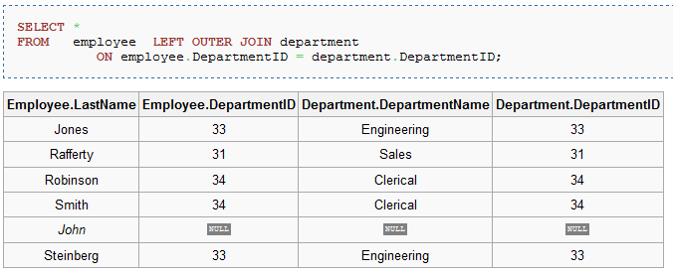
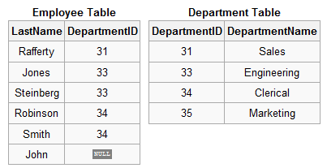
Left Outer Join
includes all dangling tuples from the left input table
NULL values filled in for all attributes of the right input table

Slide 25
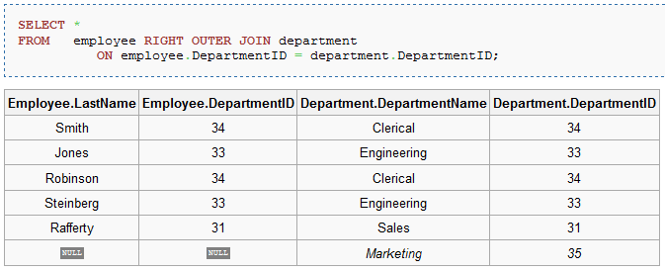
Right Outer Join
includes all dangling tuples from the right input table
NULL values filled in for all attributes of the right input table
What’s the difference between LEFT and RIGHT joins?
Can one replace the other?

Slide 26
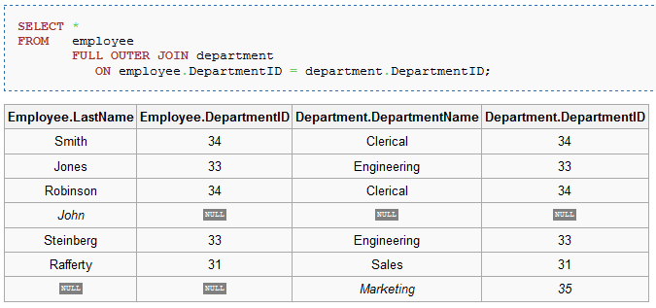
Full Outer Join
includes all dangling tuples from both input tables
NULL values filled in for all attributes of any dangling tuples

Slide 27
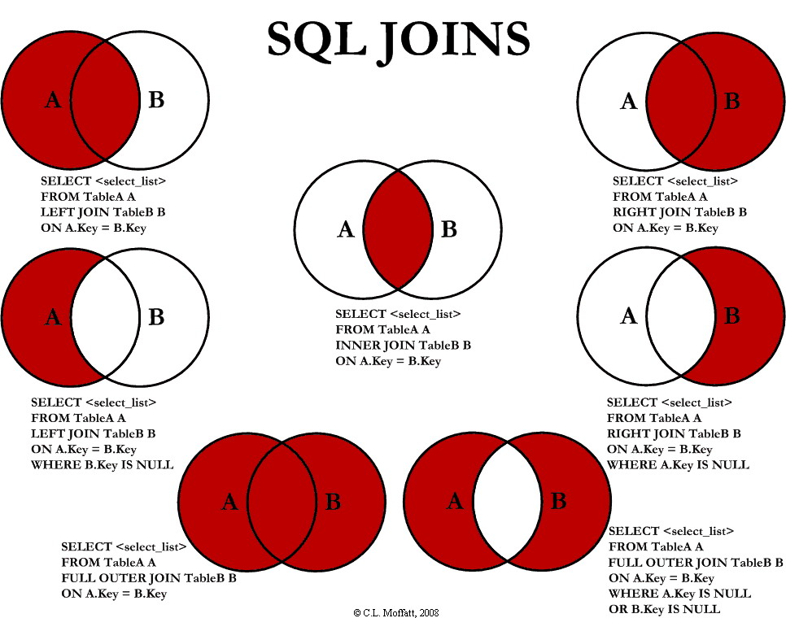

Slide 28
Tuple Variables
Tuple variable is an alias referencing a tuple from the relation over which it has been defined.
Again, use dot-notation.
Needed only if the same relation name appears twice in the query.
  SELECT S.sname
  FROM Sailors S, Reserves R1, Reserves R2
  WHERE S.sid=R1.sid AND S.sid=R2.sid
  AND R1.bid <> R2.bid
It is good style, however, to use tuple variables always.
  Benefits?

Slide 29
A Further Example
Find sailors who’ve reserved at least one boat:
    SELECT S.sid
    FROM Sailors S, Reserves R
    WHERE S.sid=R.sid
Would adding DISTINCT to this query make a difference?
What is the effect of replacing S.sid by S.sname in the SELECT clause?
What about adding DISTINCT to this variant of the query?

Slide 30
Set operators

Slide 31
Set Operations
SQL supports the three basic set operations.
UNION: union of two relations
INTERSECT: intersection of two relations
EXCEPT: set-difference of two relations
Two input relations must have same schemas. Can use AS to make input relations compatible.

Slide 32
Set Operations
Find sid’s of sailors who’ve reserved a red or a green boat.
If we replace OR by AND in the first version, what do we get?
  Sailors who reserved both red and green boats?
What do we get if we replace UNION by EXCEPT?
SELECT S.sid
FROM Sailors S, Boats B, Reserves R
WHERE S.sid=R.sid AND R.bid=B.bid
AND (B.color=‘red’ OR B.color=‘green’);
(SELECT S.sid
FROM Sailors S, Boats B, Reserves R
WHERE S.sid=R.sid AND R.bid=B.bid AND B.color=‘red’)
UNION
(SELECT S.sid
FROM Sailors S, Boats B, Reserves R
WHERE S.sid=R.sid AND R.bid=B.bid AND B.color=‘green’);

Slide 33
Set Operations
Find sid’s of sailors who’ve reserved a red or a green boat.
Find sid’s of sailors who’ve reserved a red
and a green boat.
  Complex query
  Difficult to understand
SELECT S.sid
FROM Sailors S, Boats B, Reserves R
WHERE S.sid=R.sid AND R.bid=B.bid
AND (B.color=‘red’ OR B.color=‘green’);
SELECT S.sid
FROM Sailors S, Boats B1, Reserves R1,
Boats B2, Reserves R2
WHERE S.sid=R1.sid AND R1.bid=B1.bid
AND S.sid=R2.sid AND R2.bid=B2.bid
AND (B1.color=‘red’ AND B2.color=‘green’);

Slide 34
Set Operations
Find sid’s of sailors who’ve reserved a red
and a green boat.
  Complex query
  Difficult to understand
Use INTERSECT
SELECT S.sid
FROM Sailors S, Boats B1, Reserves R1,
Boats B2, Reserves R2
WHERE S.sid=R1.sid AND R1.bid=B1.bid
AND S.sid=R2.sid AND R2.bid=B2.bid
AND (B1.color=‘red’ AND B2.color=‘green’);
Key attribute!
(SELECT S.sid
FROM Sailors S, Boats B, Reserves R
WHERE S.sid=R.sid AND R.bid=B.bid AND B.color=‘red’)
INTERSECT
(SELECT S.sid
FROM Sailors S, Boats B, Reserves R
WHERE S.sid=R.sid AND R.bid=B.bid AND B.color=‘green’);

Slide 35
Set Operations
Query(… OR …)
Query(…)
UNION
Query(…)
Query(… AND …)
Query(…)
INTERSECT
Query(…)

Slide 36
Subqueries
Breaking complex queries down

Slide 37
Subqueries
A subquery is a query nested within another SQL query.
Subqueries can
  return a single constant that can be used in the WHERE clause,
  return a relation that can be used in the WHERE clause,
  appear in the FROM clause, followed by a tuple variable through which results can be referenced in the query.
Subqueries can contain further subqueries etc., i.e. there is no restriction on the level of nesting.

Slide 38
Subqueries
The output of a subquery returning a single constant can be compared using the normal operators =, <>, >, etc.
    SELECT S.age
    FROM Sailors S
    WHERE S.age > (SELECT S.age
    FROM Sailors S
    WHERE S.sid=22);
How can we be sure that the subquery returns only one constant?
To understand semantics of nested queries, think of a nested loops evaluation
  For each Sailors tuple, check the qualification by computing the subquery.

Slide 39
Subqueries
The output of a subquery R returning an entire relation can be compared using the special operators
  EXISTS R is true if and only if R is non-empty.
  s IN R is true if and only if tuple (constant) s is contained in R.
  s NOT IN R is true if and only if tuple (constant) s is not contained in R.
  s op ALL R is true if and only if constant s fulfills op with respect to every value in (unary) R.
  s op ANY R is true if and only if constant s fulfills op with respect to at least one value in (unary) R.
Op can be one of

Slide 40
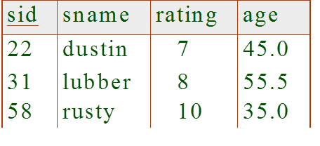
Subqueries
EXISTS, ALL and ANY can be negated by putting NOT in front of the entire expression.
    SELECT R.bid
    FROM Reserves R
    WHERE R.sid IN (SELECT S.sid
    FROM Sailors S
    WHERE S.name=‘Rusty’);
    SELECT *
    FROM Sailors S1
    WHERE S1.age > ALL (SELECT S2.age
    FROM Sailors S2
    WHERE S2.name=‘rusty’);
What is the result?

Slide 41
Subqueries
In a FROM clause, we can use a parenthesized subquery instead of a table.
    SELECT *
    FROM Reserves R, (SELECT S.sid
    FROM Sailors S
    WHERE S.age>60) OldSailors
    WHERE R.sid = OldSailors.sid;
Need to define a corresponding tuple variable to reference tuples from the subquery output.

Slide 42
Correlated Subqueries
    SELECT B.bid
    FROM Boats B
    WHERE NOT EXISTS (SELECT *
    FROM Reserves R
    WHERE R.bid=B.bid);
The second subquery is correlated to the outer query, i.e. the execution of the subquery may return different results for every tuple of the outer query.
Illustrates why, in general, subquery must be re-computed for each tuple of the outer query / tuple.
Notice the lack of variable before NOT EXISTS.
  What does NOT EXIST?

Slide 43
A Further Example
Find sid’s of sailors who’ve reserved both a red and a green boat:
    SELECT S.sid
    FROM Sailors S, Boats B, Reserves R
    WHERE S.sid=R.sid AND R.bid=B.bid AND B.color=‘red’
    AND S.sid IN (SELECT S2.sid
    FROM Sailors S2, Boats B2, Reserves R2
    WHERE S2.sid=R2.sid AND R2.bid=B2.bid AND B2.color=‘green’);
Similarly, EXCEPT queries re-written using NOT IN.
To find names (not sid’s) of Sailors who’ve reserved both red and green boats, just replace S.sid by S.sname in SELECT clause.
  What about INTERSECT query?
Red
Green

Slide 44
Division in SQL
Find sailors who’ve reserved all boats.
With EXCEPT:
    SELECT S.sname
    FROM Sailors S
    WHERE NOT EXISTS
    ((SELECT B.bid
    FROM Boats B)
    EXCEPT
    (SELECT R.bid
    FROM Reserves R
    WHERE R.sid=S.sid));
For each sailor, check to see if there are any boats that have not been reserved.
Any boats not reserved by the sailor.
All reservations by all sailors.

Slide 45
Division in SQL
Find sailors who’ve reserved all boats.
Without EXCEPT:
SELECT S.sname
FROM Sailors S
WHERE NOT EXISTS (SELECT B.bid
FROM Boats B
WHERE NOT EXISTS (SELECT R.bid
FROM Reserves R
WHERE R.bid=B.bid
AND R.sid=S.sid))
Sailors S such that ...
there is no boat
B without ...
a Reserves tuple showing S reserved B

Slide 46
Database Systems I
SQL Modifications
Notes:
The slides for this text are organized into chapters. This lecture covers Chapter 5.
Chapter 1: Introduction to Database Systems
Chapter 2: The Entity-Relationship Model
Chapter 3: The Relational Model
Chapter 4 (Part A): Relational Algebra
Chapter 4 (Part B): Relational Calculus
Chapter 5: SQL: Queries, Programming, Triggers
Chapter 6: Query-by-Example (QBE)
Chapter 7: Storing Data: Disks and Files
Chapter 8: File Organizations and Indexing
Chapter 9: Tree-Structured Indexing
Chapter 10: Hash-Based Indexing
Chapter 11: External Sorting
Chapter 12 (Part A): Evaluation of Relational Operators
Chapter 12 (Part B): Evaluation of Relational Operators: Other Techniques
Chapter 13: Introduction to Query Optimization
Chapter 14: A Typical Relational Optimizer
Chapter 15: Schema Refinement and Normal Forms
Chapter 16 (Part A): Physical Database Design
Chapter 16 (Part B): Database Tuning
Chapter 17: Security
Chapter 18: Transaction Management Overview
Chapter 19: Concurrency Control
Chapter 20: Crash Recovery
Chapter 21: Parallel and Distributed Databases
Chapter 22: Internet Databases
Chapter 23: Decision Support
Chapter 24: Data Mining
Chapter 25: Object-Database Systems
Chapter 26: Spatial Data Management
Chapter 27: Deductive Databases
Chapter 28: Additional Topics

Slide 47
Introduction
SQL provides three operations that modify the instance (state) of a DB:
  INSERT: inserts new tuple(s),
  DELETE: deletes existing tuples(s), and
  UPDATE: updates attribute value(s)s of existing tuple(s).
Individual modifications may yield an inconsistent DB state, and only a sequence of modifications (transaction) may lead again to a consistent state.
The DBS ensures certain properties of a transaction that guarantee the consistency of the resulting DB state.

Slide 48
Insertion
INSERT INTO R (A1, . . ., An)
VALUES (v1, . . ., vn);
Inserts a single tuple with values vi for attributes Ai into table R.
INSERT INTO Sailors (sid, sname,rating, age)
VALUES (69,’mike’, 2, 20);
If values are not provided for all attributes, NULL values will be inserted.
Short hand if all attribute values are given:
INSERT INTO Sailors
VALUES (69,’mike’, 2, 20);
Values need to be provided in the order of the corresponding attributes.

Slide 49
Insertion
INSERT INTO R (A1, . . ., An)
<subquery> ;
Inserts a set of tuples (relation) with values for attributes Ai into table R, as specified by a subquery.
INSERT INTO Sailors (sid)
SELECT DISTINCT R.sid
FROM Reserves R
WHERE R.sid NOT IN
(SELECT sid
FROM Sailors);
The subquery is completely evaluated before the first tuple is inserted.

Slide 50
Deletion
DELETE FROM R
WHERE <condition> ;
Deletes the set (!) of all tuples from R which satisfy the condition of the WHERE clause.
DELETE FROM Sailors // one tuple
WHERE sid = 69;
DELETE FROM Sailors // multiple tuples
WHERE rating < 3;
Cannot directly specify a tuple to be deleted as is possible for insertions.

Slide 51
Update
UPDATE R
SET <new value assignments>
WHERE <condition>;
Updates attributes in the specified manner for all R tuples satisfying the given condition.
UPDATE Sailors
SET age = age + 1;
UPDATE Sailors
SET rating = rating * 1.1, age = age + 1
WHERE age < 30 and sid IN
(SELECT R.sid
FROM Reserves R);

