Slide 1
Data Structures & Programming
Finishing up Arrays and Linked Lists
Golnar Sheikhshab

Slide 2
Chapter 3 outline
Arrays
one-dimensional // covered before
two-dimensional
Linked List
Singly Linked List // covered before
Doubly Linked List // covered before
Circular Linked List
Recursion // next lecture

Slide 3
Arrays - two dimensional
//Array of arrays - also called matrix sometimes
const int max_row_num = 10;
const int max_col_num = 20;
int A[max_row_num][max_col_num];
// dynamic array - allocating memory
int** B = new int*(max_row_num);
for (int i=0; i< max_row_num; i++ )
B[i] = new int[max_col_num];
// dynamic array -releasing memory
for (int i=0; i< max_row_num; i++ )
delete [] B[i];
delete [] B;

Slide 4
Vectors instead of Arrays
Using STL Vectors instead of arrays is the current norm
vector<int> A; // one dimensional
vector<vector<int>> B; // two dimensional
You have to include the header:
#include <vector>

Slide 5
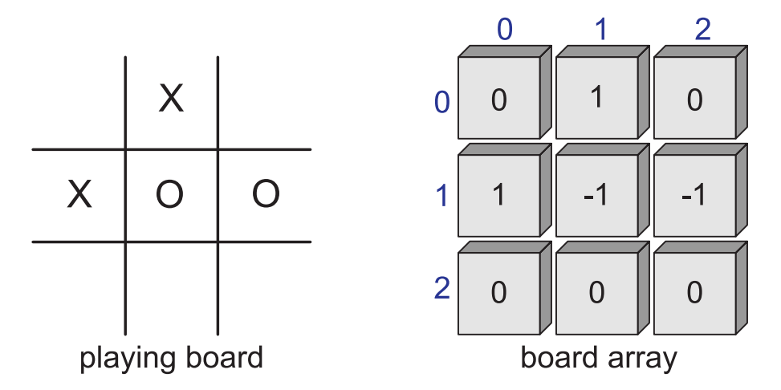
2D arrays and positional games

Slide 6
Tic-Tac-Toe
#include <iostream> // I/O definitions
using namespace std; // make std:: accessible
const int X = 1, O = -1, EMPTY = 0; // possible marks
int board[3][3]; // playing board
int currentPlayer; // current player (X or O)
void clearBoard() { // clear the board
for (int i = 0; i < 3; i++)
for (int j = 0; j < 3; j++)
board[i][j] = EMPTY; // every cell is empty
currentPlayer = X; // player X starts
}

Slide 7
Tic-Tac-Toe (2)
void putMark(int i, int j) { // mark row i column j
board[i][j] = currentPlayer; // mark with current player
currentPlayer = -currentPlayer; // switch players
}
int getWinner() { // who wins? (EMPTY means tie)
if (isWin(X)) return X;
else if (isWin(O)) return O;
else return EMPTY;
}

Slide 8
Tic-Tac-Toe (3)
bool isWin(int mark) { // is mark the winner?
int win = 3*mark; // +3 for X and -3 for O
return ((board[0][0] + board[0][1] + board[0][2] == win) // row 0
|| (board[1][0] + board[1][1] + board[1][2] == win) // row 1
|| (board[2][0] + board[2][1] + board[2][2] == win) // row 2
|| (board[0][0] + board[1][0] + board[2][0] == win) // column 0
|| (board[0][1] + board[1][1] + board[2][1] == win) // column 1
|| (board[0][2] + board[1][2] + board[2][2] == win) // column 2
|| (board[0][0] + board[1][1] + board[2][2] == win) // diagonal
|| (board[2][0] + board[1][1] + board[0][2] == win)); // diagonal
}

Slide 9
Tic-Tac-Toe (4)
void printBoard() { // print the board
for (int i = 0; i < 3; i++) {
for (int j = 0; j < 3; j++) {
switch (board[i][j]) {
case X: cout << "X"; break;
case O: cout << "O"; break;
case EMPTY: cout << " "; break;
}
if (j < 2) cout << "|"; // column boundary
}
if (i < 2) cout << "\n-+-+-\n"; // row boundary
}
}

Slide 10
Tic-Tac-Toe (5)
int main() { // main program
clearBoard(); // clear the board
putMark(0,0); putMark(1,1); putMark(0,1); // add the marks
putMark(0,2); putMark(2,0); putMark(1,2);
putMark(2,2); putMark(2,1); putMark(1,0);
printBoard(); // print the final board
int winner = getWinner();
if (winner != EMPTY) // print the winner
cout << " " << (winner == X ? 'X' : '0') << " wins" << endl;
else
cout << " Tie" << endl;
return EXIT_SUCCESS;
}

Slide 11
Tic-Tac-Toe (output)
X|X|O
-+-+-
X|O|O
-+-+-
X|O|X X wins

Slide 12
Circularly Linked List
A cursor instead of header
front
back
front

Slide 13
CircleList c++ implementation
class CircleList {
public: CircleList();
˜CircleList();
bool empty() const;
const Elem& front() const;
const Elem& back() const;
void advance();
void add(const Elem& e);
void remove();
private:
CNode* cursor;
};
typedef string Elem;
class CNode {
private:
Elem elem;
CNode* next;
friend class CircleList;
};

Slide 14
CircleList c++ implementation (2)
CircleList::CircleList() : cursor(NULL) { }
CircleList::˜CircleList() { while (!empty()) remove(); }
bool CircleList::empty() const { return cursor == NULL; } const
Elem& CircleList::back() const { return cursor−>elem; } const
Elem& CircleList::front() const { return cursor−>next−>elem; }
void CircleList::advance() { cursor = cursor−>next; }

Slide 15
CircleList c++ implementation (3)
void CircleList::add(const Elem& e) {
CNode* v = new CNode;
v−>elem = e;
if (cursor == NULL) {
v−>next = v;
cursor = v;
}
else {
v−>next = cursor−>next;
cursor−>next = v; }
}

Slide 16
CircleList c++ implementation (4)
void CircleList::remove() {
CNode* old = cursor−>next;
if (old == cursor)
cursor = NULL;
else
cursor−>next = old−>next;
delete old;
}
back
front

Slide 17
Before we move on to recursion ...
The most important topics so far:
general C++ coding
generic programing (how to use templates)
how to make and use interfaces
how to use arrays and linked list
(adding, removing, detecting if it's empty, constructing, and destructing relevant classes)

Slide 18
Reading material
Chapter 3 except for recursion

