Slide 1
Data Structures & Programming
Priority Queue
Golnar Sheikhshab

Slide 2
Priority Queue models Life!
Modern life:
Need a loan? What's your credit-score?
Need a job? How skilled are you?
Need a scholarship? How well can you play X-ball?
A little-less-modern life:
Need food? How fast are you?
Don't want to die? How strong are you?
In evolutionary theory natural selection is also known as survival of the fittest

Slide 3
Priority Queue ADT
Fundamentally different from the position-based data structures such as stacks, queues, deques, lists, and even trees:
stores elements according to their priorities
has no external notion of “position”

Slide 4
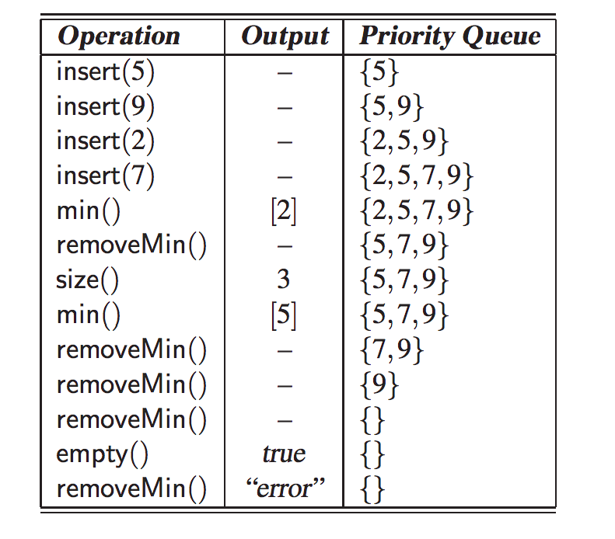

Slide 5
Keys, Priorities, and Total Order Relations
key: and object assigned to an element by a user or application to identify, rank, weigh it.
Not necessarily unique
is used in definition of order
can be complex
can be extracted from the element or not
Total order (over keys)
Reflexive property : k ≤ k
Antisymmetric property: if k1 ≤ k2 and k2 ≤ k1, then k1 = k2
Transitive property: if k1 ≤ k2 and k2 ≤ k3, then k1 ≤ k3
Then a minimum is well-defined

Slide 6
An Application of Priority Queue
Example 8.1: Suppose a certain flight is fully booked an hour prior to departure. Because of the possibility of cancellations, the airline maintains a priority queue of standby passengers hoping to get a seat. The priority of each passenger is determined by the fare paid, the frequent-flyer status, and the time when the passenger is inserted into the priority queue. When a passenger requests to fly standby, the associated passenger object is inserted into the priority queue with an insert operation. Shortly before the flight departure, if seats become available (for example, due to last-minute cancellations), the airline repeatedly removes a standby passenger with first priority from the priority queue, using a combination of min and removeMin operations, and lets this person board.

Slide 7
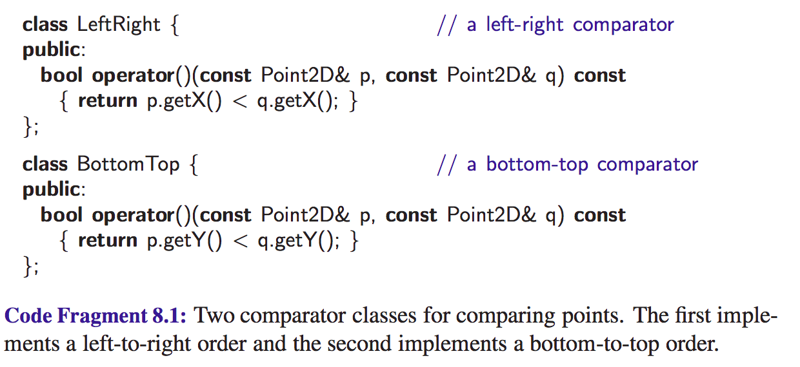
Comparators

Slide 8
Using Comparators

Slide 9
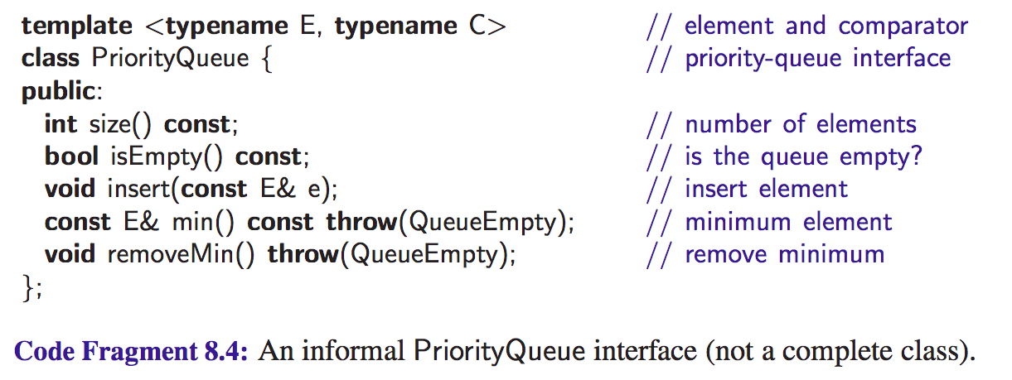
A C++ Priority Queue Interface

Slide 10
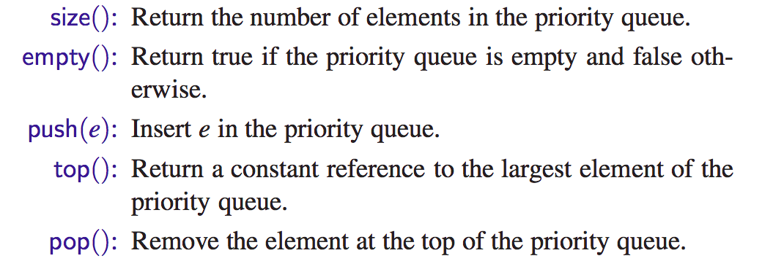
The STL priority queue Class

Slide 11
The STL priority queue Class

Slide 12
Implementing a Priority Queue with a (Sorted) List

Slide 13
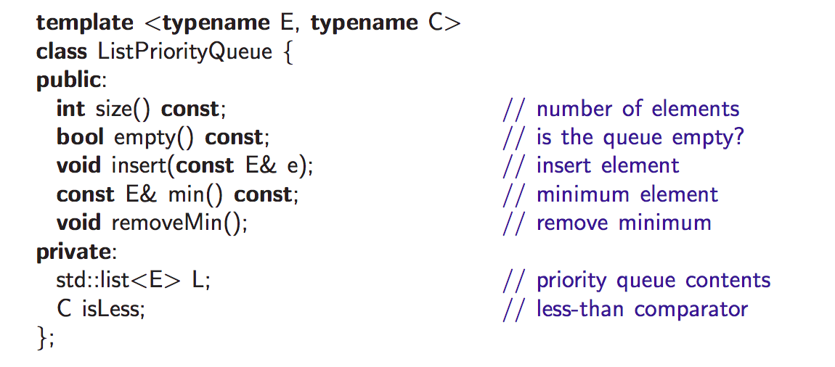
A C++ Priority Queue Class Declaration

Slide 14
A C++ Priority Queue Implementation

Slide 16
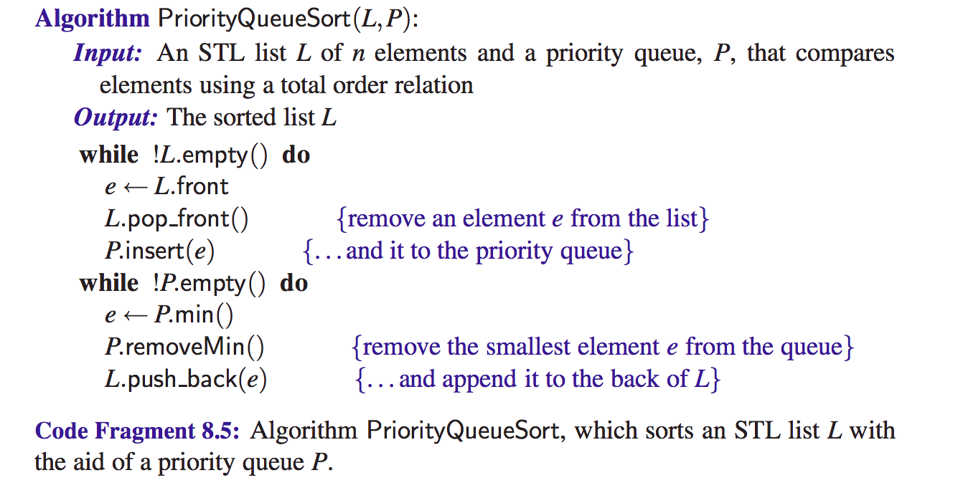
Sorting with a Priority Queue

Slide 17
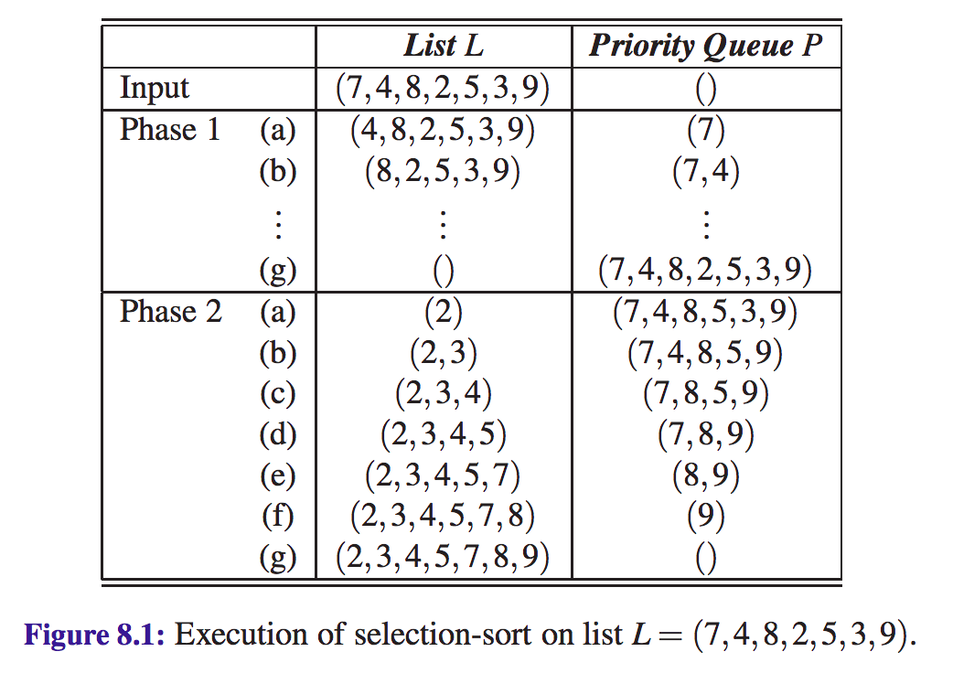
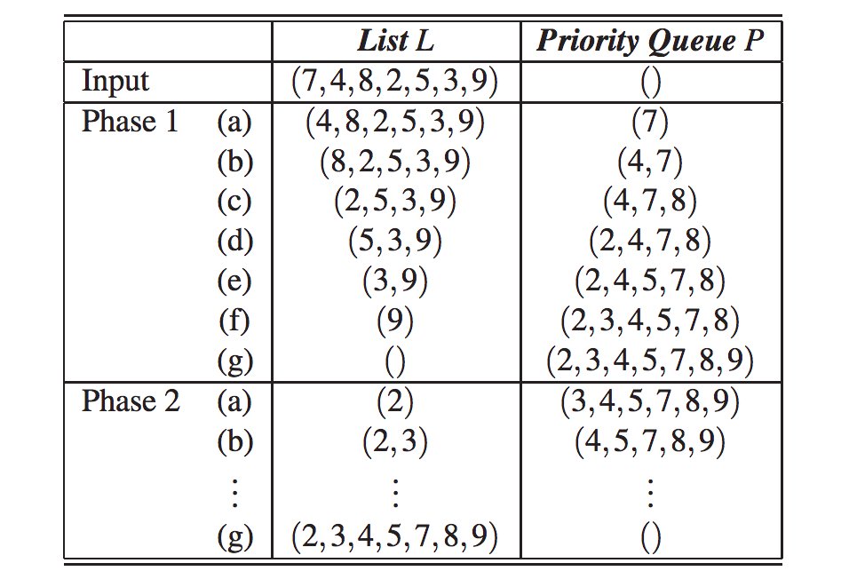
Selection-Sort and Insertion-Sort with Priority Queue
PriorityQueueSort on an Implementation with Unsorted List => Selection Sort
PriorityQueueSort on an Implementation with Sorted List => Insertion Sort

Slide 18
Final Note
Is priority queue a special case of queue or is queue a special case of priority queue?

Slide 19
Reading Material
Sections 8.1 - 8.3 of the textbook

