Slide 1
Data Structures & Programming
Binary Trees
Definitions & Linked Structures
Golnar Sheikhshab

Slide 2
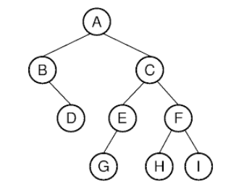
Binary Tree Definitions
Root
Left child, Right child
Left subtree, Right subtree
Proper, improper
Full
Complete
Recursive Binary Tree Definition:
a binary tree is either empty or consists of:
A node r, called the root of T and storing an element
A binary tree, called the left subtree of T
A binary tree, called the right subtree of T

Slide 3
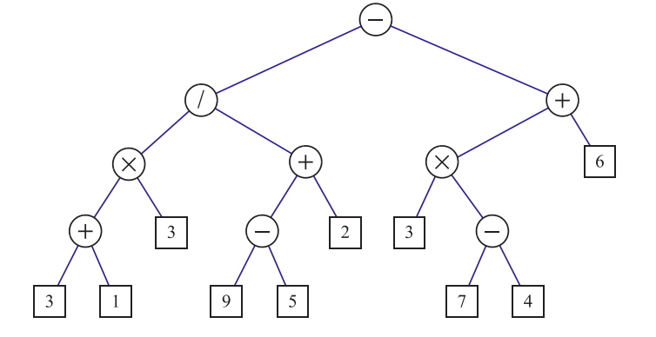
Binary Tree Examples

Slide 4
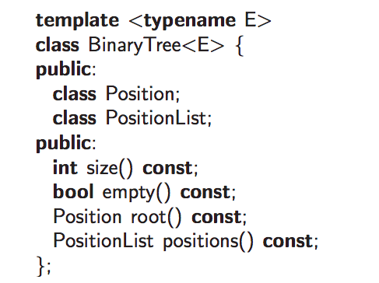
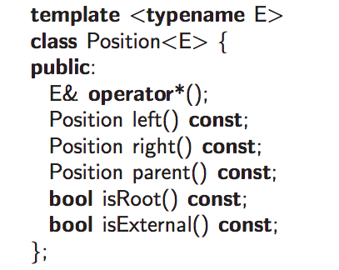
Binary Tree Informal Interface

Slide 5
Properties of Binary Trees

Slide 6
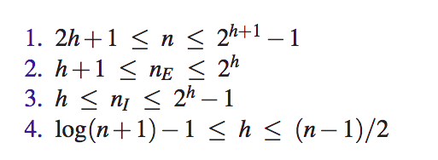
Properties of Binary Trees (2)

Slide 7
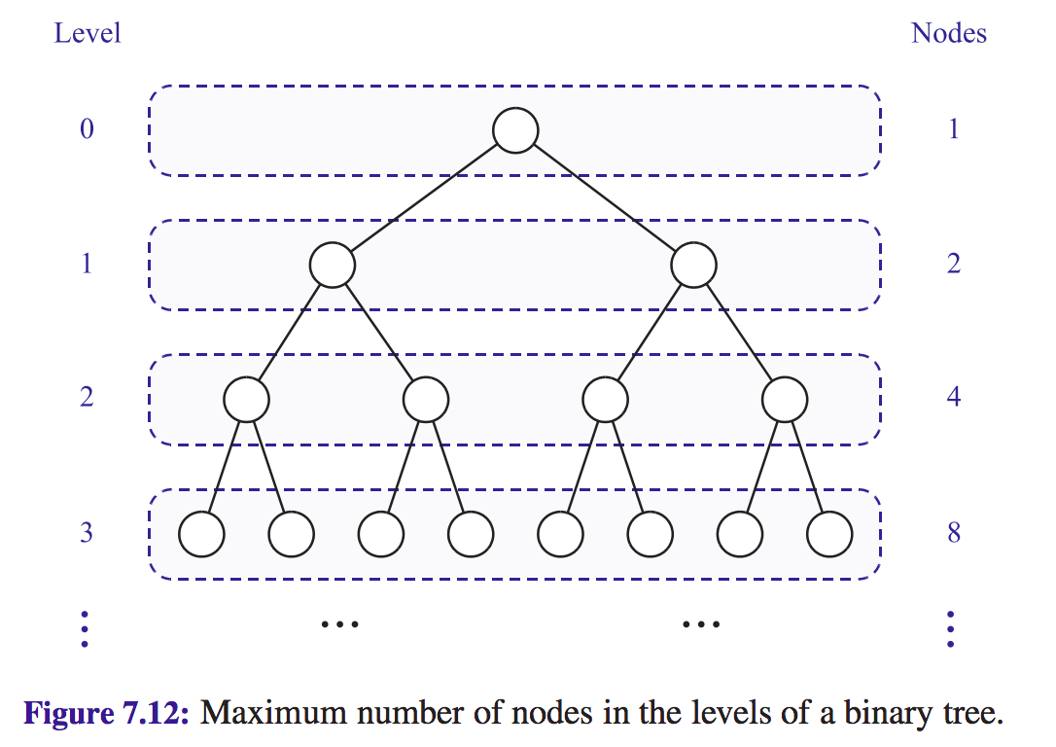

Slide 8
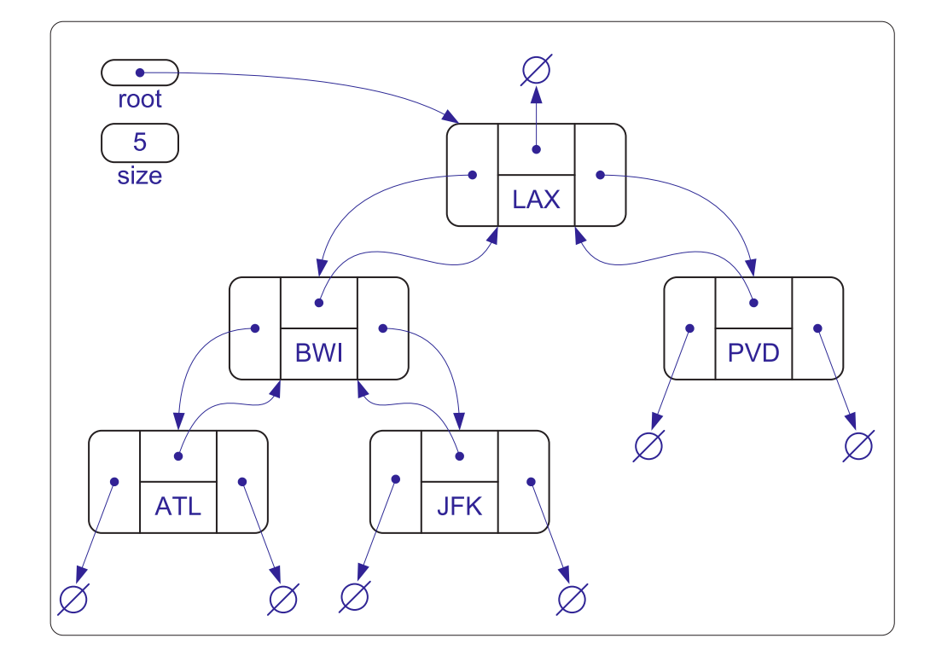
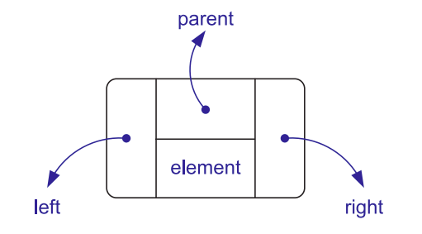
A Linked Structure for Binary Trees

Slide 9
Some C++ Code from the Textbook! (Do I sound impressed?)

Slide 10
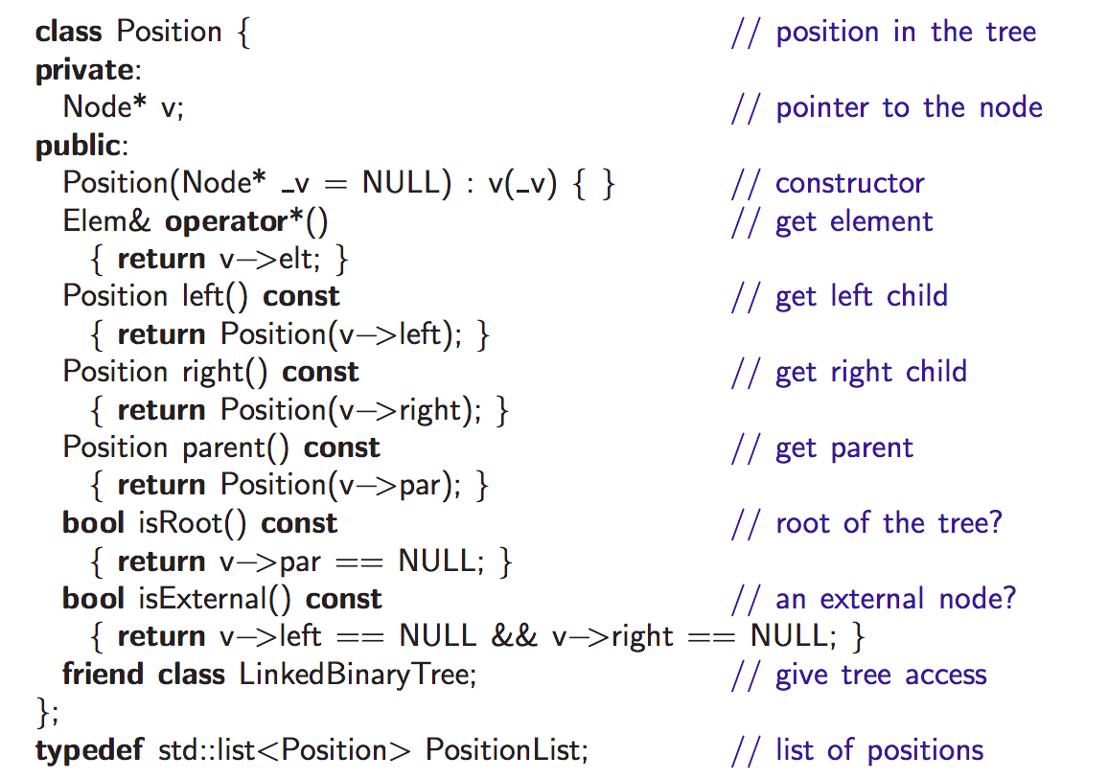

Slide 11
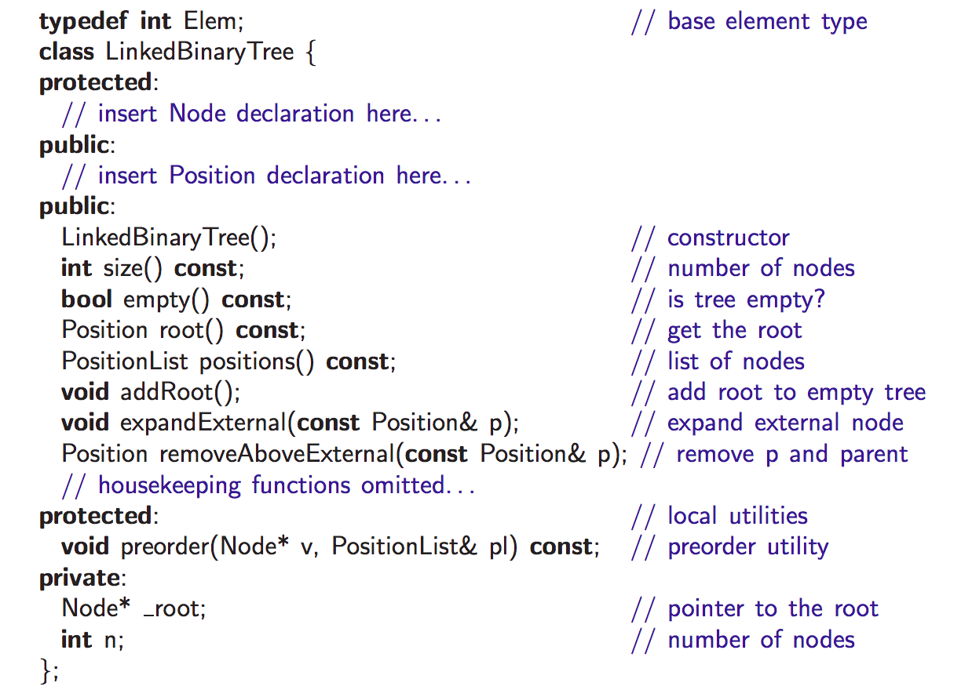

Slide 12
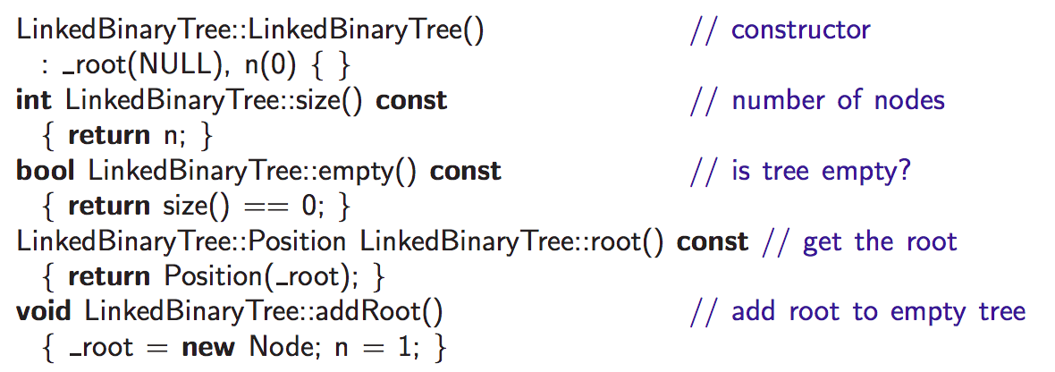

Slide 13
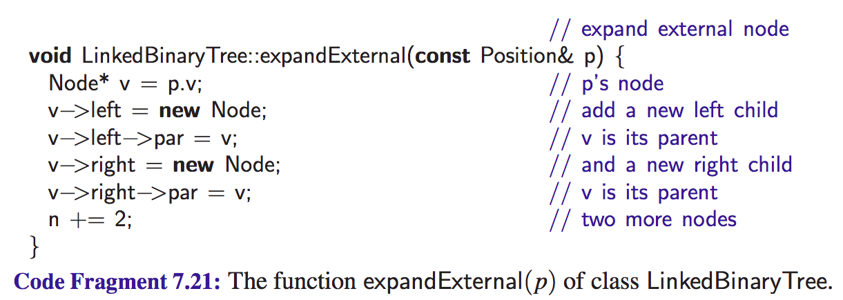

Slide 14
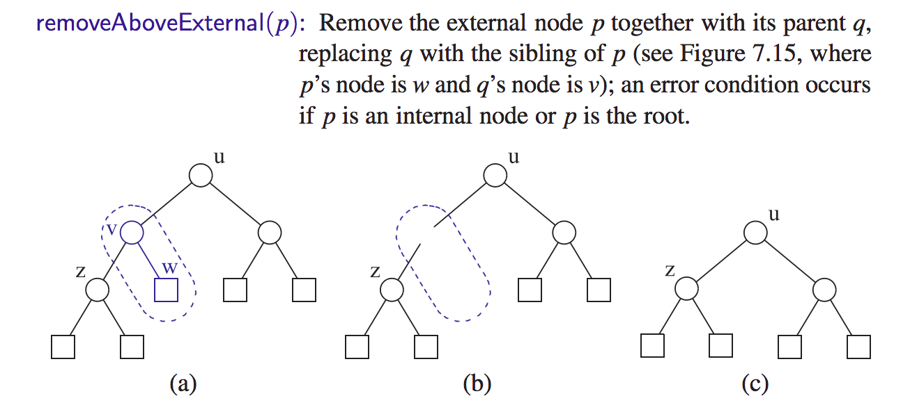

Slide 15
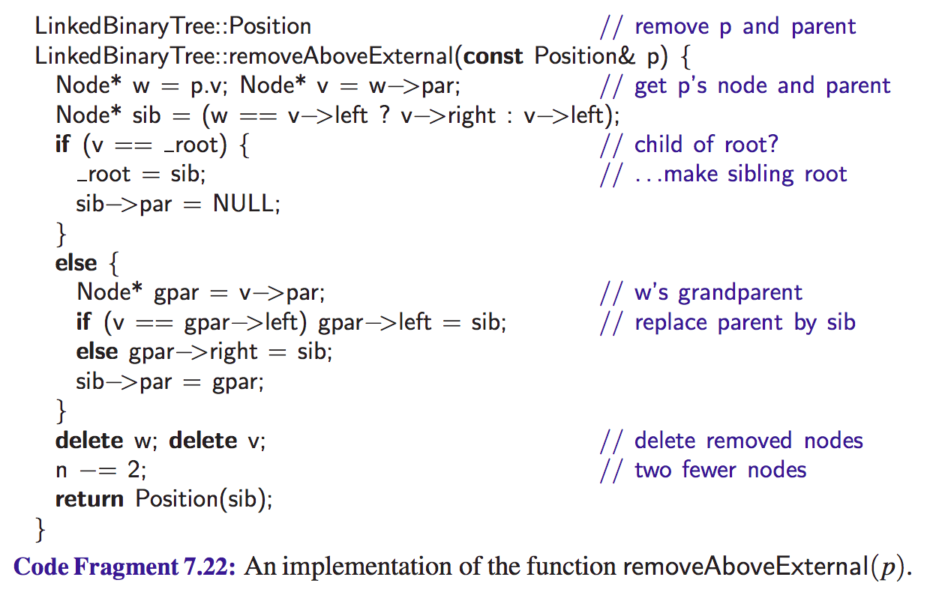

Slide 16
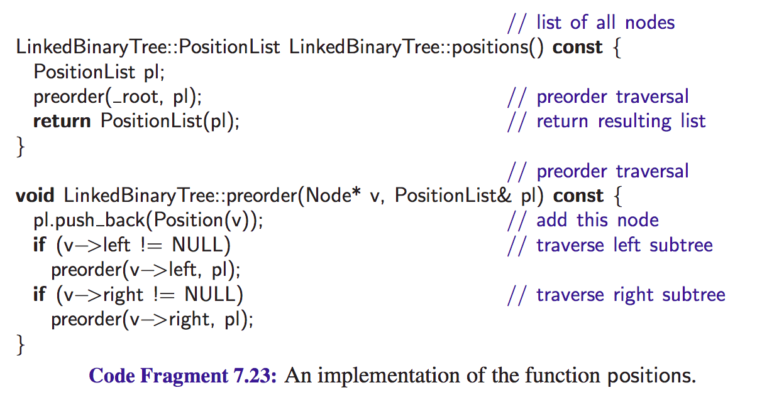

Slide 17
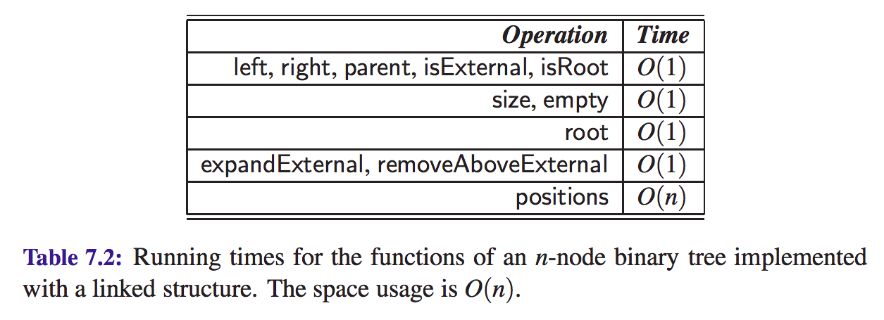
Complexity Analysis

Slide 18
ADT Tree is not nearly as standard as stack & queue
People define insert and remove according to their problem
Do I need to insert to
any position?
only root?
only leaves?
What do I do if it's a binary tree and the node already has both left and right?
Do I need to remove from
any position?
only root?
only leaves?
What do I do with the children of a node that I am removing?

Slide 19
Constructing a tree
How do I decide
what I'm putting in a tree?
with what structure?
From file?
With some logic?
Did the code from your book enables me to do what I need to do? Did your book implement tree as a data structure?
Can you change the code of gTree.h from lab4 to make a binary tree? Would that code enable you to fill a tree from a file? If yes, what are the assumptions? What if you want to fill a tree based on some logic (like in the assignment 3)?

Slide 20
Reading material
Sections 7.3.1, 7.3.2, 7.3.3, and 7.3.4 of the textbook

