Slide 1
Data Structures & Programming
General Trees &Tree Traversals
Golnar Sheikhshab

Slide 2
A Tree represents hierarchy

Slide 3
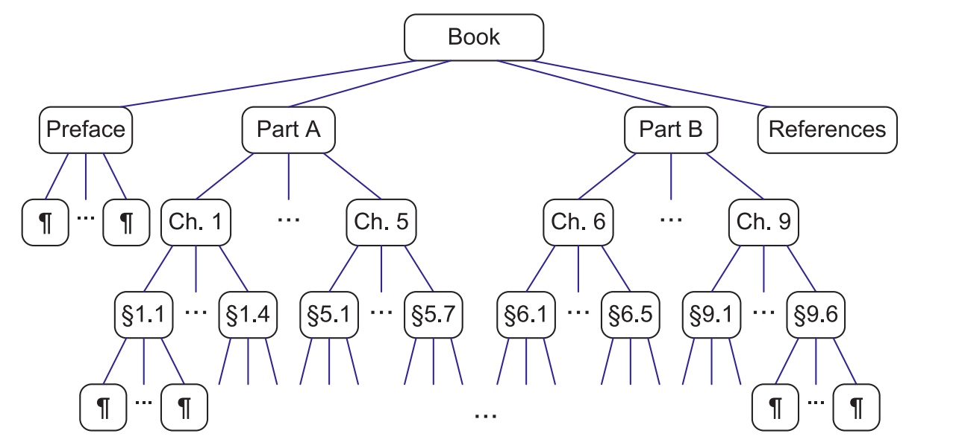
Some definitions
node
root
parent
child
sibling
edge
tree
leaf
external node
internal node
subtree (rooted at some node)
descendent
ancestor
edge
path
ordered tree

Slide 4
Tree functions
A Position class is defined in your book that is a wrapper around a pointer to a node. In reality often we have a class Node.
Given a Position (or a node) object p the following functions are defined:
p.parent(): Return the parent of p; an error occurs if p is the root.
p.children(): Return a position list containing the children of node p.
p.isRoot(): Return true if p is the root and false otherwise.
p.isExternal(): Return true if p is external and false otherwise.
The tree itself provides the following functions:
size(): Return the number of nodes in the tree.
empty(): Return true if the tree is empty and false otherwise.
root(): Return a position for the tree’s root; an error occurs if the tree is empty.
positions(): Return a position list of all the nodes of the tree.

Slide 5
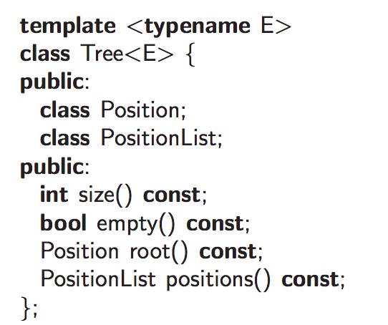
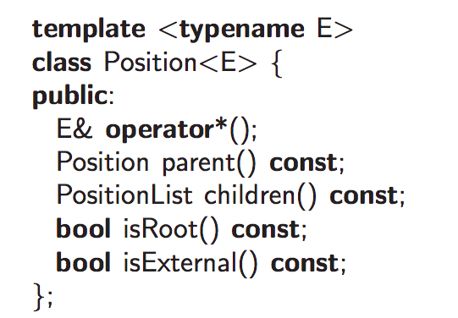
C++ Tree Interface

Slide 6
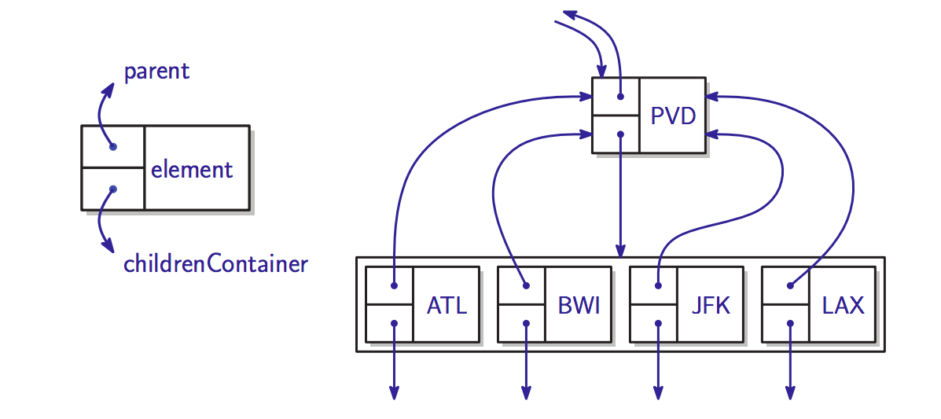
General Tree as a Linked Structure

Slide 7
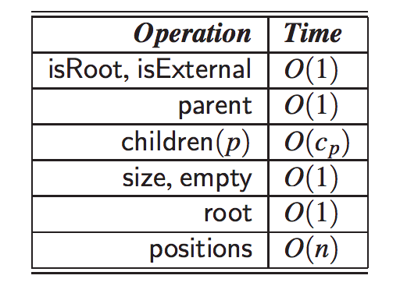
Complexity Analysis of Functions
Space usage is O(n)

Slide 8
Tree Traversal Algorithms
Pre-order Traversal
visit the root of any subtree first and then the rest of the subtree (in order of children if the tree is ordered)
Post-order Traversal
visit the root of any subtree after you visited the rest of the subtree (in order of children if the tree is ordered)

Slide 9
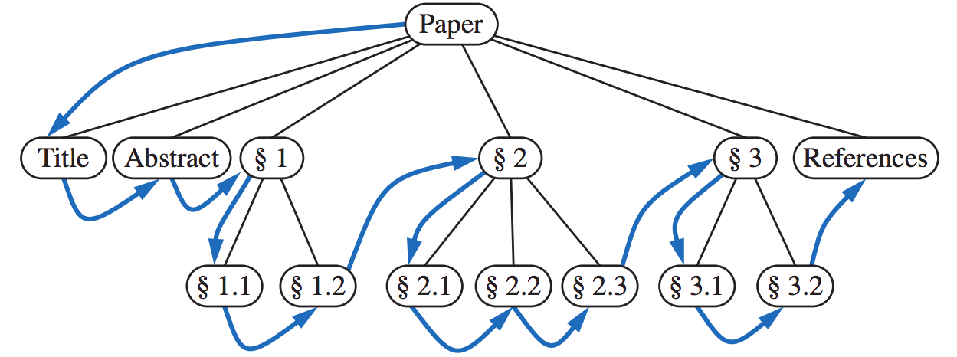
Pre-order Tree Traversal

Slide 10
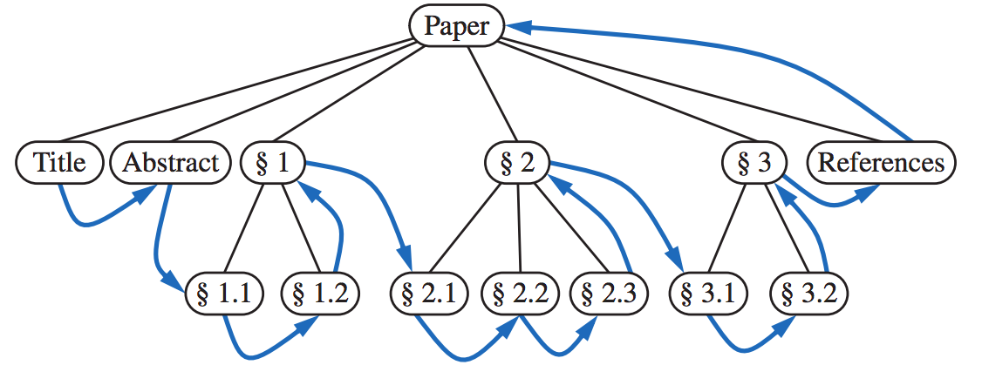
Post-order Tree Traversal

Slide 11
Height and Depth
The depth of a node p is the number of ancestors of p, excluding p itself.
The depth of p can also be defined recursively:
If p is the root, then the depth of p is 0
Otherwise, the depth of p is one plus the depth of the parent of p
The height of a node p in a tree T is also defined recursively:
If p is external, then the height of p is 0
Otherwise, the height of p is one plus the maximum height of a child of p
The height of a tree T is the height of the root of T.

Slide 12
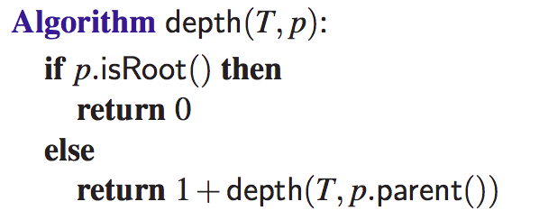
Computing depth of a node

Slide 13
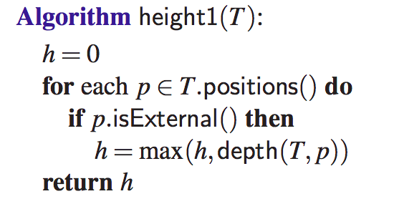
Computing the height of a node

Slide 14
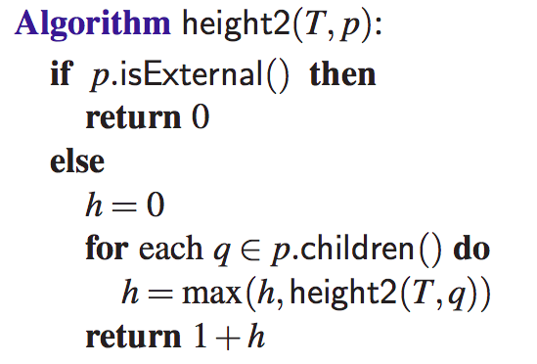
Computing the height of a node (more efficiently)

Slide 15
C++ Implementation of a general Tree
Check out the gTree.h file for lab4 to get an idea on how a general tree could be implemented in C++.

Slide 16
Reading material
Section 7.1 and 7.2 of the textbook

