Slide 1
What was the first computer?
No, it wasn’t the IPad Mini

Slide 2
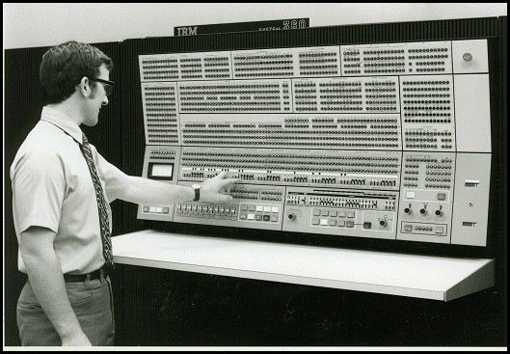
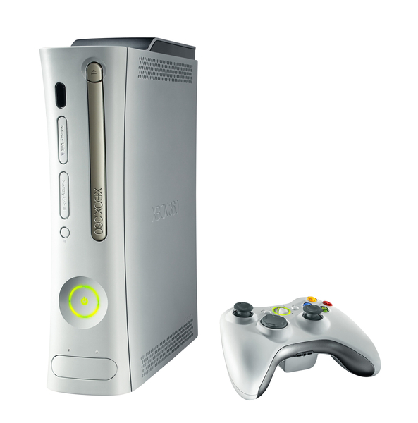
Modern computers come in all shapes and sizes
IBM 360 Mainframe (1964) 64KB, ~35,000 instructions per second
XBOX 360 (2005)
512MB, ~3 billion instructions per second (with 3 cores)
Moto 360 (2014)
512MB, ~1 billion instructions per second

Slide 3
Questions
Why did people invent computers?
What was the first “modern” computer?

Slide 4
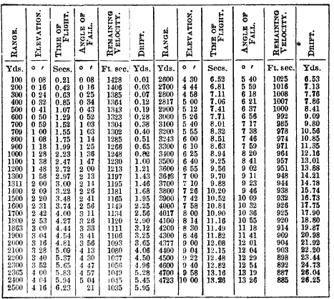
An Artillery Table (1891)
Imagine it was your job to create this table.
You’d have to do a lot of calculations.
By hand.
How long would it take you?
How many mistakes would you expect to make?

Slide 5
An Artillery Table (1891)
This is only one table!
Tables like this are useful in many applications.
e.g. navigation, business, artillery, medicine, etc.
Even by 1891, it had long been recognized that accurate tables are difficult to create efficiently.

Slide 6
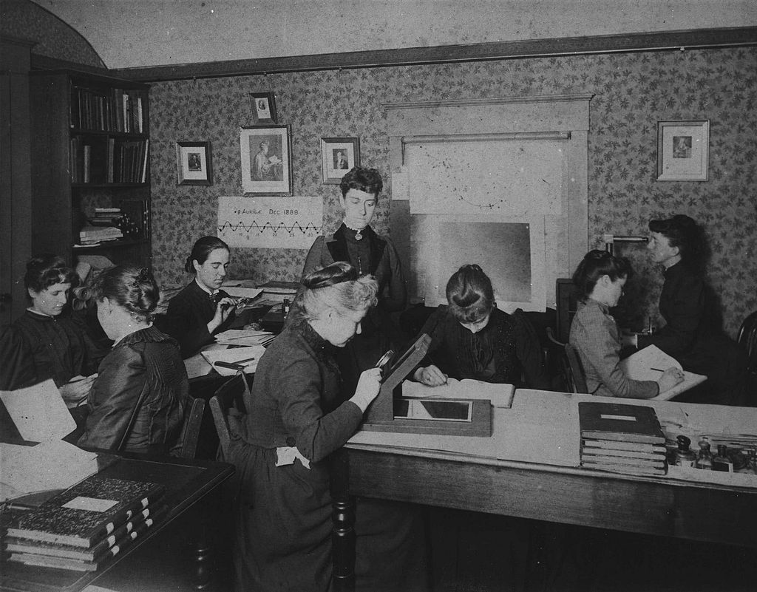
Human Calculators
Astronomer Edward Pickering was director of the Harvard observatory from 1877 to 1919.
He famously hired women to process astronomical data.
They became known as the “Harvard Calculators”, or sometimes “Pickerings Harem”.

Slide 7
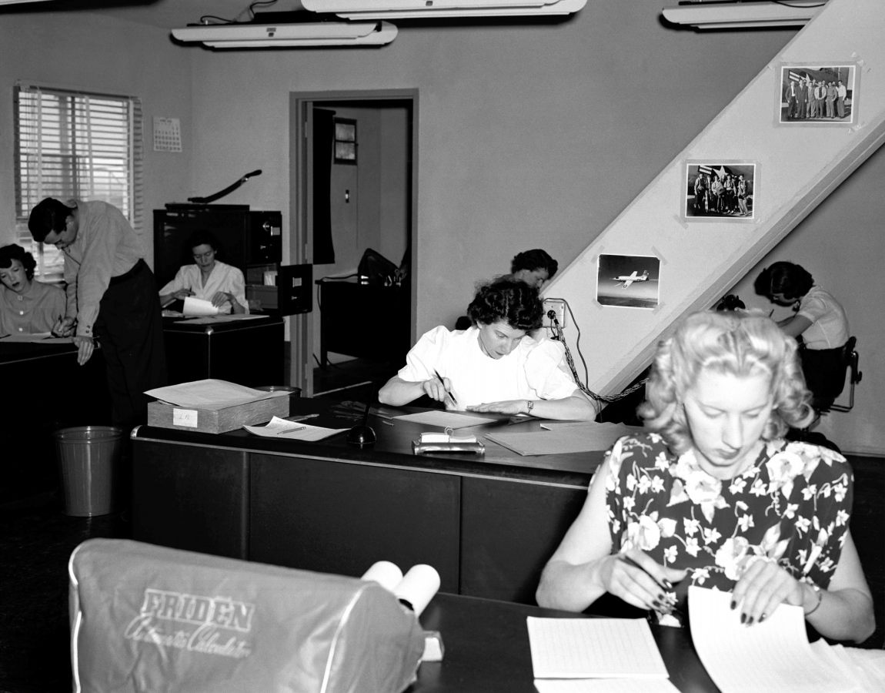
Human Calculators

Slide 8
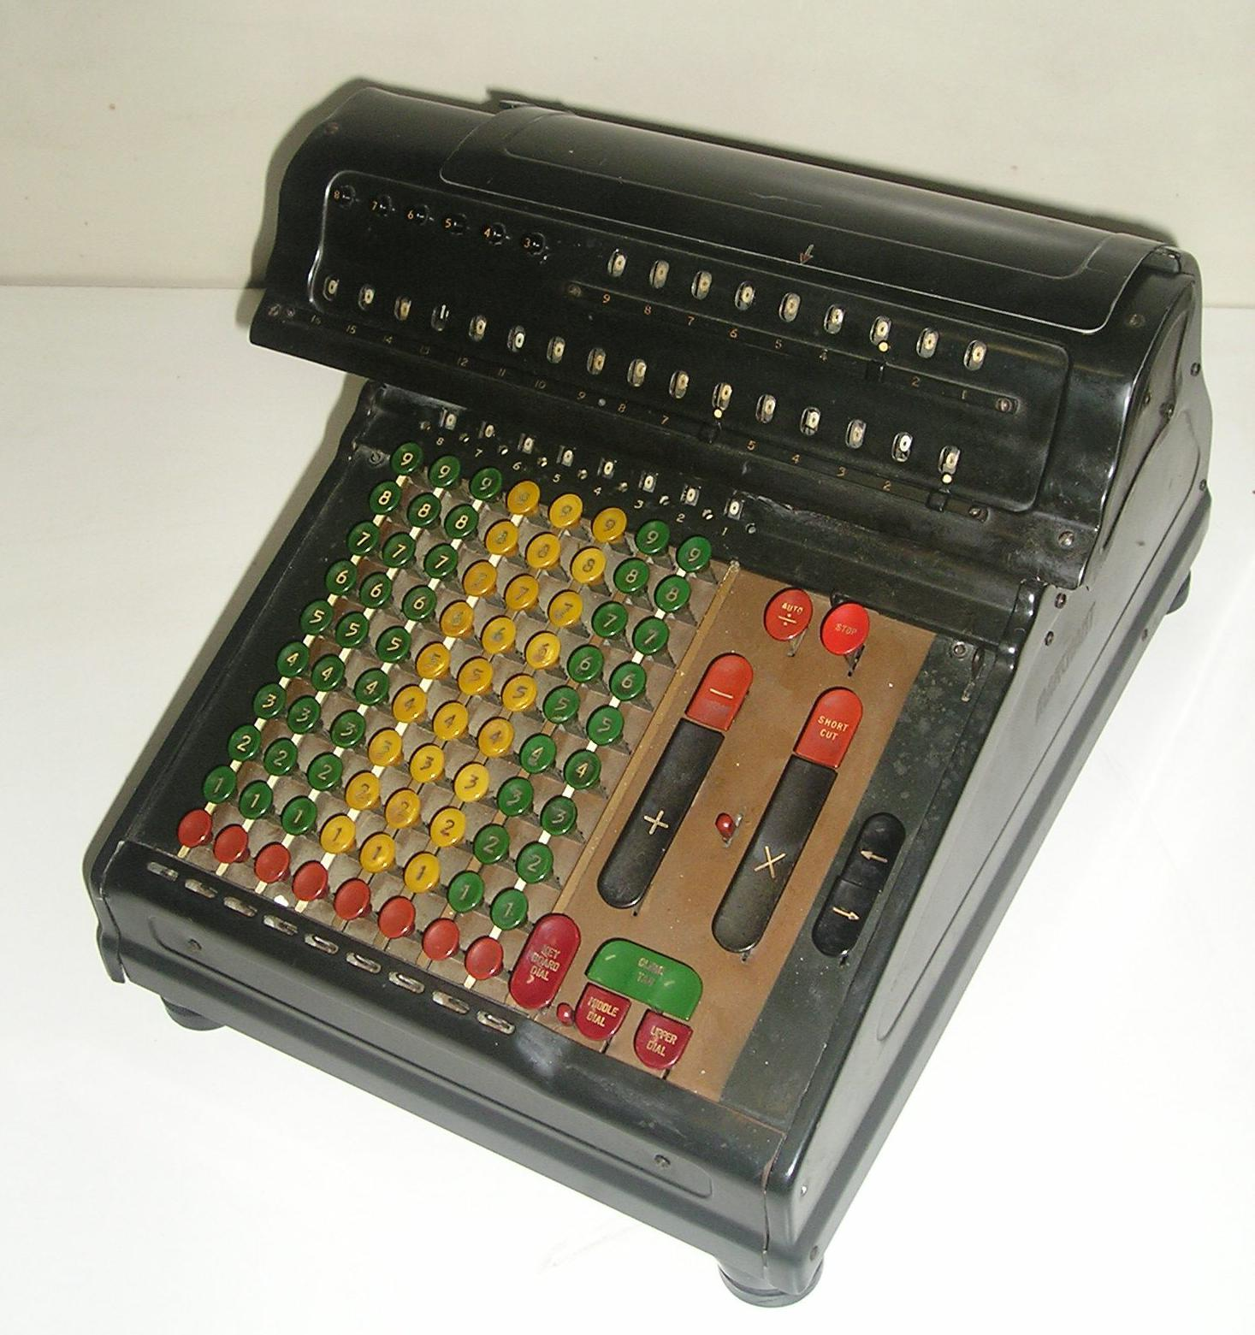
Marchant Calculator
Before the rise of cheap electronic calculators and computers in the 1970s and 1980s, people often used mechanical calculators like this.
"Marchant SilentSpeed-8D" by Ancelli - Own work. Licensed under CC BY-SA 3.0 via Wikimedia Commons - http://commons.wikimedia.org/wiki/File:Marchant_SilentSpeed-8D.jpg#/media/File:Marchant_SilentSpeed-8D.jpg

Slide 9
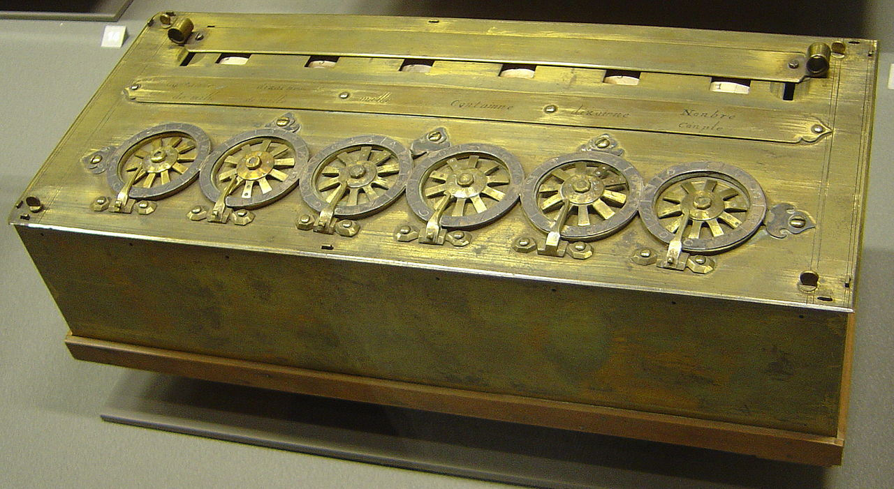
Manual Calculators
This is a Pascaline hand calculator.
It was invented by Blaise Pascal in about 1652.
By setting the dials, it could add and subtract two numbers.

Slide 10
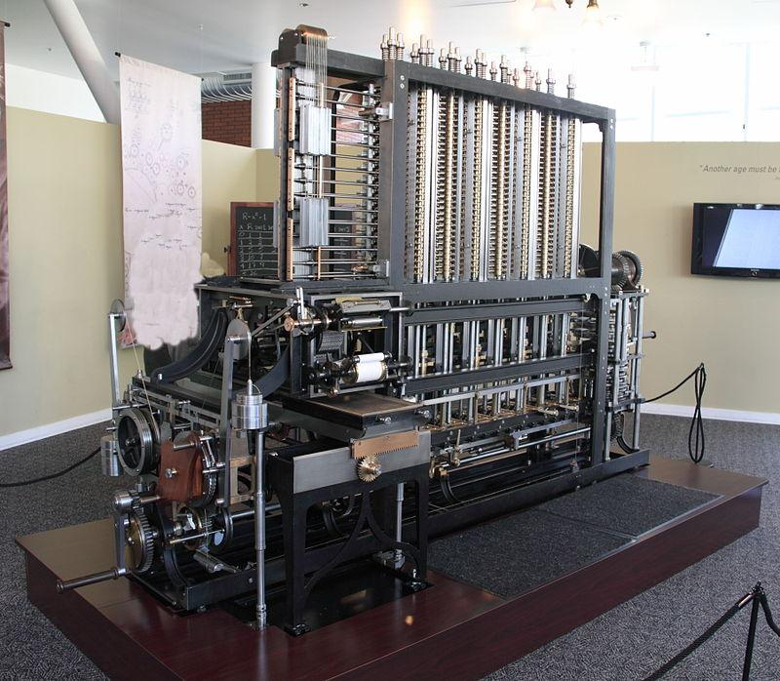
Manual Calculators
This is a re-make of the Analytical Engine.
The Analytical Engine was a manual calculator designed by Charles Babbage in the early/mid 1800s.
He never got it working during his life, but his designs were essentially correct.
Importantly, this is a programmable calculator that used punch cards to specify different programs.
The first practical programmable machine was the Jaquard Loom (1801). It was a loom for weaving --- not a calculator!

Slide 11
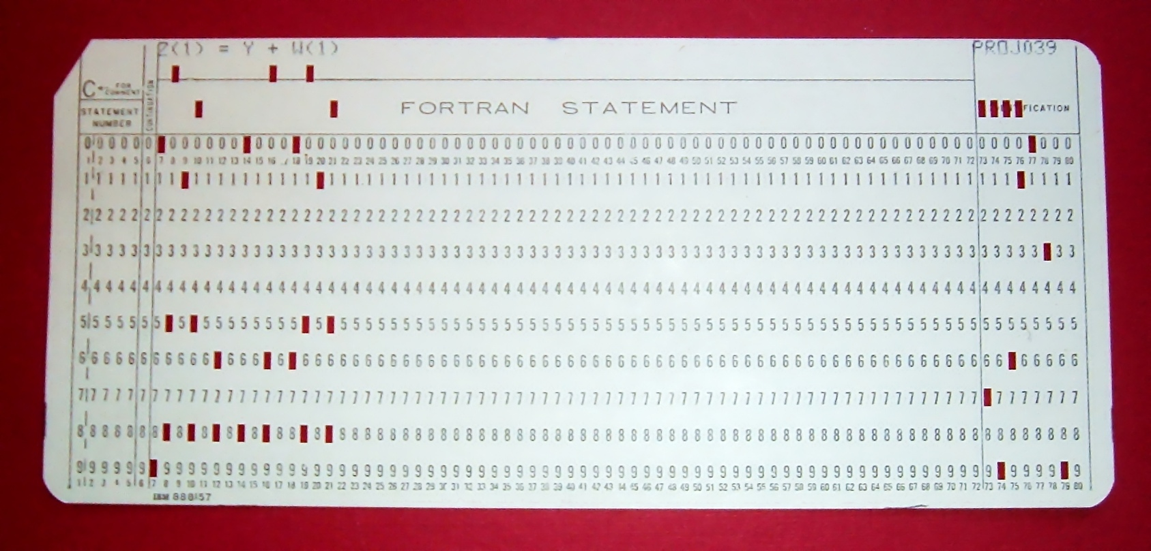
A Punch Card

Slide 12
Electronic Computers
In the late 1930s and early 1940s, a number of people hit upon the same basic idea of using electronics to control a calculator ...

Slide 13
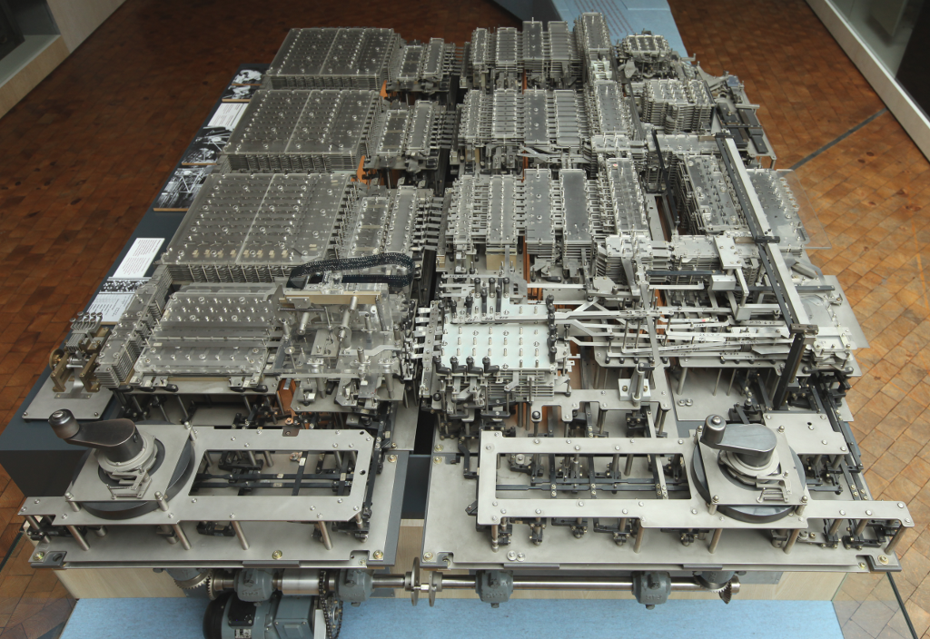
Konrad Zuse’s Z1 (1935-9)
German engineer Konrad Zuse is often credited with making (apparently in his parent’s bathroom!) the first programmable electronic calculator.
It never worked reliably, but he did go on to make several improved versions.
Unfortunately, being on the losing side of WW2 hindered his success and fame.

Slide 14
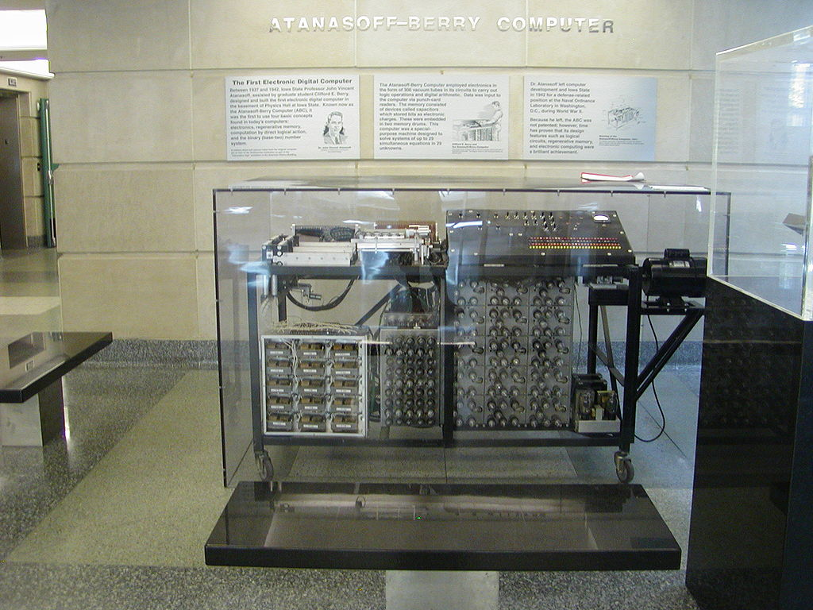
Atanasoff Berry Computer
Created by John Vincent Atanasoff and Vincent Berry, the “ABC” computer was conceived in 1937 and first tested in 1942.
While it was not programmable (it could only solve systems of linear equations), it clearly implemented some of the basic ideas of modern electronic digital computers, such as using binary to represent data.

Slide 15
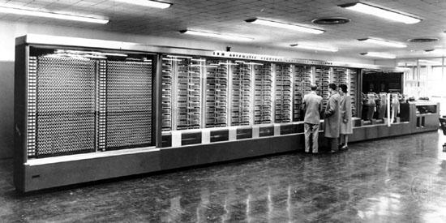
Harvard Mark I
Conceived in 1937 by Howard Aiken, it became operational in 1944, and was used by scientists from the Manhattan Project for atomic bomb calculations. It was partly mechanical, which meant it
was relatively slow, e.g. it could do
3 additions/subtractions in 1 second
1 multiplication in 6 seconds
1 division in 15 seconds.

Slide 16
What is the first computer?
Not a simple question to answer!

Slide 17
What is the first computer?
Many people hit upon the basic idea at about the same time (late 1930s).

Slide 18
What is the first computer?
The idea turned out to be the easy part.
Implementing the idea was the hard part.
Getting the right design was tricky.
Getting all the right components to work reliably was very difficult.

Slide 19
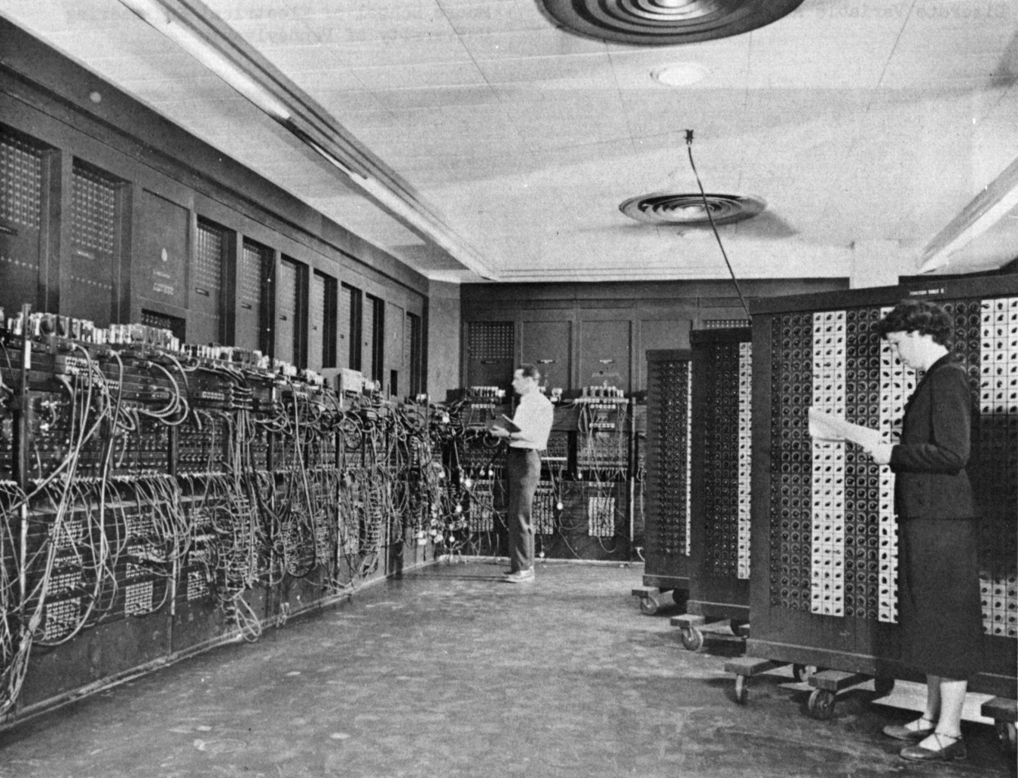
ENIAC (1943 - 1946)
ENIAC is generally considered to be the first reliable, programmable, entirely electronic modern computer. It had almost all the basic components of a modern computer, and it worked quickly and relatively reliably (it had ~50% downtime due to blown vacuum tubes).
It was was conceived and designed by
John Mauchly and J. Presper Eckert.
Many later computers took ideas and inspiration from ENIAC. Perhaps the main missing feature of ENIAC was that it did not store its programs in memory along with the data. Programs were “stored” in the mess of wires you see in the picture.
Notes:
Recall that the Harvard Mark I computer could do a single division operation in about 6 seconds. In contrast, ENIAC could do about 36 division operations in 1 second. So in the time it would take the Mark 1 to do 1 division, ENIAC could do 216 divisions.

Slide 20
Computers for Business
Here's a 1950s Univac TV commercial
https://www.youtube.com/watch?v=BX12oyxn7Ls

