Slide 1
Final Chapter
Web Applications

Slide 2
Web Programs
The programs in this chapter require the use of either Visual Web Developer 2010 (packaged with this textbook) or the complete version of Visual Studio 2010.
We assume that you are using one of these two software products.

Slide 3
Creating a Web Program
Click on New Web Site in the File menu.
Select Visual Basic in the left pane.
Select ASP.NET Web Site in the middle pane.
Select File System as the Web location.
Give a name and path for the program.
Click on the OK button.

Slide 4
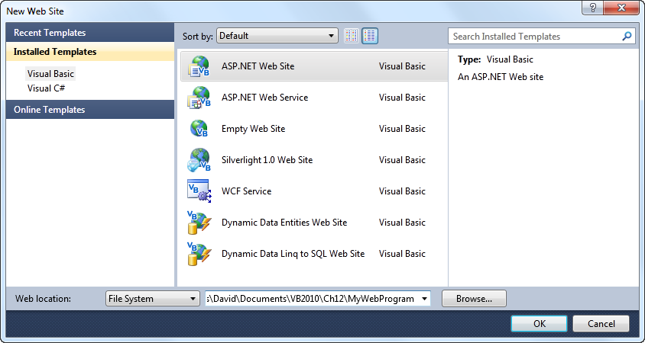
Creating a Web Program (continued)
enter name
click on OK

Slide 5
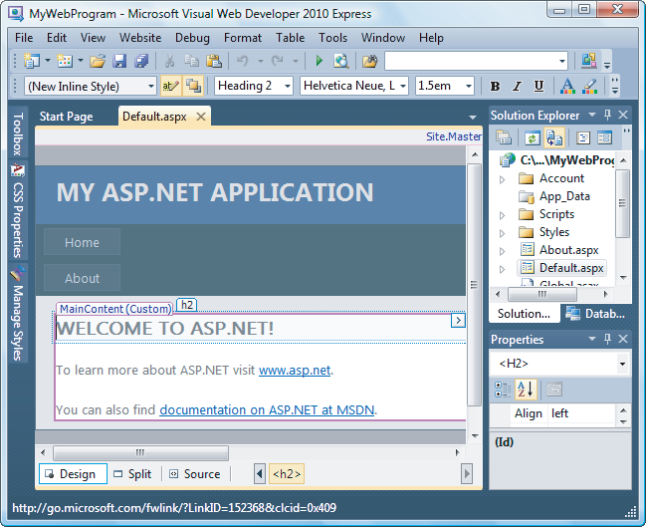
Web Page (VWD Equivalent of the Form Designer)
Web page tab
Main Content region

Slide 6
Web Page Tab
The Web page tab is titled Default.aspx instead of Form1. vb [Design]
The Web page is referred to as Default.aspx in the Solution Explorer window

Slide 7
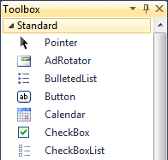
Toolbox
The common controls, such as button, text box, and list box are contained in the Standard group of the Toolbox.

Slide 8
Designing the Web Page
Begin by clearing the Main Content region
Permanent text (called static text) can be typed into the page and formatted directly without the use of labels
Text boxes and buttons can be placed at the cursor position (called the insertion point) by double-clicking on them in the Toolbox

Slide 9
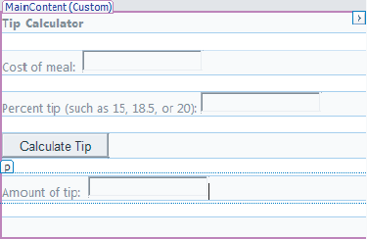
Sample Web Page

Slide 10
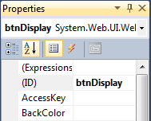
Properties Window
The name of a control is specified by the ID property instead of the Name property

Slide 11
Code Editor
The Code Editor tab reads Default.aspx.vb instead of Form1.vb
The code in the editor is referred to as the code behind.

Slide 12
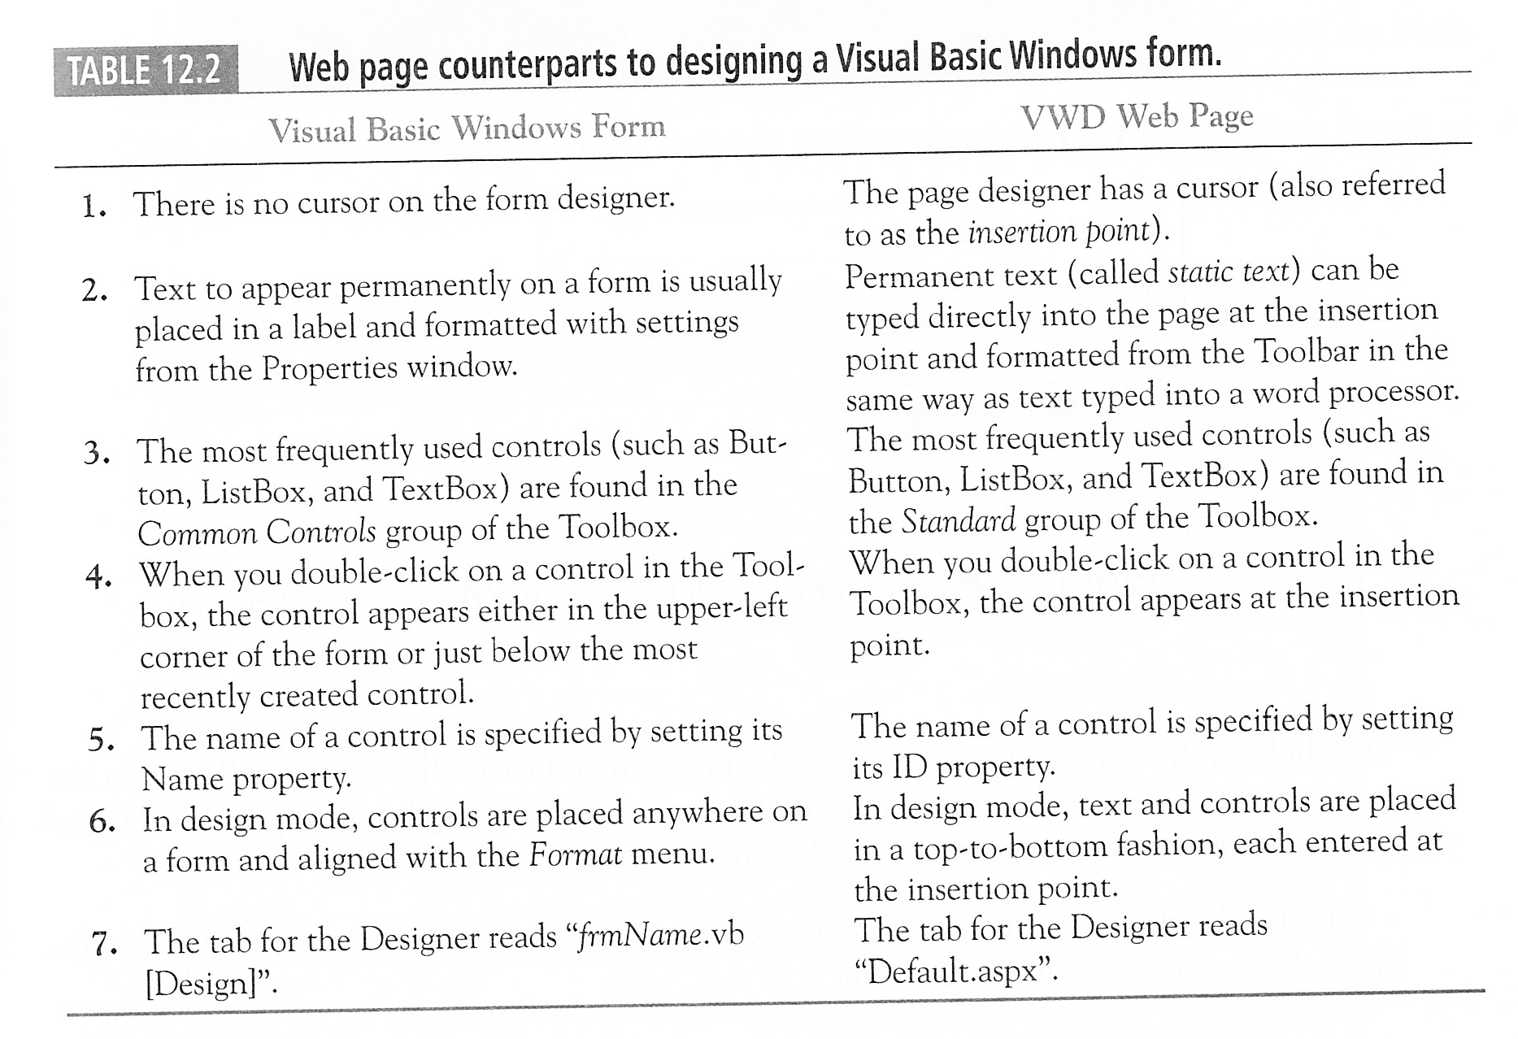
Summary Thus Far

Slide 13
Sample Code
Protected Sub btnCalculate_Click(...) Handles _ btnCalculate.Click
Dim cost As Double = CDbl(txtCost.Text)
Dim percent As Double =
CDbl(txtPercent.Text) / 100
txtTip.Text = FormatCurrency(percent * cost)
End Sub
Notice that “Sub” is proceeded by “Protected” instead of “Private”.

Slide 14
Running a Program
Press Ctrl+F5 to run program without debugging
Program runs in the computer’s Web browser
To terminate the program, close the browser by clicking on , the Close button
Close program by clicking on Close Project in the File menu.

Slide 15
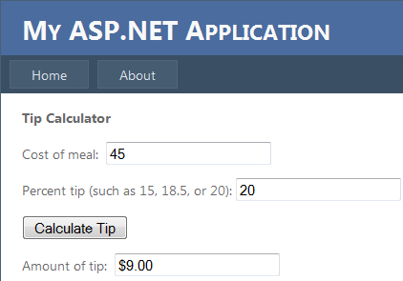
A Run of the Sample Program

Slide 16
Tables
A table control can be used to improve the layout of a Web page
Tables are created with the Insert Table command from the Table menu in the Toolbar

Slide 17
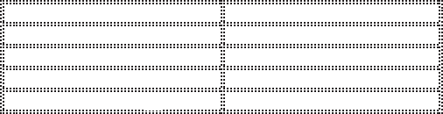
Sample Table
cell
This table has 5 rows and 2 columns. Each subdivision is called a cell.

Slide 18
Cells
Text and controls can be placed into cells
The alignment (such as right, left, or center) of the contents of a cell can be specified with the Align property from the Properties window
Commands from the Table menu allow you to insert and delete rows and columns, and to merge cells

Slide 19
Managing Tables
Assorted arrows can be used to highlight groups of cells and resize tables
Dragging of the cursor also can be used to highlight groups of cells

Slide 20
Text Files
Normally placed in the Solution Explorer’s App_Data folder
A text file can be read into an array with a statement of the form
Dim strArrayName() As String =
IO.File.ReadAllLines(MapPath("App_Data\" &
filename))

Slide 21
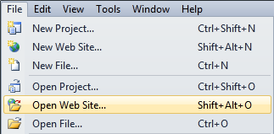
How to Open an Existing Web Program
first click here
Then navigate to the program’s folder and click on the Open button.

Slide 22
How to Add an Additional Web Page to a Program
Click on an existing Web page to make sure it has the focus
Click on Add New Item in the Website menu. (An Add New Item dialog box will appear.)
Select Web Form in the center pane, type a name into the Name box, and click on the Add button.

Slide 23
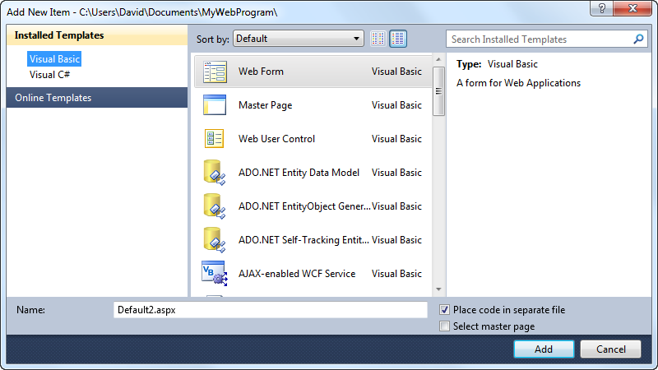
How to Add an Additional Web Page to a Program (cont.)
select
change name
click on Add button

Slide 24
Hyperlink Control
Found in the General group of the Toolbox
Appears on a page as underlined text
Used to navigate to another page
NavigateUrl property specifies the page to navigate to

Slide 25
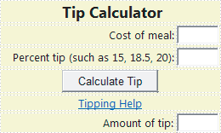
Sample Web Page
hyperlink control

Slide 26
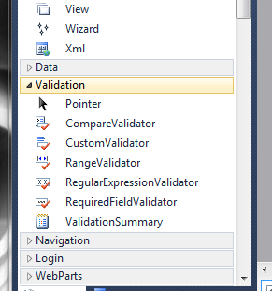
Validation Controls
Used to validate user input
The RequiredFieldValidator control checks that data has been entered into a text box or that an item of a list box has been selected
The RangeValidator control
checks that the entry in a text
box falls within a specified
range of values.

Slide 27
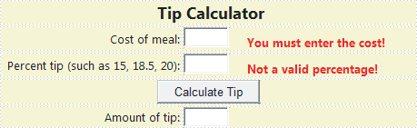
Sample Web Page
RequiredFieldValidator
RangeValidator
Validation controls are not visible at run time. Only appear when input is missing or invalid.

Slide 28
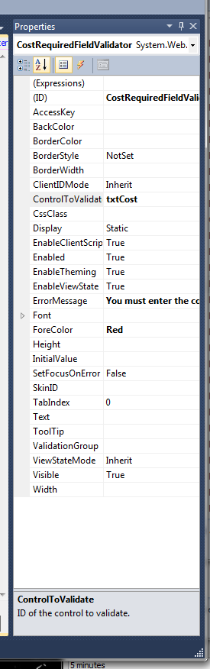
RequiredFieldValidator Control
The key properties are ControlToVerify and ErrorMessage
The ErrorMessage setting is the text that appears when input into the specified control does not meet the given criteria

Slide 29
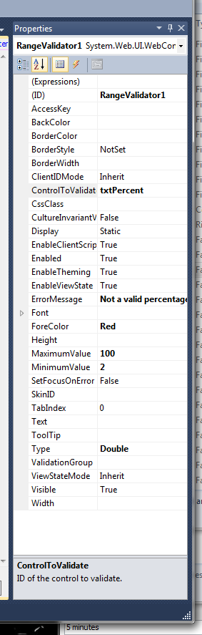
RangeValidator Control
The key properties are ControlToVerify, ErrorMessage, Type, MinimumValue, and MaximumValue
Possible settings for Type are String, Integer, Double, Date, and Currency
The entry in the text box must lie between the MinimumValue and the MaximumValue

Slide 30
Postback
A postback occurs when the contents of a Web page are sent to the server for processing. Afterwards, the server sends a new page back to the browser
When a validation control is triggered, the matter is handled entirely by the browser—no postback occurs

Slide 31
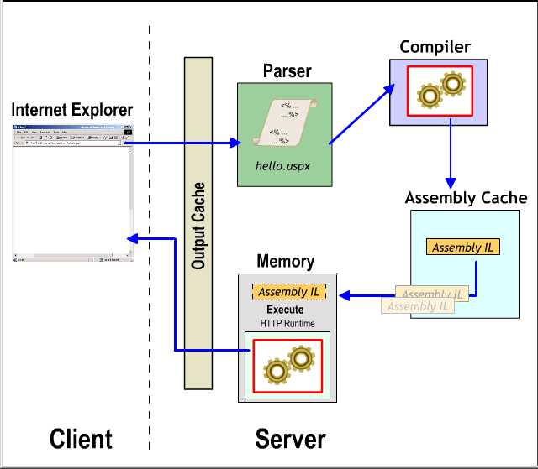
Programming Model

Slide 32
The Page Load Event
Raised when a Web page is first loaded and every time it is reloaded after a postback
The IsPostBack property can be used to guarantee that the page load event is raised only once
    if Not Page.IsPostBack Then
    …
    End if

Slide 33
Class-Level Variables
In VWD, class-level variables are of limited value since they do not retain their values after postbacks
Devices known as cookies or session variables can be used to retain values

Slide 34
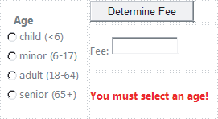
RadioButtonList Control
rblAges
rfvAge
VWD does not have a group box control. The radio-button list control is the counterpart of the VB group box containing a set of radio buttons.

Slide 35
RadioButtonList Control (continued)
The radio-button list control is populated via a ListItem Collection Editor that is invoked from the Tasks button
In the previous slide, the control rfvAge, a RequiredFieldValidator, guarantees that a radio button has been selected before the button is clicked on.

Slide 36
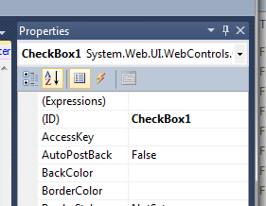
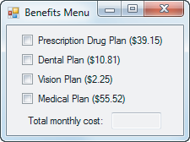
Check Box Control
Example 5 of Section 4.4.
In regular VB clicking on a check-box can cause code to run
VWD does not do this
To convert this VB program to a VWD program, the AutoPostBack property of each check box must be set to True

Slide 38
Review
Chapter 1

Slide 39
Communicating with the Computer
Machine language – low level, hard for humans to understand
Visual Basic – high level, understood by humans, consists of instructions such as Click, If, Do
  Usable in other applications (Word, Excel…)

Slide 40
Computers and Complicated Tasks
Tasks are broken down into instructions that can be expressed by a computer language
A program is a sequence of instructions
Programs can be only a few instructions or millions of lines of instructions

Slide 41
Performing a Task on the Computer
Determine Output
Identify Input
Determine process necessary to turn given Input into desired Output

Slide 42
Problem-solving: approach like algebra class
How fast is a car traveling if it goes 50 miles in 2 hours?
Output:
Input:
Process:

Slide 43
Program development cycle
Analyze: Define the problem.
Design: Plan the solution to the problem.
Choose the interface: Select the objects (text boxes, buttons, etc.).
Code: Translate the algorithm into a programming language.
Test and debug: Locate and remove any errors in the program.
Complete the documentation: Organize all the materials that describe the program.

Slide 44
Programming Tools
Three tools are used to convert algorithms into computer programs:
  Flowchart - Graphically depicts the logical steps to carry out a task and shows how the steps relate to each other
  Pseudocode - Uses English-like phrases with some Visual Basic terms to outline the program
  Hierarchy chart - Shows how the different parts of a program relate to each other

Slide 45
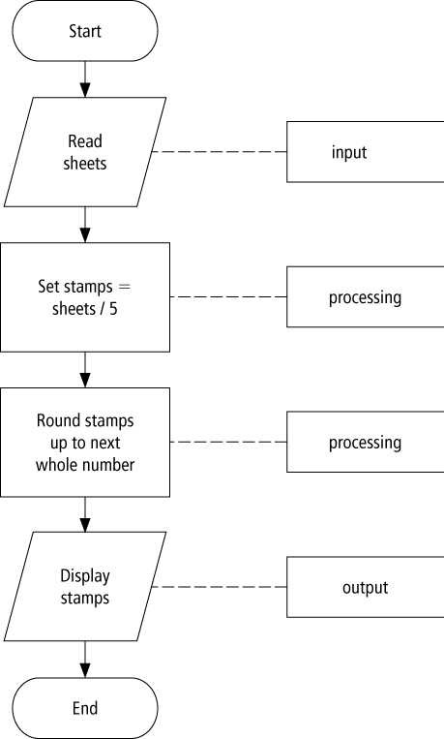
Flowchart example

Slide 46
Pseudocode example
Determine the proper number of stamps for a letter
Read Sheets (input)
Set the number of stamps to Sheets / 5 (processing)
Round the number of stamps up to the next whole number (processing)
Display the number of stamps (output)

Slide 47
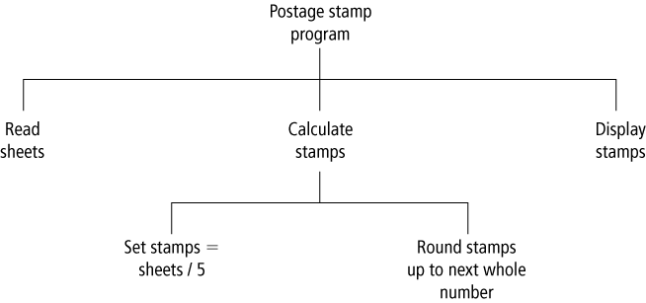
Hierarchy charts example

Slide 48
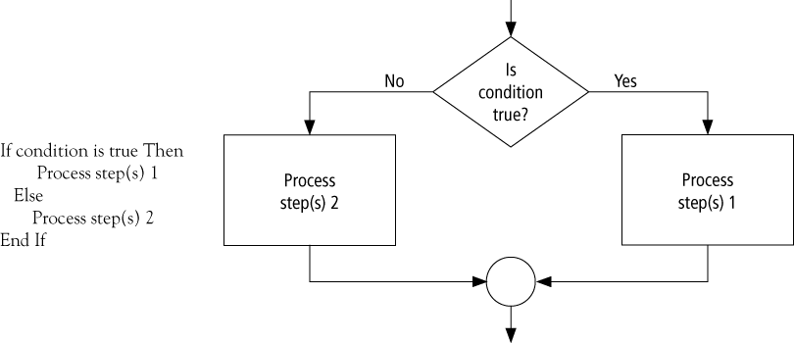
Decision flow chart

Slide 49
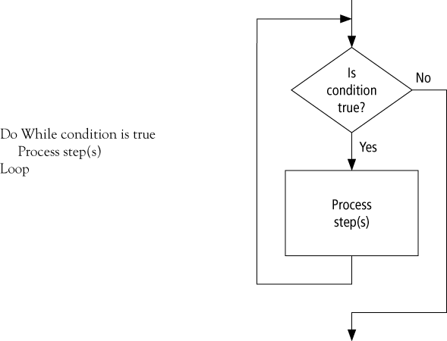
Looping flow chart

Slide 50
Review
Chapter 2&3

Slide 51
Control Name Prefixes
Control | Prefix | Example
button | btn | btnCompute
label | lbl | lblAddress
text box | txt | txtAddress
list box | lst | lstOutput

Slide 52
Event
An event is an action, such as the user clicking on a button
Usually, nothing happens in a Visual Basic program until the user does something and generates an event.
What happens is determined by statements.

Slide 53
Three Types of Errors
Syntax error
Run-time error
Logic error

Slide 54
Some Types of Syntax Errors
Misspellings
lstBox.Itms.Add(3)
Omissions
lstBox.Items.Add(2 + )
Incorrect punctuation
Dim m; n As Integer
Displayed as blue underline in VS

Slide 55
Syntax Error
The following is NOT a valid way to test if n falls between 2 and 5:
(2 < n < 5 )

Slide 56
A Type of Run-time Error
Dim numVar As Integer = 1000000
numVar = numVar * numVar
What’s wrong with the above?

Slide 57
A Logical Error
Dim average As Double
Dim m As Double = 5
Dim n As Double = 10
average = m + n / 2
What’s wrong with the above?
Value of average will be 10. Should be 7.5.

Slide 58
Common Error in Boolean Expressions
A common error is to replace the condition Not ( 2 < 3 ) with the condition ( 2 > 3 )

Slide 59
Data Conversion
Because the contents of a text box is always a string, sometimes you must convert the input or output.
dblVar = CDbl(txtBox.Text)
txtBox.Text = CStr(numVar)
Converts a String to a Double
Converts a number to a string

Slide 60
String Properties and Methods
"Visual".ToUpper is VISUAL.
.ToUpper makes everything upper case.
Varname = “blah”
Varname.ToUpper → “BLAH”

Slide 61
String Properties and Methods
"a" & " bcd ".Trim & "efg" is “abcdefg”
.trim removes leading/trailing spaces
Varname = “ blah “
Varname.trim → “blah”

Slide 62
Substring Method
Let str be a string.
str.Substring(m, n) is the substring of length n, beginning at position m in str.
“Visual Basic”.Substring(2, 3) is “sua”
“Visual Basic”.Substring(0, 1) is “V”

Slide 63
Chr Function
For n between 0 and 255,
Chr(n)
is the string consisting of the character with
ASCII value n.
EXAMPLES: Chr(65) is "A"
Chr(162) is "¢"

Slide 64
Asc Function
For a string str,
Asc(str)
is ASCII value of the first character of str.
EXAMPLES: Asc("A") is 65
Asc("¢25") is 162

Slide 65
Scope
The scope of a variable is the portion of the program that can refer to it
Variables declared inside an event procedure are said to have local scope and are only available in the event procedure in which they are declared

Slide 66
Scope
Variables declared outside an event procedure are said to have class-level scope and are available to every event procedure
Usually declared after
Public Class formName
(Declarations section of Code Editor.)

Slide 67
Review
Chapter 4

Slide 68
Logical Operators
Used with Boolean expressions
  Not – makes a False expression True and vice versa
  And – will yield a True if and only if both expressions are True
  Or – will yield a True if at least one of both expressions are True

Slide 69
Example 4.3
n = 4, answ = “Y”
Are the following expressions true or false?
1) Not (n < 6)
2) (answ = "Y") Or (answ = "y")
3) (answ = "Y") And (answ = "y")
4) Not(answ = "y")
Notes:
Not (n < 6) = False
(answ = "Y") Or (answ = "y") = True
(answ = "Y") And (answ = "y") = False
Not(answ = "y") = True

Slide 70
If Block
The program will take a course of action
based on whether a condition is true.
If condition Then
action1
Else
action2
End If
Will be executed if
condition is true
Will be executed if
condition is false

Slide 71
Another example If block
If condition Then
action1
End If
Statement2
Statement3
Regardless of whether
the condition in the
If statement is true or
alse, these statements
will be executed

Slide 72
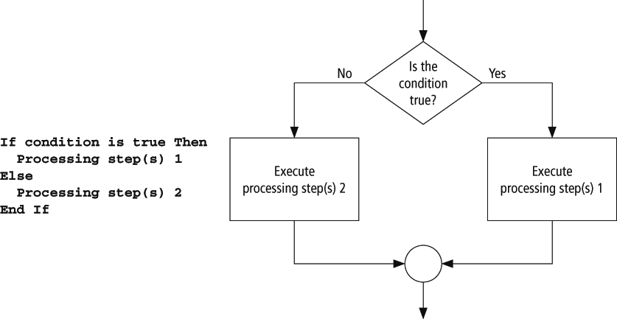
Pseudocode and Flowchart

Slide 73
ElseIf clause
If condition1 Then
action1
ElseIf condition2 Then
action2
ElseIf condition3 Then
action3
Else
action4
End If
Notes:
An extension of the If block allows for more than two possible alternatives with the
inclusion of ElseIf clauses.
Note: there is no space between the word "Else" and "If"
Only one "End If" is required.

Slide 74
Select Case Syntax
The general form of the Select Case block is
Select Case selector
Case valueList1
action1
Case valueList2
action2
Case Else
action of last resort
End Select

Slide 75
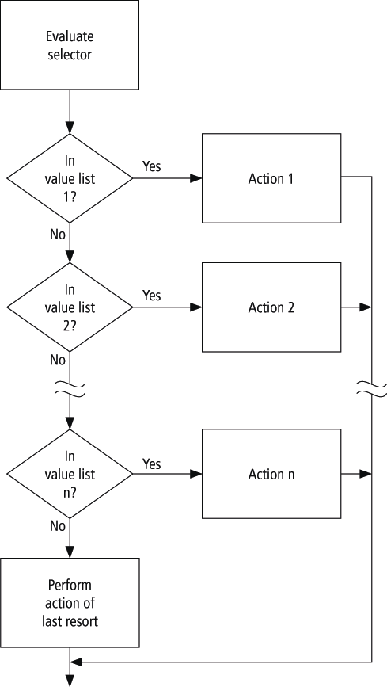
Flowchart for Select Case

Slide 76
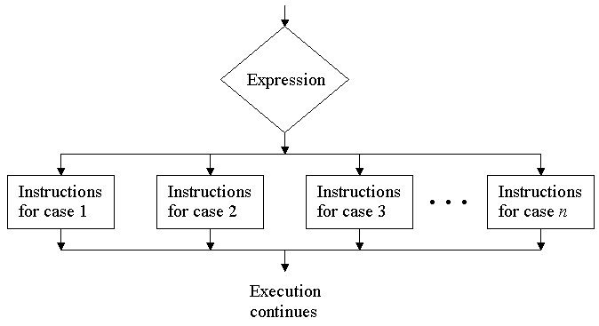
Flowchart for Select Case
(not in book, but equivalent)

Slide 77
Review
Chapter 5

Slide 78
Devices for Modularity
Visual Basic has two devices for breaking problems into smaller pieces:
  Sub procedures
  Function procedures

Slide 79
Sub Procedures
Perform one or more related tasks
General syntax
      Sub ProcedureName()
      statements
      End Sub

Slide 80
Arguments and Parameters
Sum(2, 3)
Sub Sum(ByVal num1 As Double, ByVal num2 As Double)
arguments
parameters
displayed automatically

Slide 81
Function Procedures
Function procedures (aka user-defined functions) always return one value
Syntax:
Function FunctionName(ByVal var1 As Type1, _
ByVal var2 As Type2, _
…) As dataType
statement(s)
Return expression
End Function

Slide 82
Functions vs. Procedures
Both can perform similar tasks
Both can call other subs and functions
Use a function when you want to return one and only one value

Slide 83
Example: num
Public Sub btnOne_Click (...) Handles _
btnOne.Click
Dim num As Double = 4
Triple(num)
txtBox.Text = CStr(num)
End Sub
Sub Triple(ByVal num As Double)
num = 3 * num
End Sub
Output: 4

Slide 84
Example
Public Sub btnOne_Click (...) Handles _
btnOne.Click
Dim num As Double = 4
Triple(num)
txtBox.Text = CStr(num)
End Sub
Sub Triple(ByRef num As Double)
num = 3 * num
End Sub
Output: 12

Slide 85
Review
Chapter 6

Slide 86
Do Loop Syntax
Condition is tested,
If it is true,
the loop is run.
If it is false,
the statements
following the
Loop statement
are executed.
Do While condition
statement(s)
Loop
These statements are inside
the body of the loop and
are run if the condition
above is true.
Notes:
A Do statement precedes the sequence of statements, and a Loop statement follows the sequence of statements.
The condition, preceded by either the word “While” or the word “Until”, follows the word “Do” or the word “Loop”.

Slide 87
Post Test Loop
Do
statement(s)
Loop Until condition
Loop is executed once and then the condition
is tested. If it is false, the loop is run again.
If it is frue, the statements following the
Loop statement are executed.
Notes:
If condition is true, then the program continues with the line after the Loop statement.
If condition is false, then the entire process is repeated beginning with the Do statement.
In other words, the statements inside the loop are executed once and then are repeatedly
executed until the condition is true.

Slide 88
What’s the diff?
Do
statement(s)
Loop Until condition
What’s the difference between a
Do Until
and
Do While?
Do While condition
statement(s)
Loop

Slide 89
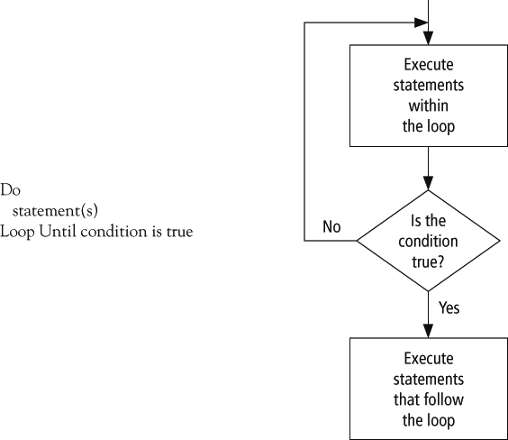
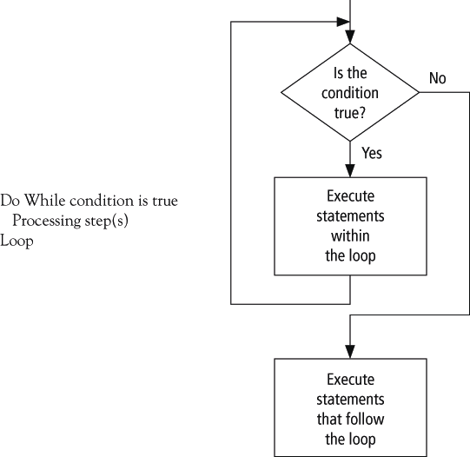
Pseudocode and Flowchart

Slide 90
Example 1: Display the Total Contents of a File
Dim sr As IO.StreamReader = _
IO.File.OpenText("PHONE.TXT")
lstNumbers.Items.Clear()
Do While sr.Peek <> -1
name = sr.ReadLine
phoneNum = sr.ReadLine
lstNumbers.Items.Add(name & " " _
& phoneNum)
Loop
sr.Close()

Slide 91
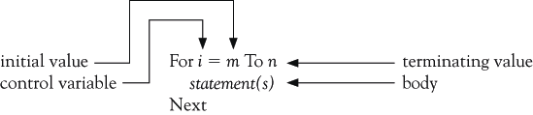
For…Next Loop Syntax

Slide 92
Example 2
Control
variable
Data
type
Start
value
Stop
value
Amount
to add to
i
For i As Integer = 0 To n Step s
lstValues.Items.Add(i)
Next
Notes:
Start value must be less than or equal to the stop value when there is a positive step value

Slide 93
Comments
The value of the control variable should not be altered within the body of the loop (For ... Next).
To skip an iteration in a For .. Next loop:
Continue For
To skip an iteration in a Do .. While loop:
Continue Do

Slide 94
Comments
  For i As Integer = 1 To 5
  (some statements)
  Continue For
  (some statements)
  Next
What will happen?

Slide 95
Comments
To break out of a For .. Next loop:
Exit For
To break out of a Do .. While loop:
Exit Do

Slide 96
Review
Chapter 7

Slide 97
Simple and Array Variables
A variable (or simple variable) is a name to which Visual Basic can assign a single value
An array variable is a collection of simple variables of the same type to which Visual Basic can efficiently assign a list of values

Slide 98
Initializing Arrays
Arrays may be initialized when they are created:
Dim arrayName() As varType = {value0, _
value1, value2, ..., valueN}
For Ex:
Dim Students() As String = {"Jack", "John", "Julie", "Jimmy", "Janet"}

Slide 99
Initializing Arrays
Arrays may be initialized when they are created:
Dim arrayName() As varType = IO.File.ReadAllLines(filespec)
Opens filespec, reads all lines from it, and stores it in arrayName
Each line in filespec is stored in one location of arrayName

Slide 100
Example
Dim Grades() As integer = {70, 75, 80, 85, 90}
Grades.Average → 80
Grades.Count → 5
Grades.Min → 70
Grades.Max → 90
Grades.Sum → 400

Slide 101
Preserve Keyword
ReDim arrayName(m) resets all values to their default. This can be prevented with the keyword Preserve.
ReDim Preserve arrayName(m)
resizes the array and retains as many
values as possible.

Slide 102
Set Operations
Concat
  Contains elements of array1 and array2
  Duplication is OK
Dim States1() As String = {"A", "B", "C", "D"}
Dim States2() As String = {"E", "F", "G", "H"}
Dim States3() As String = _
States1.Concat(States2).ToArray()

Slide 103
Set Operations
Union
  Contains elements of array1 and array2
  No Duplication
Dim States1() As String = {"A", "B", "C", "D"}
Dim States2() As String = {"E", "F", "G", "H"}
Dim States3() As String = _
States1.Union(States2).ToArray()

Slide 104
Set Operations
Intersect
  Contains elements from array1 and array2 which exist in both array1 and array2
Dim States1() As String = {"A", "B", "C", "D"}
Dim States2() As String = {"E", "F", "G", "H"}
Dim States3() As String = _
States1.Intersect(States2).ToArray()

Slide 105
Set Operations
Except
  Contains elements from array1 which do not exist in array2
Dim States1() As String = {"A", "B", "C", "D"}
Dim States2() As String = {"E", "F", "G", "H"}
Dim States3() As String = _
States1.Except(States2).ToArray()

Slide 106
Structures
A way of grouping heterogeneous data together
Also called a UDT (User Defined Type)
Sample structure definition:
  Structure College
  Dim name As String
  Dim state As String
  Dim yearFounded As Integer
  End Structure

Slide 107
Example 4
Structure FullName
Dim firstName As String
Dim lastName As String
End Structure
Structure Student
Dim name As FullName
Dim credits() As Integer
End Structure
Structure "FullName"
contained, or nested,
inside Student

Slide 108
Sorting
Sorting is an algorithm for ordering an array.
We discuss two sorting algorithms:
  bubble sort
  Shell sort
Both use the swap algorithm:
  temp = varl
  varl = var2
  var2 = temp

Slide 109
Bubble Sort Algorithm: n Items
Compare the first and second items. If they are out of order, swap them.
Compare the second and third items. If they are out of order, swap them.
Repeat this pattern for all remaining pairs. The final comparison and possible swap are between the next-to-last and last items.
The last item will be at its proper place.
Do another pass through first n – 1 items.
Repeat this process with one less item for each pass until a pass uses only the first and second items.

Slide 110
Shell Sort Algorithm
Begin with a gap of g = Int(n/2)
Compare items 0 and g, 1 and 1 + g, . . ., n - g and n. Swap any pairs that are out of order.
Repeat Step 2 until no swaps are made for gap g.
Halve the value of g.
Repeat Steps 2, 3, and 4 until the value of g is 0.

Slide 111
Review
Efficiency of Bubble and Shell Sorts
Array Elements | Bubble Sort Comparisons | Shell Sort Comparisons
5 | 10 | 17
10 | 45 | 57
15 | 105 | 115
20 | 190 | 192
25 | 300 | 302
30 | 435 | 364
50 | 1225 | 926
100 | 4950 | 2638
500 | 124,750 | 22,517
1000 | 499,500 | 58,460

Slide 112
Review
Efficiency of Sequential and Binary Search
Array Elements | Sequential Search Comparisons | Binary Search Comparisons
2000 | 1000 (Average) | 11 (At most)

Slide 113
Review
Chapter 8

Slide 114
Review
name = input.Substring(0, (input.IndexOf(",")))
Input = “James,88”
0 | 1 | 2 | 3 | 4 | 5 | 6 | 7
J | a | m | e | s | , | 8 | 8

Slide 115
WriteAllLines
IO.File.WriteAllLines _ ("fileName.txt", States)
Creates a new text file
Copies the contents of a string array
Places one element on each line
Close the file

Slide 116
RealAllLines
Read all the lines of a text-file into an array
  Method opens a file
  Reads each line of the file
  Adds each line as an element of a string array
  Closes the file
A line is defined as a sequence of characters followed
  carriage return
  a line feed
  a carriage return followed by a line feed

Slide 117
Deleting Information from a Sequential File
An individual item of a file cannot be changed or deleted directly.
A new file must be created by reading each item from the original file and recording it, with the single item changed or deleted, into the new file.
The old file is then erased, and the new file renamed with the name of the original file.

Slide 118
Delete and Move Methods
Delete method:
IO.File.Delete(filespec)
Move method (to change the filespec of a file):
IO.File.Move(oldfilespec, newfilespec)
Note: The IO.File.Delete and IO.File.Move methods cannot be used with open files.

Slide 119
Structured Exception Handling
Two types of problems in code:
  Bugs (logic error) – something wrong with the code the programmer has written
  Exceptions – errors beyond the control of the programmer
Programmer can use the debugger to find bugs; but must anticipate exceptions in order to be able to keep the program from terminating abruptly.

Slide 120
Try Catch Block Syntax
Try
normal code
Catch exc1 As FirstException
exception-handling code for FirstException
Catch exc2 As SecondException
exception-handling code for SecondException
.
.
Catch
exception-handling code for any remaining exceptions
Finally
clean-up code
End Try
Notes:
The normal code is the code that you want to monitor for exceptions.
As with a Select Case block, the Catch clauses are considered one at a time until the proper exception is located. The last Catch clause in the preceding code functions like the Case Else clause. The clean-up code in the Finally block always executes last regardless of whether any exception-handling code has executed.

Slide 121
Catch Blocks
Visual Basic allows Try-Catch-Finally blocks to have one or more specialized Catch clauses that only trap a specific type of exception
The general form of a specialized Catch clause is
Catch exp As ExceptionName
where the variable exp will be assigned the name of the exception. The code in this block will be executed only when the specified exception occurs.

Slide 122
Working with HashTable
Arrays can store only one data type
collections can hold any objects
Accessing the element is very simple and very fast
Removing the element in Collection is very simple

Slide 123
Working with HashTable
Array:
  MyArray(100) returns element 100
What if I want element “George”?
Hashtable
  MyHash.Item(“George”)

Slide 124
Working with HashTable
Adding an element to the HashTable
{hash table object}.Add(Key as Object, value as Object)
Ex: MyHash.Add(“George”, 45)

Slide 125
Working with HashTable
Accessing an element
{hash table object}.Item({key})
Ex: MyArray.Item(“George”)

Slide 126
Working with HashTable
Searching for an element
{hash table object}.Contains({key})
Ex: MyArray.Contains(“George”)

Slide 127
Review
Chapter 9

Slide 128
List Box Events
Three main types of events with list boxes:
Click – the user clicks on an item in the list box
SelectedIndexChanged - the user clicks on an item or uses the arrow keys to select it
DoubleClick - the user double-clicks on an item
All three events are triggered when the user double-clicks on an item.

Slide 129
Using an Array to Fill a List Box
The statement
lstBox.DataSource = arrayName
fills the list box with the elements of the array.

Slide 130
The Group Box Control
Group boxes are passive objects used to group other objects together
When you drag a group box, the attached controls follow as a unit
To attach a control to a group box, create the group box, then drag the control you want to attach into the group box.

Slide 131
The Check Box Control
Consists of a small square and a caption
Presents the user with a Yes/No choice
During run time, clicking on the check box toggles the appearance of a check mark
Checked property is True when the check box is checked and False when it is not
CheckedChanged event is triggered when the user clicks on the check box

Slide 132
The Radio Button Control
Consists of a small circle with a caption (that is set by the Text property)
Normally several radio buttons are attached to a group box
Gives the user a single choice from several options
Clicking on one radio button removes the selection from another

Slide 133
The Timer Control
Invisible during run time
Triggers an event after a specified period of time
The Interval property specifies the time period – measured in milliseconds
To begin timing, set the Enabled property to True
To stop timing, set the Enabled property to False
The event triggered each time Timer1.Interval elapses is called Timer1.Tick

Slide 134
Scroll Bar Properties
The main properties of a scroll bar control are
  Minimum
  Maximum
  Value
  SmallChange,
  LargeChange
hsbBar.Value, a number between hsbBar.Minimum and hsbBar.Maximum, gives the location of the scroll box,
Notes:
hsbBar.Value is a number between hsbBar.Minimum and hsbBar.Maximum determined by the position of the left of the scroll box. If the left side of the scroll box is halfway between the two arrows, then hsbBar.Value is a number halfway between hsbBar.Minimum and hsbBar.Maximum.

Slide 135
The Clipboard Object
Used to copy information from one place to another
Maintained by Windows, so it can even be used with programs outside Visual Basic
A portion of memory that has no properties or events

Slide 136
The Random Class
A random number generator declared with the statement:
Dim randomNum As New Random()
If m and n are whole numbers and m < n then the following generates a whole number between m and n (including m, but excluding n)
randomNum.Next(m, n)

Slide 137
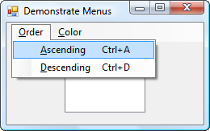
The MenuStrip Control
Used to create menus like the following:
Top-level menu
Second-level menu

Slide 138
Menu Events
Each menu item responds to the Click event
Click event is triggered by
  the mouse
  Alt + access key
  Shortcut key

Slide 139
Multiple Forms
Visual Basic programs can contain more than one form
To add the new form, select Add Windows Form from the Project menu, to invoke the Add New Items dialog box.

Slide 140
Variables and Multiple Forms
Variables declared in the Declarations section of a form with Public, instead of Dim, will be available to all forms in the program
When a Public variable is used in another form, it is referred to by an expression such as
secondForm.variableName

Slide 141
Review
Chapter 10

Slide 142
What is a database?
A database (DB) is a very large, integrated, permanent collection of data
Models real-world
  Entities (e.g., students, courses)
  Relationships (e.g., Madonna is taking CMPT354)
Example databases:
  Customer Transactions
  Human Genome
  Online Bookstore
  . . .

Slide 143
Database Terminology
A table is a rectangular array of data
Each column of the table, called a field, contains the same type of information
Each row, called a record, contains all the information about one entry in the database

Slide 144
Connecting with a DataTable
Dim dt As New DataTable()
Dim connStr As String = _
"Provider=Microsoft.Jet.OLEDB.4.0;" & _
"Data Source=MEGACITIES.MDB"
Dim sqlStr As String = "SELECT * FROM Cities"
Dim dataAdapter As New _
OleDb.OleDbDataAdapter(sqlStr, connStr)
dataAdapter.Fill(dt)
dataAdapter.Dispose()
(Boilerplate to be inserted into every program in chapter.)

Slide 145
Primary Keys
A primary key is used to uniquely identify each record
Databases of student enrollments in a college usually use a field of Social Security numbers as the primary key
Why wouldn't names be a good choice as a primary key?

Slide 146
Two or More Tables
When a database contains two or more tables, the tables are usually related
For instance, the two tables Cities and Countries are related by their country field
Notice that every entry in Cities.country appears uniquely in Countries.country and Countries.country is a primary key
We say that Cities.country is a foreign key of Countries.country

Slide 147
SQL
Structured Query Language developed for use with relational databases
Very powerful language
Allows for the request of specified information from a database
Allows displaying of information from database in a specific format

Slide 148
Virtual Tables
SQL statements create a new “virtual” table from existing tables
SELECT city, pop2015 FROM Cities WHERE pop2015>=20
Results in “virtual” table
city pop2015
Bombay 22.6
Delhi 20.9
Mexico City 20.6
Sao Paulo 20.0
Tokyo 36.2

Slide 149
Review
Chapter 11

Slide 150

What is Object Oriented Programming?
An object is like a black box.
The internal details are hidden.
Identifying objects and assigning responsibilities to these objects.
Objects communicate to other objects by sending messages.
Messages are received by the methods of an object

Slide 151
OOP Analogy
Classes
Methods
Properties
noun A word used to denote or name a person, place, thing, quality, or act.
verb That part of speech that expresses existence, action, or occurrence.
adjective Any of a class of words used to modify a noun or other substantive by limiting, qualifying, or specifying.

Slide 152
Get and Set
Private m_name As String
Public Property Name() As String
Get
Return m_name
End Get
Set(ByVal value As String)
m_name = value
End Set
End Property
Property
block
Notes:
Must be inside the class to allow access to private data
Additional code can be added to perform data validation before storing data in the member variable
The word "public" allows for this to be accessed from outside the class

Slide 153
Student Class: WriteOnly Property Blocks
Public WriteOnly Property Midterm() As Double
Set(ByVal value As String)
m_midterm = value
End Set
End Property
Public WriteOnly Property Final() As Double
Set(ByVal value As String)
m_final = value
End Set
End Property
Notes:
Must be inside the class to allow access to private data
Additional code can be added to perform data validation before storing data in the member variable
The word "public" allows for this to be accessed from outside the class

Slide 154
Student Class: Method
Function CalcSemGrade() As String
Dim grade As Double
grade = (m_midterm + m_final) / 2
grade = Math.Round(grade)
Select Case grade
Case Is >= 90
Return "A"
Case Is >= 80
Return "B"
:
End Function

Slide 155
Steps Used to Create a Class
Identify a thing in your program that is to become an object
Determine the properties and methods that you would like the object to have. (As a rule of thumb, properties should access data, and methods should perform operations.)
A class will serve as a template for the object. The code for the class is placed in a class block of the form
Class ClassName
statements
End Class

Slide 156
Steps continued
For each of the properties in Step 2, declare a private member variable with a statement of the form
Private m_variableName As DataType
For each of the member variables in Step 4, create a Property block with Get and/or Set procedures to retrieve and assign values of the variable.
For each method in Step 2, create a Sub procedure or Function procedure to carry out the task.

Slide 157
Events
User-defined events can be created for classes.
The statement for triggering an event is located in the class block
The event is dealt with in the form’s code.

Slide 158
User Defined Event
Suppose that the event is named UserDefinedEvent and has the parameters par1, par2, and so on.
In the class block, place the following statement in the Declarations section
Public Event UserDefinedEvent(ByVal par1 As _
DataType1, ByVal par2 As DataType2, ...)
The next statement should be placed at the locations in the class block code at which the event should be triggered
RaiseEvent UserDefinedEvent(arg1, arg2, ...)

Slide 159
Responding to Events
When declaring an object variable, the keyword WithEvents must be added so that the object will respond to events:
Dim WithEvents object1 As ClassName
The declaration line of an event procedure would be
Private Sub object1_UserDefinedEvent(ByVal par1 As _
DataType1, ...) Handles object1.UserDefinedEvent

Slide 160
Containment
Class A contains class B when a member variable of class A is an object of type class B.
Class DeckOfCards
Private m_deck(51) As Card
'Class DeckOfCards contains class Card

Slide 161
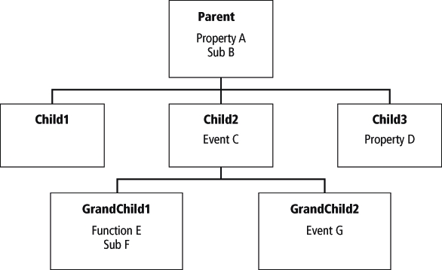
Inheritance Hierarchy
GrandChild1 has access to Property A, Sub B, and Event C from its parent and adds Function E and Sub F
Notes:
Consider the classes shown in Figure 11.6. All three children inherit Property A and Sub B from their parent. Child2 and Child3 also have an event and a property, respectively. GrandChild1 has access to Property A, Sub B, and
Event C from its parent and adds Function E and Sub F. The collection of a parent class along with its descendants is called a hierarchy.

Slide 162
Overridable
The keyword Overridable is used to designate the parent’s methods that are overridden, and the keyword Overrides is used to designate the child’s methods that are doing the overriding
There are situations where a child class's needs to access the parent class’s implementation of a method that the child is overriding. Visual Basic provides the keyword MyBase to support this functionality

Slide 163
MustOverride
Sometimes you want to insist that each child of a class have a certain property or method that it must implement for its own use
Such a property or method is said to be abstract and is declared with the keyword MustOverride

Slide 164
Good luck!

