Slide 1
Practice
Determine the output displayed when the button is clicked.
Dim actor(5,5) As String
Private Sub btnDisplay_Click(...) Handles btnDisplay.Click
Dim a As Integer = 2, b As Integer = 3, temp As Integer
actor(a, b) = “Bogart”
temp = a
a = b
b = temp
lstOutput.Items.Add(“1. ” & actor(a, b))
lstOutput.Items.Add(“2. ” & actor(b, a))
End Sub

Slide 2
Practice
Determine the output displayed when the button is clicked.
Dim a(3,4) As Integer
Private Sub btnDisplay_Click(...) Handles btnDisplay.Click
Dim row As String
For j As Integer = 0 To 3
row = “”
For k As Integer = 0 To 4
a(j, k) = j + k
row &= a(j, k) & “ ”
Next
lstOutput.Items.Add(row)
Next
End Sub

Slide 3
Chapter 10 – Database Management
10.1 An Introduction to Databases
10.2 Relational Databases and SQL

Slide 4
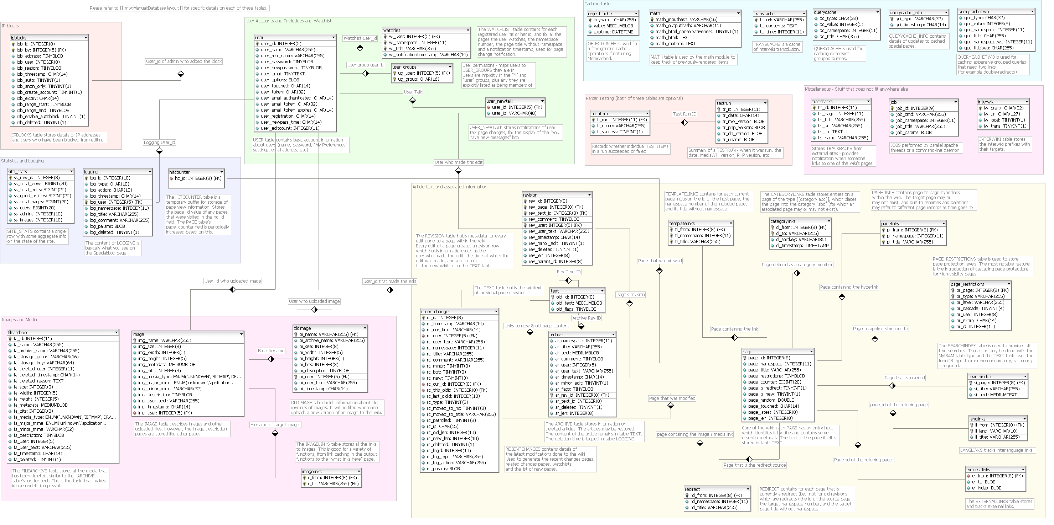
Sample DB Schema

Slide 5
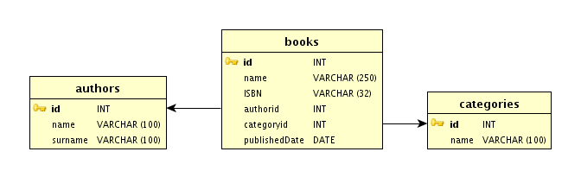
Sample DB Schema

Slide 6
Sample Table – Cities Table

Slide 7
Sample Table – Countries Table

Slide 8
What is a database?
A database (DB) is a very large, integrated, permanent collection of data.
Models real-world
Entities (e.g., students, courses)
Relationships (e.g., Madonna is taking CMPT354).
Example databases:
Customer Transactions
Human Genome
Online Bookstore
. . .

Slide 9
Database Terminology
A table is a rectangular array of data.
Each column of the table, called a field, contains the same type of information.
Each row, called a record, contains all the information about one entry in the database.

Slide 10
Database Management Software (DBMS)
Used to create databases
Databases can contain one or more related tables
Examples of DBMS include Access and Oracle

Slide 11
Database Explorer
A tool provided by Visual Basic Express to examine any database.
Invoked from the View menu
Allows you to determine the names of the tables (and their fields) and view the contents of any table.
Other edition of Visual Basic provide an analogous tool called Server Explorer.

Slide 12
Databases Provided
The Add Connection dialog box is used by Database Explorer to connect to a database
The databases used in this book can be found
in the folder Programs\Ch10\MajorDatabases
website

Slide 13
Add Connection Dialog Box

Slide 14
Add Connection Dialog Box

Slide 15
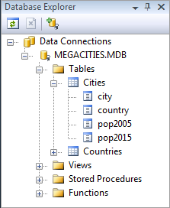
Database Explorer Window after Connection to MEGACITIES.MDB

Slide 16
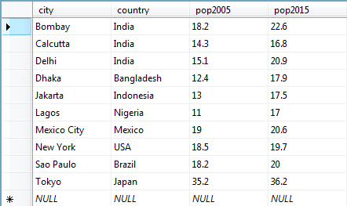
Cities Table as Displayed by Database Explorer

Slide 17
Data Table Object
A DataTable object holds the contents of a table as a rectangular array.
A data table is similar to a two-dimensional array; it has rows and columns.

Slide 18
DataTable Variable
The following declares a DataTable variable
Dim dt As New DataTable()

Slide 19
Connecting with a DataTable
Dim dt As New DataTable()
Dim connStr As String = _
"Provider=Microsoft.Jet.OLEDB.4.0;" & _
"Data Source=MEGACITIES.MDB"
Dim sqlStr As String = "SELECT * FROM Cities"
Dim dataAdapter As New _
OleDb.OleDbDataAdapter(sqlStr, connStr)
dataAdapter.Fill(dt)
dataAdapter.Dispose()
(Boilerplate to be inserted into every program in chapter.)

Slide 20
Properties of the DataTable
After the six lines of boilerplate code are executed, the number of records in the table is given by
dt.Rows.Count
The number of columns in the table is given by
dt.Columns.Count
The records are numbered 0 through
dt.Rows.Count – 1
The fields are numbered 0 through
dt.Columns.Count – 1

Slide 21
More Properties
The name of the jth field is given by
dt.Columns(j)
The entry in the jth field of the ith record is
dt.Rows(i)(j)
The entry in the specified field of the ith record is
dt.Rows(i)(fieldName)

Slide 22
Example 1: Form
Display one record at a time from the Cities table.

Slide 23
Example 1: Partial Code
Dim dt As New DataTable()
Dim rowIndex As Integer = 0
Private Sub frmCities_Load(...) Handles _ MyBase.Load
(Last five statements of boilerplate)
UpdateTextBoxes()
End Sub
Sub UpdateTextBoxes()
'Display contents of row specified by rowIndex variable
txtCity.Text = CStr(dt.Rows(rowIndex)("city"))
txtCountry.Text = CStr(dt.Rows(rowIndex)("country"))
txtPop2005.Text = CStr(dt.Rows(rowIndex)("pop2005"))
txtPop2015.Text = CStr(dt.Rows(rowIndex)("pop2015"))
End Sub

Slide 24
Example 1: Partial Code cont.
Private Sub btnNext_Click(...) Handles btnNext.Click
'Show the next record if current one is not the last
If (rowIndex < dt.Rows.Count - 1) Then
rowIndex += 1 'Increase rowIndex by 1
UpdateTextBoxes()
End If
End Sub

Slide 25
Example 1: Partial Code cont.
Private Sub btnPrevious_Click(...) Handles _
btnPrevious.Click
'Show previous record if current one is not the first
If (rowIndex > 0) Then
rowIndex = rowIndex - 1
UpdateTextBoxes()
End If
End Sub

Slide 26
Example 1: Partial Code cont.
Private Sub btnFind_Click(...) Handles btnFind.Click
Dim cityName As String
Dim cityFound As Boolean = False
cityName=InputBox("Enter name of city to search for.")
For i As Integer = 0 To (dt.Rows.Count - 1)
If CStr(dt.Rows(i)("city")) = cityName Then
cityFound = True
rowIndex = i
UpdateTextBoxes()
End If
Next
If (Not cityFound) Then
MessageBox.Show("Cannot find requested city")
End If
End Sub

Slide 27
Example 2: Form
Display Cities table along with percentage growth.

Slide 28
Example 2: Code
Private Sub btnShow_Click(...) Handles btnShow.Click
Dim fmtStr As String="{0,-15}{1,-10}{2,7:N1}{3,7:N1}{4,7:P0}"
Dim percentIncrease As Double
(Six statements of boilerplate)
lstDisplay.Items.Add(String.Format(fmtStr, "CITY", _
"COUNTRY", "2005", "2015", "INCR."))
For i As Integer = 0 To dt.Rows.Count - 1
percentIncrease = (CDbl(dt.Rows(i)("pop2015")) - _
CDbl(dt.Rows(i)("pop2005"))) / CDbl(dt.Rows(i)("pop2005"))
lstDisplay.Items.Add(String.Format(fmtStr, dt.Rows(i)(0), _
dt.Rows(i)(1),dt.Rows(i)(2),dt.Rows(i)(3),percentIncrease))
Next
End Sub

Slide 29
Example 2: Output

Slide 30
Bound Controls
A data table that is bound to a list box can transfer information automatically into the list box.
The following statement binds a list box to a data table:
lstBox.DataSource = dt
The contents of a specified field can be displayed in the list box by:
lstBox.DisplayMember = "country"

Slide 31
Example 3: Form
Display the list of countries. When the user clicks on a country, its monetary unit should be displayed.

Slide 32
Example 3: Code
Dim dt As New DataTable()
Private Sub frmCountries_Load(...) Handles MyBase.Load
(Last five statements of boilerplate)
lstCountries.DataSource = dt 'Bind list box
lstCountries.DisplayMember = "country"
End Sub
Private Sub lstCountries_SelectedIndexChanged(...) _
Handles lstCountries.SelectedIndexChanged
txtMonetaryUnit.Text = _
CStr(dt.Rows(lstCountries.SelectedIndex)("monetaryUnit")
End Sub

Slide 33
Example 3: Output

Slide 35
10.2 Relational Databases and SQL
Primary and Foreign Keys
SQL
Four SQL Requests
The DataGridView Control
Changing the Contents of a Database
Calculated Columns with SQL

Slide 36
Primary Keys
A primary key is used to uniquely identify each record.
Databases of student enrollments in a college usually use a field of Social Security numbers as the primary key.
What’s the primary key used at SFU for students?
For ICBC drivers licenses?
Why wouldn't names be a good choice as a primary key?

Slide 37
Primary Key Fields
Unique identifier of each row in the database table
Specified when database is created.
Every record must have an entry in the primary-key field
Two records cannot have the same entry in the primary-key field
This pair of requirements is called the Rule of Entity Integrity

Slide 38
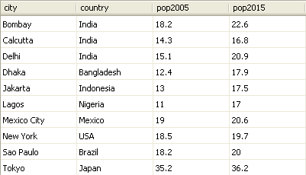
Two or More Tables
When a database contains two or more tables, the tables are usually related
For instance, the two tables Cities and Countries are related by their country field.
Notice that every entry in Cities.country appears uniquely in Countries.country and Countries.country is a primary key.
We say that Cities.country is a foreign key of Countries.country.

Slide 39
Foreign Keys
Foreign keys can be specified when a table is first created. Visual Basic will insist on the Rule of Referential Integrity.
This Rule says that each value in the foreign key must also appear in the primary key of the other table.

Slide 40
Join
A foreign key allows Visual Basic to link (or join) together two tables from a relational database
When the two tables Cities and Countries from MEGACITIES.MDB are joined based on the foreign key Cities.country, the result is the table in the next slide.
The record for each city is expanded to show its country’s population and its monetary unit.

Slide 41
A Join of Two Tables

Slide 42
SQL
Structured Query Language developed for use with relational databases
Very powerful language
Allows for the request of specified information from a database
Allows displaying of information from database in a specific format

Slide 43
Four SQL Requests
Show the records of a table in a specified order
SELECT * FROM Table1 ORDER BY field1 ASC
or
SELECT * FROM Table1 ORDER BY field1 DESC
* means
"all fields"
Specifies
ASCending
Or
DESCending

Slide 44
Show just the records that meet certain criteria
Specified
Criteria
* means
"all fields"
SELECT * FROM Table1 WHERE criteria
Name of the
table where the
records are found

Slide 45
Join the tables together
connected by a foreign key, and present the records as in previous requests
SELECT *
FROM Table1 INNER JOIN Table2
ON foreign field = primary field
WHERE criteria

Slide 46
Make available just some of the fields
of either the basic tables or the joined table.
SELECT field1, field2, . . ., fieldN
FROM Table1
WHERE criteria

Slide 47
Criteria Clause
A string containing a condition of the type used with If blocks.
Uses the standard operators <, >, and =
Also can use the operator LIKE.
LIKE uses the wildcard characters “_” and “%” to compare a string to a pattern.

Slide 48
Examples using LIKE
An underscore character stands for a single character in the same position as the underscore character.
The pattern “B_d” is matched by “Bid”, “Bud”, and “Bad”.
A percent sign stands for any number of characters in the same position as the asterisk.
The pattern “C%r” is matched by “Computer”, “Chair”, and “Car”.

Slide 49
SELECT Clause
SELECT fields FROM clause
fields is either * (to indicate all fields) or a sequence of the fields to be available (separated by commas)
clause is either a single table or a join of two tables

Slide 50
Join clause
A join of two tables is indicated by a clause of the form
table1 INNER JOIN table2 ON foreign key of table1=primary key of table2
Appending WHERE criteria to the end of the sentence restricts the records to those satisfying criteria.
Appending ORDER BY field(s) ASC (or DESC) presents the records ordered by the specified field or fields.

Slide 51
General SQL statements
SELECT www FROM xxx WHERE yyy ORDER BY zzz
SELECT www FROM xxx is always present
May be accompanied by one or both of WHERE yyy and ORDER BY zzz.
The xxx portion might contain an INNER JOIN phrase.

Slide 52
More on SQL statements
The single quote, rather than the normal double quote, is used to surround strings.
Fields may be specified with the table they come from by tableName.fieldName

Slide 54
Virtual Tables
SQL statements create a new “virtual” table from existing tables.
SELECT city, pop2015 FROM Cities WHERE pop2015>=20
Results in “virtual” table
city pop2015 Bombay 22.6 Delhi 20.9
Mexico City 20.6
Sao Paulo 20.0 Tokyo 36.2

Slide 55
Another Virtual Table
SELECT * FROM Countries WHERE country LIKE 'I%' ORDER BY pop2005 ASC
Results in “virtual” table
country pop2005 monetaryUnit Indonesia 222.8 rupiah India 103.4 rupee

Slide 56
Views
“Virtual” tables don’t exist physically.
For all practical purposes, Visual Basic acts as if they did.
You may also see a “virtual” table called a view.

Slide 57
The DataGridView Control
The DataGridView, displays the values for an entire view in a table format similar to the table displayed by Database Explorer.
The prefix for the name of a DataGridView control is dgv.
After a data table has been filled, the statement
dgvDisplay.DataSource = dt
displays the contents of the data table dt.

Slide 58
Example 1: Form
dgvDisplay

Slide 59
Example 1: Code
Private Sub frmCities_Load(...) Handles MyBase.Load
UpdateGrid("Select * From Cities")
End Sub
Private Sub btnOrderbyPop_Click(...) Handles btnOrderbyPop.Click
UpdateGrid("Select * From Cities Order By pop2005 ASC")
End Sub
Private Sub btnShowMonUnit_Click(...) _
Handles btnShowMonUnit.Click
UpdateGrid("SELECT city, Cities.country, " & _
"Cities.pop1995, monetaryUnit " & _
"FROM Cities INNER JOIN Countries " & _
"ON Cities.country=Countries.country " & _
"ORDER BY city ASC")
End Sub

Slide 60
Example 1: Code continued
Sub UpdateGrid(ByVal sqlStr As String)
Dim dt As New DataTable()
Dim connStr As String ="Provider=Microsoft.Jet.OLEDB.4.0;" & _
"Data Source = MEGACITIES.MDB"
Dim dataAdapter As New OleDb.OleDbDataAdapter(sqlStr, connStr)
dataAdapter.Fill(dt)
dataAdapter.Dispose()
dgvDisplay.DataSource = dt
End Sub

Slide 61
Example 1: Output
Click on the “Show Monetary Unit” button.

Slide 62
Example 2: Form
txtCountry
dgvDisplay

Slide 63
Example 2: Code
Private Sub btnFindCities_Click(...) _
Handles btnFindCities.Click
UpdateGrid("SELECT city FROM Cities WHERE" & _
"country = '" & txtCountry.Text & _
"' ORDER BY city ASC")
End Sub
Sub UpdateGrid(ByVal sqlStr As String)
(Boilerplate, except for Dim sqlStr statement)
If dt.Rows.Count = 0 Then
MessageBox.Show("No cities from that country " & _
"in the database")
Else
dgvDisplay.DataSource = dt
End If
End Sub

Slide 64
Example 2: Output

Slide 65
Changing the Contents of a Database
Data grid views can also be used to add, modify, and delete records from a database.
After a DataAdapter has been created, the statement
Dim commandBuilder As New _
OleDbCommandBuilder(dataAdapter)
will automatically generate the commands used for the Insert, Update, and Delete operations.

Slide 66
Using the DataAdapter to Change a Database
If changes is an Integer variable, then the statement
changes = dataAdapter.Update(dt)
will store all of the insertions, updates, and deletions made in the data table to the database and assign the number of records changed to the variable changes.

Slide 67
Example 3: Form
dgvDisplay

Slide 68
Example 3: Partial Code
Dim connStr As String = "Provider=Microsoft.Jet.OLEDB.4.0;" & _
"Data Source=MEGACITIES.MDB"
Dim sqlStr As String = "SELECT * FROM Cities"
Dim dt As New DataTable()
Private Sub btnLoad_Click(...) Handles btnLoad.Click
dt.Clear()
Dim dataAdapter As New OleDb.OleDbDataAdapter(sqlStr, connStr)
dataAdapter.Fill(dt)
dataAdapter.Dispose()
dgvDisplay.DataSource = dt
End Sub

Slide 69
Example 3: Code continued
Private Sub btnSave_Click(...) Handles btnSave.Click
Dim changes As Integer
Dim dataAdapter As New OleDb.OleDbDataAdapter(sqlStr, connStr)
Dim commandBuilder As New _
OleDb.OleDbCommandBuilder(dataAdapter)
changes = dataAdapter.Update(dt)
dataAdapter.Dispose()
If changes > 0 Then
MessageBox.Show(changes & " changed rows.")
Else
MessageBox.Show ("No changes made.")
End If
End Sub

Slide 70
Calculated Columns with SQL
In the SQL statement
SELECT field1, field2,..., fieldN FROM Table1
one of the field listings can be an expression involving other fields, followed by a clause of the form “AS header”. If so, a new column will be created whose values are determined by the expression and having the stated header. For instance, using
sqlStr = "SELECT city, Round(pop2015-pop2005, 1)" & _
"AS popGrowth FROM Cities"
to fill the table produces the output shown in the next slide.

Slide 71
Calculated Columns with SQL

