Slide 2
Review
Efficiency of Bubble and Shell Sorts
Array Elements | Bubble Sort Comparisons | Shell Sort Comparisons
5 | 10 | 17
10 | 45 | 57
15 | 105 | 115
20 | 190 | 192
25 | 300 | 302
30 | 435 | 364
50 | 1225 | 926
100 | 4950 | 2638
500 | 124,750 | 22,517
1000 | 499,500 | 58,460

Slide 3
Review
Efficiency of Sequential and Binary Search
Array Elements | Sequential Search Comparisons | Binary Search Comparisons
2000 | 1000 (Average) | 11 (At most)

Slide 4
Review
Sequential Files
Create a text file:
Imports System.IO
Dim sw As StreamWriter = File.CreateText(filespec)
sw.WriteLine(datum)
sw.Close()

Slide 5
Review
Add items to a file:
Imports System.IO
Dim sw As StreamWriter = File.AppendText(filespec)
sw.WriteLine(datum)
sw.Close()
Open a file:
Imports System.IO
Dim sr As StreamReader = File.OpenText(filespec)
sr.ReadLine()
sr.Close()

Slide 6
Review
Delete a file:
Imports System.IO
File.Delete(filespec)
Move a file (change the filespec of a file)
Imports System.IO
File.Move(oldfilespec, newfilespec)
Check existence of a file:
Imports System.IO
File.Exists(filespec)

Slide 7
Working with HashTable
Declaring HashTable
Dim MyHash As New Hashtable

Slide 8
Working with HashTable
Adding an element to the HashTable
{hash table object}.Add(Key as Object, value as Object)
Ex: MyHash.Add(“George”, 45)

Slide 9
Working with HashTable
Accessing an element {hash table object}.Item({key}) Ex: MyArray.Item(“George”)

Slide 10
Working with HashTable
Searching for an element
{hash table object}.Contains({key}) Ex: MyArray.Contains(“George”)

Slide 11
Week 9 – Chapter 9

Slide 12
Chapter 9 – Additional Controls and Objects
9.1 List Boxes, Combo Boxes, and the File-Opening Control
9.2 Seven Elementary Controls
9.3 Four Additional Objects
9.4 Graphics

Slide 13
The List Box Control

Slide 14
The List Box Control
Items can be placed into the list at design time or run time
The Sorted property allows items in the list to be sorted automatically
If the Sorted property is set to True, then the following will place an item into the list in order and assign the index of its position to num:
num = lstBox.Items.Add(str)

Slide 15
Useful Properties of the List Box
The total number of items in a list box is given by
lstBox.Items.Count
Note: Each item in lstBox is identified by an index number from 0 to lstBox.Items.Count – 1
The index number of the currently highlighted item is given by:
lstBox.SelectedIndex
Notes:
lstBox.Items.Count-1 is the value of the last subscript (index) because the list starts at 0.
If no item is highlighted, the value of SelectedIndex is –1.

Slide 16
More List Box Properties
lstBox.Items() is the list of items in the list box
The value of the item with an index of n is:
lstBox.Items(n)
The data type of the elements in the lstBox.Items() array is Object. To display the first element of lstBox.Items in a text box:
txtBox.Text = CStr(lstBox.Items(0))

Slide 17
Currently Highlighted Item in a List Boxes
The currently highlighted item can be obtained as:
lstBox.Items(lstBox.SelectedIndex)
or
lstBox.Text

Slide 18
Removing Items from a List Box
To delete an item at a given location:
lstBox.Items.RemoveAt(n)
To delete the first occurrence of an item:
lstBox.Items.Remove(str)
To remove everything from a list box:
lstBox.Items.Clear()

Slide 19
List Box Events
Three main types of events with list boxes:
Click – the user clicks on an item in the list box
SelectedIndexChanged - the user clicks on an item or uses the arrow keys to select it
DoubleClick - the user double-clicks on an item
All three events are triggered when the user double-clicks on an item.

Slide 20
Example 1: Form
lstOxys
txtSelected

Slide 21
Example 1: Code
Private Sub lstOxys_SelectedIndexChanged(...) _
Handles lstOxys.SelectedIndexChanged
txtSelected.Text = CStr(lstOxys.SelectedItem)
End Sub
Private Sub btnAdd_Click(...) Handles btnAdd.Click
Dim item As String
item = InputBox("Item to Add:")
lstOxys.Items.Add(item)
End Sub
Private Sub lstOxys_DoubleClick(...) _
Handles lstOxys.DoubleClick
lstOxys.Items.RemoveAt(lstOxys.SelectedIndex)
txtSelected.Clear()
End Sub

Slide 22
Filling a List Box at Design Time
Click on the listbox.
Select the Items property of the list box.

Slide 23
Filling a List Box at Design Time
Click on the ellipsis button on the right side of the Settings box. (A window titled String Collection Editor will be displayed.)

Slide 24
Filling a List Box at Design Time
Type in the first item, and press Enter.
Repeat Step 3 for each of the other items.
When you are finished entering items, click on the OK button.

Slide 25
Using an Array to Fill a List Box
The statement
lstBox.DataSource = arrayName
fills the list box with the elements of the array.

Slide 26
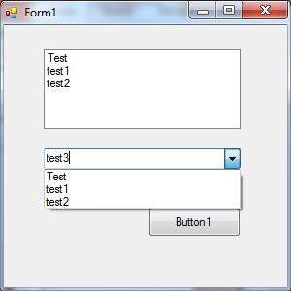
The Combo Box Control
A list box combined with a text box
The user has the option of filling the text box by selecting from a list or typing directly into the list box.
Essentially same properties, events, and methods as a list box

Slide 27
9.2 Seven Elementary Controls
The Group Box Control
The Check Box Control
The Radio Button Control
The Timer Control
The Picture Box Control
Scroll Bar Controls

Slide 28
The Group Box Control
Group boxes are passive objects used to group other objects together
When you drag a group box, the attached controls follow as a unit
To attach a control to a group box, create the group box, then drag the control you want to attach into the group box

Slide 29
Group Box Example
Text property of the group box
Three
attached controls:
Button1
Button2
Button3

Slide 30
The Check Box Control
Consists of a small square and a caption
Presents the user with a Yes/No choice
During run time, clicking on the check box toggles the appearance of a check mark
Checked property is True when the check box is checked and False when it is not
CheckedChanged event is triggered when the user clicks on the check box

Slide 31
Example 1: Form

Slide 32
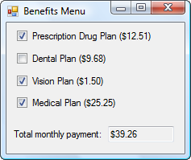
Example 1: Code
Private Sub Tally(...) Handles chkDrugs.CheckedChanged, _
chkDental.CheckedChanged, chkVision.CheckedChanged, _
chkMedical.CheckChanged
Dim sum As Double = 0
If chkDrugs.Checked Then
sum += 12.51
End If
If chkDental.Checked Then
sum += 9.68
End If
If chkVision.Checked Then
sum += 1.5
End If
If chkMedical.Checked Then
sum += 25.25
End If
txtTotal.Text = FormatCurrency(sum)
End Sub

Slide 33
The Radio Button Control
Consists of a small circle with a caption (that is set by the Text property)
Normally several radio buttons are attached to a group box
Gives the user a single choice from several options
Clicking on one radio button removes the selection from another

Slide 34
Radio Button Properties
To determine if the button is on or off
radButton.Checked
has value True if button in on
To turn a radio button on
radButton.Checked = True

Slide 35
Example 2: Form
radCandidate1
radCandidate2
txtVote

Slide 36
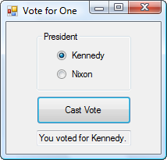
Example 2: Code
Private Sub btnVote_Click(...) Handles btnVote.Click
If radCandidate1.Checked Then
txtVote.Text = "You voted for Kennedy."
ElseIf radCandidate2.Checked Then
txtVote.Text = "You voted for Nixon."
Else
txtVote.Text = "You voted for neither."
End If
End Sub

Slide 37
The Timer Control
Invisible during run time
Triggers an event after a specified period of time
The Interval property specifies the time period – measured in milliseconds
To begin timing, set the Enabled property to True
To stop timing, set the Enabled property to False
The event triggered each time Timer1.Interval elapses is called Timer1.Tick

Slide 38
Example 3: Form
txtSeconds
OBJECT | PROPERTY | SETTING
tmrWatch | Interval | 100
 | Enabled | False

Slide 39
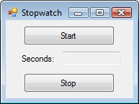
Example 3: Code
Private Sub btnStart_Click(...) Handles btnStart.Click
txtSeconds.Text = "0" 'Reset watch
tmrWatch.Enabled = True
End Sub
Private Sub btnStop_Click(...) Handles btnStop.Click
tmrWatch.Enabled = False
End Sub
Private Sub tmrWatch_Tick(...) Handles tmrWatch.Tick
txtSeconds.Text = CStr((CDbl(txtSeconds.Text) + 0.1))
End Sub

Slide 41
Pixels
The graphics unit of measurement is called a pixel.
To get a feel for pixel measurement, place a picture box on a form and look at the picture box’s Size property
The two numbers in the setting give the width and height of the picture box in pixels

Slide 42
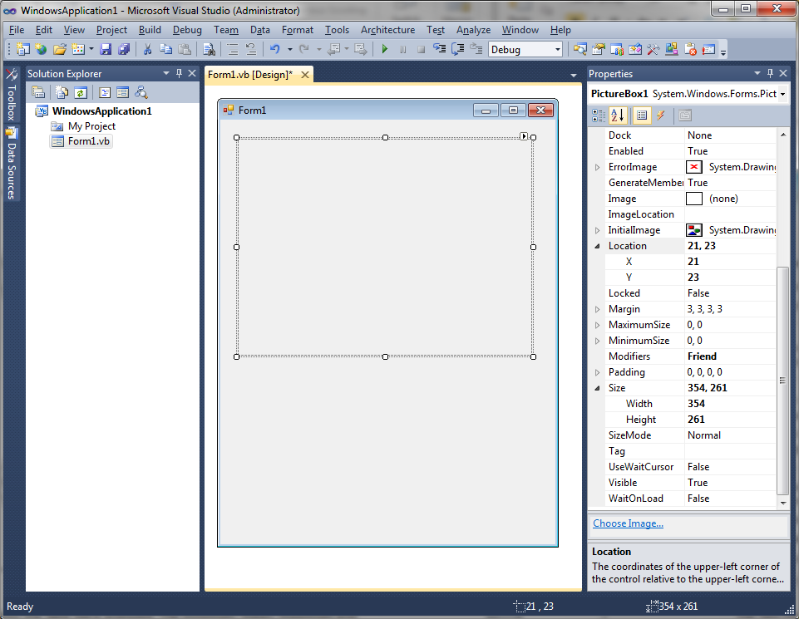
Y
X

Slide 43
Y
X

Slide 44
Coordinates in a Picture Box
Each point in a picture box is identified by a pair of coordinates, (x, y).
y pixels
(x, y)
x pixels

Slide 45
The Picture Box Control
Designed to hold drawings and pictures
To draw a blue rectangle inside the picture box with the upper left hand corner having coordinates (x, y), width w, and height h:
picBox.CreateGraphics.
DrawRectangle(Pens.Blue, x, y, w, h)

Slide 46
The Picture Box Control
To draw a blue circle with diameter d:
picBox.CreateGraphics.
DrawEllipse(Pens.Blue, x, y, d, d)
The numbers x and y give the coordinates of the upper-left corner of a rectangle having the circle inscribed in it.

Slide 47
Picture Box Containing a Red Circle
picBox.CreateGraphics.
DrawEllipse(Pens.Red, 35, 35, 70, 70)

Slide 48
Picture Box Properties
A picture can be placed in a picture box control with the Image property
.
Prior to setting the Image property, set the SizeMode property
AutoSize will cause the picture box control to be resized to fit the picture
StretchImage will cause the picture to be resized to fit the picture box control

Slide 49
Picture Box at Run Time
A picture also can be assigned to a picture box control at run time:
picBox.Image = Image.FromFile(filespec)
The SizeMode property can be altered at run time with a statement such as
picBox.SizeMode = PictureBoxSizeMode.AutoSize

Slide 50
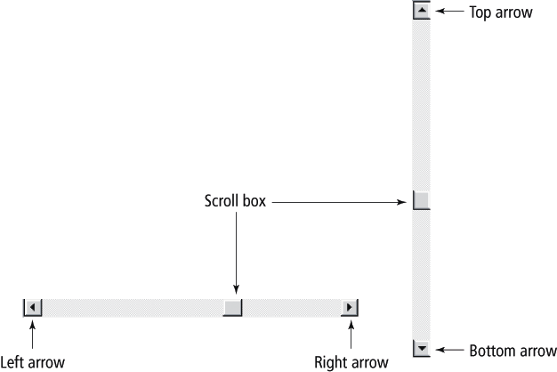
The Horizontal and Vertical Scroll Bars

Slide 51
Scroll Bar Behavior
When the user clicks on one of the arrow buttons, the scroll box moves a small amount toward that button
When the user clicks between the scroll box and one of the arrow buttons, the scroll box moves a large amount toward that button
The user can also move the scroll box by dragging it.

Slide 52
Scroll Bar Properties
The main properties of a scroll bar control are
Minimum
Maximum
Value
SmallChange,
LargeChange
hsbBar.Value, a number between hsbBar.Minimum and hsbBar.Maximum, gives the location of the scroll box
Notes:
hsbBar.Value is a number between hsbBar.Minimum and hsbBar.Maximum determined by the position of the left of the scroll box. If the left side of the scroll box is halfway between the two arrows, then hsbBar.Value is a number halfway between hsbBar.Minimum and hsbBar.Maximum.

Slide 53
Scroll Bar Notes
The setting for the Minimum property must be less than the setting for the Maximum property
The Minimum property determines the values for the left and top arrow buttons
The Maximum property determines the values for the right and bottom arrow buttons
The Scroll event is triggered whenever any part of the scroll bar is clicked

Slide 54
9.3 Four Additional Objects
The Clipboard Object
The Random Class
The MainMenu Control
Multiple Forms

Slide 55
The Clipboard Object
Used to copy information from one place to another
Maintained by Windows, so it can even be used with programs outside Visual Basic
A portion of memory that has no properties or events

Slide 56
Using the Clipboard Object
To place something in the Clipboard:
Clipboard.SetText(str)
To get something out of the Clipboard:
str = Clipboard.GetText
To delete the contents of the Clipboard:
Clipboard.SetText("")

Slide 57
The Random Class
A random number generator declared with the statement:
Dim randomNum As New Random()
If m and n are whole numbers and m < n then the following generates a whole number between m and n (including m, but excluding n)
randomNum.Next(m, n)

Slide 58
Example 1
Private Sub btnSelect_Click(...) Handles _
btnSelect.Click
'Display three randomly chosen digits
Dim randomNum As New Random()
Dim num1, num2, num3 As Integer
num1 = randomNum.Next(0, 10)
num2 = randomNum.Next(0, 10)
num3 = randomNum.Next(0, 10)
txtNumbers.Text = num1 & " " & num2 & " " & num3
End Sub

Slide 59
Example 1: Output

Slide 60
The MenuStrip Control
Used to create menus like the following:
Top-level menu
Second-level menu

Slide 61
Menu Events
Each menu item responds to the Click event
Click event is triggered by
the mouse
Alt + access key
Shortcut key

Slide 62
Multiple Forms
Visual Basic programs can contain more than one form
To add the new form, select Add Windows Form from the Project menu, to invoke the Add New Items dialog box.

Slide 63
Add New Items dialog box

Slide 64
Add New Items dialog box
Select Windows Form from the Installed Templates pane
Optionally type in a name
Press the Add button

Slide 65
Solution Explorer
Both forms will be accessible through Solution Explorer

Slide 66
Variables and Multiple Forms
Variables declared in the Declarations section of a form with Public, instead of Dim, will be available to all forms in the program
When a Public variable is used in another form, it is referred to by an expression such as
secondForm.variableName

Slide 67
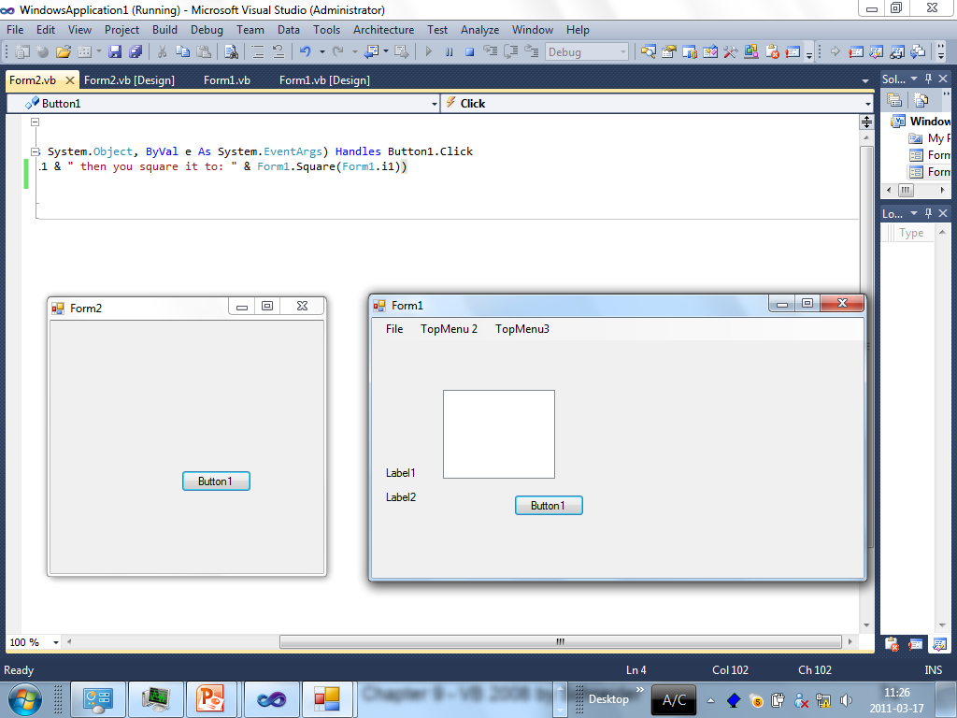

Slide 68
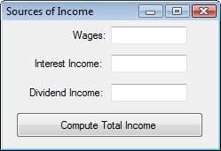
Example 3
txtTotIncome
frmIncome
frmSources
FormBorderStyle property set to FixedDialog

Slide 69
Example 3: frmIncome’s Code
Private Sub btnDetermine_Click(...) Handles_ btnDetermine.Click
'Instantiate the second form
Dim secondForm As New frmSources()
secondForm.ShowDialog() 'Show the second 'form and wait until it closes. Then
'execute the rest of the code in this 'procedure.
txtTotIncome.Text = _ FormatCurrency(secondForm.sum)
End Sub

Slide 70
Example 3: frmSource’s Code
Public sum As Double 'Holds the sum of the
'text boxes' values
Private Sub btnCompute_Click(...) Handles _
btnCompute.Click
'Store total into the Public variable sum
sum = CDbl(txtWages.Text) + _
CDbl(txtIntIncome.Text) + _
CDbl(txtDivIncome.Text)
'Close the form as it is not needed anymore
Me.Close()
End Sub

Slide 71
9.4 Graphics
Graphics Objects
Lines, Rectangles, Circles, and Sectors
Pie Charts
Bar Charts
Animation

Slide 72
Graphics Objects
Our objective is to draw bar charts and pie charts in a picture box
A statement of the form
Dim gr As Graphics = picBox.CreateGraphics
declares gr to be a Graphics object for the picture box picBox

Slide 73
Pixels
The graphics unit of measurement is called a pixel
To get a feel for pixel measurement, place a picture box on a form and look at the picture box’s Size property. The two numbers in the setting give the width and height in pixels.

Slide 74
Coordinates in a Picture Box
Each point in a picture box is identified by a pair of coordinates, (x, y).
y pixels
(x, y)
x pixels

Slide 75
Display Text in Picture Box
Dim gr As Graphics = picBox.CreateGraphics
gr.DrawString(string, Me.Font, _
Brushes.Color, x, y)
Displays string in the picture box. The upper-left corner of the text has coordinates (x, y), the font used is the Form’s font, and the color of the text is specified by color
Note: IntelliSense will provide a list of colors

Slide 76
Display Text
Dim gr As Graphics = picBox.CreateGraphics
Dim strVar As String = "Hello"
gr.DrawString(strVar, Me.Font, Brushes.Blue, 4, 30)
gr.DrawString("World",Me.Font, Brushes.Red, 35, 50)

Slide 77
Draw a Line in a Picture Box
Dim gr As Graphics = picBox.CreateGraphics
gr.DrawLine(Pens.Color, x1, y1, x2, y2)
draws a line in the specified color from (x1, y1) to (x2, y2)

Slide 78
Draw a Line
Dim gr As Graphics = picBox.CreateGraphics
gr.DrawLine(Pens.Blue, 50, 20, 120, 75)

Slide 79
Draw a Solid Rectangle in a Picture Box
Dim gr As Graphics = picBox.CreateGraphics
gr.FillRectangle(Brushes.Color, x, y, w, h)
draws a solid rectangle of width w and height h in the color specified and having the point with coordinates (x, y) as its upper-left corner

Slide 80
Draw a Solid Rectangle in a Picture Box
Dim gr As Graphics = picBox.CreateGraphics
gr.FillRectangle(Brushes.Blue, 50, 20, 70, 55)

Slide 81
Draw a Solid Ellipse in a Picture Box
Dim gr As Graphics = picBox.CreateGraphics
gr.FillEllipse(Brushes.Color, x, y, w, h)
draws a solid ellipse in the color specified inscribed in the rectangle described by the values x, y, w, and h
Note: When w = h, the ellipse is a circle. This is the only type of ellipse we will consider

Slide 82
Draw a Solid Ellipse
The statement
gr.FillEllipse(Brushes.Color, _
a - r, b - r, 2 * r, 2 * r)
draws a solid circle in the color specified with center (a, b) and radius r
For example,
gr.FillEllipse(Brushes.Blue, _
80 - 40, 50 - 40, 2 * 40, 2 * 40)
Draws a solid blue circle of radius 40 and center (80, 50)

Slide 83
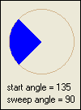
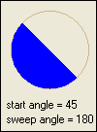
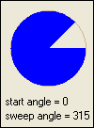
A Sector of a Circle
A sector of a circle (shown below as upper-left sector) is specified by two angles, θ₁ (the start angle) and θ₂ (the sweep angle).

Slide 84
Draw a Sector
The statement
gr.FillPie(Brushes.Color, a - r, b - r, _
2 * r, 2 * r, startAngle, sweepAngle)
draws a solid sector of a circle with center (a, b), radius r, and having the specified startAngle and sweepAngle
The color of the sector is determined by the value of Color

Slide 85
Brushes, Pens, and Fonts
Variables can be used for brushes, pens, and fonts. For example, the statement
gr.FillRectangle(Brushes.Blue, 50,20,70,55)
can be replaced with
Dim br As Brush = Brushes.Blue
gr.FillRectangle(br, 50, 20, 70, 55)

Slide 86
Financing Public Schools Data
 | Amount (in billions) | Percent
Federal | $33 | 8%
State | $206 | 49%
Local | $180 | 43%

Slide 87
Financing Public Schools Pie Chart

Slide 88
Create the Pie Chart
Dim gr As Graphics = picBox.CreateGraphics
Dim percent() As Single = {.08, .49, .43}
Dim br() As Brush = {Brushes.Blue, _
Brushes.Red, Brushes.Tan}
Dim sumOfSweepAngles As Single = 0
For i As Integer = 0 To 2
gr.FillPie(br(i), 5, 5, 200, 200, _
sumOfSweepAngles, percent(i) * 360)
sumOfSweepAngles += percent(i) * 360
Next

Slide 89
Financing Public Schools Bar Chart

Slide 90
Financing Public Schools Bar Chart
Suppose the x-axis is 110 pixels below the top of the picture box
Let the unit for the rectangle heights be .5 pixels
Then the top of a rectangle corresponding to the quantity q is 110 – q/2 pixels from the top of the picture box

Slide 91
Create the Bar Chart
Dim gr As Graphics = picBox.CreateGraphics
Dim quantity() As Single = {33, 206, 180}
'Draw x-axis
gr.DrawLine(Pens.Black, 40, 110, 210, 110) 'Draw y-axis
gr.DrawLine(Pens.Black, 40, 110, 40, 0)
For i As Integer = 0 To 2
gr.FillRectangle(Brushes.Blue, _
60 + i * 40, (110 – quantity(i) / 2), _
20, quantity(i) / 2)
Next

Slide 92
Animation
Place an image into a picture box, and move the picture box a small distance with each tick of a Timer control

Slide 93
Move Ball
The following code moves the ball along a diagonal with each tick of the timer
Private Sub Timer1_Tick(...) Handles _
Timer1.Tick
picBall.Left += 1
picBall.Top += 1
End Sub

