Slide 1
Administrative
Midterm

Slide 2
Administrative
Assignment #3
Console Application
Writing to the console
Console.WriteLine(“Writing to the console”)
UserInput = Console.ReadLine()
Using Console.ReadLine will PAUSE the program until the user enters something.

Slide 3
Example Code
Console.WriteLine(">Welcome _
to the Gradebook program!")
number = CInt(Console.ReadLine)

Slide 4
Chapter 7 - Arrays

Slide 5
Chapter 7 – Arrays
7.1 Creating and Accessing Arrays
7.2 Using Arrays
7.3 Some Additional Types of Arrays
7.4 Sorting and Searching
7.5 Two-Dimensional Arrays

Slide 6
Simple and Array Variables
A variable (or simple variable) is a name to which Visual Basic can assign a single value.
An array variable is a collection of simple variables of the same type to which Visual Basic can efficiently assign a list of values.

Slide 7
Simple and Array Variables
Many variables
An array variable
7
2
Value1
…
Value4
…
Value7
Values
7
2
Location
1 2 3 4 5 6 7

Slide 8
Simple and Array Variables
Many variables
Vs.
An array variable

Slide 9
Example
Suppose that you want to evaluate the exam grades for 30 students and display the names of the students whose scores are above average.
COULD DO
Private Sub btnDisplay_Click(...) _
Handles btnDisplay.Click
Dim student0 As String, score0 As Double Dim student1 As String, score1 As Double Dim student2 As String, score2 As Double

Slide 10
Example
Suppose that you want to evaluate the exam grades for 30 students and display the names of the students whose scores are above average.
BETTER
Private Sub btnDisplay_Click(...) _
Handles btnDisplay.Click Dim student(29) As String, score(29) As Double

Slide 11
Using Arrays
Upper bound of subscripts
in the array
Dim student(29) As String
Dim score(29) As Double
Array name
Data type

Slide 12
Putting Values into an Array
student(0) = "Tom Brown"
subscript
Read: "student sub zero equals Tom Brown"
Which means that the string "Tom Brown" is being
stored at the first location in the array called
student… because all arrays begin counting at 0.

Slide 13
Array Terminology
Dim arrayName(n) As DataType
0 is the "lower bound" of the array
n is the "upper bound" of the array – the last available subscript in this array
The number of elements, n + 1, is the size of the array

Slide 14
Example 1: Form
txtNumber
txtWinner

Slide 15
Example 1
Private Sub btnWhoWon_Click(...) _
Handles btnWhoWon.Click
Dim teamName(3) As String
Dim n As Integer
'Place Super Bowl Winners into the array
teamName(0) = "Packers"
teamName(1) = "Packers"
teamName(2) = "Jets"
teamName(3) = "Chiefs"
'Access array
n = CInt(txtNumber.Text)
txtWinner.Text = teamName(n - 1)
End Sub
Notes:
Note that the array is created and the array is loaded each and every time the user clicks on the Who Won button. See example 2 for an improvement where the array is only loaded once.

Slide 16
Example 1: Output

Slide 17
Load Event Procedure
Occurs as the Form loads in memory
Private Sub frmName_Load(...) _
Handles MyBase.Load
The keyword MyBase refers to the form being loaded. This event procedure is a good place to assign values to an array.
This is the FIRST thing that loads
Loads BEFORE you see the form

Slide 18
Load Event Procedure
Occurs as the Form loads in memory
Private Sub frmName_Load(...) _
Handles MyBase.Load
Errors here are handled differently!!!
http://blog.paulbetts.org/index.php/2010/07/20/the-case-of-the-disappearing-onload-exception-user-mode-callback-exceptions-in-x64/
http://stackoverflow.com/questions/4933958/vs2010-does-not-show-unhandled-exception-message-in-a-winforms-application-on-a
Write the code for a button
When debugged, put it into MyBase.Load

Slide 19
Example 2
Dim teamName(3) As String
Private Sub btnWhoWon_Click(...) Handles btnWhoWon.Click
Dim n As Integer
n = CInt(txtNumber.Text)
txtWinner.Text = teamName(n - 1)
End Sub
Private Sub frmBowl_Load(...) Handles MyBase.Load
'Place Super Bowl Winners into the array
teamName(0) = "Packers"
teamName(1) = "Packers"
teamName(2) = "Jets"
teamName(3) = "Chiefs"
End Sub

Slide 20
Initializing Arrays
Arrays may be initialized when they are created:
Dim arrayName() As varType = {value0, _
value1, value2, ..., valueN}
declares an array having upper bound N and assigns value0 to arrayName(0), value1 to arrayName(1), ..., and valueN to arrayName(N).

Slide 21
Initializing Arrays
Arrays may be initialized when they are created:
Dim arrayName() As varType = {value0,_
value1, value2, ..., valueN}
For Ex:
Dim Students() As String = {"Jack", "John", "Julie", "Jimmy", "Janet"}

Slide 22
Initializing Arrays
Arrays may be initialized when they are created:
Dim arrayName() As varType = IO.File.ReadAllLines(filespec)
Opens filespec, reads all lines from it, and stores it in arrayName
Each line in filespec is stored in one location of arrayName

Slide 23
GetUpperBound Method
The value of
arrayName.GetUpperBound(0)
is the upper bound of arrayName().

Slide 24
Example
Dim teamName() As String = {"Packers", _
"Packers", "Jets", "Chiefs"}
txtBox.Text = CStr(teamName.GetUpperBound(0))
Output: 3

Slide 25
Example
Dim Grades() As integer = {70, 75, 80, 85, 90}
Grades.Average → 80
Grades.Count → 5
Grades.Min → 70
Grades.Max → 90
Grades.Sum → 400

Slide 26
ReDim Statement
The size of an array may be changed after
it has been created.
ReDim arrayName(m)
changes the upper bound of the array to m.
Notes:
Note the size of the array may change after the array is created, but not the data type.

Slide 27
Preserve Keyword
ReDim arrayName(m) resets all values to their default. This can be prevented with the keyword Preserve.
ReDim Preserve arrayName(m)
resizes the array and retains as many
values as possible.

Slide 28
Example 4: Using an Array as a Frequency Table

Slide 29
Example 4: Code
Private Sub btnAnalyze_Click(...) Handles btnAnalyze.Click
'Count occurrences of the various letters in a sentence
Dim sentence, letter As String
Dim index, charCount(25) As Integer
'Examine and tally each letter of the sentence
sentence = (txtSentence.Text).ToUpper
For letterNum As Integer = 1 To sentence.Length
‘Get a specific letter from the sentence
letter = sentence.Substring(letterNum - 1, 1)
If (letter >= "A") And (letter <= "Z") Then
index = Asc(letter) - 65 'The ANSI value of "A" is 65
charCount(index) += 1
End If
Next

Slide 30
Example 4: Code Continued
'List the tally for each letter of alphabet
lstCount.Items.Clear()
For i As Integer = 0 To 25
letter = Chr(i + 65)
If charCount(i) > 0 Then
lstCount.Items.Add(letter & " " & _
charCount(i))
End If
Next
End Sub

Slide 31
Example 4 Output

Slide 32
Out of Bounds Error
The following code references an array element that doesn't exist. This will cause an error.

Slide 33
Assignment Statement for Arrays
If arrayOne() and arrayTwo() have been declared
with the same data type, then the statement
arrayOne = arrayTwo
makes arrayOne() an exact duplicate of arrayTwo().
Actually, they share the same location in memory

Slide 34
Assignment Statement for Arrays
How to make an independent copy?
Array1 = Array2.clone
Changing Array1 does not change Array2.

Slide 35
User-Defined Array-Valued Functions
Headers have the form
Function FunctionName(ByVal var1 As _
Type1, ByVal var2 As Type2, ...) As _ DataType()

Slide 36
Erasing an Array
An array can consume a large block of memory.
After the array is no longer needed, we can release all memory allocated to the array by executing the following statement:
Erase arrayName

Slide 37
Using .SPLIT
'read the entire file in, 1 line per array entry
Dim arrayName() As String = IO.File.ReadAllLines("input.txt")
'iterate through all lines in the input file
For i = 0 To arrayName.GetUpperBound(0)
'split all elements of the line into various entries
Dim Stuff() As String
Stuff = arrayName(i).Split(vbTab)
MsgBox("HERE")
Next i

Slide 38
7.2 Using Arrays
Ordered Arrays
Using Part of an Array
Merging Two Ordered Arrays
Passing Arrays to Procedures

Slide 39
Ordered Arrays
An array has ascending order if
[each element] ≤ [next element]
An array has descending order if
[each element] ≥ [next element]
An array is ordered if it has ascending or
descending order

Slide 40
Searching Ordered Arrays
Ordered arrays can be searched more efficiently than unordered arrays
For instance, when searching an array having ascending order, you can terminate the search when you find an element whose value is ≥ the sought-after value.

Slide 41
Example 1: Task
Given a name input by the user, determine
if it is in an increasing list of ten names

Slide 42
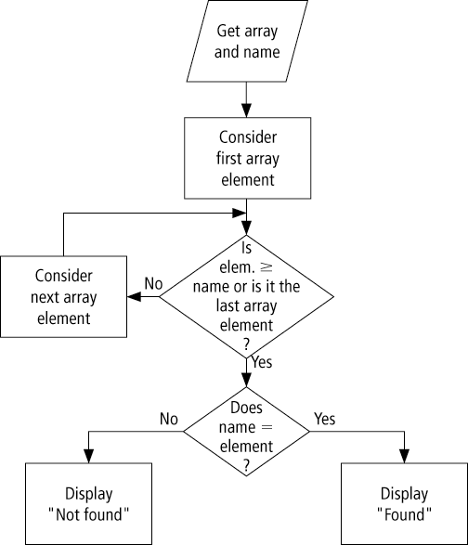
Flowchart for a Search of an Increasing Array

Slide 43
Example 1: Code
Dim nom() As String = {"AL", "BOB", "CARL", "DON", "ERIC", _
"FRED", "GREG", "HERB", "IRA", "JACK"}
Private Sub btnSearch_Click(...) Handles btnSearch.Click
Dim name2Find As String
Dim n As Integer = -1 'Subscript of the array
name2Find = txtName.Text.ToUpper
Do
n += 1 'Add 1 to n
Loop Until (nom(n) >= name2Find) Or (n = 9)
If nom(n) = name2Find Then
txtResult.Text = "Found."
Else
txtResult.Text = "Not found."
End If
End Sub

Slide 44
Example 1: Output

Slide 45
Using Part of an Array
- Sometimes we do not know how many
elements will be needed in an array
- We can declare a large array, say of 100
elements, and use a counter variable to
record the number of elements used
- In Example 2, the names are an unknown number of companies is placed into an array.

Slide 46
Example 2: Output
txtCompany

Slide 47
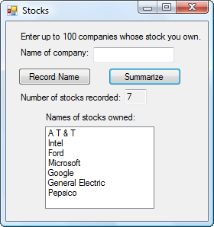
Example 2: Code
'Demonstrate using part of an array
Dim stock(99) As String
Dim counter As Integer
Private Sub btnRecord_Click(...) Handles btnRecord.Click
If (counter < 99) Then
counter += 1 'Increment counter by 1
stock(counter - 1) = txtCompany.Text
txtCompany.Clear()
txtCompany.Focus()
txtNumber.Text = CStr(counter)
Else
MessageBox.Show("No space to record _
more companies.")
txtCompany.Clear()
End If
End Sub

Slide 48
Example 2: Code Continued
Private Sub btnSummarize_Click(...) _
Handles btnSummarize.Click
'List companies that were recorded
lstStocks.Items.Clear()
For i As Integer = 0 To counter - 1
lstStocks.Items.Add(stock(i))
Next
End Sub

Slide 49
Merging Two Ascending Arrays
To consolidate the two lists into a single ordered third list:
Compare the two names at the top of the first and second lists.
If one name alphabetically precedes the other, copy it onto the third list and cross it off its original list.
If the names are the same, copy the name onto the third list and cross out the name from the first and second lists.
Repeat Step 1 with the current top names until you reach the end of either list.
Copy the names from the remaining list into the third list.

Slide 50
Passing Arrays to Procedures
An array declared in a procedure is local to that procedure
An entire array can be passed to a Sub or Function procedure
The header of the Sub of Function procedure uses the name with empty set of parentheses.

Slide 51
Example 4
This example uses a Function procedure to add up the numbers in an array. The GetUpperBound method is used to determine how many numbers are in the array.

Slide 52
Example 4
Private Sub btnCompute_Click(...) Handles btnCompute.Click
Dim score() As Integer = {85, 92, 75, 68, 84, 86, _
94, 74, 79, 88}
txtAverage.Text = CStr(Sum(score) / 10)
End Sub
Function Sum(ByVal s() As Integer) As Integer
Dim total As Integer = 0
For index As Integer = 0 To s.GetUpperBound(0)
total += s(index)
Next
Return total
End Function
Notes:
Notice that the function call is written Sum(score), not Sum(score()), and that
the parameter declaration is written ByVal s() As Integer, not ByVal s As Integer.

Slide 53
Passing an Array Element
A single element of an array can be passed to a procedure just like any ordinary numeric or string variable.
Private Sub btnDisplay_Click(...) Handles _
btnDisplay.Click
Dim num(20) As Integer
num(5) = 10
lstOutput.Items.Add(Triple(num(5)))
End Sub
Private Function Triple(ByVal x As Integer) As Integer
Return 3 * x
End Function

Slide 54
7.3 Some Additional Types of Arrays
Control Arrays
Array of Structures
Displaying and Comparing Structure Values

Slide 55
Control Arrays
Control arrays are arrays of controls, such as labels, text boxes, etc.
They are created in much the same way as any other array:
Dim arrayName(n) As ControlType
or
Dim arrayName() As ControlType

Slide 56
Control Arrays continued
The following statements declare control arrays.
Dim lblTitle(10) As Label
Dim txtNumber(8) As TextBox
Dim btnAmount() As Button

Slide 57
Example 2: Form
TextBox1
TextBox5
txtTotal

Slide 58
Example 1
Array of controls
Dim lblDept(4) As Label
Dim txtDept(4) As TextBox
Private Sub frmSales_Load(...) Handles MyBase.Load
lblDept(0) = Label1
lblDept(1) = Label2
lblDept(2) = Label3
lblDept(3) = Label4
lblDept(4) = Label5
txtDept(0) = TextBox1
txtDept(1) = TextBox2
txtDept(2) = TextBox3
txtDept(3) = TextBox4
txtDept(4) = TextBox5
Placing controls
into arrays

Slide 59
Example 1 continued
Private Sub Clear() Handles btnClear.Click
For depNum As Integer = 1 To 5
lblDept(depNum - 1).Text = "Department " & depNum
txtDept(depNum).Clear()
Next
End Sub
Private Sub btnCompute_Click(...) _
Handles btnCompute.Click
Dim totalSales As Double = 0
For depNum As Integer = 1 To 5
totalSales += CDbl(txtDept(depNum - 1).Text)
Next
txtTotal.Text = FormatCurrency(totalSales)
End Sub

Slide 60
Example 1 Output

Slide 61
Structures

Slide 62
Structures
A way of grouping heterogeneous data together
Also called a UDT (User Defined Type)
Sample structure definition:
Structure College
Dim name As String
Dim state As String
Dim yearFounded As Integer
End Structure

Slide 63
Structure Definition
Each subvariable in a structure is called a
Member
To declare a variable of a structure type:
Dim college1 As College
Each member is accessed via
variable name.member name
college1.state = "Maryland"

Slide 64
Example 2
Structure College
Dim name As String
Dim state As String
Dim yearFounded As Integer
End Structure
Dim college1, college2, collegeOlder As College
Private Sub btnFirst_Click(...) Handles btnFirst.Click
Dim prompt As String
college1.name = InputBox("Enter name of college.", "Name")
college1.state = InputBox("Enter state.", "State")
prompt = "Enter the year the first college was founded."
college1.yearFounded = CInt(InputBox(prompt, "Year"))
End Sub

Slide 65
Structure Members
Integer, String, Double, etc.
Another User Defined Type
Arrays
Must not specify range
Range must be set using ReDim

Slide 66
Example 4
This example gathers information about a student and determines when the student will be eligible to graduate.

Slide 67
Example 4
Structure FullName
Dim firstName As String
Dim lastName As String
End Structure
Structure Student
Dim name As FullName
Dim credits() As Integer
End Structure
Structure "FullName"
contained, or nested,
inside Student

Slide 68
Example 4 continued
Private Sub btnGet_Click(...) Handles btnGet.Click
Dim numYears As Integer
Dim person As Student
txtResult.Clear()
person.name.firstName = InputBox("First Name:")
person.name.lastName = InputBox("Second Name:")
numYears = CInt(InputBox("Number of years " & _
"completed:"))
ReDim person.credits(numYears - 1)
For i As Integer = 0 To numYears - 1
person.credits(i)=CInt(InputBox("Credits in year " _
& i + 1))
Next
DetermineStatus(person)
End Sub

Slide 69
Example 4 continued
Sub DetermineStatus(ByVal person As Student)
Dim total As Integer = 0
For i As Integer = 0 To person.credits.GetUpperBound(0)
total += person.credits(i)
Next
If (total >= 120) Then
txtResult.Text = person.name.firstName & " " & _
person.name.lastName & " has enough credits" & _
" to graduate."
Else
txtResult.Text = person.name.firstName & " " & _
person.name.lastName & " needs " & _
(120 - total) & " more credits to graduate."
End If
End Sub

Slide 70
7.4 Sorting

Slide 71
7.4 Sorting and Searching
Bubble Sort
Shell Sort
Searching

Slide 72
Sorting
Sorting is an algorithm for ordering an array
We discuss two sorting algorithms:
bubble sort
Shell sort
Both use the swap algorithm:
temp = varl
varl = var2
var2 = temp

Slide 73
Example 1 Output
txtFirstWord
txtSecondWord
txtResult

Slide 74
Example 1 Swap Algorithm
Private Sub btnAlphabetize_Click(...) _
Handles btnAlphabetize.Click
Dim firstWord, secondWord, temp As String
firstWord = txtFirstWord.Text
secondWord = txtSecondWord.Text
If (firstWord > secondWord) Then
temp = firstWord
firstWord = secondWord
secondWord = temp
End If
txtResult.Text = firstWord & " before " & _
secondWord
End Sub

Slide 75
Bubble Sort Algorithm: n Items
Compare the first and second items. If they are out of order, swap them
Compare the second and third items. If they are out of order, swap them
Repeat this pattern for all remaining pairs. The final comparison and possible swap are between the next-to-last and last items
The last item will be at its proper place
Do another pass through first n – 1 items
Repeat this process with one less item for each pass until a pass uses only the first and second items

Slide 76
Bubble Sort
Sub BubbleSort(arr As Variant, Optional numEls As Variant, Optional descending As Boolean)
' account for optional arguments
If IsMissing(numEls) Then numEls = UBound(arr)
firstItem = LBound(arr)
lastSwap = numEls
Do
indexLimit = lastSwap - 1
lastSwap = 0
For index = firstItem To indexLimit
value = arr(index)
If (value > arr(index + 1)) Xor descending Then
' if the items are not in order, swap them
' … swap values at index and index + 1
End If
Next
Loop While lastSwap
End Sub
Demo:
http://www.sorting-algorithms.com/random-initial-order

Slide 77
Shell Sort Algorithm
Begin with a gap of g = Int(n/2)
Compare items 0 and g, 1 and 1 + g, . . ., n - g and n. Swap any pairs that are out of order
Repeat Step 2 until no swaps are made for gap g
Halve the value of g
Repeat Steps 2, 3, and 4 until the value of g is 0

Slide 78
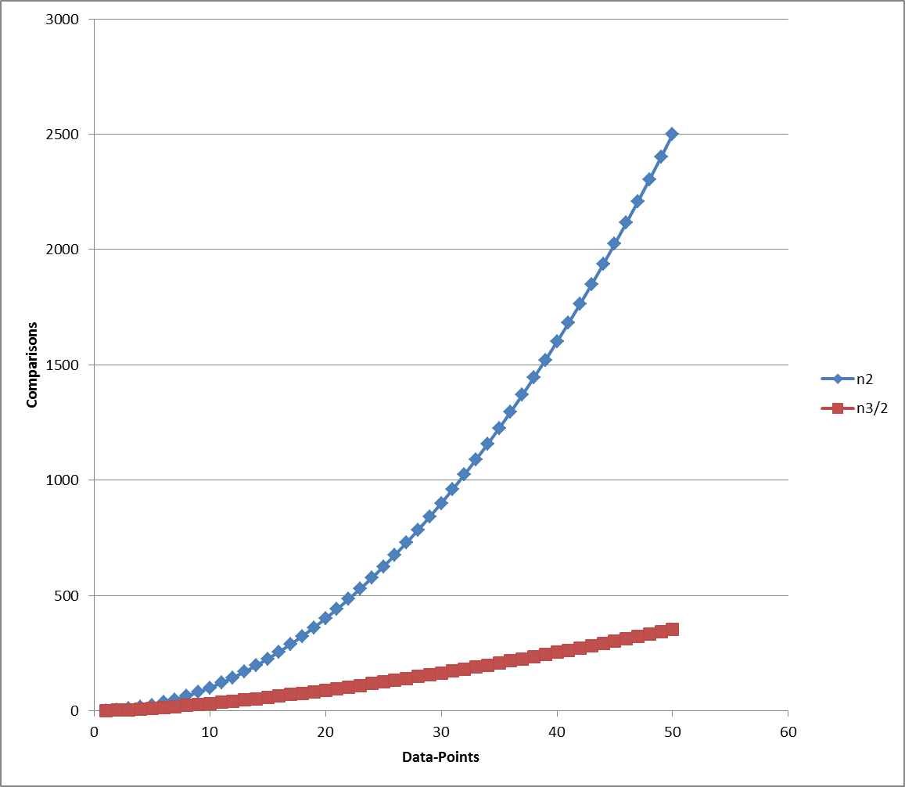
Comparison
Bubble Sort
O(n²) comparisons and swaps
O(n) when nearly sorted
Shell
O(n^{3/2}) time as shown
O(n lg(n)) time when nearly sorted

Slide 79
Searching
Sequential search
Starts at the beginning of a list and keeps looking one by one until the item is found or the end of the list is reached
For a sequential search, the list need not be sorted
Binary Search
Usually more efficient than sequential search
List must be sorted
Half-interval search

Slide 80
Binary Search: Algorithm
Given: an array in ascending order and a sought-after value, query, that may be in the array
Repeatedly halve the range of indices where query might be found.
Halving routine looks at the middle value of the current range and compares it to query with =, >, and <.
If middle value = query, then search is over.
If middle value > query, then we can limit our search to the half of the range below the middle value.
If middle value < query, then we can limit our search to the half of the range above the middle value.

Slide 81
Binary Search
1 | 5 | 7 | 9 | 11 | 15 | 17 | 20 | 24 | 29

Slide 82
Binary Search: Variables
first – lower limit of range of values to search
last – upper limit of range of values to search
middle = Int((first + last) / 2)
a() – ordered array to be searched
foundFlag – True when query is found
Note: If query is not in the array, eventually last will be greater than first.
Note: Initially first = 0 and last = a.GetUpperBound(0)

Slide 83
Binary Search: Code
Do While (first <= last) And (Not FoundFlag)
middle = CInt((first + last) / 2)
Select Case a(middle)
Case query
foundFlag = True
Case Is > query
last = middle – 1
Case Is < query
first = middle + 1
End Select
Loop

Slide 84
Binary Search: Notes
If a binary search ends with foundFlag = True, the subscript of the found item might be useful
This would be the case if the array were an array of structures that was ordered with respect to one of its members
The binary search would serve as an efficient table lookup process

Slide 85
7.5 Two Dimensional Arrays
One-dimensional arrays store a list of items of the same type
Two-dimensional arrays store a table of items of the same type
Consider the rows of the table as numbered 0, 1, 2, ,,, m and the columns numbered 0, 1, 2, …, n. Then the array is declared with the statement
Dim arrayName(m, n) As DataType
and the item in the ith row, jth column is denoted
arrayName(i,j)

Slide 86
Road-Mileage Table
 | Chicago | LA | NY | Philly
Chicago | 0 | 2054 | 802 | 738
LA | 2054 | 0 | 2786 | 2706
NY | 802 | 2786 | 0 | 100
Philly | 738 | 2706 | 100 | 0
Dim rm(3, 3) As Double
rm(0,0)=0, rm(0,1)=2054, rm(1,2)=2786

Slide 87
Populating a Two-Dimensional Array
Dim rm(3, 3) As Double
Private Sub frmDistances_Load(...) Handles MyBase.Load
'Fill two-dimensional array with intercity mileages
Dim sr As IO.StreamReader = _
IO.File.OpenText("DISTANCE.TXT")
For row As Integer = 0 To 3
For col As Integer = 0 To 3
rm(row, col) = CDbl(sr.ReadLine)
Next
Next
sr.Close()
End Sub

Slide 88
Notes on Two-Dimensional Arrays
An unsized two-dimensional array can be declared with a statement of the form
Dim arrayName(,) As varType
and a two-dimensional array can be declared and initialized at the same time with a statement of the form
Dim arrayName(,) As varType = {{ROW0}, {ROW1},... {ROWm}}

Slide 89
Notes on Two-Dimensional Arrays
Dim rm(,) As Double =
{{0, 2054, 802, 738},
{2054, 0, 2786, 2706},
{802, 2786, 0, 100},
{738, 2706, 100, 0}}

Slide 90
ReDim and Two-Dimensional Arrays
An already-created array can be resized with
ReDim arrayName(r, s)
which loses the current contents, or with
ReDim Preserve arrayName(r, s)
When Preserve is used, only the column can be resized
ReDim cannot change the number of dimensions in an array

Slide 91
Notes on Two-Dimensional Arrays
The upper bound of the row (the first coordinate) of the array:
arrayName.GetUpperBound(0)
The upper bound of the column (the second coordinate) of the array:
arrayName.GetUpperBound(1)

