Slide 1
Repetition

Slide 2
Chapter 6 – Repetition
6.1 Do Loops
6.2 Processing Lists of Data with Do
Loops
6.3 For...Next Loops
6.4 A Case Study: Analyze a Loan

Slide 3
6.1 Do Loops
A loop is one of the most important structures in programming.
Used to repeat a sequence of statements a number of times.
The Do loop repeats a sequence of statements either as long as or until a certain condition is true.

Slide 4
Do Loop Syntax
Condition is tested,
If it is true,
the loop is run.
If it is false,
the statements
following the
Loop statement
are executed.
Do While condition
statement(s)
Loop
These statements are inside
the body of the loop and
are run if the condition
above is true.
Notes:
A Do statement precedes the sequence of statements, and a Loop statement follows the sequence of statements.
The condition, preceded by either the word “While” or the word “Until”, follows the word “Do” or the word “Loop”.

Slide 5
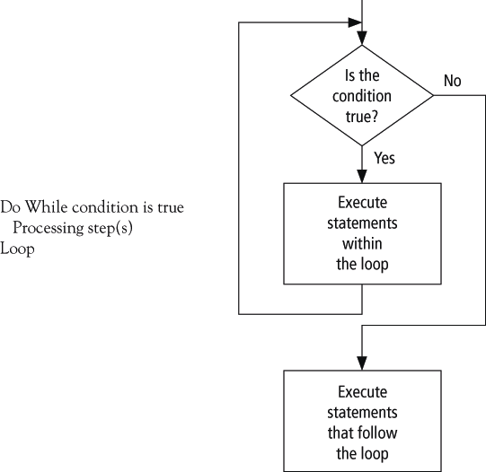
Pseudocode /Flow Chart for a Do Loop

Slide 6
Example 1
Private Sub btnDisplay_Click(...) _
Handles btnDisplay.Click
'Display the numbers from 1 to 7
Dim num As Integer = 1
Do While num <= 7
lstNumbers.Items.Add(num)
num += 1 'Add 1 to the value of num
Loop
End Sub
Notes:
Num is the "loop control variable" because based on the value of num, the loop will either continue or stop. Note that the value of the loop control variable must change inside the loop.

Slide 7
Example: Repeat Request as Long as Response is Incorrect
Dim passWord As String = ""
Do While passWord <> "SHAZAM"
passWord = InputBox("What is the password?")
passWord = passWord.ToUpper
Loop
passWord is the loop control variable because the value stored in passWord is what is tested to determine if the loop should continue or stop.

Slide 8
Post Test Loop
Do
statement(s)
Loop Until condition
Loop is executed once and then the condition
is tested. If it is false, the loop is run again.
If it is frue, the statements following the
Loop statement are executed.
Notes:
If condition is true, then the program continues with the line after the Loop statement.
If condition is false, then the entire process is repeated beginning with the Do statement.
In other words, the statements inside the loop are executed once and then are repeatedly
executed until the condition is true.

Slide 9
Example: Repeat Request Until Proper Response is Given
Do
passWord = InputBox("What is the password?")
passWord = passWord.ToUpper
Loop Until passWord = "SHAZAM"

Slide 10
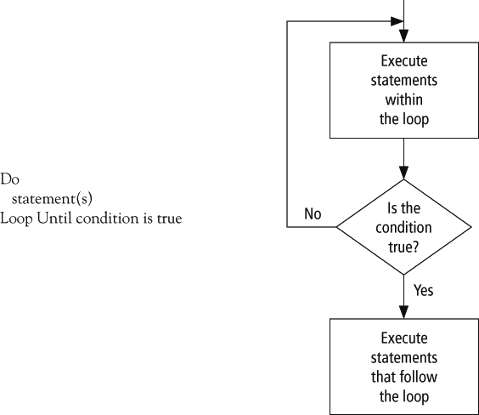
Pseudocode and Flowchart for a Post-Test Loop

Slide 11
What’s the diff?
Do
statement(s)
Loop Until condition
What’s the difference between a
Do Until
and
Do While?
Do While condition
statement(s)
Loop

Slide 12
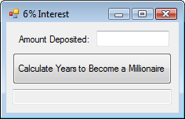
Example 4: Form
txtAmount
txtWhen

Slide 13
Example 4: Code
Private Sub btnCalculate_Click(...) Handles
btnCalculate.Click
Dim balance As Double, numYears As Integer
balance = CDbl(txtAmount.Text)
Do While balance < 1000000
balance += 0.06 * balance
numYears += 1
Loop
txtWhen.Text = "In " & numYears & _
" years you will have a million dollars."
End Sub
See how bad this code is without comments?

Slide 14
Example 4: Code
‘calculate how long it’ll take the balance to reach $1m
Private Sub btnCalculate_Click(...) Handles btnCalculate.Click
Dim balance As Double, numYears As Integer
‘ask what the current balance is
balance = CDbl(txtAmount.Text)
‘loop until the balance reaches $1m
Do While balance < 1000000
balance += 0.06 * balance
numYears += 1
Loop
‘display a message
txtWhen.Text = "In " & numYears & " years you will have a million dollars."
End Sub

Slide 15
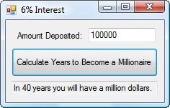
Example 4: Output

Slide 16
Comments
Be careful to avoid infinite loops – loops that never end
Visual Basic allows for the use of either the While keyword or the Until keyword at the top or the bottom of a loop
This textbook will use only While at the top and only Until at the bottom

Slide 17
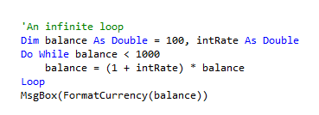
Infinite Loop
Why?

Slide 18
6.2 Processing Lists of Data with Do Loops
  Peek Method
  Counters and Accumulators
  Flags
  Nested Loops

Slide 19
Processing Lists of Data with Do Loops
Display all or selected items from lists
Search lists for specific items
Perform calculations on the numerical entries of a list

Slide 20
Peek Method
Data to be processed are often retrieved from a file by a Do loop
To determine if we have reached the end of the file from which we are reading, we use the Peek method.

Slide 21
Peek Example
Suppose a file has been opened as a StreamReader object named sr.
sr.Peek is the ANSI value of the first character of the line about to be read with ReadLine. If the end of the file has been reached, the value of sr.Peek is -1

Slide 22
Example 1: Display the Total Contents of a File
Dim sr As IO.StreamReader = _
IO.File.OpenText("PHONE.TXT")
lstNumbers.Items.Clear()
Do While sr.Peek <> -1
name = sr.ReadLine
phoneNum = sr.ReadLine
lstNumbers.Items.Add(name & " " _
& phoneNum)
Loop
sr.Close()

Slide 23
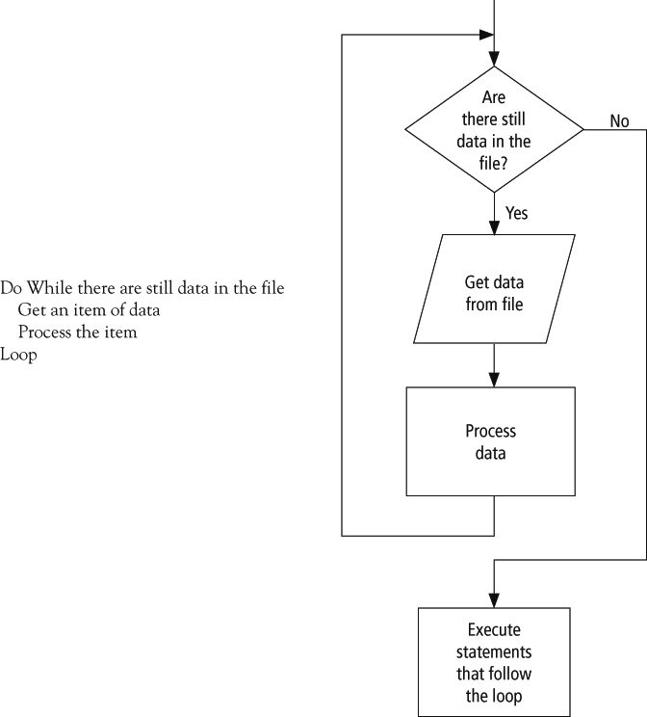
Pseudocode and Flowchart for Processing Data from a File

Slide 24
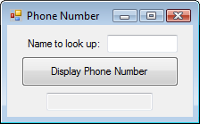
Example 2: Form
txtName
txtNumber

Slide 25
Example 2: Partial Code
Do While (name <> txtName.Text) _
And (sr.Peek <> -1)
name = sr.ReadLine
phoneNum = sr.ReadLine
Loop
As long as the name being searched for has not been found AND the end of the file has not been reached, the loop will continue

Slide 26
Counters and Accumulators
A counter is a numeric variable that keeps track of the number of items that have been processed.
An accumulator is a numeric variable that totals numbers.

Slide 27
File COINS.TXT
1
1
5
10
10
25
Count the number of coins and determine the total value

Slide 28
Example 3: Partial Code
Dim numCoins As Integer = 0
Dim sum As Integer = 0
Dim coin As String
Do While sr.Peek <> -1
coin = sr.ReadLine
numCoins += 1
sum += CDbl(coin)
Loop
sum
is an
accumulator.
It is
used to
total up
the
values
of the
coins.
numCoins is a counter,
it increases by 1 each
time through the loop

Slide 29
Flags
A flag is a variable that keeps track of whether a certain situation has occurred.
The data type most suited to flags is Boolean.

Slide 30
More About Flags
When flagVar is a variable of Boolean type, the
statements
If flagVar = True Then
and
If flagVar = False Then
can be replaced by
If flagVar Then
and
If Not flagVar Then

Slide 31
Flags continued
The statements
Do While flagVar = True
and
Do While flagVar = False
can be replaced by
Do While flagVar
and
Do While Not flagVar

Slide 32
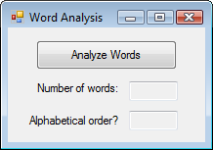
Example 4: Form
The file WORDS.TXT contains words from a spelling bee, one word per line. Count the words and determine whether they are in alphabetical order.

Slide 33
Example 4: Partial Code
Dim word1 As String = ""
Dim orderFlag As Boolean = True
Do While (sr.Peek <> -1)
word2 = sr.ReadLine
wordCounter += 1
If word1 > word2 Then
orderFlag = False
End If
word1 = word2
Loop
Notes:
This program counts the number of words in the file WORDS.TXT and then reports whether the words are in alphabetical order. In each execution of the loop, a word is compared to the next word in the list. The flag variable,
called orderFlag, is initially assigned the value True and is set to False if a pair of adjacent words is out of order.

Slide 34
Nested Loops
Statements inside a loop can contain
another loop.

Slide 35
6.3 For…Next Loops
Nested For … Next Loops
Local Type Inference

Slide 36
For…Next Loops
Used when we know how many times we want the loop to execute
A counter controlled loop

Slide 37
Sample
For i As Integer = 1 To 5
lstTable.Items.Add(i & " " & i ^ 2)
Next
The loop control variable, i, is
  initialized to 1
  tested against the stop value, 5
  incremented by 1 at the Next statement

Slide 38
Similar Do While Loop
i = 1
Do While i <= 5
lstTable.Items.Add(i & " " & i ^ 2)
i += 1
Loop
Notes:
Note how much more simple the For loop is

Slide 39
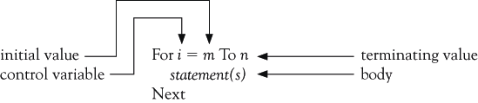
For…Next Loop Syntax

Slide 40
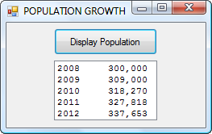
Example 1: Output
Notes:
Yr is the control variable
2002 is the start value
2006 is the stop value
Yr will keep being increased by 1 at the Next statement until yr is > 2006

Slide 41
Example 1: Code
Dim pop as Double = 300000
Dim fmtStr As String = "{0,4}{1,12:N0}"
For yr As Integer = 2008 To 2012 lstPop.Items.Add(String.Format( _
fmtStr, yr, pop)
pop += 0.03 * pop
Next
Notes:
Yr is the control variable
2002 is the start value
2006 is the stop value
Yr will keep being increased by 1 at the Next statement until yr is > 2006

Slide 42
Example 2
Control
variable
Data
type
Start
value
Stop
value
Amount
to add to
i
For i As Integer = 0 To n Step s
lstValues.Items.Add(i)
Next
Notes:
Start value must be less than or equal to the stop value when there is a positive step value

Slide 43
Example with Negative Step
For j As Integer = 10 To 1 Step -1
lstBox.Items.Add(j)
Next
lstBox.Items.Add("Blastoff")
Notes:
Start value must be >= the stop value when there is a NEGATIVE step value

Slide 44
Example: Nested Loops
For i As Integer = 65 To 70
For j As Integer = 1 To 25
lstBox.Items.Add(Chr(i) & j)
Next
Next
OUTPUT: A1
A2
A3
:
Outer
loop
Inner
loop

Slide 45
For and Next Pairs
For and Next statements must be paired.
If one is missing, the automatic syntax checker will complain with a wavy underline and a message such as
“A ‘For’ must be paired with a ‘Next’.”

Slide 46
Start, Stop, and Step values
Consider a loop beginning with
For i As Integer = m To n Step s.
The loop will be executed exactly once if m equals n no matter what value s has.
The loop will not be executed at all if m is greater than n and s is positive, or if m is less than n and s is negative.

Slide 47
Altering the Control Variable
The value of the control variable should not be altered within the body of the loop.
Doing so might cause the loop to repeat indefinitely or have an unpredictable number of repetitions.

Slide 48
Non-integer Step Values
Can lead to round-off errors with the result that the loop is not executed the intended number of times.
We will only use Integers for all values in the header.

Slide 49
Comments
  For i As Integer = 1 To 1 Step 10
  (some statements)
  Next
  How many times of loops?

Slide 50
Comments
  For i As Integer = 2 To 1 Step 2
  (some statements)
  Next
  How many times of loops?

Slide 51
Comments
  For i As Integer = 1 To 5 Step -1
  (some statements)
  Next
  How many times of loops?

Slide 52
Comments
The value of the control variable should not be altered within the body of the loop (For ... Next).
To skip an iteration in a For .. Next loop:
Continue For
To skip an iteration in a Do .. While loop:
Continue Do

Slide 53
Comments
  For i As Integer = 1 To 5
  (some statements)
  Continue For
  (some statements)
  Next
What will happen?

Slide 54
Comments
To break out of a For .. Next loop:
Exit For
To break out of a Do .. While loop:
Exit Do

Slide 55
Practice
Why won’t the following lines of code work as intended?
For i As Integer = 15 To 1
lstBox.Items.Add(i)
Next

Slide 56
Practice
When is a For ... Next loop more appropriate than a Do loop?

Slide 57
Review

Slide 58
Performing a Task on the Computer
Determine Output
Identify Input
Determine process necessary to turn given Input into desired Output

Slide 59
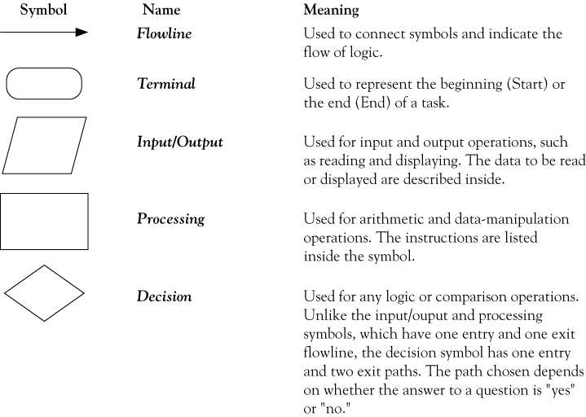
Flowchart symbols

Slide 60
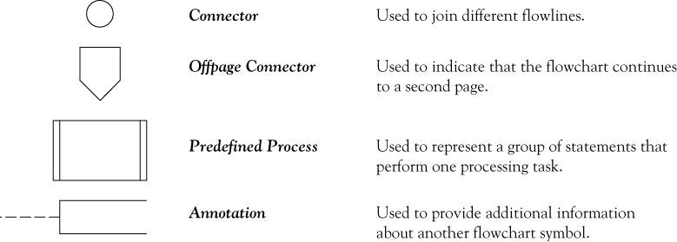
Flowchart symbols continued

Slide 61
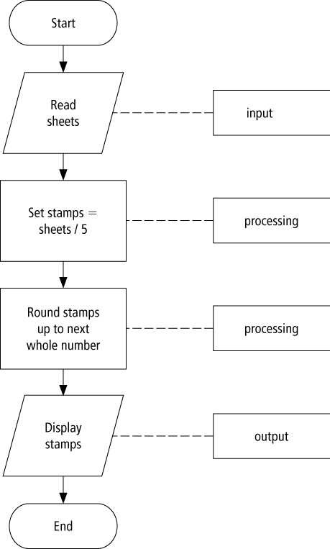
Flowchart example

Slide 62
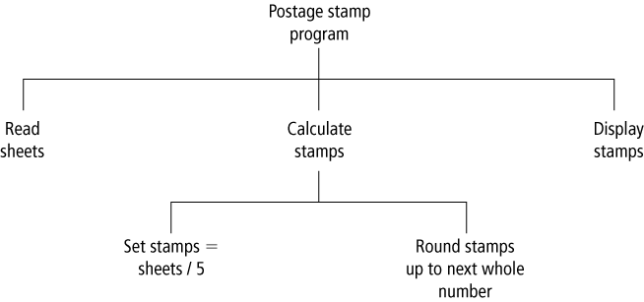
Hierarchy charts example

Slide 63
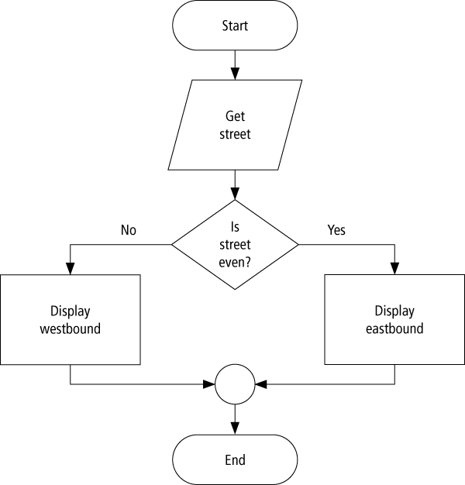
Flowchart

Slide 64
Control Name Prefixes
Control | Prefix | Example
button | btn | btnCompute
label | lbl | lblAddress
text box | txt | txtAddress
list box | lst | lstOutput

Slide 65
Variables
Declaration:
  Dim speed As Double
Variable name
Data type
Assignment:
  speed = 50

Slide 66
Variables
Visual Basic type | structure Storage size | Value range
Boolean | 4 bytes | True or False
Byte | 1 byte | 0 to 255 (unsigned)
Char | 2 bytes | 0 to 65535 (unsigned)
Date | 8 bytes | January 1, 1 CE to December 31, 9999
Decimal | 12 bytes | +/-79,228,162,514,264,337,593,543,950,335 with no decimal point;
Double | 8 bytes | -1.79769313486231E308 to -4.94065645841247E-324 for negative values; 4.94065645841247E-324 to 1.79769313486232E308 for positive values

Slide 67
Variables
Visual Basic type | structure Storage size | Value range
Integer | 4 bytes | -2,147,483,648 to 2,147,483,647
Long | 8 bytes | -9,223,372,036,854,775,808 to 9,223,372,036,854,775,807
Object | 4 bytes | Any type can be stored in a variable of type Object
Short | 2 bytes | -32,768 to 32,767
Single | 4 bytes | -3.402823E38 to -1.401298E-45 for negative values; 1.401298E-45 to 3.402823E38 for positive values
String | 10 bytes + (2 * string length) | 0 to approximately two billion Unicode characters

Slide 68
Some Types of Syntax Errors
Misspellings
lstBox.Itms.Add(3)
Omissions
lstBox.Items.Add(2 + )
Incorrect punctuation
Dim m; n As Integer
Displayed as blue underline in VS

Slide 69
A Type of Run-time Error
Dim numVar As Integer = 1000000
numVar = numVar * numVar
What’s wrong with the above?

Slide 70
A Logical Error
Dim average As Double
Dim m As Double = 5
Dim n As Double = 10
average = m + n / 2
What’s wrong with the above?

Slide 71
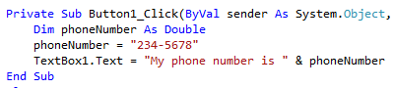
What’s wrong with this?

Slide 72
Is this allowed?
Dim x as double = “23”
dblVar = txtBox.text
dblVar = 2 & 3

Slide 73
String Variable
Declaration:
  Dim firstName As String
Data type
Variable name
Assignment:
  firstName = "Fred"

Slide 74
String Literal
A string literal is a sequence of
characters surrounded by quotation marks.
Examples:
  Does this work?
“She said: “I’m tired.””

Slide 75
Substring Method
Let str be a string.
str.Substring(m, n) is the substring of length
n, beginning at position m in str.
“Visual Basic”.Substring(2, 3) is “sua”
“Visual Basic”.Substring(0, 1) is “V”

Slide 76
Scope
The scope of a variable is the portion of the program that can refer to it.
Variables declared inside an event procedure are said to have local scope and are only available in the event procedure in which they are declared.

Slide 77
Scope
Variables declared outside an event procedure are said to have class-level scope and are available to every event procedure.
Usually declared after
Public Class formName
(Declarations section of Code Editor.)

Slide 78
Example
When a = 3, b = 4
(a + b) < 2 * a TRUE?

Slide 79
Logical Operators
Used with Boolean expressions
Not – makes a False expression True and vice versa
And – will yield a True if and only if both expressions are True
Or – will yield a True if at least one of both expressions are True

Slide 80
If Block
The program will take a course of action
based on whether a condition is true.
If condition Then
action1
Else
action2
End If
Will be executed if
condition is true
Will be executed if
condition is false

Slide 81
Sub Procedures
Perform one or more related tasks
General syntax
      Sub ProcedureName()
      statements
      End Sub

Slide 82
Calling a Sub Procedure
The statement that invokes a Sub procedure is also referred to as a Call statement.
A Call statement looks like this:
  ProcedureName()

Slide 83
Example
Public Sub btnOne_Click (...) Handles _
btnOne.Click
Dim n As Double = 19
Triple(n)
txtBox.Text = CStr(n)
End Sub
Sub Triple(ByVal num As Double)
num = 3 * num
End Sub
What is output?

Slide 84
Example
Public Sub btnOne_Click (...) Handles _
btnOne.Click
Dim num As Double = 4
Triple(num)
txtBox.Text = CStr(num)
End Sub
Sub Triple(ByRef num As Double)
num = 3 * num
End Sub
What is output?

Slide 85
Named Constants
Const CONSTANT_NAME As DataType _
= value
Ex)
Const PI As Double = 3.14
Dim num As Double = 4

Slide 86
Structured Programming
Control structures in structured programming:
  Sequences: Statements are executed one after another.
  Decisions: One of two blocks of program code is executed based on a test for some condition.
  Loops (iteration): One or more statements are executed repeatedly as long as a specified condition is true.

