Slide 1
Today’s Quote
“Debugging is twice as hard as writing the code in the first place. Therefore, if you write the code as cleverly as possible, you are–by definition–not smart enough to debug it.” (Brian Kernighan)

Slide 3
Admin Stuff
Assignment #1 due
Assignment #2
Posted to website
Due Oct 11
Midterm
Review session Oct 16
Midterm in class Oct 18 [2 hours long]

Slide 4
Logical Operators
< less than
<= less than or equal to
> greater than
>= greater than or equal to
= equal to
<> not equal to
ASCII values are used to decide order for strings

Slide 5
Condition
Decisions are a result of evaluating a condition
A condition is an expression involving relational and/or logical operators
Result of the condition is Boolean

Slide 6
Logical Operators
Used with Boolean expressions
Not – makes a False expression True and vice versa
And – will yield a True if and only if both expressions are True
Or – will yield a True if at least one of both expressions are True

Slide 7
If Block
The program will take a course of action
based on whether a condition is true.
If condition Then
action1
ElseIf condition Then
action2
Else
action3
End If
Will be executed if
condition is true
Will be executed if
condition is true
Will be executed if
condition is false

Slide 8
Example 1: Code
Private Sub btnEvaluate_Click(...) _
Handles btnEvaluate.Click
Dim position As Integer = CInt(txtPosition.Text)
Select Case position
Case 1
txtOutcome.Text = "Win"
Case 2
txtOutcome.Text = "Place"
Case 3
txtOutcome.Text = "Show"
Case 4, 5
txtOutcome.Text = "You almost placed in the money."
Case Else
txtBox.Text = "Out of the money."
End Select
End Sub
Selector
Value Lists

Slide 9
Chapter 5

Slide 10
Chapter 5 - General Procedures
5.1 Sub Procedures, Part I
5.2 Sub Procedures, Part II
5.3 Function Procedures
5.4 Modular Design
5.5 A Case Study: Weekly Payroll

Slide 11
Devices for Modularity
Visual Basic has two devices for breaking problems into smaller pieces:
Sub procedures
Function procedures

Slide 12
Sub Procedures
Perform one or more related tasks
General syntax
Sub ProcedureName()
statements
End Sub

Slide 13
Calling a Sub Procedure
The statement that invokes a Sub procedure is also referred to as a Call statement
A Call statement looks like this:
ProcedureName()
The rules for naming Sub procedures are the same as the rules for naming variables
Make them self-explanatory

Slide 14
Example
lstBox.Items.Clear()
ExplainPurpose()
lstBox.Items.Add("")
Sub ExplainPurpose()
lstBox.Items.Add("Program displays a sentence")
lstBox.Items.Add("identifying a sum.")
End Sub

Slide 15
Passing Values
You can send values to a Sub procedure
Sum(2, 3)
Sub Sum(ByVal num1 As Double, ByVal num2 As Double)
lstBox.Items.Add("The sum of " & num1 & " and " _
& num2 & " is " & (num1 + num2) & "."
End Sub
In the Sum Sub procedure, 2 will be stored in num1 and 3 will be stored in num2

Slide 16
Arguments and Parameters
Sum(2, 3)
Sub Sum(ByVal num1 As Double, ByVal num2 As Double)
arguments
parameters
displayed automatically

Slide 17
Several Calling Statements
ExplainPurpose()
Sum(2, 3)
Sum(4, 6)
Sum(7, 8)
Output:
Program displays a sentence identifying a sum.
Sub Sum(ByVal num1 As Double, ByVal num2 As Double)
lstBox.Items.Add("The sum of " & num1 & " and " _
& num2 & " is " & (num1 + num2) & "."
End Sub

Slide 18
Passing Strings and Numbers
Demo("CA", 38)
Sub Demo(ByVal state As String, ByVal pop As Double)
txtBox,Text = state & " has population " & pop & _
" million."
End Sub
Note: The statement Demo(38, "CA") would not be valid. The types of the arguments must be in the same order as the types of the parameters.

Slide 19
Variables and Expressions
Dim s As String = "CA"
Dim p As Double = 19
Demo(s, 2 * p)
Sub Demo(ByVal state As String, ByVal pop As Double)
txtBox.Text = state & " has population " & pop & _
" million."
End Sub
Note: The variable names in the arguments need not match the parameter names. For instance, s versus state..

Slide 20
Calling
A Sub procedure can call another Sub procedure.
Private Sub btnAdd_Click(...) Handles btnAdd.Click
Sum(2, 3)
End Sub
Sub Sum(ByVal num1 As Double, ByVal num2 As Double)
DisplayPurpose()
lstBox.Items.Add("The sum of " & num1 & " and " _
& num2 & " is " & (num1 + num2) & "."
End Sub

Slide 21
“Any code of your own that you haven’t looked at for six or more months might as well have been written by someone else.” (Eagleson’s Law)

Slide 22
5.2 Sub Procedures, Part II
Passing by Value
Passing by Reference
Lifetime and Scope of a Variable
Debugging

Slide 23
ByVal and ByRef
Parameters in Sub procedure headers are proceeded by ByVal or ByRef
ByVal stands for By Value
ByRef stands for By Reference

Slide 24
Passing by Value
When a variable argument is passed to a ByVal parameter, just the value of the argument is passed.
After the Sub procedure terminates, the variable has its original value.

Slide 25
Example
Public Sub btnOne_Click (...) Handles _
btnOne.Click
Dim n As Double = 4
Triple(n)
txtBox.Text = CStr(n)
End Sub
Sub Triple(ByVal num As Double)
num = 3 * num
End Sub

Slide 26
Same Example: n num
Public Sub btnOne_Click (...) Handles _
btnOne.Click
Dim num As Double = 4
Triple(num)
txtBox.Text = CStr(num)
End Sub
Sub Triple(ByVal num As Double)
num = 3 * num
End Sub

Slide 27
Passing by Reference
When a variable argument is passed to a ByRef parameter, the parameter is given the same memory location as the argument
After the Sub procedure terminates, the variable has the value of the parameter

Slide 28
Example
Public Sub btnOne_Click (...) Handles _
btnOne.Click
Dim num As Double = 4
Triple(num)
txtBox.Text = CStr(num)
End Sub
Sub Triple(ByRef num As Double)
num = 3 * num
End Sub

Slide 29
Example: num n
Private Sub btnOne_Click(...) Handles _
btnOne_Click
Dim n As Double = 4
Triple(n)
txtBox.Text = CStr(n)
End Sub
Sub Triple(ByRef num As Double)
num = 3 * num
End Sub

Slide 30
Lifetime and Scope of a Variable
Lifetime: Period during which it remains in memory
Scope: In Sub procedures, defined same as in event procedures
Suppose a variable is declared in procedure A that calls procedure B. While procedure B executes, the variable is alive, but out of scope

Slide 31
Debugging
Programs with Sub procedures are easier to debug
Why?

Slide 32
“The first 90% of the code accounts for the first 90% of the development time. The remaining 10% of the code accounts for the other 90% of the development time.” (Tom Cargill)

Slide 33
5.3 Function Procedures
User-Defined Functions Having Several Parameters
User-Defined Functions Having No Parameters
User-Defined Boolean-valued Functions
Comparing Function Procedures with Sub Procedures
Named Constants

Slide 34
Some Built-In Functions
Function
Example
Input
Output
Int
Int(2.6) is 2
number
number
Math.Round
Math.Round(1.23,1) is 1.2
number, number
number
FormatPercent
FormatPercent(.12) is 12.00%
number
string
FormatNumber
FormatNumber(12345.628, 1) is 12,345.6
number, number
string

Slide 35
Function Procedures
Function procedures (aka user-defined functions) always return one value
Syntax:
Function FunctionName(ByVal var1 As Type1, _
ByVal var2 As Type2, _
…) As dataType
statement(s)
Return expression
End Function

Slide 36
Example: Form
txtFullName
txtFirstName
Notes:
ByVal is used in function parameters so the function will not inadvertently return more than one value
Value in return statement is sent back to the place where the function was called – the function call "becomes" that value – which must then be stored, or printed, or used in some way by the calling routine.
There is a one to one relationship between the arguments being passed to the function and the parameters that the function receives

Slide 37
Example: Code
Private Sub btnDetermine_Click(...) _
Handles btnDetermine.Click
Dim name As String
name = txtFullName.Text
txtFirstName.Text = FirstName(name)
End Sub
Function FirstName(ByVal name As String) As String
Dim firstSpace As Integer
firstSpace = name.IndexOf(" ")
Return name.Substring(0, firstSpace)
End Function
Function call
Return statement
Notes:
The "As String" at the end of the line which begins "Function First Name" is the data type of the value being returned from this function

Slide 38
Example: Form
txtSideOne
txtSideTwo
txtHyp
Notes:
ByVal is used in function parameters so the function will not inadvertently return more than one value
Value in return statement is sent back to the place where the function was called – the function call "becomes" that value – which must then be stored, or printed, or used in some way by the calling routine.
There is a one to one relationship between the arguments being passed to the function and the parameters that the function receives

Slide 39
Example: Code
Private Sub btnCalculate_Click(...) _
Handles btnCalculate.Click
Dim a, b As Double
a = CDbl(txtSideOne.Text)
b = CDbl(txtSideTwo.Text)
txtHyp.Text = CStr(Hypotenuse(a, b))
End Sub
Function Hypotenuse(ByVal a As Double, _
ByVal b As Double) As Double
Return Math.Sqrt(a ^ 2 + b ^ 2)
End Function
Notes:
ByVal is used in function parameters so the function will not inadvertently return more than one value
Value in return statement is sent back to the place where the function was called – the function call "becomes" that value – which must then be stored, or printed, or used in some way by the calling routine.
There is a one to one relationship between the arguments being passed to the function and the parameters that the function receives

Slide 40
Function Having No Parameters
Private Sub btnDisplay_Click(...) _
Handles btnDisplay.Click
txtBox.Text = Saying()
End Sub
Function Saying() As String
Dim strVar As String
strVar = InputBox("What is your" _
& " favorite saying?")
Return strVar
End Function

Slide 41
Comparing Function Procedures with Sub Procedures
Subs are accessed using a Call statement
Functions are called where you would expect to find a literal or expression
For example:
result = functionCall
lstBox.Items.Add (functionCall)

Slide 42
Functions vs. Procedures
Both can perform similar tasks
Both can call other subs and functions
Use a function when you want to return one and only one value

Slide 43
Named Constants
Constant: value does not change during program execution (different from variable)
(ex. Minimum wage, sales tax rate, name of a master file, mathematical constants, etc.)

Slide 44
Named Constants
Const CONSTANT_NAME As DataType = value
Const PI As Double = 3.14
Dim num As Double = 4

Slide 45
Named Constants
Convention
Uppercase letters with words separated by underscore.
Place them in the Declaration sections.

Slide 46
Named Constants
Const INTEREST_RATE As Double = 0.04
Const MINIMUM_VOTING_AGE As Integer = 18
Const MASTER_FILE As String = 3.14
interstEarned = INTEREST_RATE * CDbl(txtAmount.Text)
If (age >= MINIMUM_VOTING_AGE) Then
MessageBox.Show(“You are eligible to vote”)
End If
Dim sr As IO.StreamReader = IO.File.OpenText(MASTER_FILE)

Slide 47
“If debugging is the process of removing bugs, then programming must be the process of putting them in.” (Edsger W. Dijkstra)

Slide 48
5.4 Modular Design
Top-Down Design
Structured Programming
Advantages of Structured Programming

Slide 49
Design Terminology
Large programs can be broken down into smaller problems
"divide-and-conquer" approach called "stepwise refinement“
Stepwise refinement is part of top-down design methodology

Slide 50
Top-Down Design
General problems are at the top of the design
Specific tasks are near the end of the design
Top-down design and structured programming are techniques to enhance programmers' productivity

Slide 51
Top-Down Design Criteria
The design should be easily readable and emphasize small module size
Modules proceed from general to specific as you read down the chart
The modules, as much as possible, should be single minded. That is, they should only perform a single well-defined task
Modules should be as independent of each other as possible, and any relationships among modules should be specified

Slide 52
Top-Level Design Chart

Slide 53
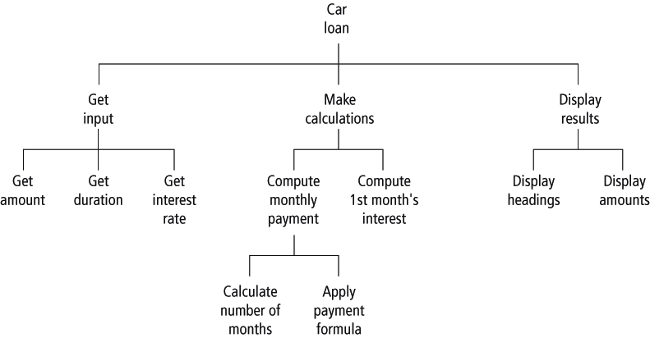
Detailed Chart

Slide 54
Structured Programming
Control structures in structured programming
Sequences: Statements are executed one after another
Decisions: One of two blocks of program code is executed based on a test for some condition
Loops (iteration): One or more statements are executed repeatedly as long as a specified condition is true

Slide 55
Advantages of Structured Programming
Goal to create correct programs that are easier to
write
understand
Modify
"GOTO –less" programming

Slide 56
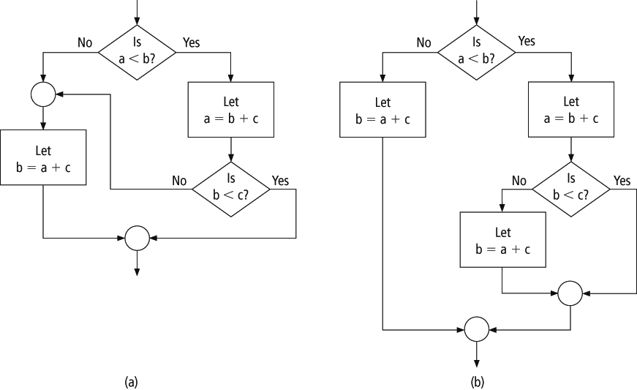
Comparison of Flow Charts

Slide 57
Easy to Write
Allows programmer to first focus on the big picture and take care of the details later
Several programmers can work on the same program at the same time
Code that can be used in many programs is said to be reusable

Slide 58
Easy to Debug
Procedures can be checked individually
A driver program can be set up to test modules individually before the complete program is ready
Using a driver program to test modules (or stubs) is known as stub testing

Slide 59
Easy to Understand
Interconnections of the procedures reveal the modular design of the program
The meaningful procedure names, along with relevant comments, identify the tasks performed by the modules
The meaningful variable names help the programmer to recall the purpose of each variable
Because a structured program is self-documenting, it can easily be deciphered by another programmer

Slide 60
Example
Private Sub btnDetermine_Click() Handles btnDetermine.Click
Dim num As Integer
num = 2
MsgBox(Function1(num))
End Sub
Function Function1(ByVal num As Integer) As Integer
Debug.Print(num)
num = num ^ 2
Function1 = Function2(num)
End Function
Function Function2(ByVal num As Integer) As Integer
Debug.Print(num)
num = num ^ 2
Function2 = Function1(num)
End Function
What’s the result?

Slide 61
Function Example
How to calculate Factorials?
Ex: 5! = 5 * 4 * 3 * 2 * 1 = 120

