Slide 1
Today’s Quote
"The computers do what you tell them to do, not what you want them to do. " (Alexander Atanasov)

Slide 2
Chapter 4 – Decisions

Slide 3
4.1 – Part 1 – ASCII

Slide 4
ASCII values
Standard characters available
http://www.asciitable.com/

Slide 5
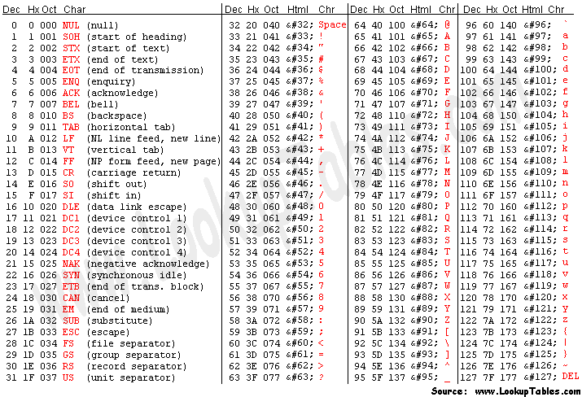
ASCII values

Slide 6
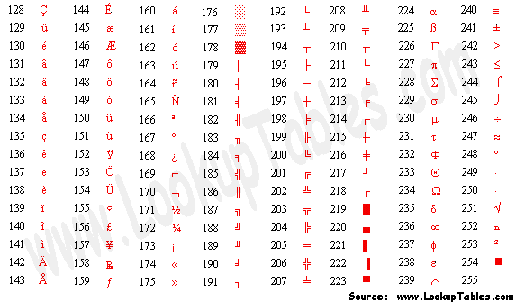
Extended ASCII Values

Slide 7
ASCII values
What are some critical characters when reading/writing files?
Code VB
009 → TAB → vbTab
013 → CHR → vbCr
010 → LF → vbLf
vbCr & vbLf → vbCrLf

Slide 8
ASCII Character Set
A numeric representation for every key on the keyboard and for other assorted characters.

Slide 9
ASCII Character Set: continued
A numeric representation for every key on the keyboard and for other assorted characters.

Slide 10
Chr Function
For n between 0 and 255,
Chr(n)
is the string consisting of the character with
ASCII value n.
EXAMPLES
Chr(65) is "A"
Chr(162) is "¢"

Slide 11
Asc Function
For a string str,
Asc(str)
is ASCII value of the first character of str.
EXAMPLES
Asc("A") is 65
Asc("¢25") is 162

Slide 12
4.1 – Part 2 – Logical Operators

Slide 13
Logical Operators
< less than
<= less than or equal to
> greater than
>= greater than or equal to
= equal to
<> not equal to
ASCII values are used to decide order for strings.

Slide 14
Condition
Decisions are a result of evaluating a condition
A condition is an expression involving relational and/or logical operators
Result of the condition is Boolean
???

Slide 15
Example
When a = 3, b = 4
(a + b) < 2 * a TRUE?
3 + 4 = 7
2 * 3 = 6

Slide 16
Another Example
a = 4 b = 3 c = "hello" d = "bye"
( c.Length – b ) = ( a / 2 )
TRUE?
5 – 3 = 2
4 / 2 = 2

Slide 17
Relational Operator Notes
Relational operators are binary – they require an operand on both sides of the operator
Value of a relational expression will always be True or False
Expressions are evaluated from left to right with no order of operations

Slide 18
Logical Operators
Used with Boolean expressions
Not – makes a False expression True and vice versa
And – will yield a True if and only if both expressions are True
Or – will yield a True if at least one of both expressions are True

Slide 19
Example 4.3
n = 4, answer = “Y”
Are the following expressions true or false?
1) Not (n < 6)
2) (answer = "Y") Or (answer = "y")
3) (answer = "Y") And (answer = "y")
4) answer = "y")
Notes:
Not (n < 6) = False
(answ = "Y") Or (answ = "y") = True
(answ = "Y") And (answ = "y") = False
Not(answ = "y") = True

Slide 20
Boolean Expression
An expression that evaluates to either True or False is said to have Boolean data type.
Example:
The statement
txtBox.Text = CStr((2+3)<6)
displays True in the text box.

Slide 21
Boolean Variable
A variable declared with a statement of the form
Dim var As Boolean
is said to have Boolean data type. It can assume
just the two values True and False.
Example:
Dim boolVar As Boolean
boolVar = 2 < 6
txtBox.Text = CStr(boolVar)
What’s the result?

Slide 22
Syntax Error
The following is NOT a valid way to test if n falls between 2 and 5:
(2 < n < 5 )

Slide 23
Correction to Syntax Error
To test if n falls between 2 and 5 use:
(2 < n ) And ( n < 5 )
A complete relational expression must be
on either side of the logical operators And
and Or.
Notes:
And and Or are binary operators requiring two operands
Not is a unary operator requiring only one operand

Slide 24
Common Error in Boolean Expressions
A common error is to replace the condition
Not ( 2 < 3 )
with the condition
( 2 > 3 )
What’s wrong??

Slide 25
4.2 If Blocks
If Block
ElseIf Clauses

Slide 26
If Block
The program will take a course of action
based on whether a condition is true.
If condition Then
action1
Else
action2
End If
Will be executed if
condition is true
Will be executed if
condition is false

Slide 27
Another example If block
If condition Then
action1
End If
Statement2
Statement3
Regardless of whether
the condition in the
If statement is true or
alse, these statements
will be executed

Slide 28
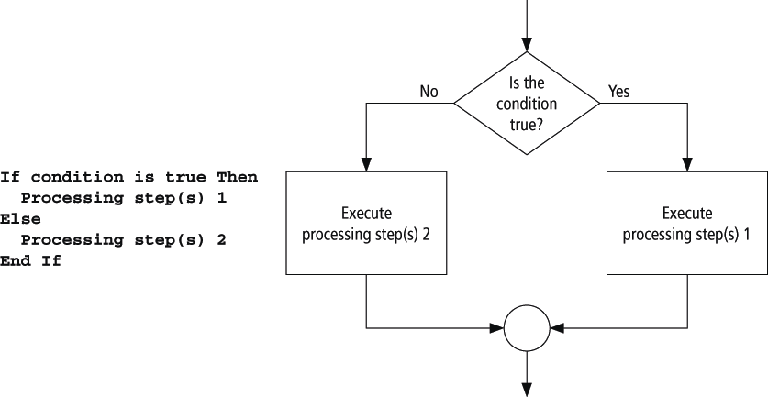
Pseudocode/Flowchart for an If Block

Slide 29
Example 1: Form
txtFirstNum
txtSecondNum
txtResult

Slide 30
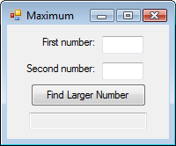
Example 1: Code
Private Sub btnFindLarger_Click(...) _
Handles btnFindLarger.Click
Dim num1, num2, largerNum As Double
num1 = CDbl(txtFirstNum.Text)
num2 = CDbl(txtSecondNum.Text)
If num1 > num2 Then
largerNum = num1
Else
largerNum = num2
End If
txtResult.Text = "The larger number is " & largerNum
End Sub
What happens?

Slide 31
Example 1: Output

Slide 32
Example 2: Form

Slide 33
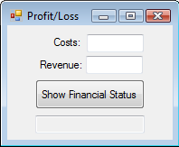
Example 2: Partial Code
What happens?
If costs = revenue Then
txtResult.Text = "Break even"
Else
If costs < revenue Then
profit = revenue - costs
txtResult.Text = "Profit is " & _
FormatCurrency(profit) & "."
Else
loss = costs - revenue
txtResult.Text = "Loss is " & _
FormatCurrency(loss) & "."
End If
End If
Notes:
Note the nested if statement – the If inside an If. This can be rewritten using the ElseIf construct.

Slide 34
Example 2: Output

Slide 35
Example 3: Form
txtAnswer
txtSolution

Slide 36
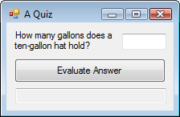
Example 3: Code
Private Sub btnEvaluate_Click(...) _
Handles btnEvaluate.Click
Dim answer As Double
answer = CDbl(txtAnswer.Text)
If (answer >= 0.5) And (answer <= 1) Then
txtSolution.Text = "Good, "
Else
txtSolution.Text = "No, "
End If
txtSolution.Text &= "it holds about 3/4 of" _
& " a gallon."
End Sub
What happens?

Slide 37
Example 3: Output

Slide 38
Example 4: Form
mtxtAnswer
txtQuote

Slide 39
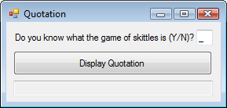
Example 4
Private Sub btnDisplay_Click(...) _
Handles btnDisplay.Click
Dim message As String
message = "Skittles is an old form of bowling in " _
& "which a wooden disk is used to knock down nine" _
& " pins arranged in a square."
If txtAnswer.Text.ToUpper = "N" Then
MessageBox.Show(message, "")
End If
txtQuote.Text = "Life ain't all beer and skittles.“
txtQuote.Text &= " – Du Maurier (1894)."
End Sub
What happens?
Notes:
No matter what the user enters in the text box, the quote will appear.

Slide 40
Example 4: Output

Slide 41
Example 4: Output continued

Slide 42
ElseIf clause
If condition1 Then
action1
ElseIf condition2 Then
action2
ElseIf condition3 Then
action3
Else
action4
End If
Notes:
An extension of the If block allows for more than two possible alternatives with the
inclusion of ElseIf clauses.
Note: there is no space between the word "Else" and "If"
Only one "End If" is required.

Slide 43
Example 5: Form
txtFirstNum
txtSecondNum
txtResult

Slide 44
Example 5: Code
Private Sub btnFindLarger_Click(...) _
Handles btnFindLarger.Click
Dim num1, num2 As Double
num1 = CDbl(txtFirstNum.Text)
num2 = CDbl(txtSecondNum.Text)
If (num1 > num2) Then
txtResult.Text = "Larger number is " & num1
ElseIf (num2 > num1) Then
txtResult.Text = "Larger number is " & num2
Else
txtResult.Text = "The two are equal."
End If
End Sub
What happens?
Notes:
Note: there is no "if" required after the last Else to determine if the two numbers are equal. There have already been if statements to evaluate if num1 is larger than num2 and if num2 is larger than num1, so if the last Else is reached, there is no other alternative left but that they are both equal.

Slide 45
Example 6: Form

Slide 46
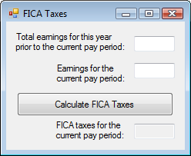
Example 6: Partial Code
Dim ytdEarnings, curEarnings As Double
Dim socSecBenTax, medicareTax, ficaTaxes As Double
ytdEarnings = CDbl(txtToDate.Text)
curEarnings = CDbl(txtCurrent.Text)
If (ytdEarnings + curEarnings) <= 102000 Then
socSecBenTax = 0.062 * curEarnings
ElseIf ytdEarnings < 102000 Then
socSecBenTax = 0.062 * (102000 - ytdEarnings)
End If
medicareTax = 0.0145 * curEarnings
ficaTaxes = socSecBenTax + medicareTax
txtText.Text = FormatCurrency(ficaTaxes)
End Function
What happens?
Notes:
Note ElseIf construct replaces nested If statement. Only one "End If" is required with the ElseIf.

Slide 47
Example 6: Output

Slide 48
Comments
When one If block is contained inside another If block, the structure is referred to as nested If blocks.
Care should be taken to make If blocks easy to understand.

Slide 49
Simplified Nested If Statement
If cond1 Then If cond1 And cond2 Then
If cond2 Then action
action End If
End If
End If
Nested
If
Is this equivalent?

Slide 50
More Comments
Some programs call for selecting among many possibilities
Can be accomplished with complicated nested If blocks
Select Case block is often a better alternative

Slide 51
4.3 Select Case Blocks
Notes:
A Select Case block is an efficient decision-making structure that simplifies choosing
among several actions. It avoids complex nested If constructs. If blocks make decisions
based on the truth value of a condition; Select Case choices are determined by the value
of an expression called a selector. Each of the possible actions is preceded by a clause
of the form
Case valueList
where valueList itemizes the values of the selector for which the action should be taken.

Slide 52
Select Case Block
A decision-making structure that simplifies choosing among several actions.
Avoids complex nested If constructs.
If blocks make decisions based on the truth value of a condition. Select Case choices are determined by the value of an expression called a selector.
Notes:
A Select Case block is an efficient decision-making structure that simplifies choosing
among several actions. It avoids complex nested If constructs. If blocks make decisions
based on the truth value of a condition; Select Case choices are determined by the value
of an expression called a selector. Each of the possible actions is preceded by a clause
of the form
Case valueList
where valueList itemizes the values of the selector for which the action should be taken.

Slide 53
Select Case Terminology
Each of the possible actions is preceded
by a clause of the form
Case valueList
where valueList itemizes the values of the
selector for which the action should be
taken.

Slide 54
Example 1: Form
txtPosition
txtOutcome

Slide 55
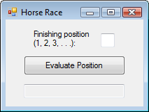
Example 1: Code
What happens?
Private Sub btnEvaluate_Click(...) _
Handles btnEvaluate.Click
Dim position As Integer = CInt(txtPosition.Text)
Select Case position
Case 1
txtOutcome.Text = "Win"
Case 2
txtOutcome.Text = "Place"
Case 3
txtOutcome.Text = "Show"
Case 4, 5
txtOutcome.Text = "You almost placed in the money."
Case Else
txtBox.Text = "Out of the money."
End Select
End Sub
Selector
Value Lists

Slide 56
Example 1: Output

Slide 57
Example 2: Code
Private Sub btnEvaluate_Click(...) _
Handles btnEvaluate.Click
Dim position As Integer = CInt(txtPosition.Text)
Select Case position
Case 1 To 3
txtOutcome.Text = "In the money. Congratulations"
Case Is >= 4
txtOutcome.Text = "Not in the money."
End Select
End Sub
What happens?
Notes:
The keyword "To" allows the programmer to specify a range of values in the value list.
The keyword "Is" allows the programmer to form a relational expression with the selector

Slide 58
Example 2: Output

Slide 59
Select Case Syntax
The general form of the Select Case block is
Select Case selector
Case valueList1
action1
Case valueList2
action2
Case Else
action of last resort
End Select

Slide 60
Rules for Select Case
Case Else (and its action) is optional
Each value list contains one or more of the following types of items separated by commas:
a literal (value);
a variable;
an expression;
an inequality sign preceded by Is and followed by a literal, variable, or expression;
a range expressed in the form a To b, where a and b are literals, variables, or expressions.

Slide 61
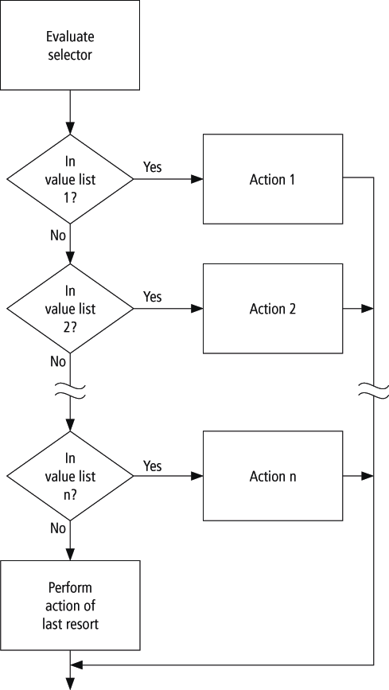
Flowchart for Select Case

Slide 62
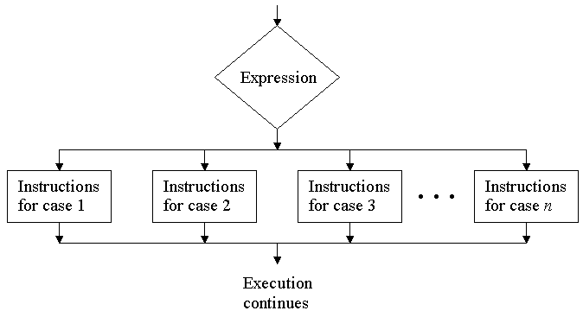
Flowchart for Select Case
(not in book, but equivalent)

Slide 63
Example 3: Partial Code
Dim x As Integer = 2, y As Integer = 3
Select Case num
Case y - x, x
txtPhrase.Text = "Buckle my shoe."
Case Is <= 4
txtPhrase.Text = "Shut the door."
Case x + y To x * y
txtPhrase.Text = "Pick up sticks."
Case 7, 8
txtPhrase.Text = "Lay them straight."
Case Else
txtPhrase.Text = "Start all over again."
End Select
What happens?

Slide 64
Example 4: Form
txtReply

Slide 65
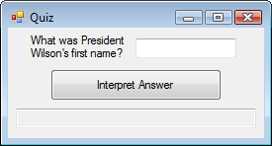
Example 4: Partial Code
Select Case firstName
Case "THOMAS"
txtReply.Text = "Correct."
Case "WOODROW"
txtReply.Text = "Sorry, his name" _
& " was Thomas Woodrow Wilson."
Case "PRESIDENT"
txtReply.Text = "Are you for real?"
Case Else
txtReply.Text = "Nice try."
End Select
What happens?

Slide 66
Example 4: Output

Slide 67
Example 7: Form

Slide 68
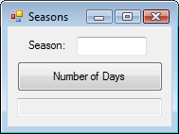
Example 7: Partial Code
Dim season As String, numDays As Integer
Select Case season.ToUpper
Case "WINTER"
numDays = 87
Case "SPRING"
numDays = 92
Case "SUMMER", "AUTUMN", "FALL"
numDays = 93
End Select
What happens?

Slide 69
Example 7: Form & Output

Slide 70
Comments
In a Case clause of the form Case b To c, the value of b should be less than or equal to the value of c
The word Is should precede an inequality sign in a value list
If the word Is is accidentally omitted where required, the editor will automatically insert it when checking the line

Slide 71
Data Type Comment
The items in the value list must evaluate to a literal of the same data type as the selector
For instance, if the selector evaluated to a string value, as in
Dim firstName As String = txtBox.Text
Select Case firstName
then the clause
Case firstName.Length
would be meaningless.

Slide 72
Block-level Scope
A variable declared inside an If … Then or Select Case block has block-level scope
The variable cannot be referred to outside the block

